Slide 1
Manufacturing Engineering Technology in SI Units, 6th Edition
Chapter 23:
Machining Processes: Hole Making
– Part A (Lathe Operations, Boring, Reaming, Tapping)
Manufacturing Processes (2), IE-352
Ahmed M El-Sherbeeny, PhD
Spring 2017
Copyright © 2010 Pearson Education South Asia Pte Ltd
Notes:
Presentation slide for courses, classes, lectures et al.

Slide 2
Chapter Outline
Introduction
Boring and Boring Machines
Reaming and Reamers
Tapping and Taps

Slide 3

Introduction
Machining processes discussed here:
  with capability of producing parts that are round in shape
  most basic is turning: part is rotated while it is being machined
  Lathe (or by similar machine tools):
  Considered to be the oldest machine tools
  Carry out turning processes (see next 4 slides):
  Highly simple, versatile machines
  Requires a skilled machinist
  Inefficient for repetitive operations and for large production
  All parts are circular (property known as axisymmetry)
  Processes produce a wide variety of shapes
  Speeds range from moderate to high speed machining
Notes:
i.e. symmetric with respect to an axis

Slide 4
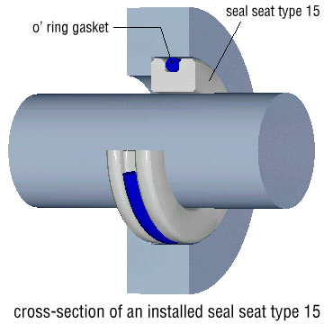
Introduction
  Processes carried out on a lathe:
Turning (figure a-d):
  Produce straight, conical, curved, or grooved workpieces
  Examples: shafts, spindles, pins
Facing (figure e):
  Produce flat surface at end of part and ⊥ to its axis
Face grooving (figure f):
  Produce grooves for applications such as O-ring seats

Slide 5
Introduction
  Cont. Processes carried out on a lathe:
Cutting with forms tools (figure g):
  Produce axisymmetric shapes (functional, aesthetic purposes)
Boring:
  Enlarge hole/cylindrical cavity made by previous process:
  Produce circular internal grooves (figure h)
Drilling (figure i):
  Produce a hole
  May be followed by boring to improve dim. acc./ surface finish

Slide 6
Introduction
  Cont. Processes carried out on a lathe:
Parting (figure j): AKA cutting off
  Cut a piece from the end of a part
  Used with production of blanks for additional processing/parts
Threading (figure k):
  Produce external or internal threads
Knurling (figure l):
  Produce regularly shaped roughness on cylindrical surfaces
  Example: making knobs, handles (remember micrometer)

Slide 7
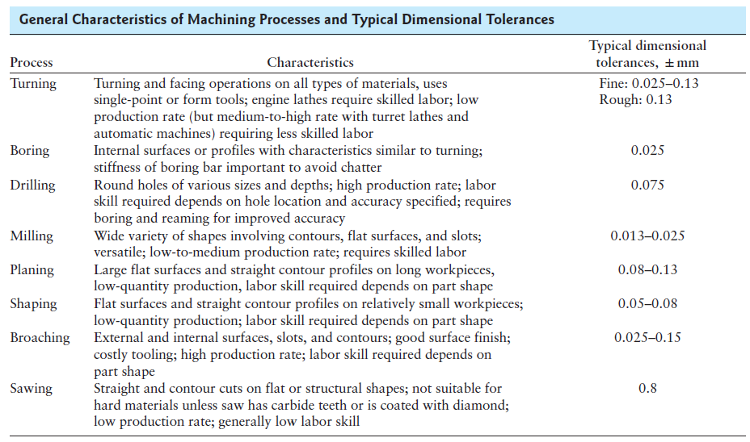
Introduction
Notes:
* Broaching is a machining process that uses a toothed tool, called a broach, to remove material.
* Planing is a manufacturing process of material removal in which the workpiece reciprocates against a stationary cutting tool producing a plane or sculpted surface. Planing is analogous to shaping.

Slide 8
Introduction
  Lathes:
  Available in different designs, sizes, capacities, computer-controlled features
  Below: general view of typical lathe, showing various components

Slide 9
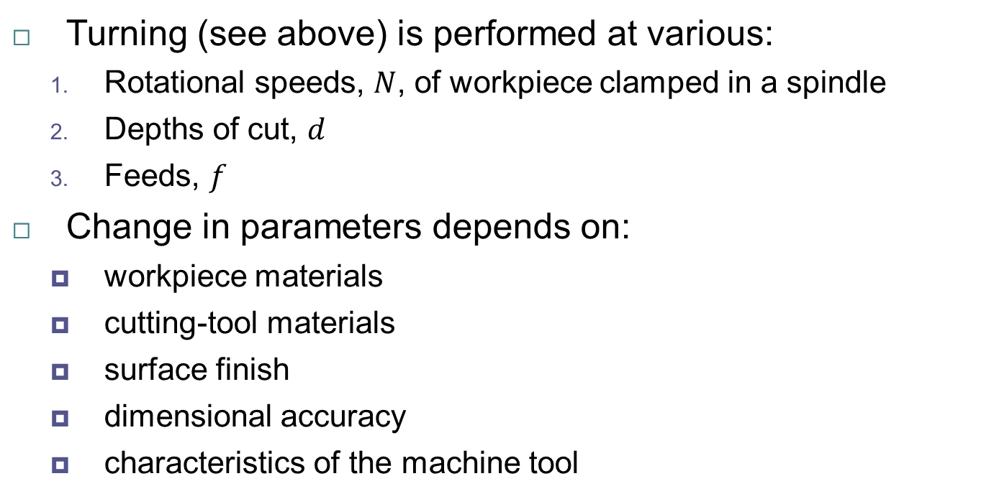

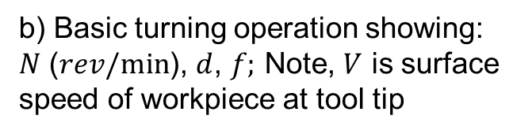
Introduction
$$V$$
a) Turning operation
(showing insert and chip removal)
b) Basic turning operation showing:
$N$ ($rev/min$), $d$, $f;$ Note, $V$ is surface speed of workpiece at tool tip
Turning (see above) is performed at various:
  Rotational speeds, $N$, of workpiece clamped in a spindle
  Depths of cut, $d$
  Feeds, $f$
Change in parameters depends on:
  workpiece materials
  cutting-tool materials
  surface finish
  dimensional accuracy
  characteristics of the machine tool

Slide 10
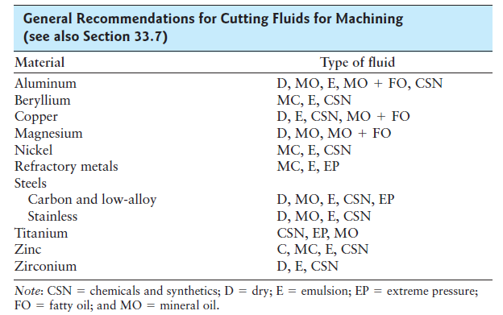
Introduction
Cutting Fluids
Recommendations for cutting fluids suitable for various workpiece materials
Note:
  Aluminum
  Copper
  Carbon/
  low alloy
  steels
Current
trend:
DM/NDM
Notes:
* Remember NDM: near dry machining (see notes from chapter on cutting fluids)

Slide 11
Boring and Boring Machines
Properties of Boring
Boring:
  Enlarges hole made by other process (e.g. turning), or
  Produces circular internal profiles in hollow workpieces (fig. h)
Cutting tools mounted on boring bar (next slide)
Boring bars:
  Used to reach full length of bore
  Must be stiff to minimize tool deflection & maintain dimen. acc.
  Designed, built with capabilities to dampen vibration/chatter
  ⇒ better to use material with high elastic modulus (e.g. WC)
Notes:
Remember, WC: Tungsten Carbide

Slide 12
Boring and Boring Machines
a) Steel boring bar with carbide insert (note passageway in bar for cutting fluid)
b) Boring bar with W “inertia disks”, sealed in bar to dampen vibration/chatter

Slide 13
Boring and Boring Machines
Boring Machines
Boring operations carried out on
  Lathes for small workpieces
  Boring mills for large workpieces
Boring mills
  Either horizontal or vertical
  Capable of performing different operations (e.g. turning, facing, chamfering)
Horizontal boring machines
  Workpiece is mounted on a table
  Table can move horizontally in axial and radial directions

Slide 14
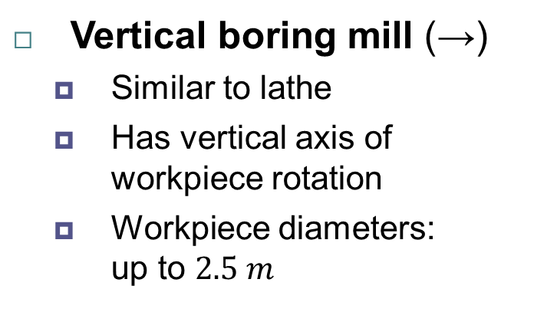
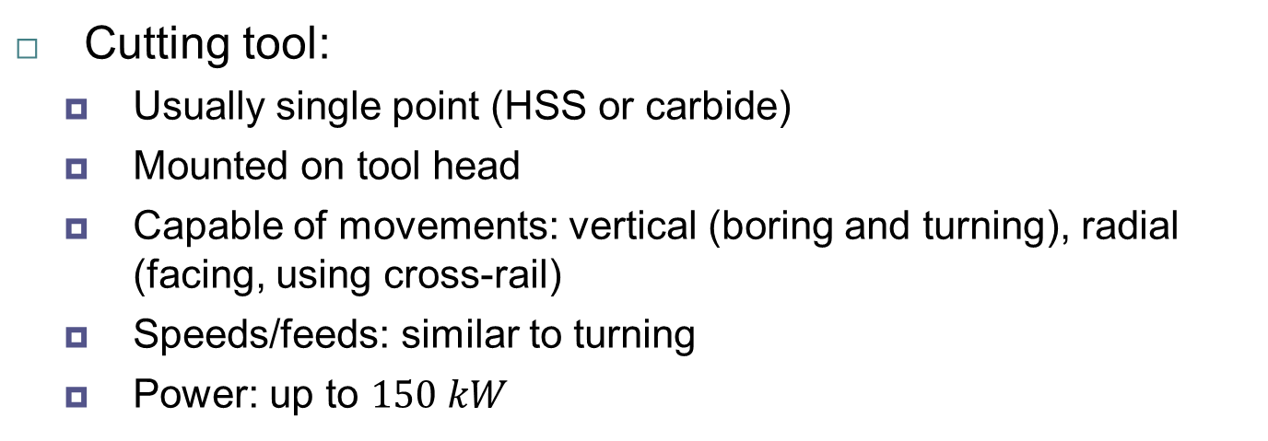
Boring and Boring Machines
Vertical boring mill (→)
  Similar to lathe
  Has vertical axis of
  workpiece rotation
  Workpiece diameters:
  up to $2.5 m$
Cutting tool:
  Usually single point (HSS or carbide)
  Mounted on tool head
  Capable of movements: vertical (boring and turning), radial (facing, using cross-rail)
  Speeds/feeds: similar to turning
  Power: up to $150 kW$

Slide 15
Boring and Boring Machines
Design Considerations for Boring (similar to turning):
Through holes should be specified (not blind holes)
  Blind hole: doesn’t go through thickness of workpiece
Greater the length-to-bore-diameter ratio ⇒
  More difficult it is to hold dimensions
  More deflections of boring bar
  This is due to cutting forces & higher vibration/chatter
Interrupted internal surfaces:
  Should be avoided
  e.g. internal splines, radial holes going through thickness

Slide 16
Reaming and Reamers
Reaming: operation used to:
  Make existing hole dimensionally more accurate (than drilling)
  Improve surface finish
Sequence to produce accurate holes in workpieces:
  Centering
  Drilling
  Boring
  Reaming
For even better accuracy & surface finish, holes may be
  burnished, or
  internally ground and honed
Copyright © 2010 Pearson Education South Asia Pte Ltd

Slide 17
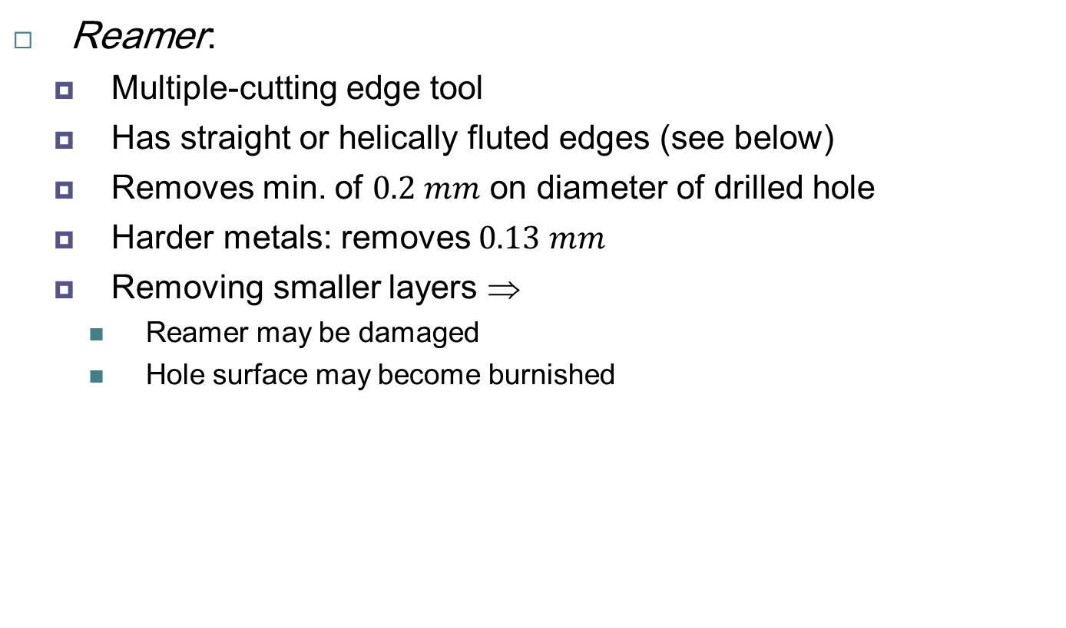
Reaming and Reamers
Reamer:
  Multiple-cutting edge tool
  Has straight or helically fluted edges (see below)
  Removes min. of $0.2 mm$ on diameter of drilled hole
  Harder metals: removes $0.13 mm$
  Removing smaller layers ⇒
    Reamer may be damaged
    Hole surface may become burnished
Rose reamers
Terminology for helical reamer
Notes:
Rose reamers: since cutting edges resemble the shape of a rose

Slide 18
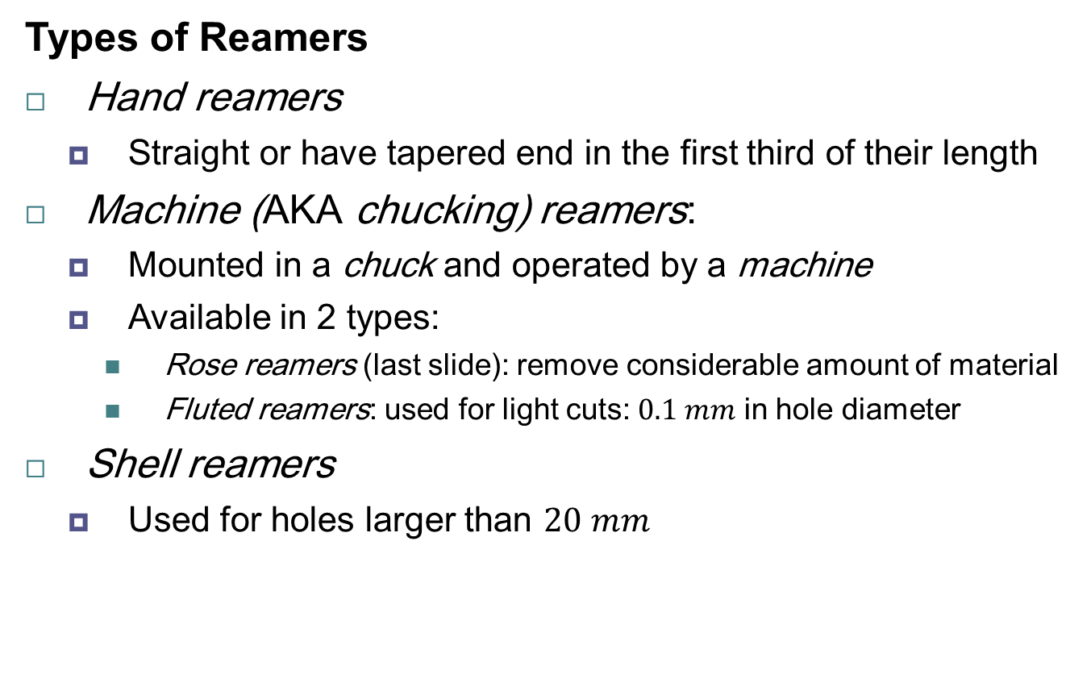
Reaming and Reamers
Types of Reamers
Hand reamers
  Straight or have tapered end in the first third of their length
Machine (AKA chucking) reamers:
  Mounted in a chuck and operated by a machine
  Available in 2 types:
    Rose reamers (last slide): remove considerable amount of material
    Fluted reamers: used for light cuts: $0.1 mm$ in hole diameter
Shell reamers
  Used for holes larger than $20 mm$

Slide 19
Reaming and Reamers
Cont. Types of Reamers
Expansion reamers
  Adjustable for small variations in hole size
  Compensate for wear of reamer’s cutting edges
Adjustable reamers (see above)
  Set for specific hole diameters ⇒ versatile
  Dreamer (recent development)
  Tool combines: drilling + reaming
  Tool tip: drilling; rest of tool: reaming
Reamer material:
  HSS, or solid carbides, or carbide cutting edge
  Maintenance/reconditioning important for accuracy/S.F.
Inserted-blade adjustable reamer
Notes:
SF: surface finish

Slide 20
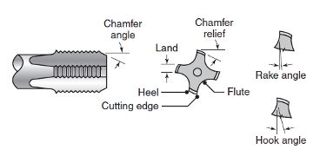
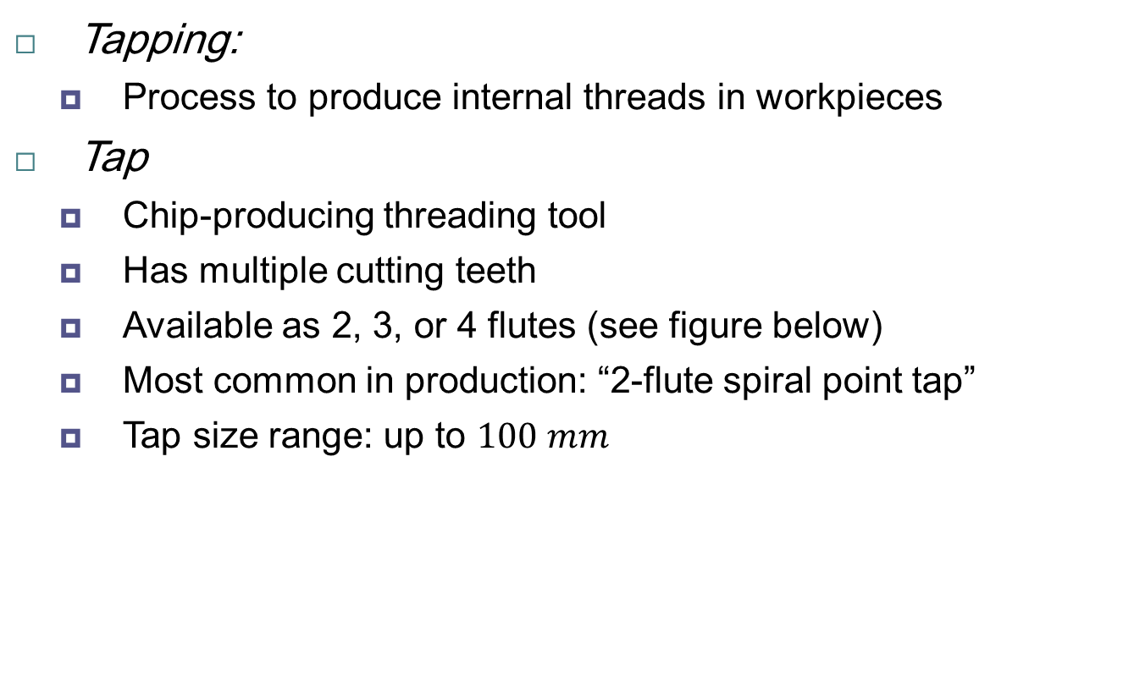
Tapping and Taps
Tapping:
  Process to produce internal threads in workpieces
Tap
  Chip-producing threading tool
  Has multiple cutting teeth
  Available as 2, 3, or 4 flutes (see figure below)
  Most common in production: “2-flute spiral point tap”
  Tap size range: up to $100 mm$
terminology for a tap

Slide 21
Tapping and Taps
Types of Taps
Tapered taps:
  Reduce torque required for tapping of through holes
Bottoming taps:
  Used for tapping blind holes to their full depth
Collapsible taps
  Used in large-diameter holes
Drapping:
  Combination of drilling and tapping (in a single tool)
  Increases tapping productivity
  Tip: drilling; rest of tool: tapping

Slide 22
Tapping and Taps
Removing chips:
  Problem during tapping (due to small clearances)
  Chips must be removed
  Otherwise: large torque ⇒ break the tap
  Solutions:
    Use of cutting fluid
    Periodic reversal and removal of tap
  Result:
    Effective ways to remove chips
    Improved tapped hole quality

Slide 23
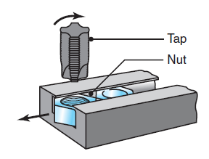
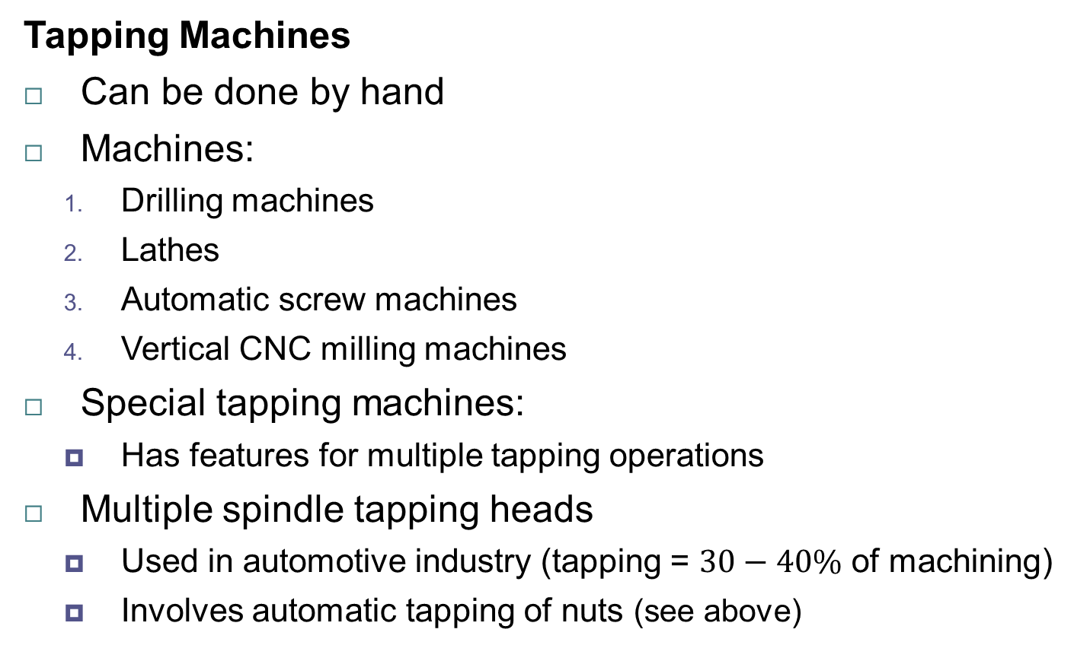
Tapping and Taps
Tapping Machines
Can be done by hand
Machines:
  Drilling machines
  Lathes
  Automatic screw machines
  Vertical CNC milling machines
Special tapping machines:
  Has features for multiple tapping operations
Multiple spindle tapping heads
  Used in automotive industry (tapping = $30−40\%$ of machining)
  Involves automatic tapping of nuts (see above)

Slide 24
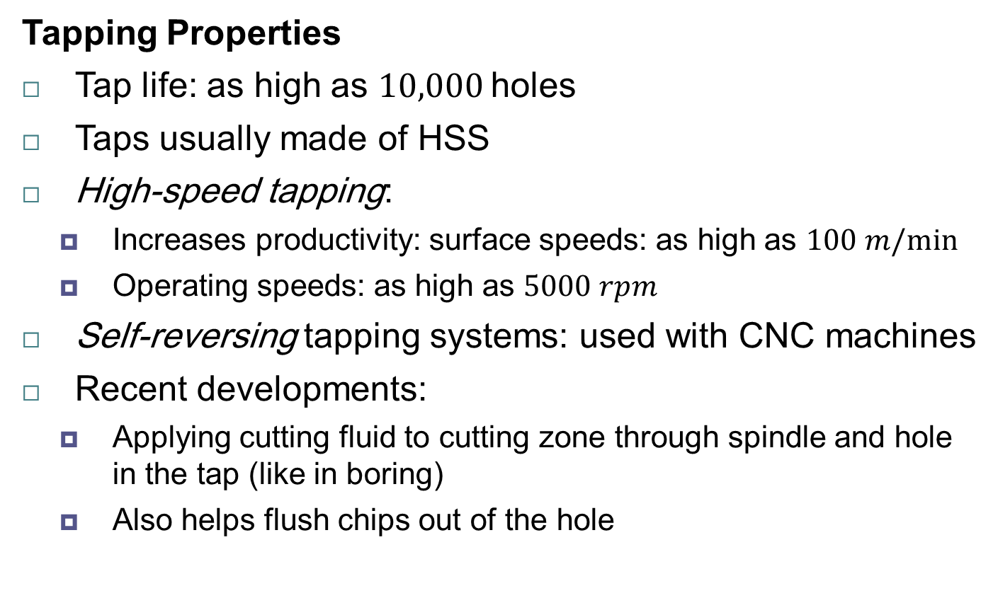
Tapping and Taps
Tapping Properties
Tap life: as high as $10,000$holes
Taps usually made of HSS
High-speed tapping:
  Increases productivity: surface speeds: as high as $100 m/min$
  Operating speeds: as high as $5000 rpm$
Self-reversing tapping systems: used with CNC machines
Recent developments:
  Applying cutting fluid to cutting zone through spindle and hole in the tap (like in boring)
  Also helps flush chips out of the hole
Notes:
Good short video on drilling, boring, tapping: https://youtu.be/om6GQKfoS1g

