Slide 1
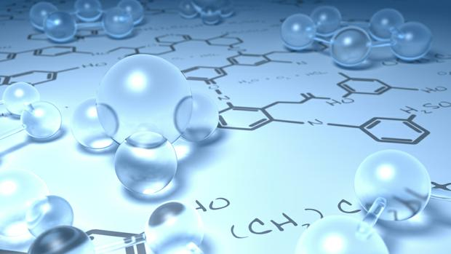
By
Dr. Mohamed El-Newehy
Chemistry Department, College of Science, King Saud University
http://fac.ksu.edu.sa/melnewehy

Slide 2
Alcohols and Phenols

Slide 3
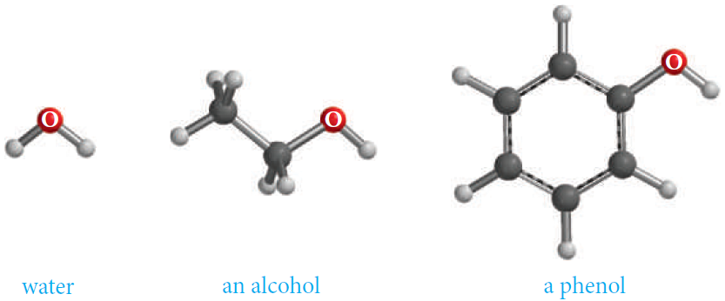
Alcohols and Phenols
- Alcohols and phenols may be viewed as organic derivatives of water.
Alcohols have the general formula R-OH, and structurally similar to water, but with one of the hydrogens replaced by an alkyl group.
Phenols have a hydroxyl group attached directly to an aromatic ring.
- Alcohols and phenols have a common functional group, the hydroxyl group, -OH.

Slide 4
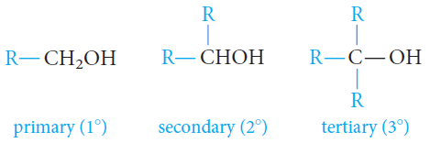
Classification of Alcohols
- Alcohols are classified as primary (1°), secondary (2°), or tertiary (3°), depending on whether one, two, or three organic groups are connected to the hydroxyl-bearing carbon atom.
- Methyl alcohol, which is not strictly covered by this classification, is usually grouped with the primary alcohols.

Slide 5
Nomenclature of Alcohols
- The common names for the simplest alcohols consist of alkyl group attached to the hydroxyl function followed by the word alcohol.
Alkyl alcohol
- In the IUPAC system, alcohols are named according to the following rules.
1. Select the longest continuous carbon chain that contains the -OH group.
Drop the –e ending of the parent alkane and replace it by the suffix -ol.
ALKANOL
2. When isomers are possible, the chain is numbered so as to give the functional group (-OH) the lowest possible number.

Slide 6
Nomenclature of Alcohols
- In the IUPAC system, alcohols are named according to the following rules.
3. When alkyl side chains or other groups are present, they are named alphabetically and their positions are indicated by a number.
The position of the functional group (-OH) is always given the lowest possible number at the end of the name.

Slide 7
Nomenclature of Alcohols
- In the IUPAC system, alcohols are named according to the following rules.
4. With Unsaturated Alcohols; If a molecule contains both an -OH group and a C=C or C-C triple bond, the -OH group takes preference before the double or triple bonds in getting the lower number.
The name should include (if possible) both the hydroxyl and the unsaturated groups, even if this does not make the longest chain the parent hydrocarbon.

Slide 8
Nomenclature of Alcohols
- In the IUPAC system, alcohols are named according to the following rules.
For cyclic alcohols, numbering always starts from the carbon bearing the -OH group.

Slide 9
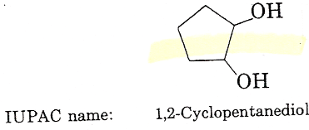
Nomenclature of Alcohols
- Alcohols with More Than One Hydroxyl Group
Compounds with two adjacent alcohol groups are called glycols.
The most important example is ethylene glycol.
Compounds with more than two hydroxyl groups are also known, and several, such as glycerol and sorbitol, are important commercial chemicals.
Ethylene glycol is used as the “permanent” antifreeze in automobile radiators and as a raw material in the manufacture of Dacron.
Ethylene glycol is completely miscible with water.
Glycerol is a syrupy, colorless, water-soluble, high-boiling liquid with a distinctly sweet taste. Its soothing qualities make it useful in shaving and toilet soaps and in cough drops and syrups.

Slide 10
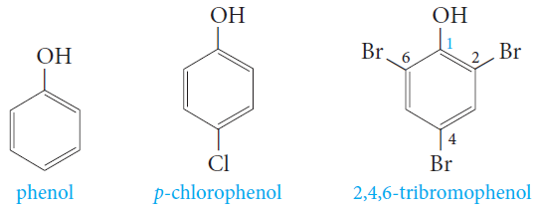
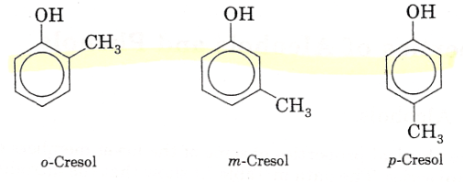
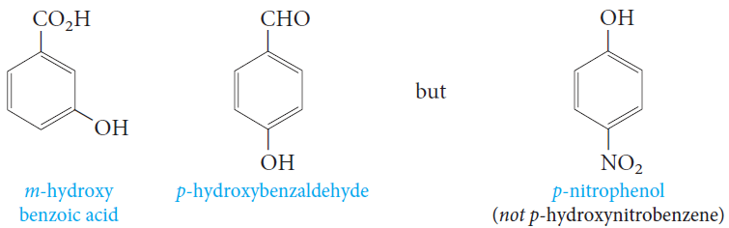
Nomenclature of Phenols
- Phenols are usually named as derivatives of the parent compounds.
- The hydroxyl group is named as a substituent when it occurs in the same molecule with carboxylic acid, aldehyde, or ketone functionalities, which have priority in naming.

Slide 11
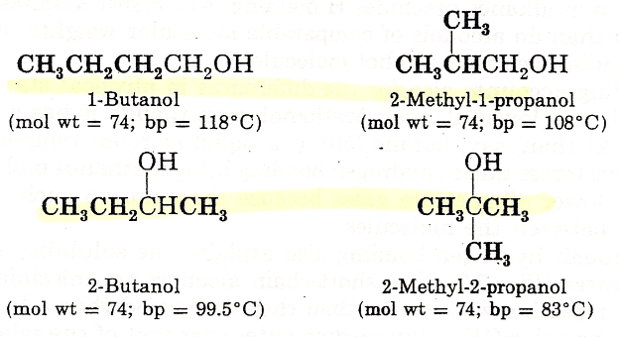
Physical Properties of Alcohols
- Physical State
The simplest alcohol, methanol, is a liquid at room temperature.
In contrast, alkanes from methane to butane are gases.
- Solubility
The lower alcohols are completely miscible with water.
As the number of carbons in the alcohol increases, the solubility in water decreases.
- Boiling Points
Series of normal alcohols; The boiling points increase with increase in molecular weights.
A comparison of boiling points among isomeric alcohols; The boiling points decrease as the number of alkyl branches from the carbinol group increases.

Slide 12
Hydrogen Bonding in Alcohols
- The boiling points (bp’s) of alcohols are much higher than those of ethers or hydrocarbons with similar molecular weights.
Why? Because alcohols form hydrogen bonds with one another.
The O-H bond is polarized by the high electronegativity of the oxygen atom and places a partial positive charge on the hydrogen atom and a partial negative charge on the oxygen atom.
Two or more alcohol molecules thus become loosely bonded to one another through hydrogen bonds.
- Consequently, alcohols have relatively high boiling points because they must supply enough heat to break the hydrogen bonds before each molecule.
- Hydrogen bonds are weaker than ordinary covalent bonds.

Slide 13
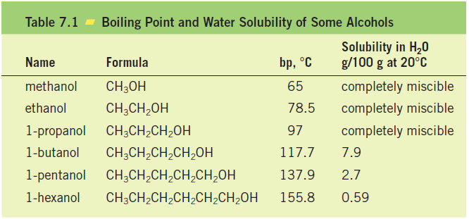
Hydrogen Bonding in Alcohols
Water, of course, is also a hydrogen-bonded liquid.
The lower molecular-weight alcohols can readily replace water molecules in the hydrogen bonded network.
This accounts for the complete miscibility of the lower alcohols with water.
However, as the organic chain lengthens and the alcohol becomes relatively more hydrocarbon like, its water solubility decreases.

Slide 14
Physical Properties of Phenols
- Phenol is a colorless, crystalline, low-melting solid, with a high boiling point, that is moderately soluble in water.
- Most other phenols also are solids, with slight solubility in water and high boiling points.
- The most significant physical property that distinguishes alcohols from phenols is the acidity of phenols.

Slide 15
The Acidity of Alcohols and Phenols
- Like water, alcohols and phenols are weak acids.
The hydroxyl group can act as a proton donor, and dissociation occurs in a manner similar to that for water

Slide 16
The Acidity of Alcohols and Phenols
- Phenols are stronger acids than alcohols mainly because the corresponding phenoxide ions are stabilized by resonance.
The negative charge of an alkoxide ion is concentrated on the oxygen atom, but the negative charge on a phenoxide ion can be delocalized to the ortho and para ring positions through resonance.
Because phenoxide ions are stabilized in this way, the equilibrium for their formation is more favorable than that for alkoxide ions

Slide 17
The Acidity of Alcohols and Phenols
- All electron-withdrawing groups increase acidity by stabilizing the conjugate base. Electron-donating groups decrease acidity because they destabilize the conjugate base.

Slide 18
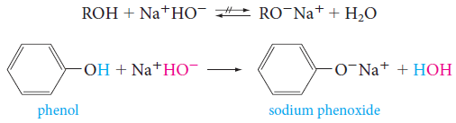
The Acidity of Alcohols and Phenols
- Alkoxides, the conjugate bases of alcohols, can be prepared by the reaction of an alcohol with sodium or potassium metal.
- Treatment of alcohols with sodium hydroxide does not convert them to their alkoxides.
This is because alkoxides are stronger bases than hydroxide ion, so the reaction goes in the reverse direction.
Since alcohols are weaker acids than water, it is not possible to form the salt of an alcohol in aqueous alkaline solutions.
- Treatment of phenols with sodium hydroxide converts them to phenoxide ions.

Slide 19
Preparation of Alcohols
1) From Alkenes
A. Hydration of Alkenes
1. Addition of water to a double bond in the presence of an acid catalyst, H⁺.
2. The addition follows Markovnikov’s rule.
3. It is not possible to prepare primary alcohols except Ethanol.
B. Oxidation of Cycloalkenes
Alkenes react with alkaline potassium permanganate to form glycols (compounds with two adjacent hydroxyl groups).

Slide 20
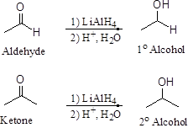
Preparation of Alcohols
2) Nucleophilic Substitution of Alkyl Halide
3) Reduction of Ketones, and Aldehydes
Aldehydes and ketones are easily reduced to primary and secondary alcohols, respectively.

Slide 21
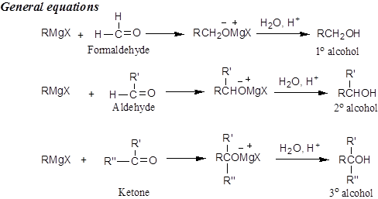
Preparation of Alcohols
4) Addition of Grignard’s Reagent to Aldehydes and Ketones

Slide 22
Reactions of Alcohols
- Alcohols undergo two kinds of reactions:
Those that involve the breaking of the oxygen-hydrogen bond (CO-H).
Those that involve the rupture of the carbon-oxygen bond (C-OH).
- Phenols do not participate in reactions where the C-OH bond is broken.

Slide 23
Reactions of Alcohols
A) Those that involve the breaking of the oxygen-hydrogen bond (CO-H).
1) Reactions of Alcohols and Phenols as Acids: Salt Formation.
2) Ester Formation (Esterification).
Organic esters, derived from a carboxylic acid and an alcohol.

Slide 24
Reactions of Alcohols
B) Those that involve the rupture of the carbon-oxygen bond (C-OH).
1) Nucleophilic Substitution Reaction; The Reaction of Alcohols with Hydrogen Halides: Alkyl Halides
Alcohols react with hydrogen halides (HCl, HBr and HI) to give alkyl halides.
2) Elimination Reaction: Dehydration of Alcohols: Formation of Alkenes
Alcohols can be dehydrated by heating them with strong acid.

Slide 25
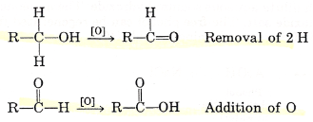
Reactions of Alcohols
C) Oxidation Reactions
Oxidation is the removal of H from a compound and/or the addition of O to a compound.
An oxidizing agent is the chemical reagent that does the oxidation.
Reduction is the addition of H to a compound and/or the removal of O from a compound.
A reducing agent is a substance that does the reduction.

Slide 26
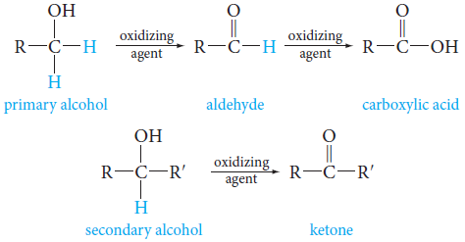
Reactions of Alcohols
C) Oxidation Reactions
Alcohols with at least one hydrogen attached to the hydroxyl-bearing carbon can be oxidized to carbonyl compounds.
- Primary alcohols give aldehydes, which may be further oxidized to carboxylic acids.
- Secondary alcohols give ketones.
- Tertiary alcohols, having no hydrogen atom on hydroxyl-bearing carbon, do not undergo oxidation.

Slide 27
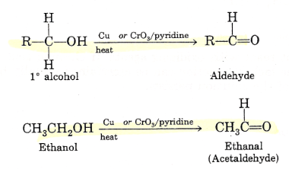
Reactions of Alcohols
C) Oxidation Reactions
- Primary alcohols, oxidation can be stopped at aldehyde stage by special reagents, such as “pyridinium chlorochromate (PCC)”.
- Primary alcohols yield aldehydes when treated with mild oxidizing agents such as hot metallic copper or CrO₃ in pyridine.

Slide 28
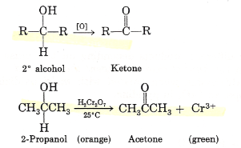
Reactions of Alcohols
C) Oxidation Reactions
- Primary alcohols yield aldehydes when treated with stronger oxidizing agents, such as chromic acid, H₂Cr₂O₇, or neutral potassium permanganate, KMnO₄, the intermediate aldehydes formed initially are oxidized further to carboxylic acids.
- Secondary alcohols, when treated with any of the oxidizing agents mentioned previously, yield ketones.

Slide 29
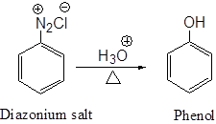
Preparation of Phenols
- The Alkali Fusion of Sulfonates
The alkali fusion of sulfonates involves the following steps;
1. Sulfonation of an aromatic ring.
2. Melting (fusion) of the aromatic sulfonic acid with sodium hydroxide to give a phenoxide salt.
3. Acidification of the phenoxide with HCl to produce the phenol.
- From Diaznoium salt

Slide 30
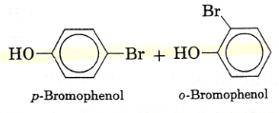
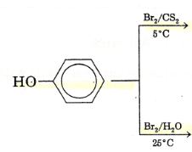
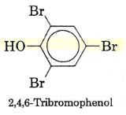
Reactions of Phenols
1) Reactions of Phenols as Acids: Salt Formation.
2) Halogenation takes place without catalyst.

