Slide 1
King Saud University College of Engineering IE – 341: “Human Factors” Fall – 2015 (1st Sem. 1436-7H)
Applied Anthropometry, Work-Space Design
Part II - Design of Work Surfaces
(Chapter 13)
Prepared by: Ahmed M. El-Sherbeeny, PhD

Slide 2
Lesson Overview
Design of Work Surfaces
Horizontal Work Surface Area
Work-Surface Height
Seated
Standing

Slide 3
Design of Work Surfaces
Important use of anthropometric data: work space
Work-space envelope (Def^{n}): 3-D space within which individual works
Involves mostly space where hands can move
Within envelope, design decisions must be made about features of the workspace, e.g.
location and design of benches, desks, tables, and control panels
Discussed here samples of work surfaces: horizontal, vertical

Slide 4
Horizontal Work Surface Area
This is area used by:
Seated worker
“Sit-stand” worker
Area should allow for manual activities within “convenient” arm reach (what is convenient?)
Research on horizontal work surface area:
Barnes (1963) and Farley (1955):
Shown in next slide (carefully examine dimensions)
Normal Area: area conveniently reached by forearm (while upper arm hangs in natural position)
Maximum Area: area reached by extending the arm from the shoulder
Squires (1956): suggests “optimal area”: takes into account dynamic interaction of forearm movement as the elbow is also moving (also shown next slide)

Slide 5
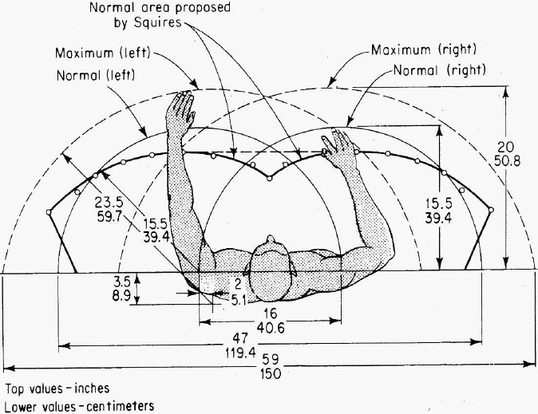

Slide 6
Cont. Horizontal Work Surface Area
Cont. Research on horiz. work surface area
Squires (optimal) area vs. Farley area (normal-max.)
Squires area more shallow but covers more area
Squires area requires less forearm extension ⇒ minimal stress on elbow joint
Ayoub (1973): suggests “optimal work” area:
approx. 25 * 25 cm (see next slide; note similarities)
located @ 10 cm from the table edge
body mid-line crossing at the middle of the area
Source [Pheasant textbook];

Slide 7
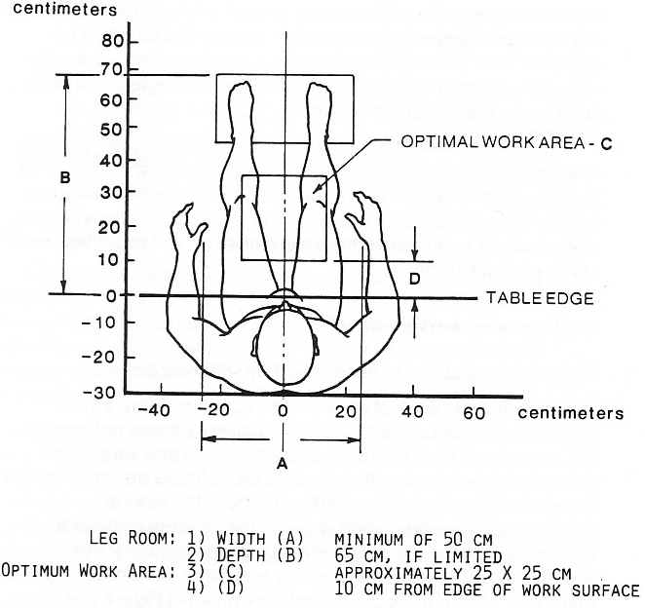

Slide 8
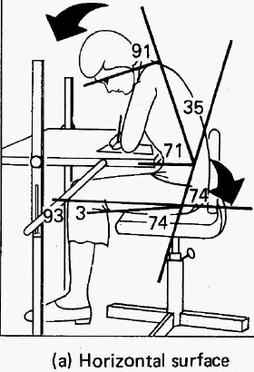
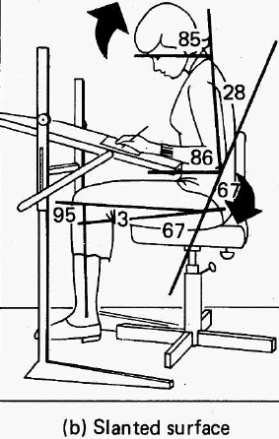
Cont. Horizontal Work Surface Area
Cont. Research on horiz. work surface area
Bridger (1988): slanted working surface is better:
trunk: less motion –upright- (vs. horizontal)
neck: less bending
also less fatigue and discomfort
slant (here) = 15º
slant (other research): 12º and 24º
applications:
Visual tasks (e.g. reading)
Can you name any dis- advantages of slanted surfaces?

Slide 9
Work-Surface Height
Height of work surface:
Can cause backaches, neck aches, shoulder pains
Too low ⇒ back is bent over too much
Too high ⇒ shoulders raised over relaxed posture ⇒ discomfort in shoulder and neck
Work-surface height vs. working height
Work-surface height:
height of upper surface of table, bench, desk, etc.
measured from the floor
for slanted surface: need height of front edge + angle
Working height
Depends on what operator is working on
e.g. writing paper ⇒ working ht. = work-surface ht.
e.g. writing on keyboard ⇒ working ht. = ht.: “asdfg…”
how about when washing vegetable in a sink?

Slide 10
Work-Surface Height: 1. Seated
Seated Work-Surface: Height & Arm Posture
Work surface height is affected by:
Arm posture
Seat height
Thickness of the work surface (which affects …?)
Thickness of the thighs
As work-surface height ↓ ⇒
More relaxed posture of upper arms (@ working ht.)
Elbows are at 90º (with respect to working ht.)
Wrists are straight
Overall comfortable working (shoulders, spine, etc.)
Beneficial for repetitive tasks (e.g. typing, assembly)
Common desk work-surface heights
76 cm (30 in)
Research: recommend reduction to 72 cm, 68.6 cm

Slide 11
Cont. Work-Surface Height: 1. Seated
Seated Work-Surface: Height & Thigh Clearance
Thigh clearance:
Determined by dist. bet. seat & work surface bottom
Design here for max, min, average, adjustable?
Non-adjustable height work surface
ANSI: 26.2 in (66.5 cm) as min. ht. of bottom
Small users
raise seat so elbows are at 90º to work surface
⇒ feet don’t touch floor
⇒ foot rest is needed to support feet
or use adjustable-height work surface
Adjustable-height work surface
ANSI: 51.3 – 66.5 cm for bottom of work surface

Slide 12
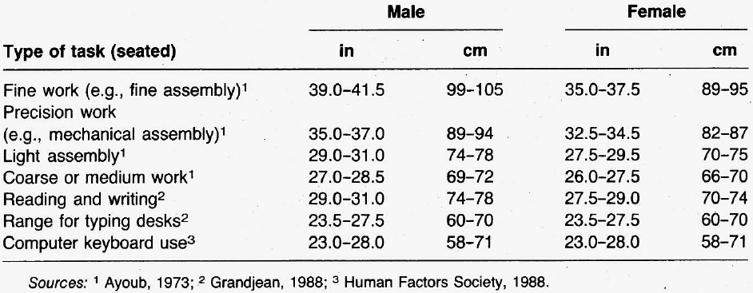
Cont. Work-Surface Height: 1. Seated
General Principles for Seated Work Surfaces:
Best to find work surfaces with adjustable height (e.g. adjustable computer tables)
Best if work surface is such that elbow height = working height
Work surface should provide enough clearance for people with thick thighs
Recomm. seated work surface ht. for different tasks:

Slide 13
Work-Surface Height: 2. Standing
Factors governing standing work-surface ht
Elbow height
Type of work
Type of work vs. elbow height (next slide):
Light and heavy work: work-surface height: below elbow height
Precision work:
work-surface height: slightly above elbow height
Reason: to support elbow while performing work
but recommended: sitting down for precision work
Fixed vs. adjustable standing work surface height
Fixed: designed for max. (i.e. tallest) users
Shorter users:
either use a platform to account for height difference
or use adjustable ht. (e.g. electric, manual, hydraulic)

Slide 14
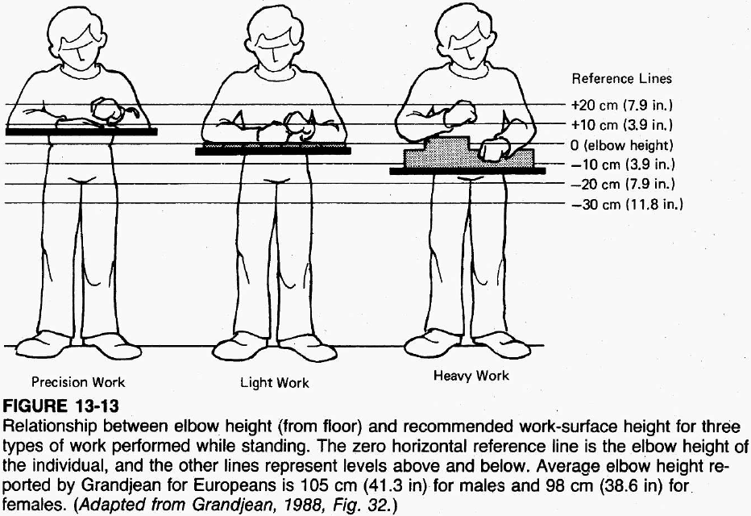

Slide 15
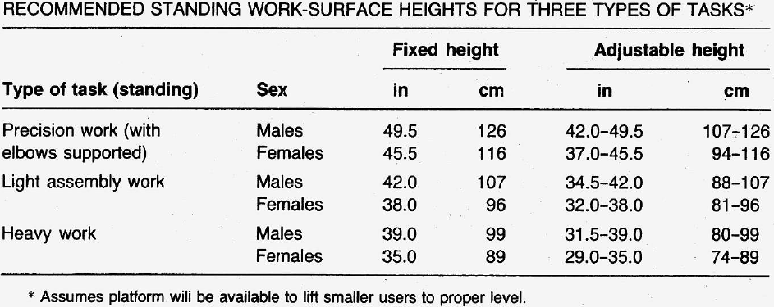
Cont Work-Surface Height: 2. Standing
Other recommendations:
Work height: too high ⇒ shoulders & upper limbs raised ⇒ fatigue, strain on shoulder muscles
Work height: too low ⇒ trunk, neck, head: inclined forward ⇒ stress on spine
Recommended hts. for different tasks: below for fixed vs. adjustable ht (and for male, female)

