Slide 1
Basic Immunology
CLS 212

Slide 2
Terminology
Immunology
The branch of biomedical science, which covers the immune system physiological functions in health or disease
Immune system
Organs, tissues, cells & molecules involved in the defense mechanism
Immunity
From the Latin word Immunis, meaning “free from burden”, which is the ability of an organism to protect itself from disease
Innate immunity
Natural defenses against any pathogen
Adaptive immunity
Acquired defenses against a specific pathogen
Notes:
Immunity:
Is a biological term that describes a state of having sufficient biological defenses to avoid infection, disease, or other unwanted biological invasion.
In other words, it is nothing but the capability of the body to resist harmful microbes from entering the body.

Slide 3
Terminology
Resistance
The ability to ward off disease
Susceptibility
Vulnerability or lack of resistance
Functions of the immune
system
The main functions of the immune system is:
Protect the body from infection & disease.
Maintain the body's organs, tissues & cells (homeostasis).

Slide 4
Immune response
The immune response is how your body recognizes and defends itself against bacteria, viruses, and substances that appear foreign and harmful.
To defend the body against these invaders, the immune system must be able to distinguish between:
What belongs in the body (self)
What does not (nonself or foreign)

Slide 5
Immunity
1. Innate immunity or “nonspecific”
Defenses against any pathogen.
Refers to defenses that are present at birth.
Rapid response.
2. Adaptive immunity or “specific ”
Defenses to a specific pathogen.
Acquired during the lifetime of an organism.
Slower to respond.
Has memory component.

Slide 6
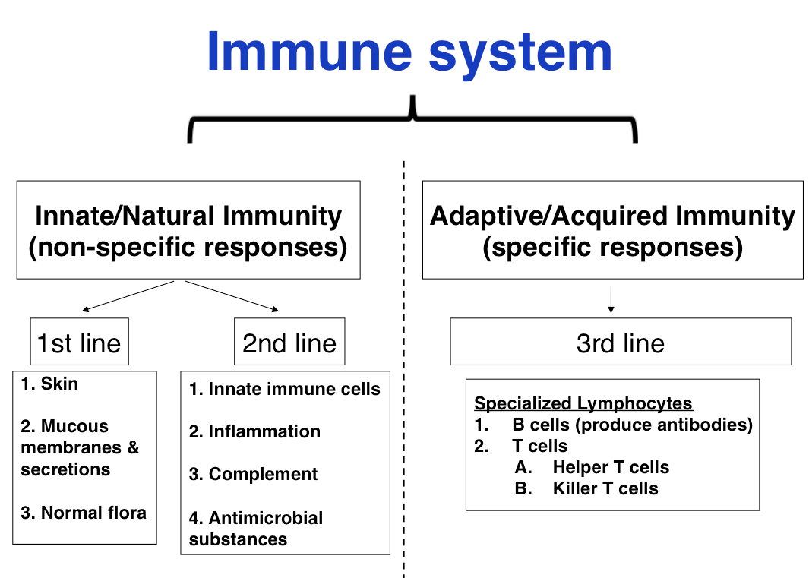

Slide 7
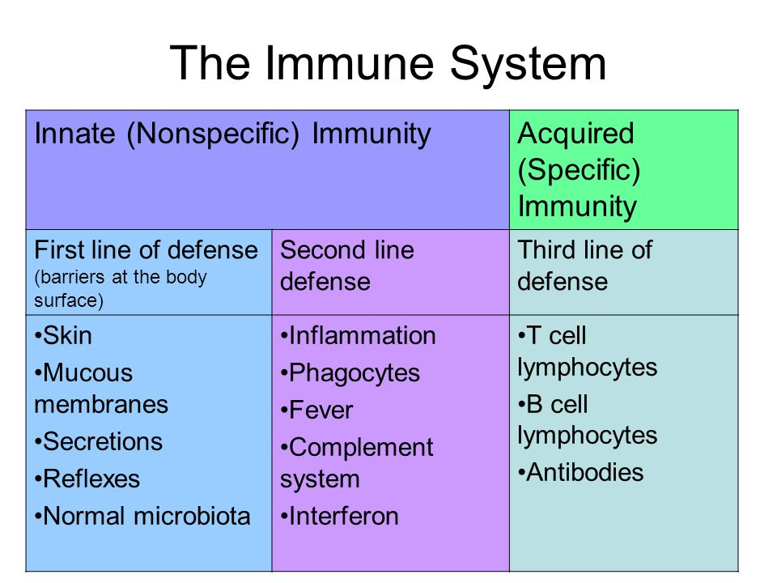

Slide 8
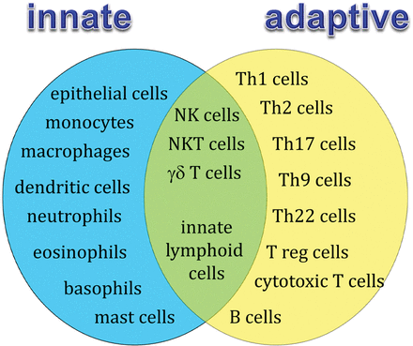

Slide 9
Host Defenses

Slide 10
Host Defenses
Innate (Nonspecific) Immunity |  | Adaptive (Acquired) Immunity
First line of defense | Second line of defense | Third line of defense
Physical / Mechanical factors Chemical factors Biological factors | Immune defensive cells Inflammation Fever Antimicrobial substances | Humoral immunity Cellular immunity

Slide 11
Innate (Nonspecific) immunity
First line of defense
A) Physical/Mechanical | B) Chemical | C) Biological
Skin Mucous membranes Lacrimal apparatus Saliva Earwax Hair Epiglottis Coughing & sneezing Vomiting & diarrhea Urination Vaginal secretions | Sebum Lysozyme Perspiration salts Gastric Juice Vaginal Fluid Transferrins Mother’s milk | Microbiota

Slide 12
Innate (Nonspecific) immunity
Second line of defense
A) Defensive cells | B) Inflammation | C) Fever | D) Antimicrobial substances
Defensive myeloid cells Defensive lymphoid cells | Acute/Chronic response Released chemicals | Temperature Metabolism | Complement system Interferons Iron-binding proteins Antimicrobial peptides

Slide 13
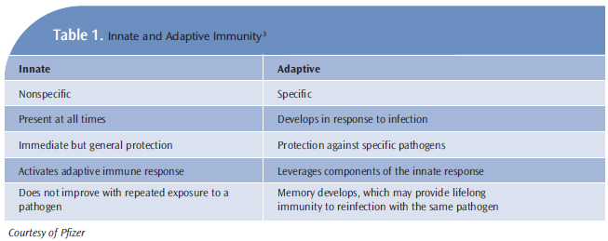

Slide 15
Blood elements
Blood consists of:
- Plasma (fluid).
Cells & cell fragments suspended in plasma.
Blood cells:
Erythrocytes (red blood cells).
Leukocytes (white blood cells).
Thrombocytes (platelets).

Slide 16
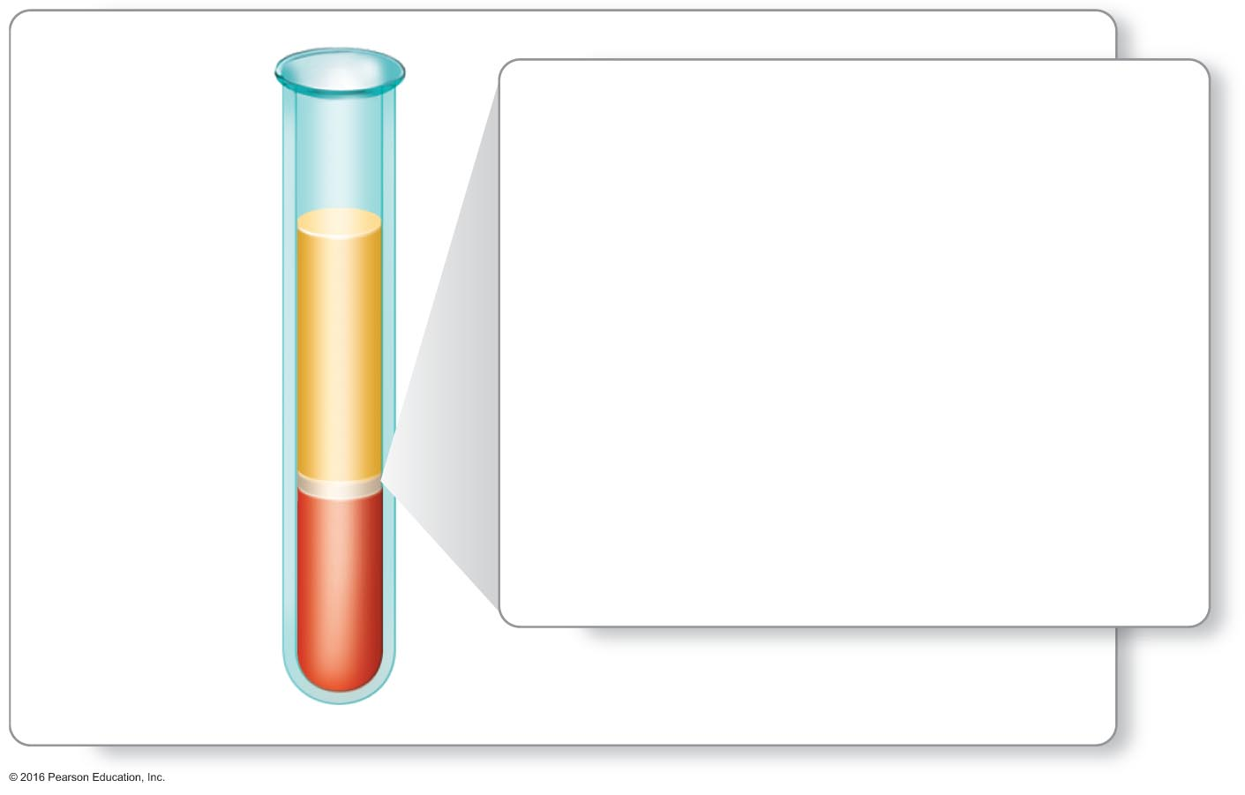
White blood cell count
White blood cell count for
men and women:
5,000–10,000 WBCs
per cubic millimeter (mm³)
or
5.0–10.0 x 10⁹ WBCs per liter (L).
Plasma
White
blood cells
Red blood
cells
© 2016 Pearson education, Ltd.

Slide 17
Leukocytes
Leukocytes (white blood cells):
Are cells of the immune system that protect against infection
& disease.
All white blood cells are nucleated.
High leukocyte counts (Leukocytosis) may indicate bacterial infections, autoimmune disease or side effects from medications.
Low leukocyte counts (Leukopenia) may indicate viral infections, pneumonia, autoimmune disease or cancers.

Slide 18
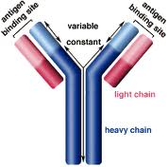
Antigens and Antibodies
Antigens: any agent (microorganism, molecule, protein…etc) that can stimulate the production of antibodies.
Antibodies Specific glycoprotiens produced by lymphocytes in response to the presence of an antigen.
All antibodies are in a class of proteins called Immunoglobulins.
Each antibody is specific to the
antigen that stimulates its production.
Notes:
Primary functions of immune system are to diffreniate between self and non self (something foreign) and destroy that which is non self

Slide 19
Primary vs. Secondary Immune Response
Primary Response | Secondary Response
The initial immune response to a particular antigen | The second immune response to the same antigen
Takes approximately 10 to 14 days for antibodies to be produced. SLOW RESPONSE | Takes less time FAST RESPONSE
Result in the production of memory cells NO memory cell (stage of production) | Large quantities of antibodies due to the presence of memory cell Memory cell present

Slide 20
Immunosuppression
If a persons immune system is functioning properly, that person is said to be an immunocompetent person. If a persons immune system is not functioning properly, that person is said to be immunosuppressed, immunodepressed or immunocompromised.
Immunodeficiency's
Acquired:
May be caused by drugs, (e.g., cancer chemotherapeutic agents and drugs given to transplant patients), irradiation, or certain infectious diseases (e.g., HIV)
Inherited:
Can be the result of deficiencies in antibody production, or any of immunological cells.
Notes:
https://www.youtube.com/watch?v=6uwVhn-APsQ

