Slide 1
Atomic-absorption spectroscopy

Slide 2
Introduction
Atomic absorption spectroscopy (AAS) is a technique for determining the concentration of a particular metal element (e.g.Fe, Cu, Al, Pb, Ca, Zn)in a sample ( water, medicine, food) . Atomic absorption spectroscopy can be used to analyze the concentration of over 70 different metals in a solution.

Slide 3
Technique
Atomic-absorption (AA) spectroscopy uses the absorption of light to measure the concentration of gas-phase atoms. Since samples are usually liquids or solids, the analyte atoms must be vaporized or atomized in a flame.

Slide 4
Steps
The steps are involved in turning a liquid sample into an atomic gas:
Desolvation – the liquid solvent is evaporated, and the dry sample remains.
Vaporisation or Volatilization – the solid sample vaporises to a gas.

Slide 5
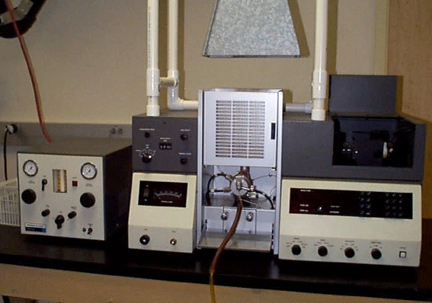
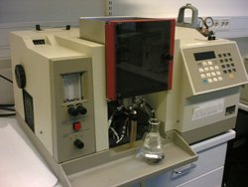
Instrumentation

Slide 6
Light Source: Hollow Cathode Lamp
The light that is focused into the flame is produced by a hollow cathode lamp.

Slide 7
The type of hollow cathode tube depends on the metal being analyzed. For analyzing the concentration of copper, a copper cathode tube would be used.

Slide 8
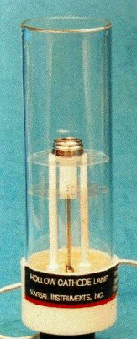

Slide 9
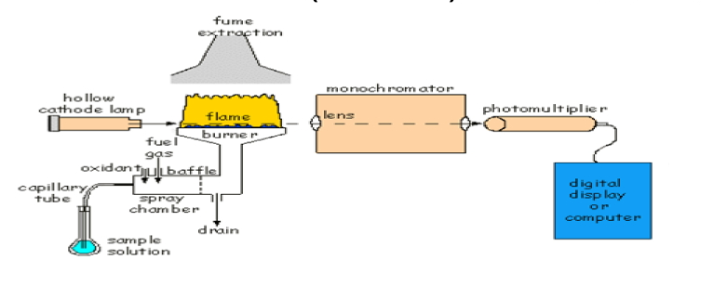

Slide 10
Sample solutions are usually aspirated and entering to the flame →excitation by heat of flame→ absorb light from hallow cathode lamb →to go from ground state E˳→ to higher energy level E1→monochromator→ detector measuring the reduction of intensity of light refer to conc of sample.
Each Element have specific E that will absorb a specific wavelength of light .

Slide 11
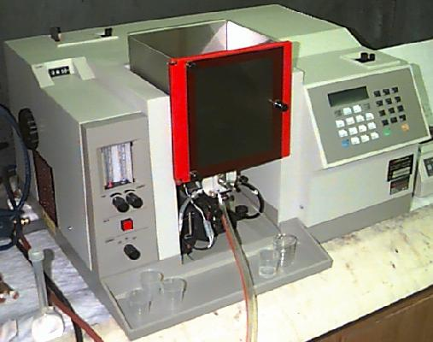
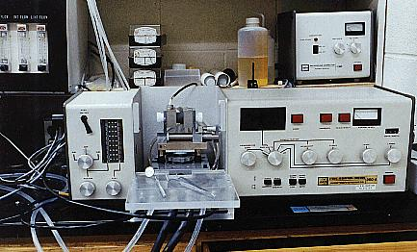
a flame atomic-absorption spectrometer
a graphite-furnace atomic-absorption spectrometer:

Slide 12
Monochromator
Which is set to isolate the radiation at the specified wavelength and travels into the detector.

Slide 13
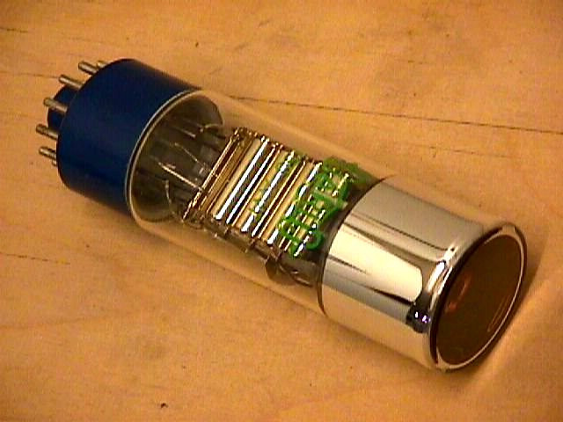
Detector
Photo multiplier tube
Extremely sensitive
Can detect single photons
Measures the intensity of the beam of light. When some of the light is absorbed by metal, the beam's intensity is reduced. The detector records that reduction as absorption. That absorption is shown on output device by the data system

Slide 14
Schematic of an atomic-absorption experiment

