Slide 1
Management Information Systems
DBMS
MS Access 2010
By:
Mr. Imdadullah
Lecturer, Department of M.I.S.
College of Business Administration, KSU
http://faculty.ksu.edu.sa/imdad

Slide 2
MS Access
MS Access is an application software that facilitates us to create Database Management Systems (DBMS)
(DataBase Management System) Software that controls the organization, storage, retrieval, security and integrity of data in a database. It accepts requests from the application and instructs the operating system to transfer the appropriate data.

Slide 3
Access Terminology
Field – A single characteristic or attribute of a person, place, object, event, or idea. A field is also called as a Key.
Record – A set of related field values.
Table – A collection of records that identify a category of data, such as Customers, Orders, or Inventory.
Query – A tool (object) that extracts records from other tables / queries under some criteria.
Form – A tool (object) that makes easy operations on database like Insertion, deletion, saving, searching etc.
Report – A tool (object) through which we can take output (Hardcopy or softcopy) from the database.

Slide 4
To Create New Database
To create The Database,
Click on File Menu > New
Click on Blank Database
Type database filename and click on button. The database is created. You can see database name in the title bar of the database window.
Notes:
4

Slide 5
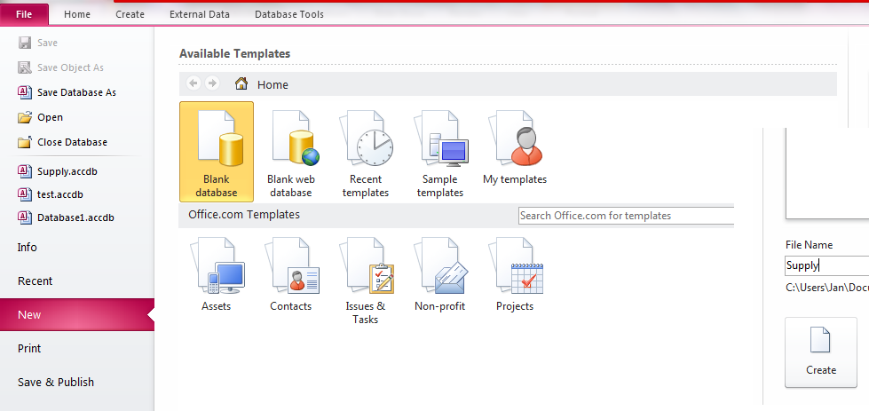
Database
Name

Slide 6
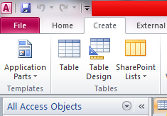
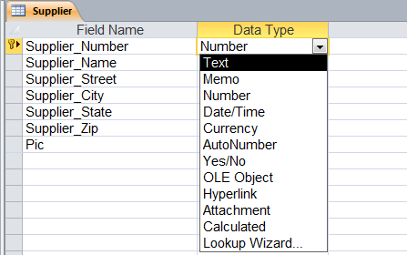
To Create New Table in Database
To create new table, follow the following steps:
Click on Create Menu
Click on ‘Table Design’
Type fieldnames and select data type in
front of each fieldname
(as shown in the following figure).
When completed, then click on Save. Type Table name and click on OK.
Click Here
Notes:
6

Slide 7
Creating the primary key:
Primary Key can be created in
any of three ways. With a table open in Design
view:
Select the field to be used as the primary key and click the Primary Key button in the Tools group in the ribbon’s Design tab.
Right-click on the field and select Primary Key.
Save the table without creating a primary key, and allow Access to automatically create an AutoNumber field.

Slide 8
Setting Field Data Types
Data Type | Type of Data Stored | Storage Size
Text | Alphanumeric Characters | 255 characters or less
Memo | Alphanumeric Characters | 65,536 characters or less
Number | Numeric values | 1, 2, 4, or 8 bytes, 16 bytes
Date/Time | Date and time data | 8 bytes
Currency | Monetary data | 8 bytes
AutoNumber | Automatic number Increments | 4 bytes, 16 bytes

Slide 9
Data Type | Type of Data Stored | Storage Size
Yes/No | Logical values: Yes/No, True/False | 1 bit (0 or –1)
OLE Object | Pictures, graphs, sound, video | Up to 1GB (disk space limitation)
Hyperlink Link | to an Internet resource | 64,000 characters or less
Attachment | A special field that enables you to attach external files to an Access database. | Varies by attachment
Lookup Wizard | Displays data from another table | Generally 4 bytes
Calculated | the value automatically, based on an expression with simple math and combine the values from other fields.

Slide 10
Open an Access Database Table
To open a table, you must first open a database:
In the Objects Pan on left side, in the list of tables, select the table you want to open and click on the Open button
When a table is opened, it is in Datasheet view, which shows the table's data as a collection of rows and columns
Each row in the Datasheet view represents a record in the table
Notes:
10

Slide 11
Data Sheet View of Table
Fieldnames
Primary Key Field

Slide 12
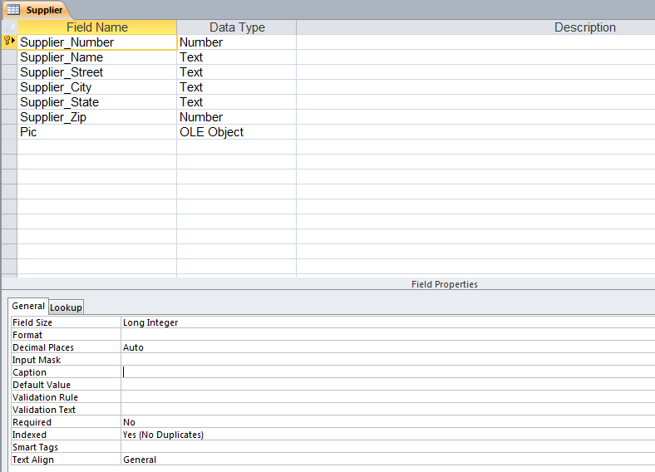
Design View of Table

Slide 13
Relational Database Management System
Primary Key – The key that uniquely identifies record in the table is called Primary Key.
Foreign Key – A foreign key (sometimes called a referencing key) is a key used to link two tables together. Typically you take the primary key field from one table and insert it into the other table where it becomes a foreign key (it remains a primary key in the original table).
Relational Database: In Relational Database, data is held in tables (also called relations) and the tables are linked by means of common fields. Relational databases support a number of different types of relationships between tables, all designed to enforce the concept of referential integrity. Access supports three different types of relationships between tables.
One-to-one relationships occur when there is exactly one record in Table-A that corresponds to exactly one record in Table-B.
One-to-many relationships occur when each record in Table-A may have many linked records in Table-B but each record in Table-B may have only one corresponding record in Table-A.
Many-to-many relationships occur when each record in Table-A may have many linked records in Table-B and vice-versa.
Referential integrity is a database concept that ensures that relationships between tables remain consistent. When one table has a foreign key to another table, the concept of referential integrity states that you may not add a record to the table that contains the foreign key unless there is a corresponding record in the linked table. It also includes the techniques known as cascading update and cascading delete, which ensure that changes made to the linked table are reflected in the primary table.
Notes:
13

Slide 14
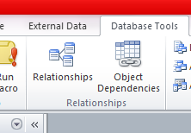
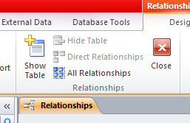
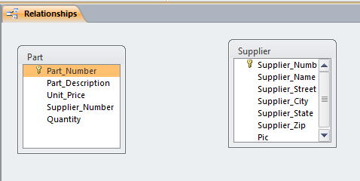
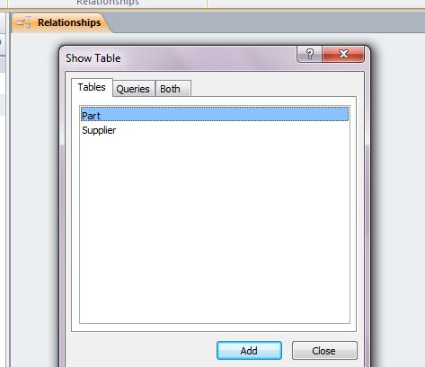
Creating Relationships Between Tables
Close any open table.
Click on Database Tools (menu) > Relationships, or Click on the Relationships icon . The Relationships window appears:
Now click an Show Tables Icon if it has not been displayed already
Add tables or queries you want to relate
Relate the tables as explained in the next slide
List of Tables/Queries
Select Table / Query from List and click on Add
Notes:
14

Slide 15
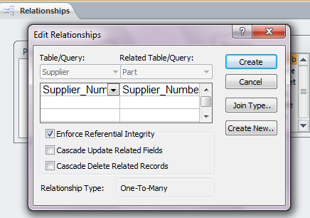
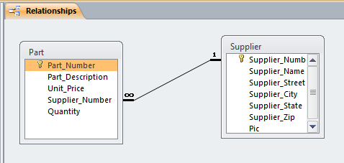
Relating Two Tables
Move the mouse pointer to the primary key field in the primary table. That key is boldfaced.
Drag that fieldname to the corresponding field in the related table (Child table) i.e. drag it to the appropriate foreign key.
Release the mouse button to display a dialogue box
Select (Check) the to enforce referential integrity between the two tables.
Click the button to finish the job
One to Many Relationship
Primary Key
Foreign Key
Notes:
15

Slide 16
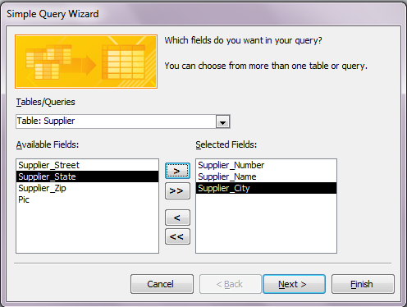
To Create New Query in Database
To create new Query, follow the following steps:
Click on Create > Query Wizard
Then select the type of wizard e.g., Simple Query Wizard and click OK
You will see the following dialogue box
Notes:
16

Slide 17
Fields Selection in Query
In the Simple Query Wizard dialog box, select which fields you want included in the query.
Move all the fields into the Selected Fields box
Move the fields one at a time
Remove fields out of the Selected Fields box by pressing one of the remove buttons
If you wanted to select all the fields except one, you can move them all to the selected fields list and then remove the one field you don't want.
Once you have made your selections, press Next to move to the next dialog box in the Wizard.
Notes:
17

Slide 18
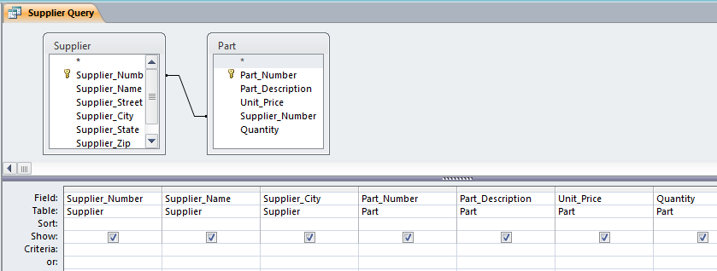
Data Sheet View of Query
Design View of Query
Criteria is written in this row

Slide 19
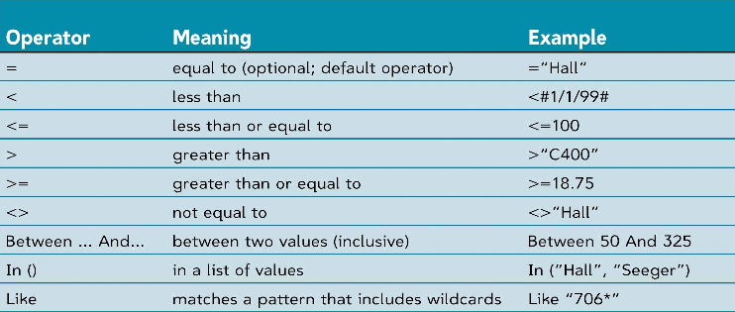
Criteria in Query
Criteria in the query means the condition which is fulfilled for extraction of records from table like Unit_Price<=300.
Access contains the following comparison operators. These operators are used in criteria as per requirements:
Notes:
19

Slide 20
Criteria in Query
Another criteria “Display the records in which Supplier City is Riyadh”
Criteria
Unit_price<300
Calculated field in the Query
Total Amt: [Unit_Price]*[Quantity]
Unit_price<300

Slide 21
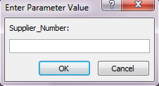
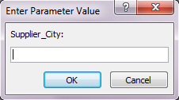
Parameter Query
The parameter query will prompt the user to enter the value they want to use to select records. Once the user has supplied this information, those records that match the value will be displayed in the query datasheet.
To create papameter query, enter the fields (for which the query will ask the user for values) in the Criteria under that fieldname as [fieldname:]. In the following example, there are two queries in each of them there is one parameter for which the user is asked when the query is run Supplier_Number and Supplier_City respectively
Parameter Fieldname
Parameter Fieldname
Notes:
21

Slide 22
Creating Forms in Database
Form – A tool (object) that makes it easy to operate on database like Insertion, deletion, saving, searching records etc.
To create new Form, follow the following steps:
Click on Create > Form Wizard (an easy step by step way to create form)
Form Wizard: Select the Form Wizard option to have Access create the form for you according to your specifications. The form wizard option lets you choose the specific fields to include which might belong to one or more tables or queries.
Notes:
22

Slide 23
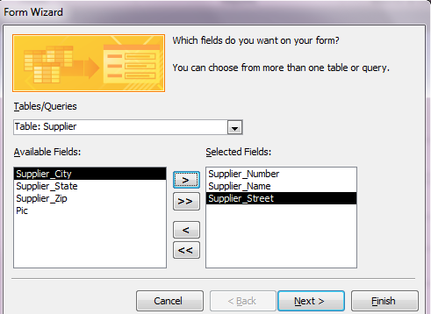
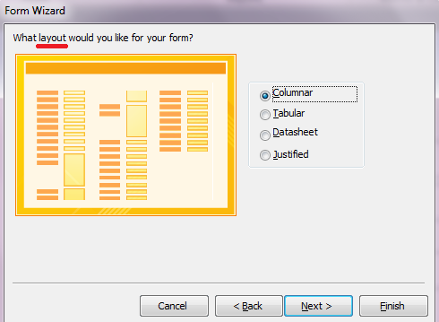
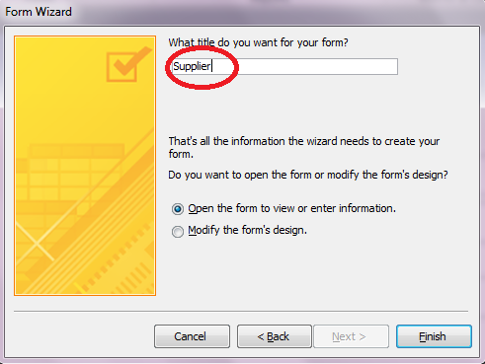
Form Wizard
Once you click on Form, then on Create Form by using Wizard, you will see the following dialogue box
Select Table/Query, select fields and click on OK.
Select Layout of Form i.e. Columnar, Tabular, Datasheet……..
Then save form with any title.
1
2
3
Notes:
23

Slide 24
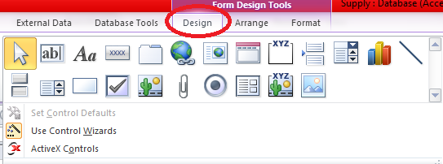
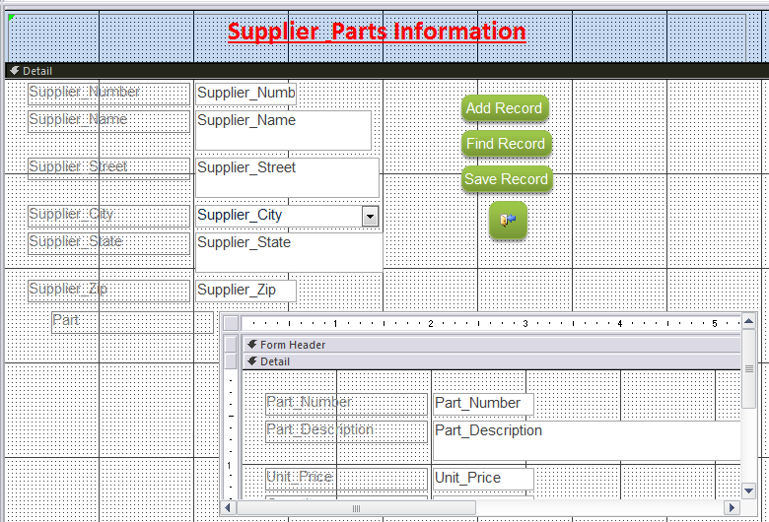
Creating Form (Continued)
You can add controls to the form
this toolbox
Open the form in Design View
Notes:
24

Slide 25
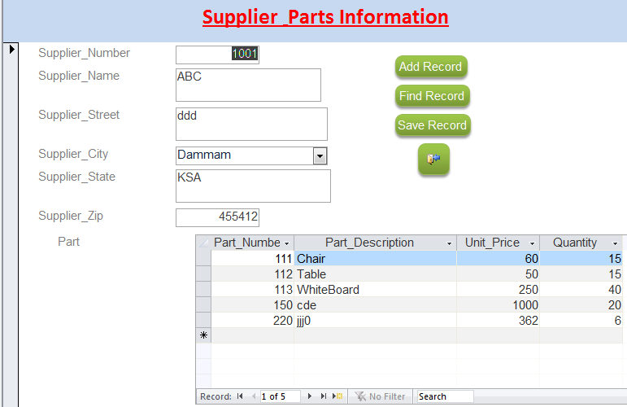
Form View of the form

Slide 26
Creating Reports in Database
Report is a tool (object) through which you get output (hardcopy or softcopy) from the database.
To create new Report, follow the following steps:
Click on Create > Reprt Wizard (an easy step by step way to create Report)
There are different methods to create a report like Form / Form Design / Blank Form /Form Wizard
Report Wizard: Select the Report Wizard option to have Access create the Report for you according to your specifications. The Report wizard option lets you choose the specific fields to include which might belong to one or more tables or queries.
Notes:
26

Slide 27
Create a Report Using the Report Wizard
You can easily create a formatted printout of data in table(s) in a database by using the Report Wizard.
The Report Wizard will ask you a series of questions to help you format the report.
Once the report has been created, either with the Report Wizard or your own design, you can change the design later.
You will find that the choices you make in the Report Wizard are similar to the choices in the Form Wizard.
Choices include grouping and sorting options, as well as report layout options. You can preview the report to view how it will look when printed.

Slide 28
Steps in Creating a Report
Create a new report with Report Wizard.
Select primary table (or query) – In this example, select Supplier table.
Move the following fields from the Available Fields list box to the Selected fields list box:
Supplier_Number
Supplier_Name
Supplier_City
Select related table (or query) – In this example, select Part table.
Move the following fields from the Available Fields list box to the Selected fields list box:
Part_Number
Part_Name
Unit_Price
Quantity
Click Next to get further dialogue box for grouping level.

Slide 29
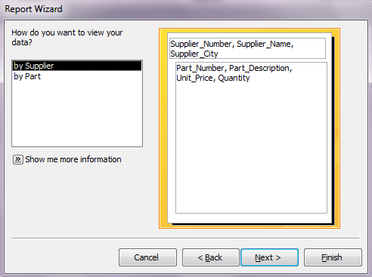
See data by Table in Report
You can select the table from the related tables to view the data on the base of the selected table:

Slide 30
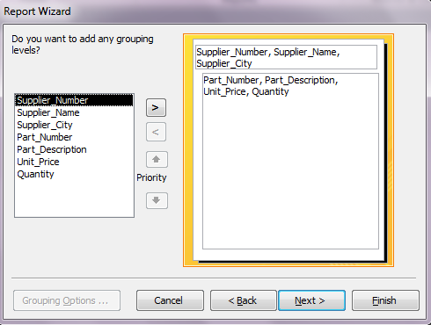
Grouping Report Data
You should decide how you want the report to be grouped. This figure shows a sample report (in the Report Wizard) that is grouped by the Supplier table.
Data Grouped by Table
The secondary table is the Salary table. This will develop a report where each Part_Number is grouped under that employer.

Slide 31
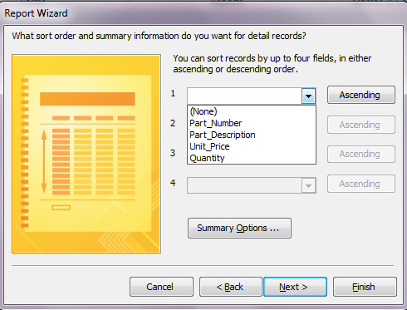
Sort Order
You can sort records on any field in ascending or descending order.

Slide 32
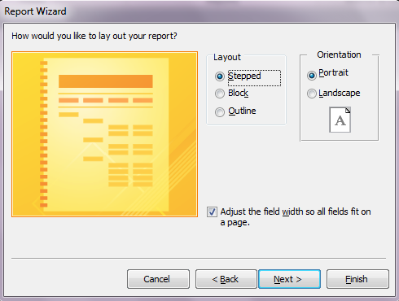
Report layout
Choose one of the layouts:
Stepped
Block
Outline
Select the orientation i.e. Portrait or Landscape

Slide 33
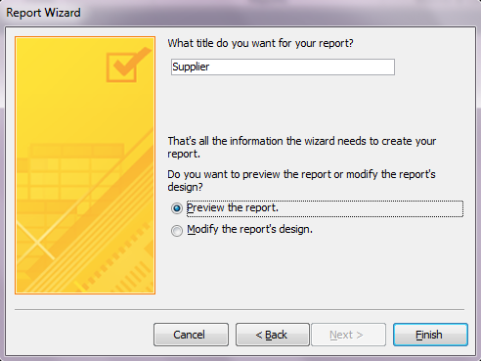
Save Report with any Title
Type any meaningful name for the report with which it will be saved.
Then click finish.
The report appears in the left pan.

Slide 34
Preview and Print a Report
Before printing the report, you can view it in Print Preview by pressing the Print Preview button.
If the preview looks OK, you can print the report. To print the report:
Click the File menu, and then click Print

Slide 35
* * * The End * * *

