Slide 1
Air pollution

Slide 3
Air pollution may be defined as the presence in the air of one or more contaminants in such quantities and of such durations that may be injurious to human, animal or plant life, or which interferes with the comfortable enjoyment of life
A pollutant can be solid (large or sub-molecular), liquid or gas

Slide 4
Primary & Secondary Pollutants
Primary: emitted directly into air :
• Carbon monoxide (58%)
• Nitrogen oxides (15%)
• Sulfur oxides (13%)
• Volatile organic compounds VOCs (11%)
• Particulates (3%)
Secondary: produced thru reactions (ozone)

Slide 5
Many people believe that soil, water, and air in a so-called natural state are clean and good and become bad only if people contaminate and pollute them

Slide 6
Many natural events, including dust storms, floods, and volcanic processes, can introduce materials harmful to humans and to other living things into the soil, water, and air
Pollution happens because no process is 100% efficient; each process produces pollution (waste) and waste energy

Slide 7
The biggest contributors to air pollution are mobile sources (e.g. cars, trucks, buses, planes).
Carbon monoxide (CO), carbon dioxide (CO2), and nitrogen oxides (NOx) represent the largest portion of pollutants

Slide 8
Major Air Pollutants: Sulfur Dioxide (SO2)
Converts into particulate sulfate (SO4) in atmosphere
Produced by fossil fuel combustion (coal), petroleum refinement, cement, aluminum, and paper production
Corrosive to paints and metals
Plant damage (esp alfalfa, cotton, barley)
Lung damage
ACID RAIN precursor

Slide 9
Nitrogen Oxides (NOX)
Nitric oxide (NO) and nitrogen dioxide (NO2)
It can lead to smog and acid rain
Source: automobiles and power plants
Suppress plant growth in air; but as nitrate form in soil, it is a fertilizer
Eye, lung irritation; increased susceptibility to infections, e.g. influenza

Slide 10
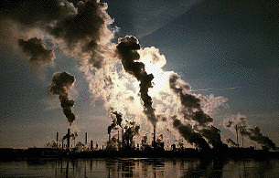
Acid Rain
is a result of industries and cars burning oil and coal and sending sulfur dioxide and nitrogen oxides high into the atmosphere. While in the air they mix with water vapor and turn into sulfuric and nitric acids. Eventually, this harmful acid returns to earth in rain, hail, fog, or snow.

Slide 12
This acid damages plant life and may eventually kill insects, frogs, and fish in our waters
Acid rain is a worldwide problem because it can be carried in the atmosphere for great distances before falling back to earth.

Slide 13
Carbon Monoxide (CO)
colorless, odorless, extremely toxic
CO gets locked on hemoglobin in blood 250 x faster than O2, leading to hypoxia
• Do not burn camping stove in a tent
• Repair car exhaust leaks into your car
Most emissions through tailpipes of vehicles
Recent reductions due to cleaner burning engines

Slide 14
Ozone (O3)
natural O3 in stratosphere: good
anthropogenic O3 at surface: bad
produced near surface by:
• photochemical reaction, i.e. sunlight + NO2 -> O3
more readily oxidizes (burns) things than O2
used to purify water (kill bacteria)
very damaging to plants.

Slide 15
VOCs
Volatile Organic Compounds (VOCs)
Primary source: automobiles
Can cause smog, toxic to plants & animals

Slide 16
Particulate Matter
smoke, soot, dust
Agriculture is a considerable source, as is industry
particles smaller than 10 μm • e.g. Heavy metals, arsenic, copper, lead, zinc, and asbestos emitted by industrial activities are harmful.
particles smaller than 2.5 μm are • Easily inhaled and absorbed in blood stream = harmful
• Most significant are sulfates & nitrates, secondary Pollutants

Slide 18
Total suspended particulates : TSPs
TSPs tend to be higher in developing nations and in large cities
Globally, 2-9% mortality associated with TSPs
60,000 deaths in USA Annually
Block sunlight to Earth

Slide 20
Smog
1- Photochemical smog (brown air)
Solar radiation is important
Directly related to automobile use

Slide 22
2. Sulfurous smog (London-type; industrial; grey air)

Slide 23
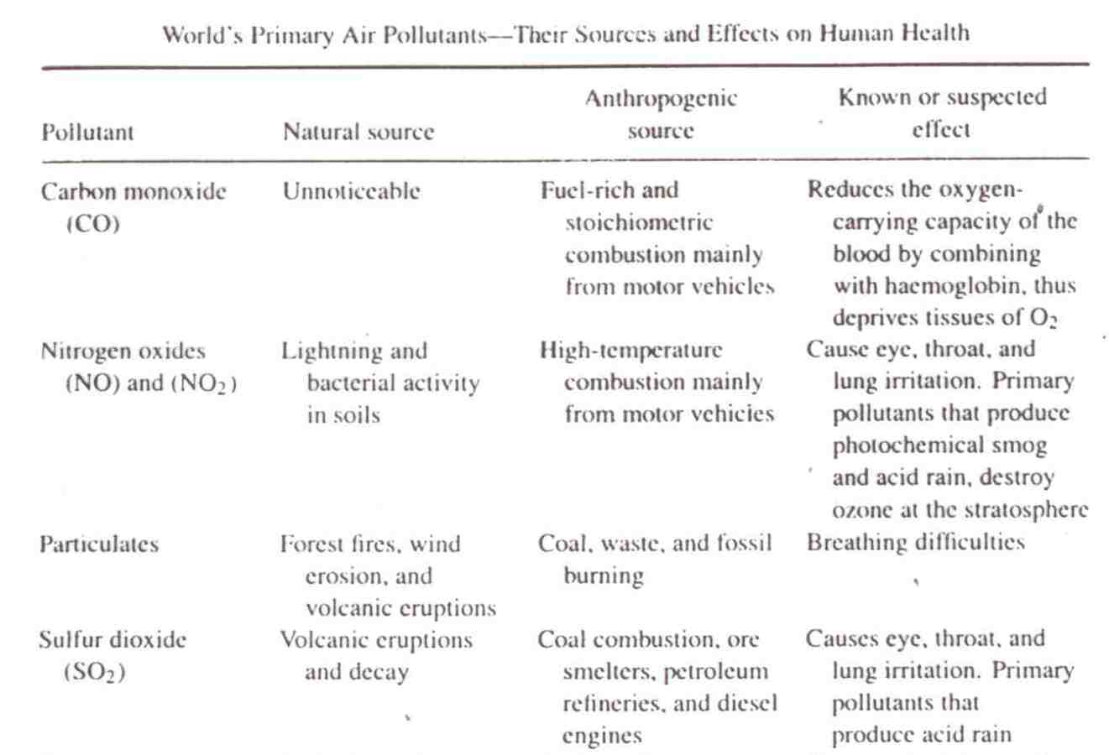

Slide 24
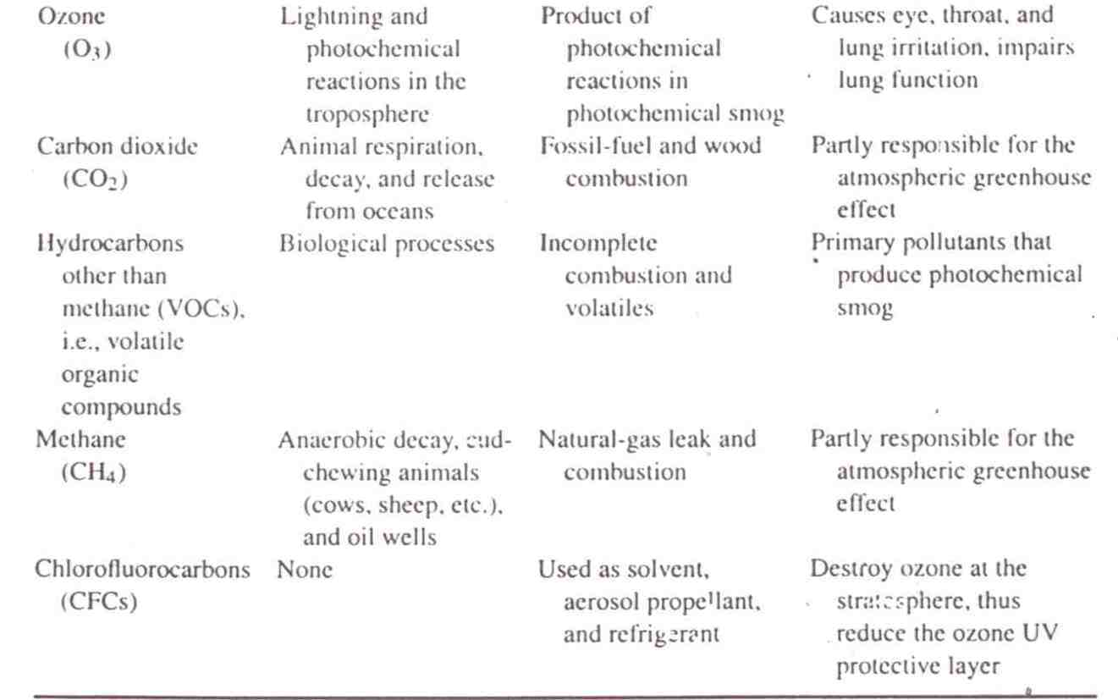

Slide 25
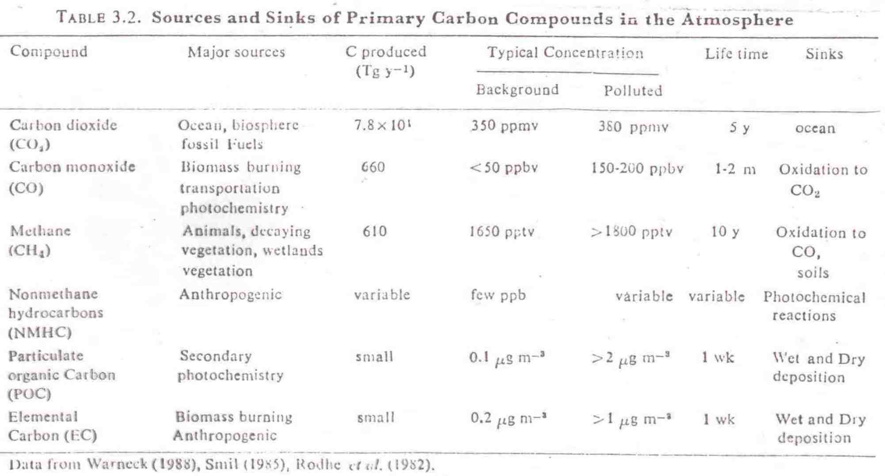

Slide 26
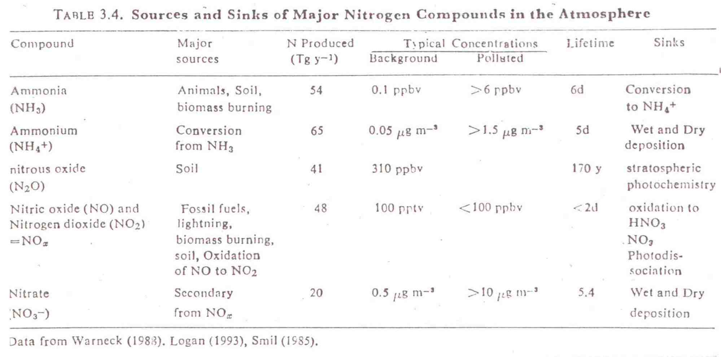

Slide 27
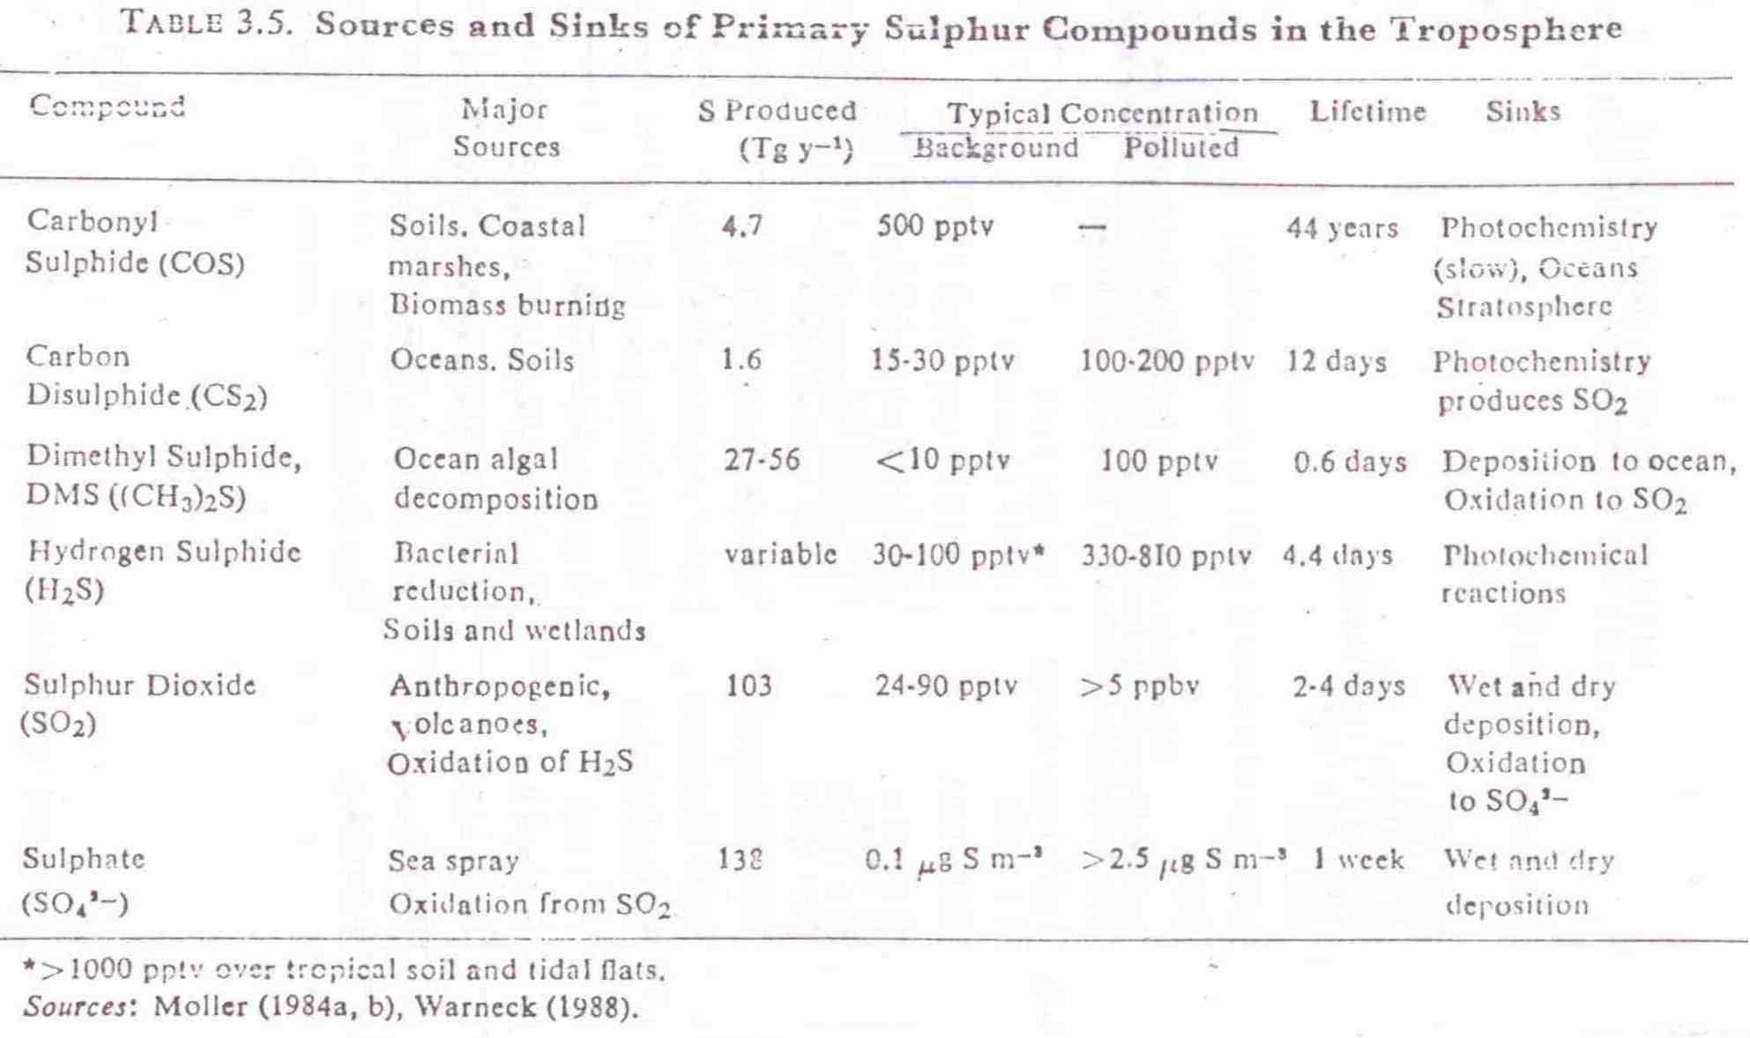

Slide 28
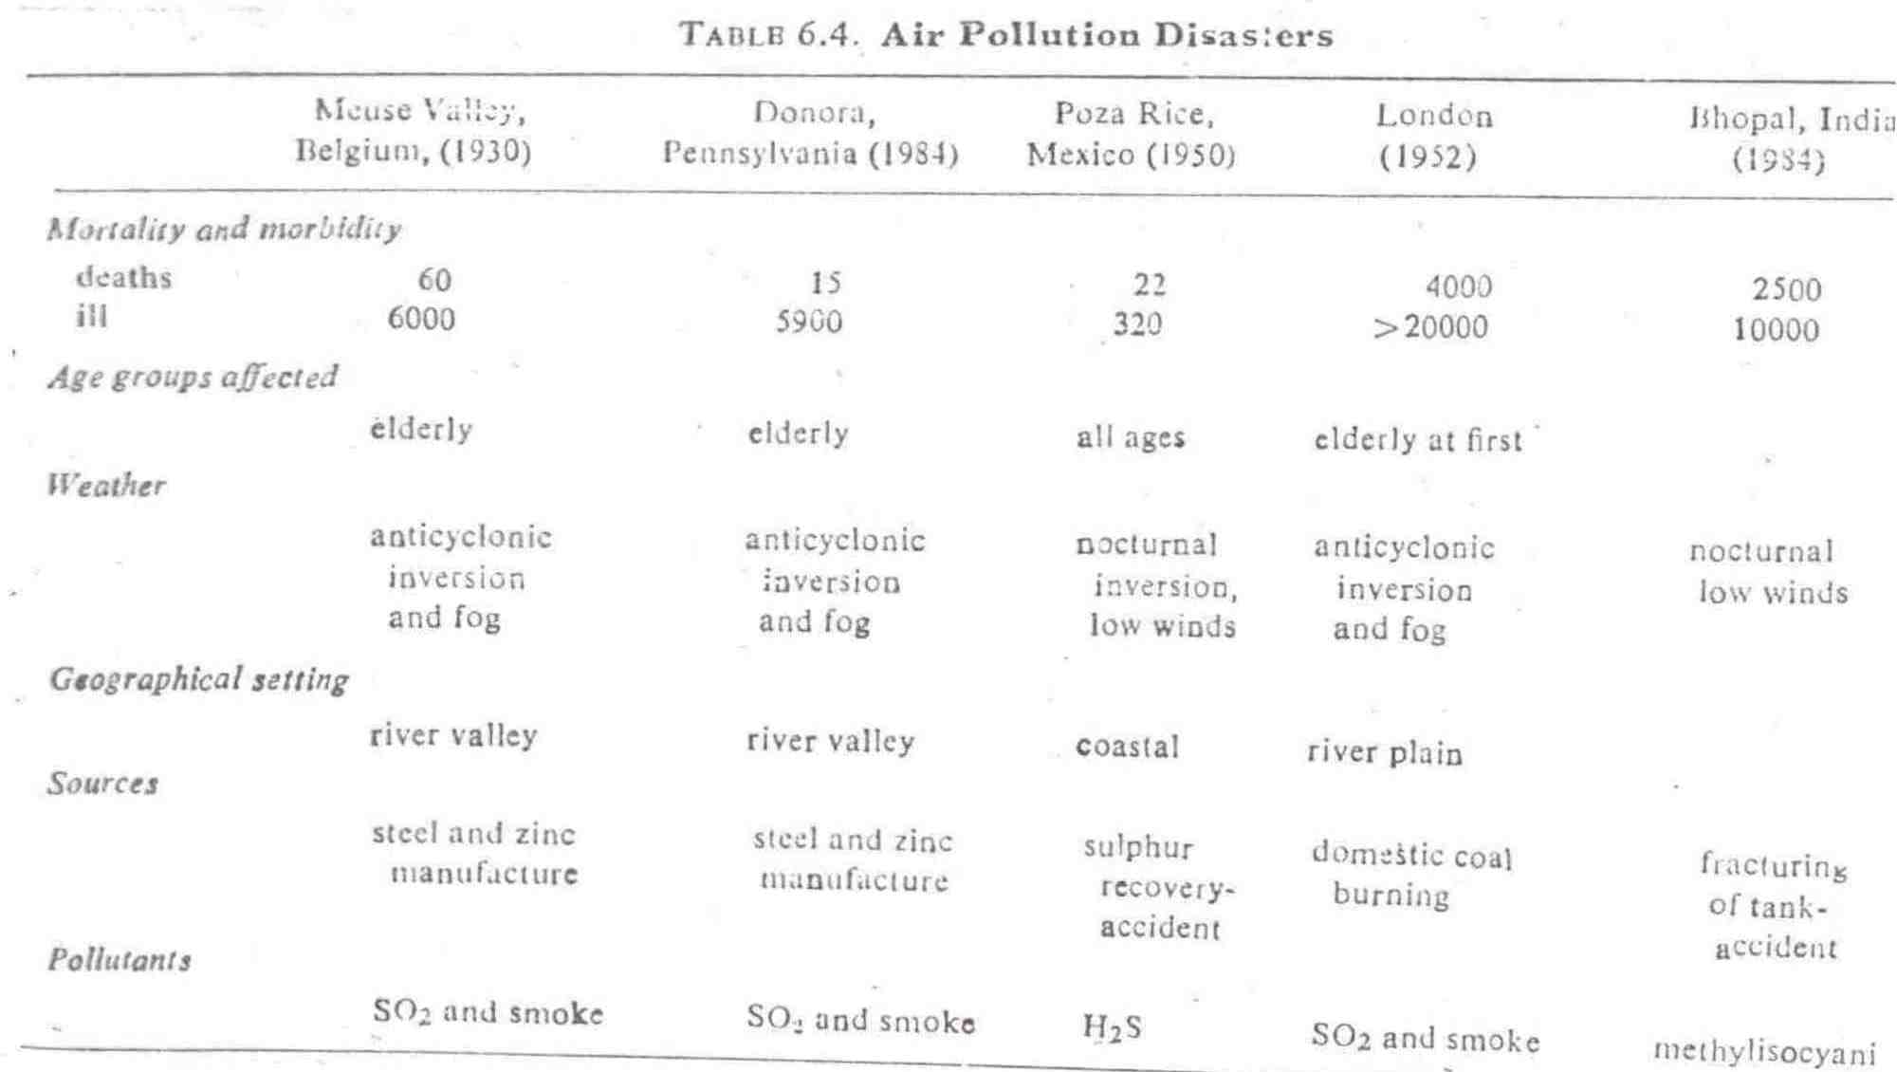

Slide 29
INDOOR AIR
Inadequate ventilation can increase indoor pollutant levels by not bringing in enough outdoor air to dilute emissions and by not carrying indoor air pollutants out.
indoor levels of many pollutants may be 2-5 times higher than outdoor levels.
These levels of pollutants are of particular concern because it is estimated that most people spend as much as 90% of their time indoors esp. for babies and seniors, people with compromised health.

Slide 30
sources of indoor air pollution
combustion sources (e.g. tobacco products, oil, gas, coal, wood)
building materials and furnishings (e.g. asbestos, off-gassing of formaldehyde);
products for household cleaning or hobbies (e.g. glue)
outdoor sources (e.g. outdoor air pollution, radon, pesticides).

Slide 31
Health effects from indoor air pollutants
Health effects from indoor air pollutants may be experienced soon after exposure, or possibly years later.
Short-term effects may include headaches, dizziness, fatigue, and irritation of the eyes, nose or throat.
Long-term effects may include respiratory diseases, heart disease and cancer.

