Slide 1
CSC 111 Lab 1

Slide 2
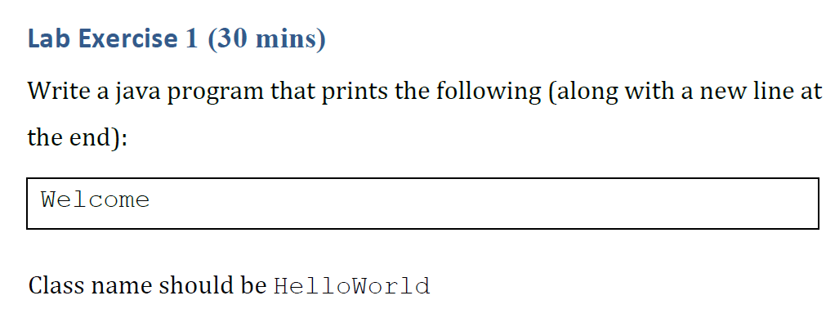

Slide 4
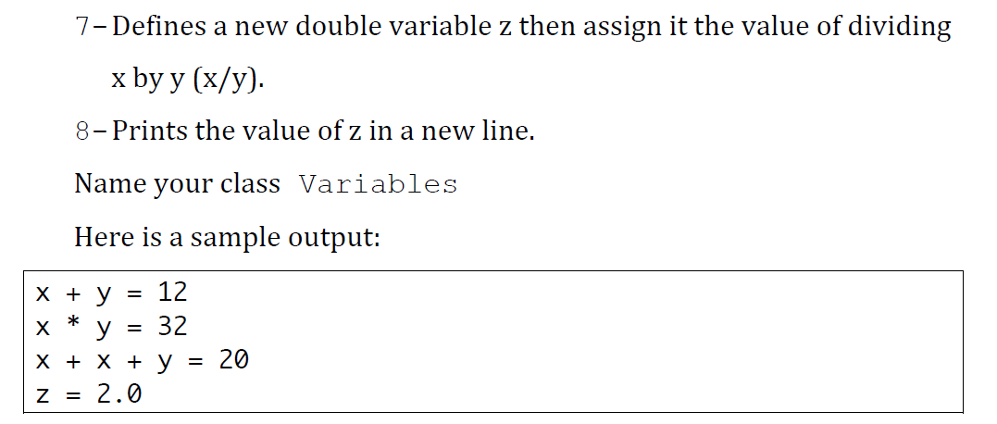

Slide 6
