Slide 1
CSC 111 Lab 8

Slide 2
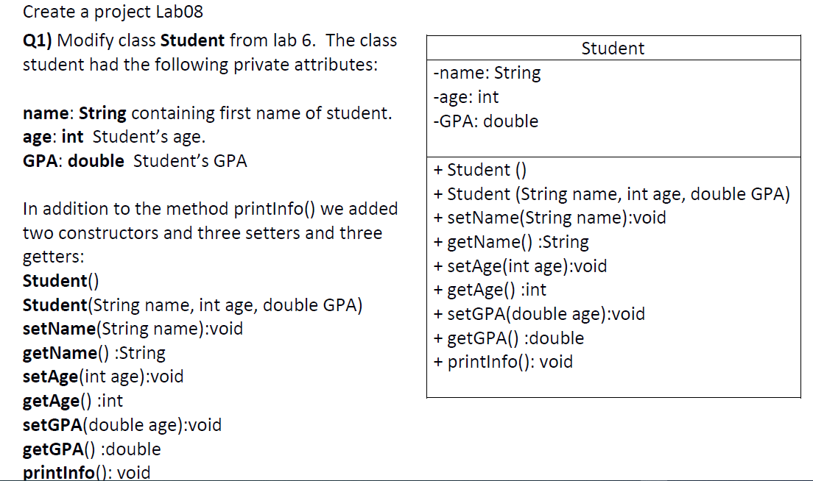

Slide 5
