Slide 1
Week 2 Lab
Revision
CSC113

Slide 2
Evaluation Question

Slide 3
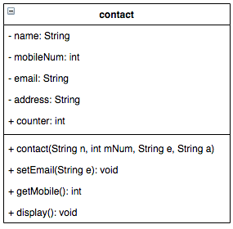
Question
The contact class has the following instance attributes:
name: contact Name.
Mobilenum: mobile number.
email: email of the contact.
address: the address of the contact.
The contact class has the following class attributes:
counter: represents the number of objects that created from class contact .
We want to manage our contact list using contact class that have the following UML diagram:

Slide 4
Question
Write the java code of:
contact class.
contactList class the contains the main method. Then create these two objects of class contact and print their information.
Name | MobileNum | email | Address
Ahmed | 0551122 | Ahmad@gmail.com | Riyadh
Ali | 0553344 | Ali@gmail.com | Jeddah

