Slide 1
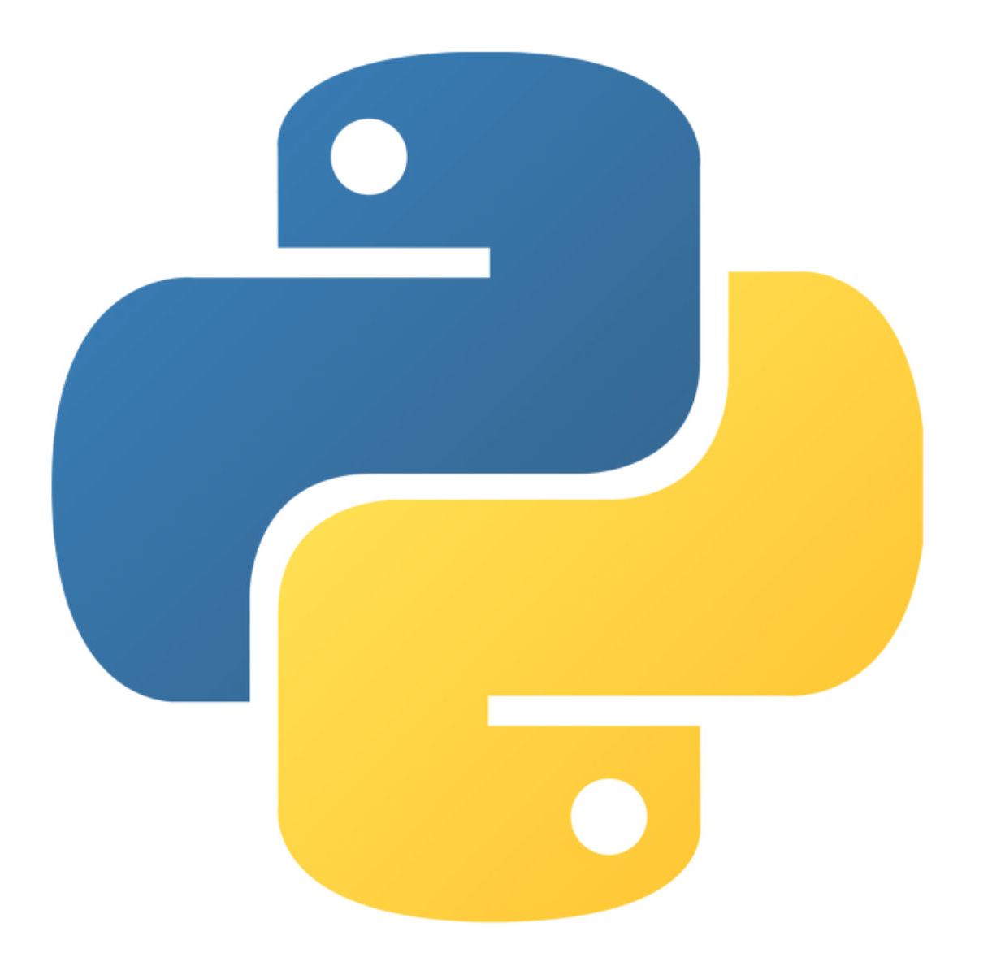
Exceptions
Edited by :Nouf almunyif

Slide 2
Python Errors

Slide 3
Python Syntax Errors
Error caused by not following the proper structure (syntax) of the language is called syntax error or parsing error.

Slide 4
Exceptions

Slide 5
Exceptions (cont’d.)
Many exceptions can be prevented by careful coding
Example: input validation
Usually involve a simple decision construct
Some exceptions cannot be avoided by careful coding
Examples
Trying to convert non-numeric string to an integer
Trying to open for reading a file that doesn’t exist

Slide 6
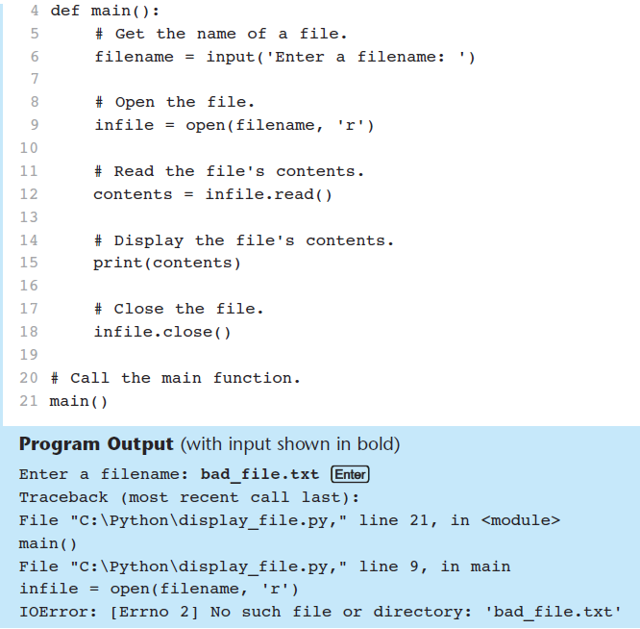
Exceptions
IOError – file specified does not exist

Slide 7
Exceptions (cont’d.)
Exception handler: code that responds when exceptions are raised and prevents program from crashing
In Python, written as try/except statement
Try suite: statements that can potentially raise an exception
Handler: statements contained in except block

Slide 8
Exceptions
try block
except clause
handler

Slide 9
Exceptions (cont’d.)
If statement in try suite raises exception:
Exception specified in except clause:
Handler immediately following except clause executes
Continue program after try/except statement
Other exceptions:
Program halts with traceback error message
If no exception is raised, handlers are skipped

Slide 10
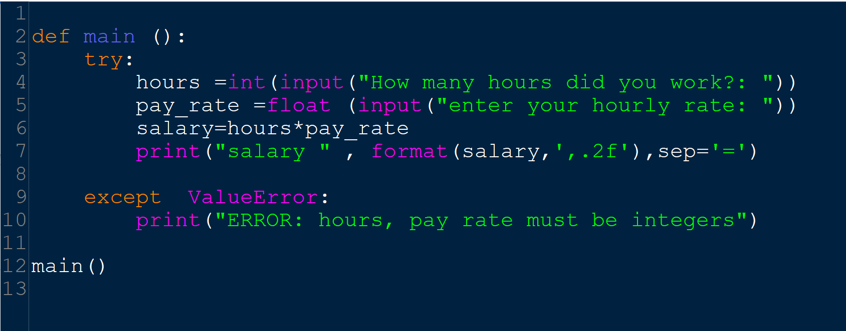
try/except statement to respond to a ValueError exception.
Normal run
With exceptions

Slide 11
Handling Multiple Exceptions
Often code in try suite can throw more than one type of exception
Need to write except clause for each type of exception that needs to be handled
An except clause that does not list a specific exception will handle any exception that is raised in the try suite
Should always be last in a series of except clauses

Slide 12
Displaying an Exception’s Default Error Message
Exception object: object created in memory when an exception is thrown
Usually contains default error message pertaining to the exception
Can assign the exception object to a variable in an except clause
Example: except ValueError as err:
Can pass exception object variable to print function to display the default error message

Slide 13
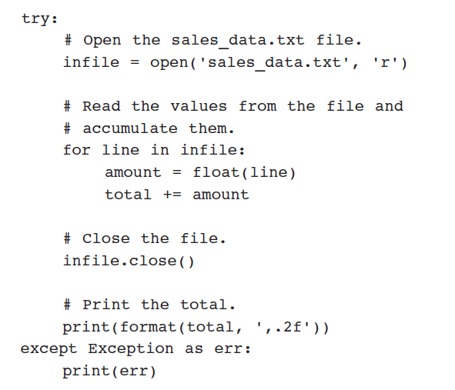
Exceptions
Displaying an Exception’s Default Error Message

Slide 14
The else Clause
try/except statement may include an optional else clause, which appears after all the except clauses
Aligned with try and except clauses
Syntax similar to else clause in decision structure
Else suite: block of statements executed after statements in try suite, only if no exceptions were raised
If exception was raised, the else suite is skipped

Slide 15
The finally Clause
try/except statement may include an optional finally clause, which appears after all the except clauses
Aligned with try and except clauses
General format: finally:
statements
Finally suite: block of statements after the finally clause
Execute whether an exception occurs or not
Purpose is to perform cleanup before exiting

Slide 16
What If an Exception Is Not Handled?
Two ways for exception to go unhandled:
No except clause specifying exception of the right type
Exception raised outside a try suite
In both cases, exception will cause the program to halt
Python documentation provides information about exceptions that can be raised by different functions

Slide 17
Exceptions
Built-in Exceptions:
exception ValueError :Raised when an operation or function receives an argument that has the right type but an inappropriate value
exception ArithmeticError: ZeroDivisionError , OverflowError
exception ImportError :Raised when the import statement has troubles trying to load a module
exception IndexError :Raised when a sequence subscript is out of range
exception NameError :Raised when a local or global name is not found
exception FileNotFoundError:Raised when a file or directory is requested but doesn’t exist.
For more exceptions see :
https://docs.python.org/3/library/exceptions.html

Slide 18
Raise an exception
As a Python developer you can choose to throw an exception if a condition occurs. To throw (or raise) an exception, use the raise keyword.
Example
Raise an error and stop the program if x is lower than 0:

Slide 19
Raise an exception
The raise keyword is used to raise an exception.
You can define what kind of error to raise, and the text to print to the user.
Example
Raise a TypeError if x is not an integer:

Slide 20
References:
Tony Gaddis - Starting Out with Python, Global Edition (2018, Pearson Education)
https://docs.python.org/3/library/exceptions.html

