Slide 1
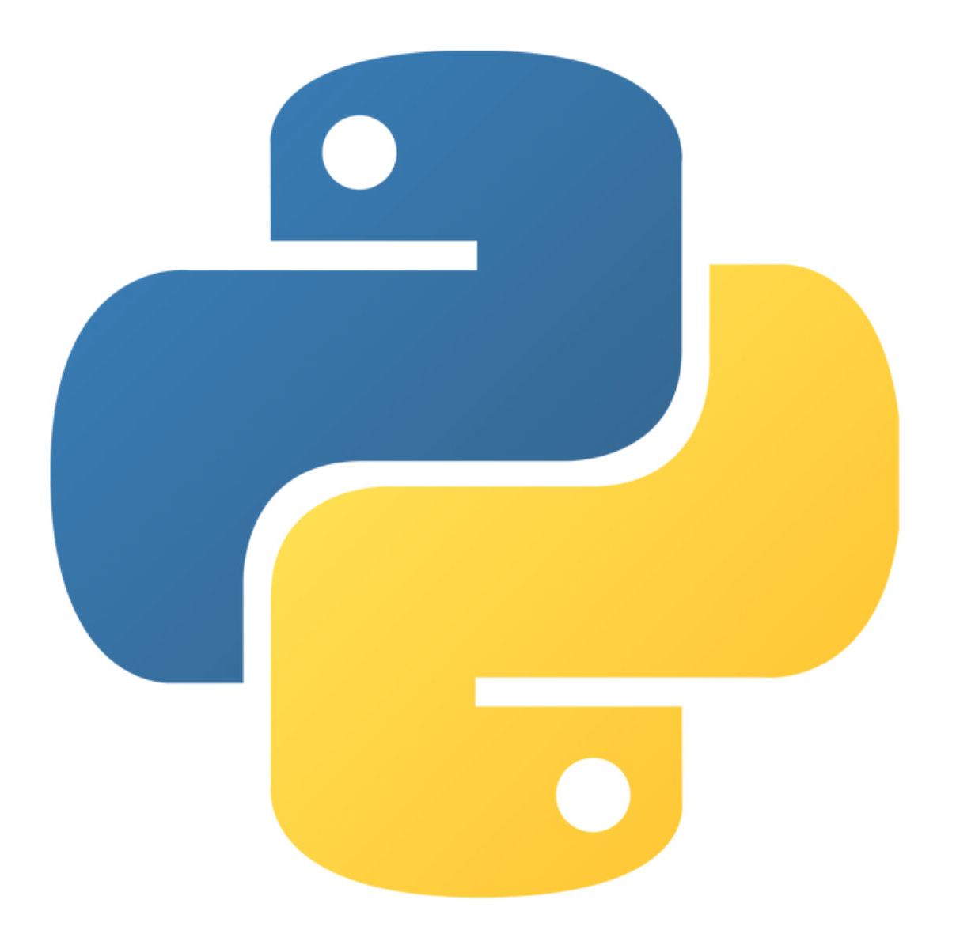
GUI Programming
Edited by :Nouf almunyif

Slide 2
Graphical User Interfaces
A graphical user interface allows the user to interact with the operating system and other programs using graphical elements such as icons, buttons, and dialog boxes.
Instead of requiring the user to type commands on the keyboard, GUIs allow the user to point at graphical elements and click the mouse button to activate them.

Slide 3
GUI Programs Are Event-Driven
In text-based environments, programs determine the order in which things happen
The user can only enter data in the order requested by the program
GUI environment is event-driven
The user determines the order in which things happen
User causes events to take place and the program responds to the events

Slide 4
Python - GUI Programming (Tkinter)
Python provides various options for developing graphical user interfaces (GUIs).
Tkinter: Tkinter is the Python interface to the Tk GUI toolkit shipped with Python. The name “tkinter” is short for “Tk interface.”
Tkinter provides a fast and easy way to create GUI applications and a powerful object-oriented interface to the Tk GUI toolkit.

Slide 5
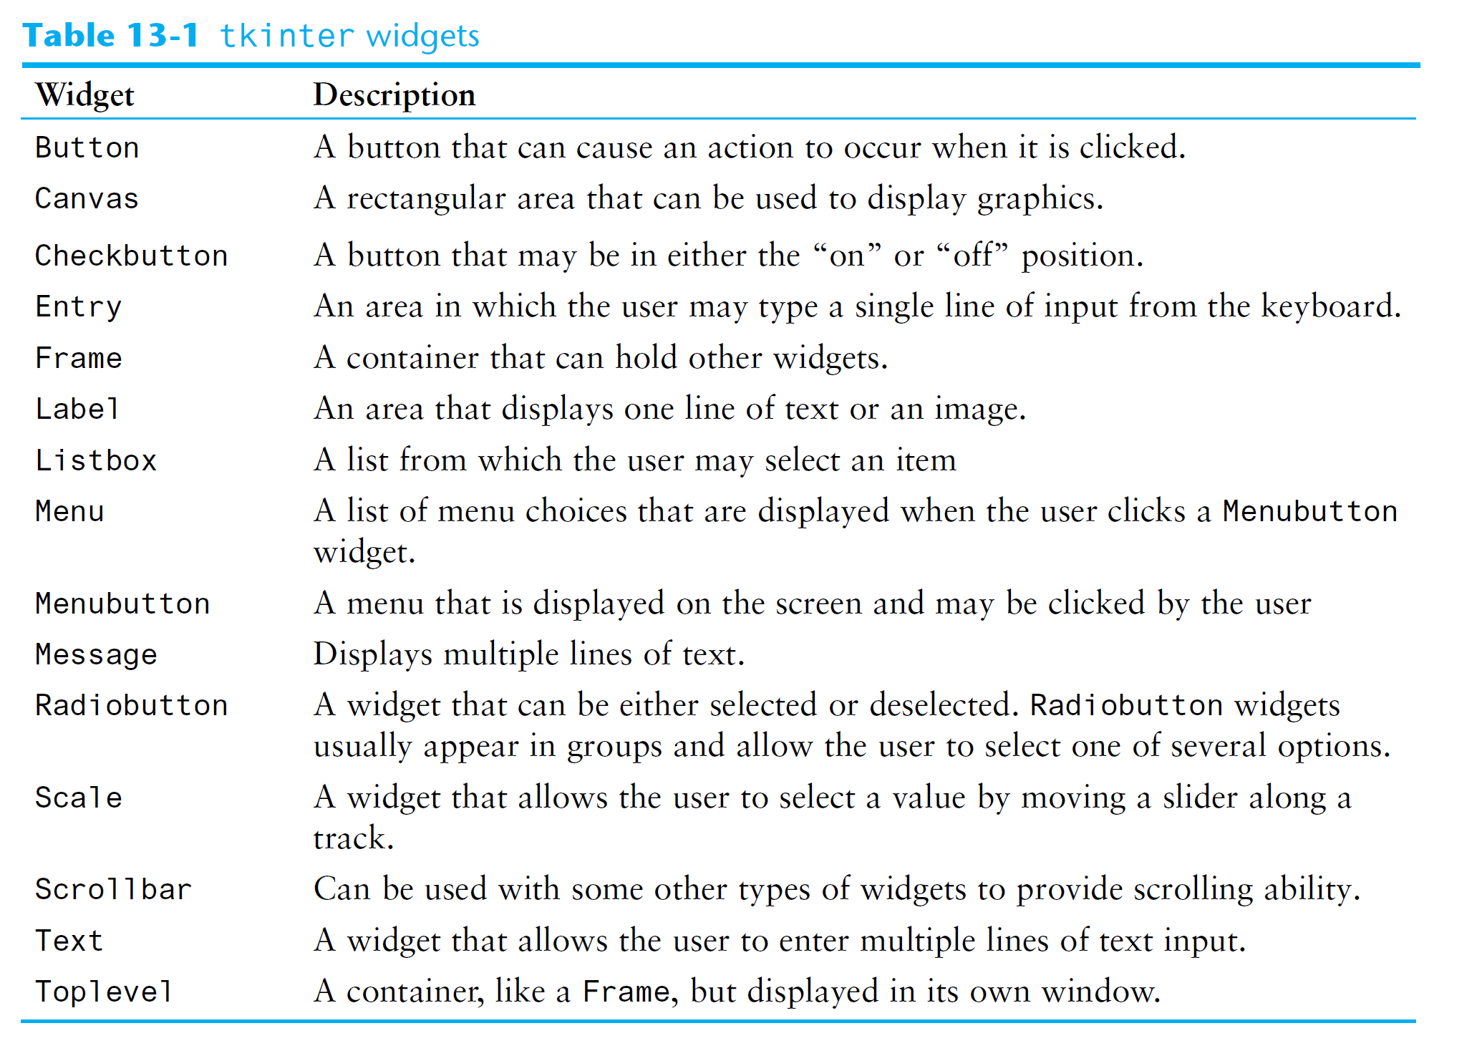
Using the tkinter Module
A GUI program presents a window with various graphical widgets with which the user can interact or view. The tkinter module provides 15 widgets

Slide 6
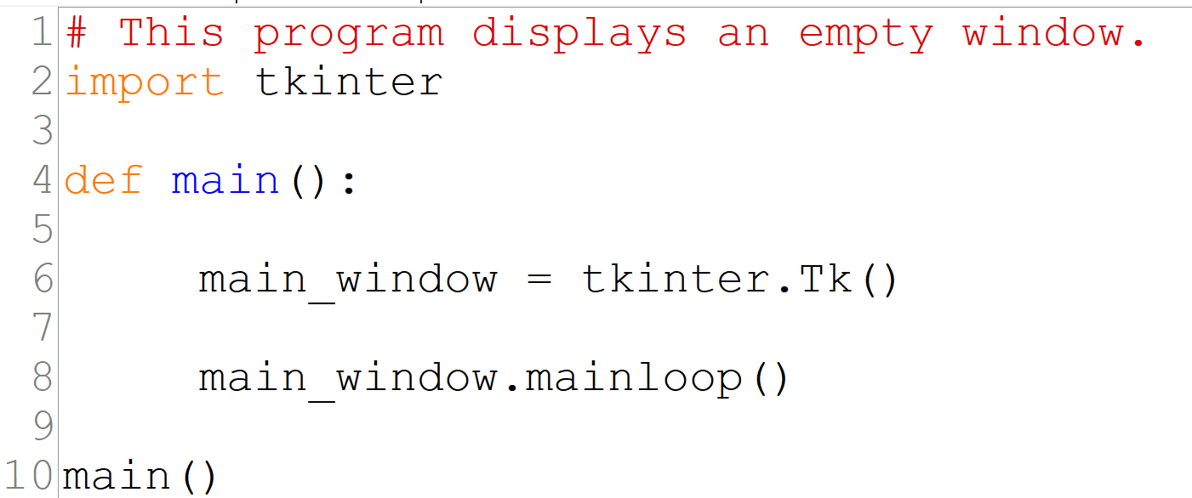
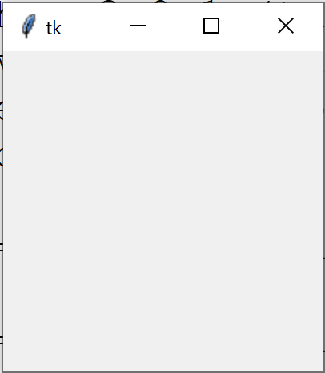
The simplest GUI program
The simplest GUI program that we can demonstrate is one that displays an empty window.
line 6 creates an instance of the tkinter module’s Tk class and assigns it to the main_window variable.
Line 8 calls the tkinter module’s
mainloop function. This function runs like an infinite loop until you close the main window

Slide 7
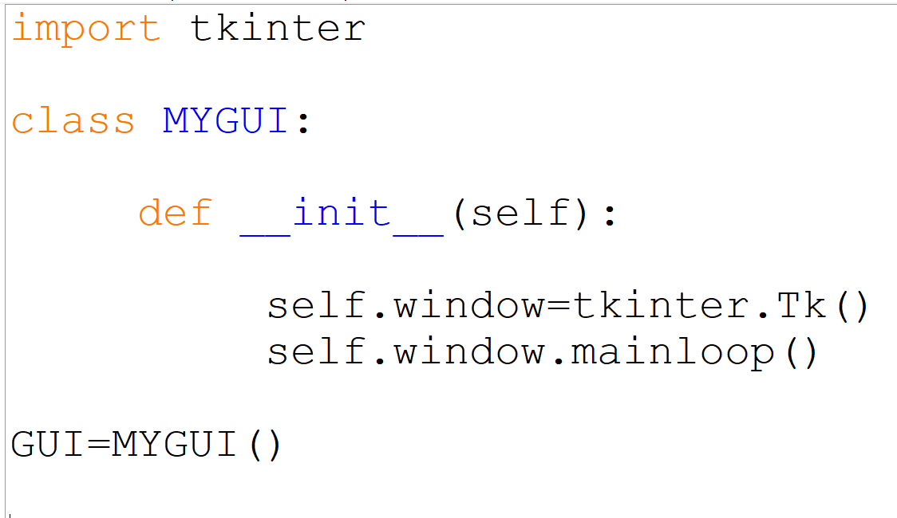
Using the tkinter Module
Most programmers take an object-oriented approach when writing GUI programs
__init__ method builds the GUI
When an instance is created the GUI appears on the screen

Slide 8
Display Text with Label Widgets
Label widget: displays a single line of text in a window
Made by creating an instance of tkinter module’s Label class
Format: tkinter.Label(self.main_window, text = 'my text')
First argument references the root widget, second argument shows text that should appear in label
pack method: determines where a widget should be positioned and makes it visible when the main window is displayed
Called for each widget in a window
Receives an argument to specify positioning
Positioning depends on the order in which widgets were added to the main window
Valid arguments: side='top', side='left', side='right'

Slide 9
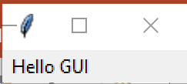
Display Text with Label Widgets

Slide 10
Display Text with Label Widgets
pack()
pack(side='top')
pack(side='left')

Slide 11
Organizing Widgets with Frames
Frame widget: container that holds other widgets
Useful for organizing and arranging groups of widgets in a window
Example:
self.top_frame= tkinter.Frame(self.main_window)
The contained widgets are added to the frame widget which contains them
Example:
tkinter.Label(self.top_frame,text = 'hi')

Slide 12
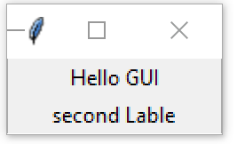
Organizing Widgets with Frames

Slide 13
Button Widgets and Info Dialog Boxes
Button widget: widget that the user can click to cause an action to take place
When creating a button can specify:
Text to appear on the face of the button
A callback function
Callback function: function or method that executes when the user clicks the button, Also known as
an event handler
tkinter.Button(self.main_window, text=' Text to appear!', command= Callback function)

Slide 14
Button Widgets and Info Dialog Boxes
Info dialog box: a dialog box that shows information to the user
Format for creating an info dialog box:
Import tkinter.messagebox module
tkinter.messagebox.showinfo(title, message)
title is displayed in dialog box’s title bar
message is an informational string displayed in the main part of the dialog box

Slide 15
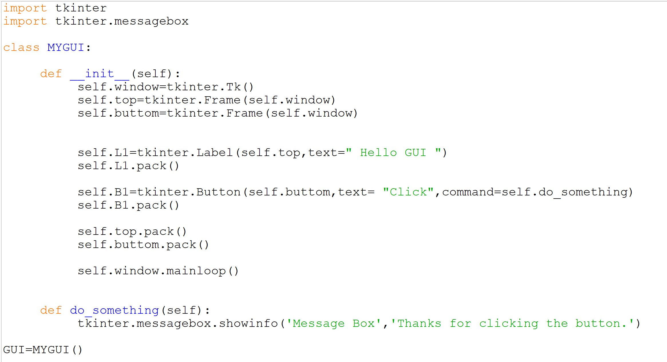

Slide 16
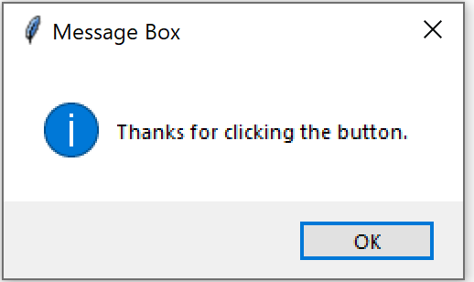
Output:

Slide 17
Creating a Quit Button
Quit button: closes the program when the user clicks it
To create a quit button in Python:
Create a Button widget then set the root widget’s destroy method as the callback function
tkinter.Button(self.main_window,text='Quit‘,
command=self.main_window.destroy)

Slide 18
Getting Input with the Entry Widget
Entry widget: rectangular area that the user can type text into
Used to gather input in a GUI program
Typically followed by a button for submitting the data
The button’s callback function retrieves the data from the Entry widgets and processes it
tkinter.Entry(self.main_window, width=10)
Entry widget’s get method: used to retrieve the data from an Entry widget
Returns a string

Slide 19
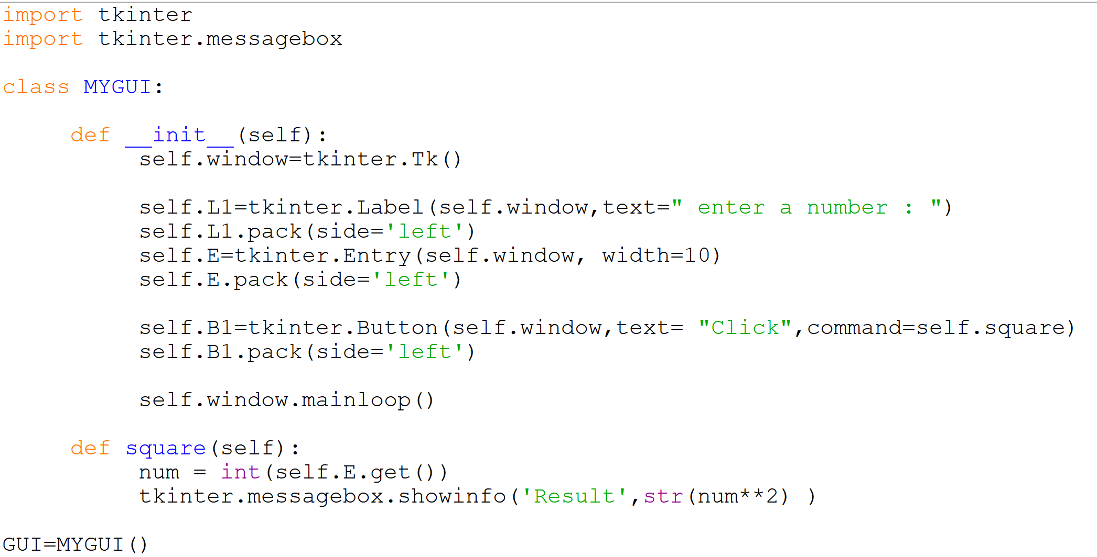
Example:

Slide 20
Using Labels as Output Fields
Can use Label widgets to dynamically display output: Used to replace info dialog box ,Create empty Label widget in main window, and write code that displays desired data in the label when a button is clicked
StringVar class: tkinter module class that can be used along with Label widget to display data
Create StringVar object and then create Label widget and associate it with the StringVar object
Subsequently, any value stored in the StringVar object with automatically be displayed in the Label widget

Slide 21
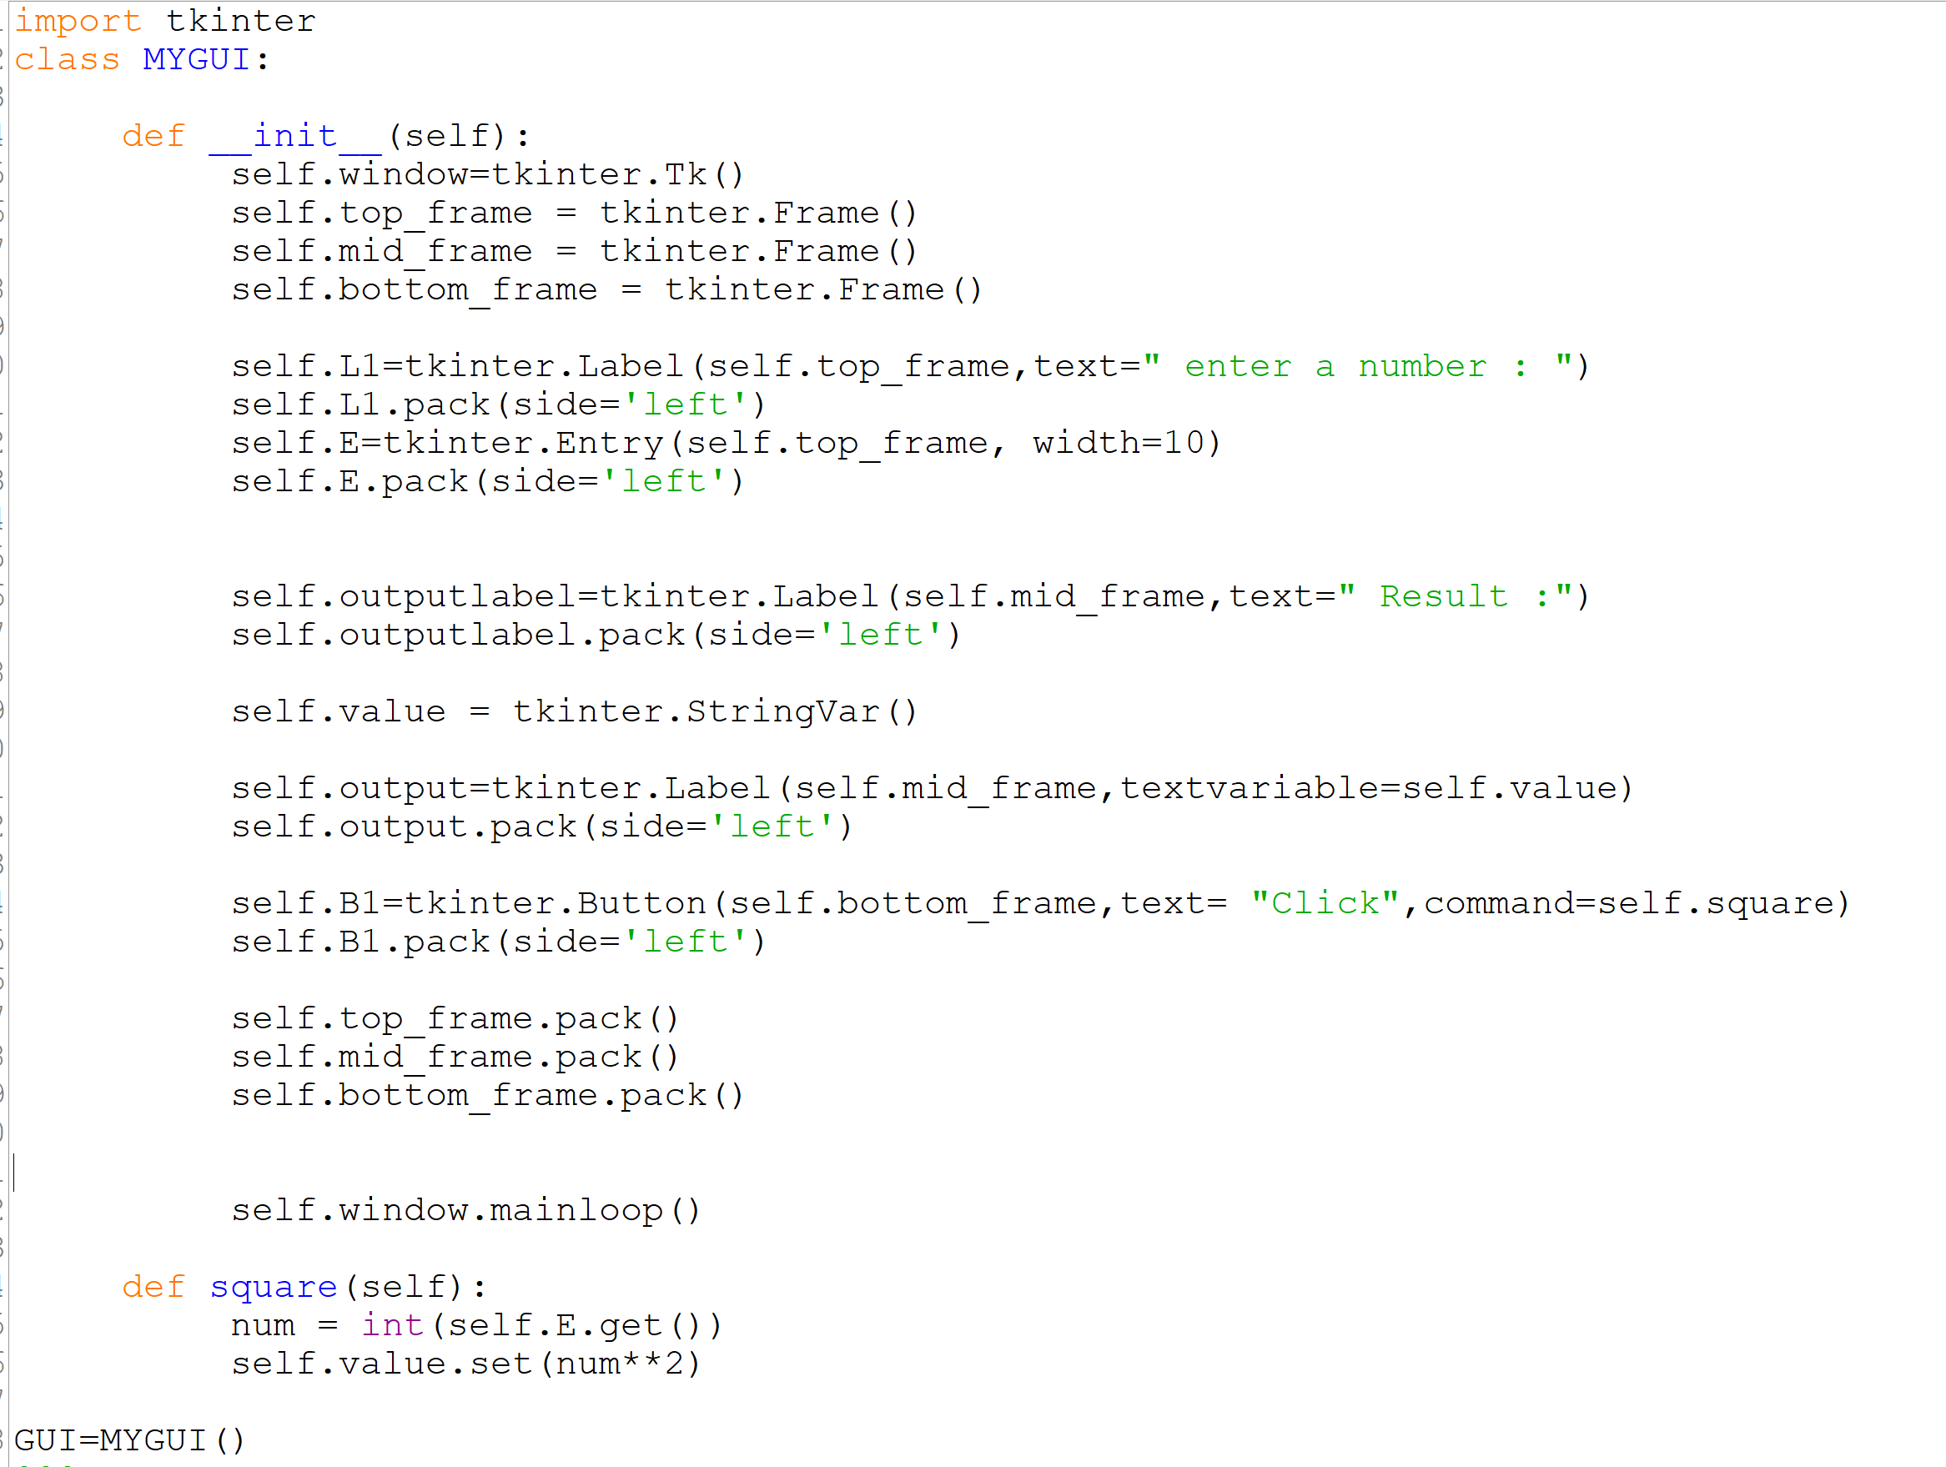
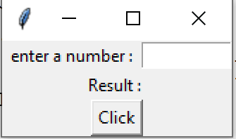
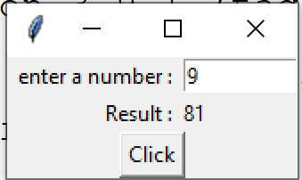
Using Labels as Output Fields

Slide 22
References:
Tony Gaddis - Starting Out with Python, Global Edition (2018, Pearson Education)

