Slide 1
Python Functions 2

Slide 2
Python Value-Returning Functions

Slide 3
Introduction to Value-Returning Functions
Value-returning function: similar to void function, returns a value
Value returned to part of program that called the function when function finishes executing

Slide 4
Writing Your Own Value-Returning Functions
To write a value-returning function, you write a simple function and add one or more return statements
Format: return expression
The value for expression will be returned to the part of the program that called the function
The expression in the return statement can be a complex expression, such as a sum of two variables or the result of another value- returning function

Slide 5
How to Use Value-Returning Functions
Value-returning function can be useful in specific situations
Example: have function prompt user for input and return the user’s input
Simplify mathematical expressions
Complex calculations that need to be repeated throughout the program
Use the returned value
Assign it to a variable or use as an argument in another function

Slide 6
Writing Your Own Value-Returning Functions
Making the Most of the return statement
def add(num1, num2):
result = num1 + num2
return result
def add(num1, num2):
return num1 + num2

Slide 7
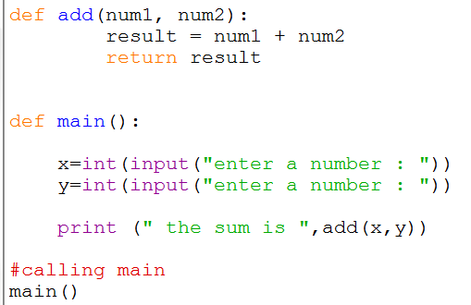
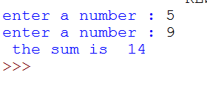
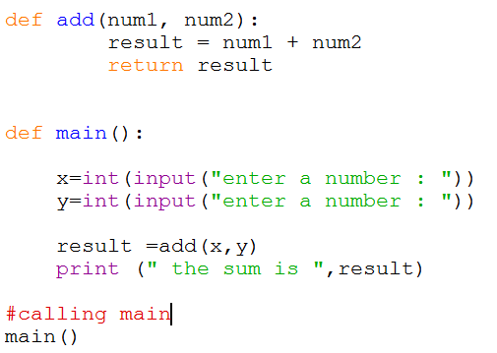
OR

Slide 8
Returning Strings
You can write functions that return strings
For example:

Slide 9
Returning Boolean Values
Boolean function: returns either True or False
Use to test a condition such as for decision and repetition structures
Common calculations, such as whether a number is even, can be easily repeated by calling a function
Use to simplify complex input validation code

Slide 10
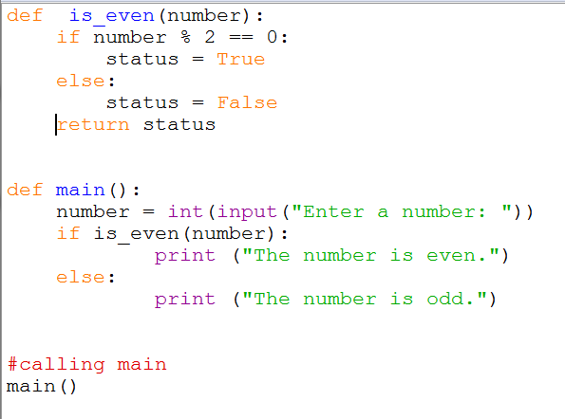
Writing Your Own Value-Returning Functions
Returning Boolean Values
For example: Determine whether a number is even or odd …

Slide 11
Returning Multiple Values

Slide 12
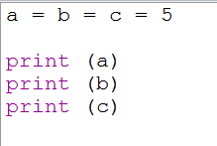
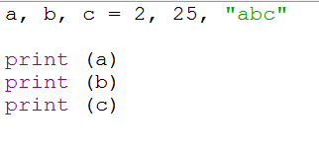
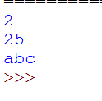
variables
We can assign a single value to multiple variables as follows:
Also, we can assign multiple values to multiple variables as follows:

Slide 13
Returning Multiple Values
In Python, a function can return multiple values
Specified after the return statement separated by commas
Format: return expression1,
expression2, etc.
When you call such a function in an assignment statement, you need a separate variable on the left side of the = operator to receive each returned value

Slide 14
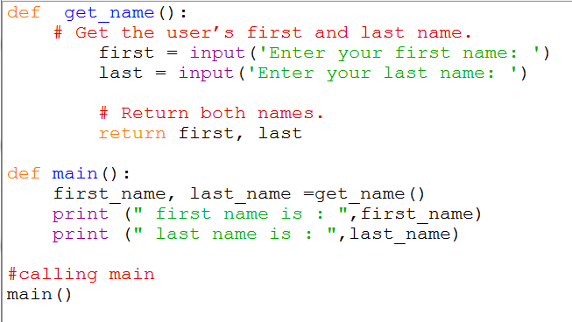
Writing Your Own Value-Returning Functions
Returning Multiple Values

Slide 15
Python Modules

Slide 16
the import Statement
Modules: files that stores functions of the standard library
Help organize library functions not built into the interpreter
Copied to computer when you install Python
To call a function stored in a module, need to write an import statement
Written at the top of the program
Format: import module_name

Slide 17
Generating Random Numbers
Random number are useful in a lot of programming tasks
random module: includes library functions for working with random numbers
Dot notation: notation for calling a function belonging to a module
Format: module_name.function_name()

Slide 18
Generating Random Numbers (cont’d.)
randint function: generates a random number in the range provided by the arguments
Returns the random number to part of program that called the function
Returned integer can be used anywhere that an integer would be used
You can experiment with the function in interactive mode

Slide 19
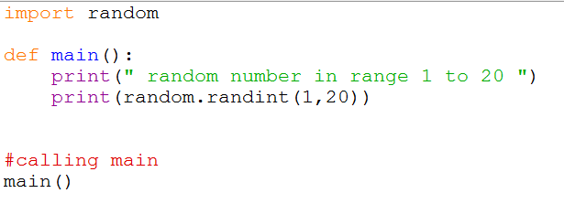
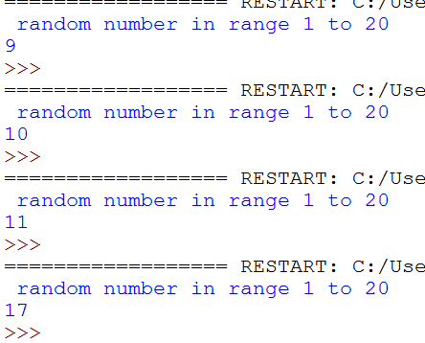
Generating Random Numbers (cont’d.)

Slide 20
Generating Random Numbers (cont’d.)
randrange function: similar to range function, but returns randomly selected integer from the resulting sequence
Same arguments as for the range function
random function: returns a random float in the range of 0.0 and 1.0
Does not receive arguments
uniform function: returns a random float but allows user to specify range

Slide 21
Generating Random Numbers
# generates a random integer number in the range of 5 through 9
number = random.randrange(5, 10)
# generates a random number in the [0, 10, 20, 30, 40, 50, 60, 70, 80, 90, 100]
number = random.randrange(0, 101, 10)
# generates a random floating-point number in the range of 0.0 through 1.0(it returns a value >= 0 and < 1.0(not including 1.0)).
number = random.random()
# generates a random floating-point number in the range of 1.0 through 10.0
it returns a value >= 1.0 and <= 10.0,
number = random.uniform(1.0, 10.0)

Slide 22
The math Module
math module: part of standard library that contains functions that are useful for performing mathematical calculations
Typically accept one or more values as arguments, perform mathematical operation, and return the result
Use of module requires an import math statement

Slide 23
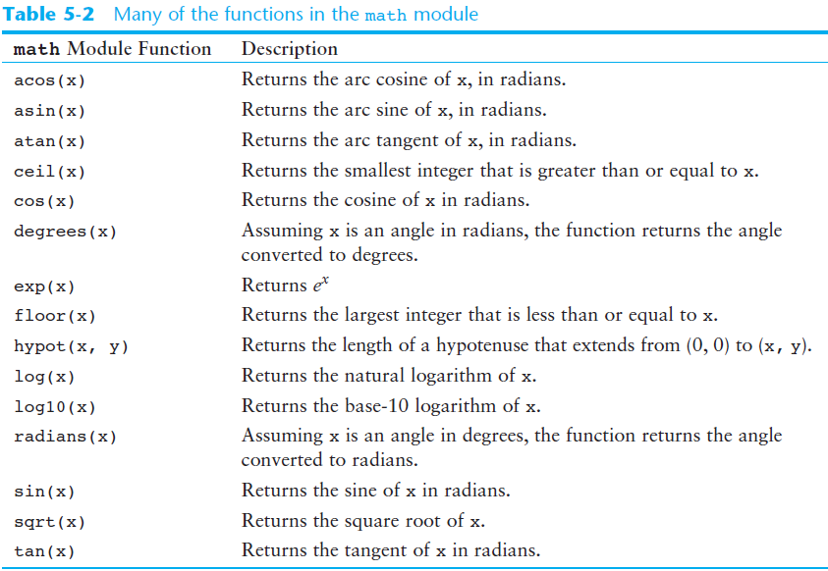
The math Module (cont’d.)

Slide 24
The math Module (cont’d.)
The math module defines variables pi and e, which are assigned the mathematical values for pi and e
Can be used in equations that require these values, to get more accurate results
Variables must also be called using the dot notation
Example:
circle_area = math.pi * radius**2

Slide 25
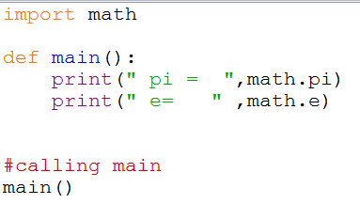

Slide 26
Storing Functions in Modules
In large, complex programs, it is important to keep code organized
Modularization: grouping related functions in modules
Makes program easier to understand, test, and maintain
Make it easier to reuse code for multiple different programs
Import the module containing the required function to each program that needs it

Slide 27
Storing Functions in Modules (cont’d.)
Module is a file that contains Python code
Contains function definition but does not contain calls to the functions
Importing programs will call the functions
Rules for module names:
File name should end in .py
Cannot be the same as a Python keyword
Import module using import statement

Slide 28
References:
Tony Gaddis - Starting Out with Python, Global Edition (2018, Pearson Education)

