Slide 1
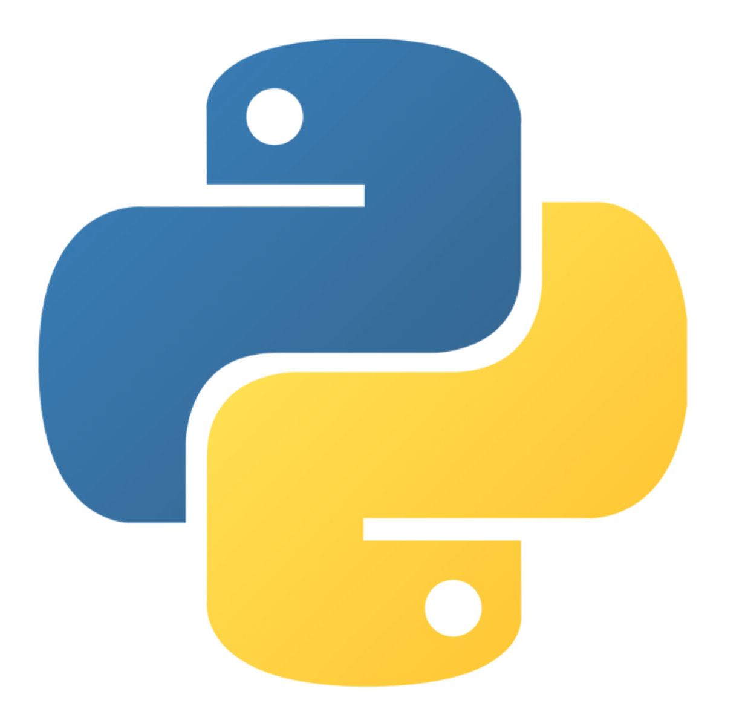
Python Functions 3

Slide 2
functions as arguments

Slide 3
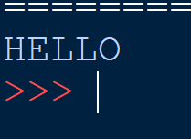
functions as arguments
functions can be passed around and used as arguments, just like any other object (string, int, float, list, and so on).
Consider the following :

Slide 4
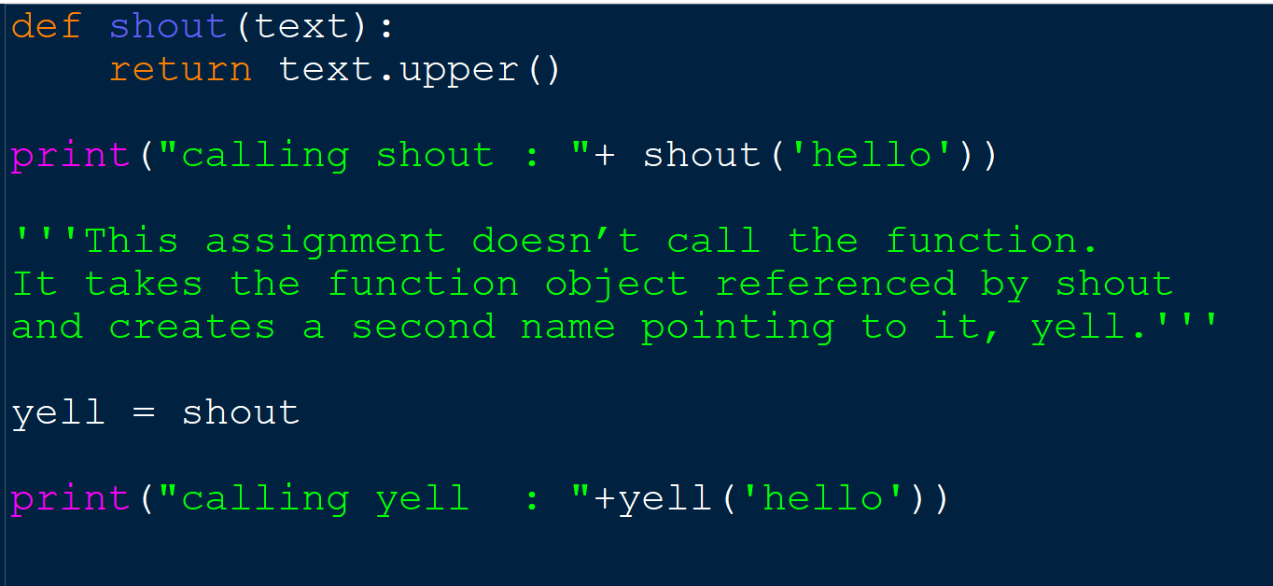
functions as arguments
Python functions are first class objects. In the example below, a function is assigned to a variable.
It takes the function object referenced by shout and creates a second name pointing to it, yell.

Slide 5
functions as arguments
Because functions are objects we can pass them as arguments to other functions

Slide 6
Python Arbitrary Arguments

Slide 7
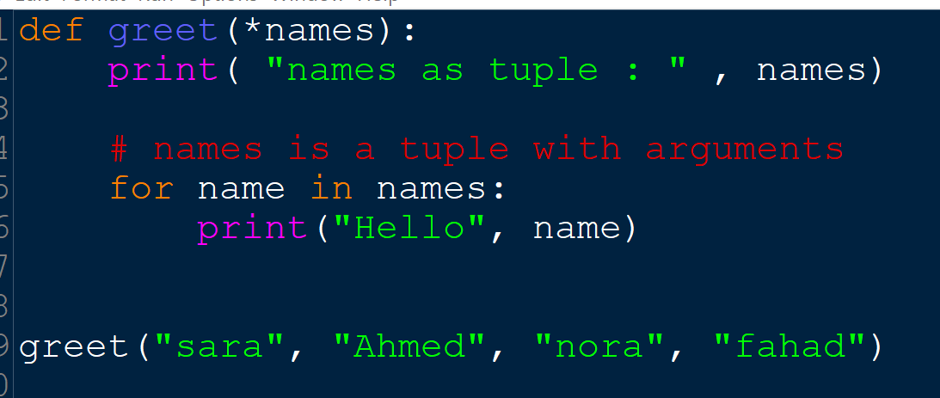
Arbitrary Arguments
Sometimes, we do not know in advance the number of arguments that will be passed into a function. Python allows us to handle this kind of situation through function calls with an arbitrary number of arguments.
In the function definition, we use an asterisk (*) before the parameter name to denote this kind of argument.

Slide 8
Inner Functions

Slide 9
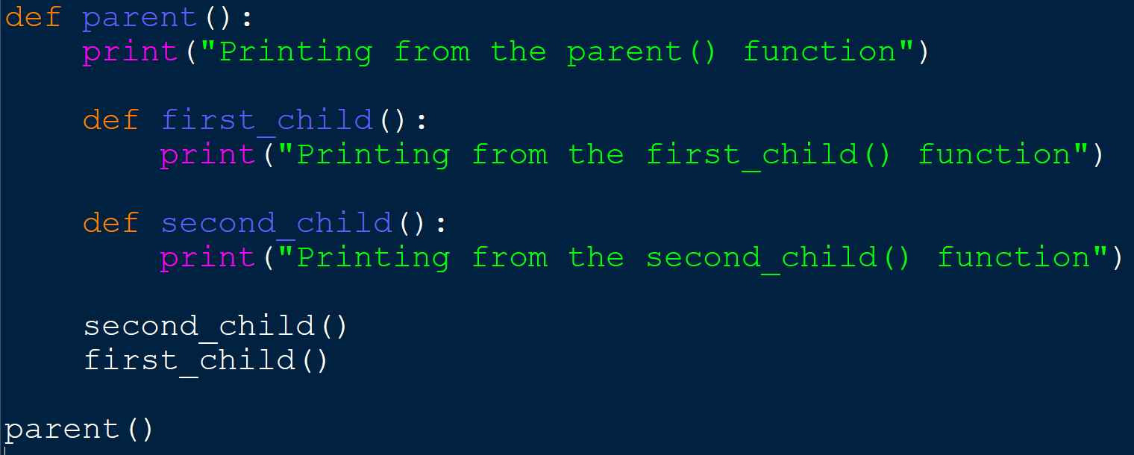
Inner Functions
It’s possible to define functions inside other functions. Such functions are called inner functions also known as nested functions. Here’s an example of a function with two inner functions:

Slide 10
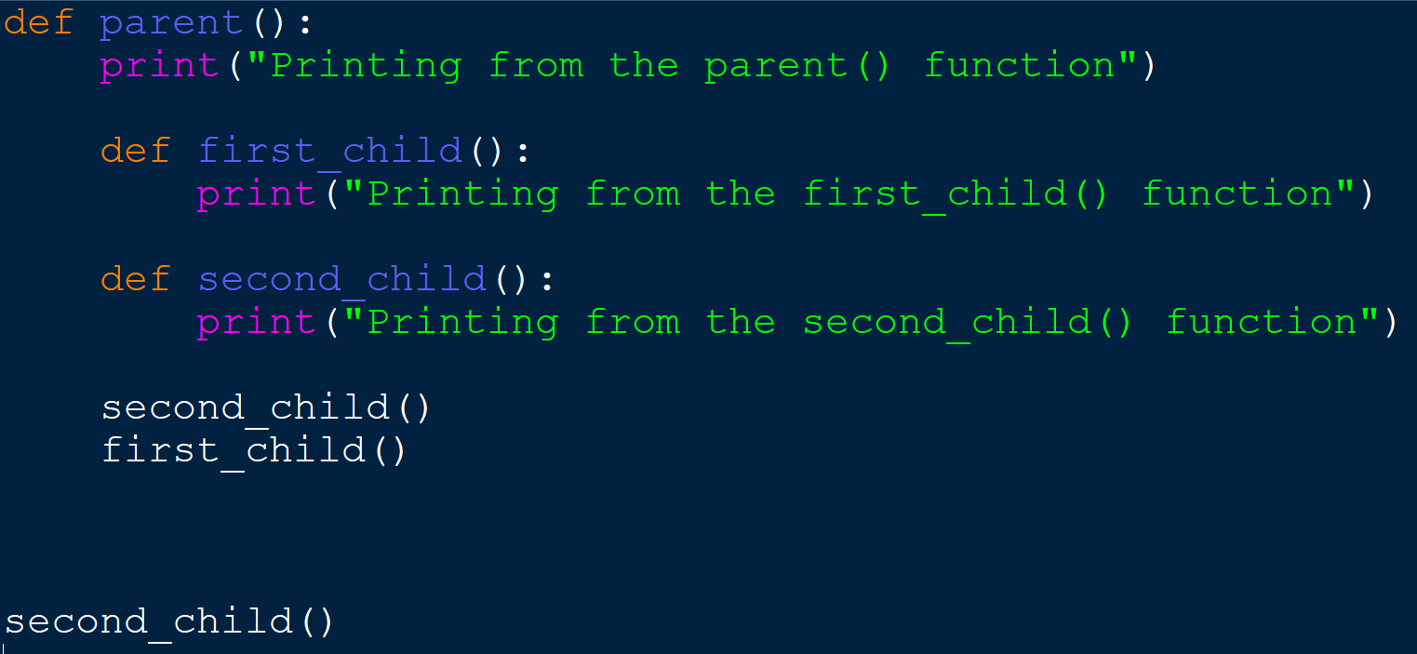
Inner Functions
the inner functions are not defined until the parent function is called. They are locally scoped to parent(): they only exist inside the parent() function as local variables.
Try calling second_child(). You should get an error:

Slide 11
Returning Functions From Functions

Slide 12
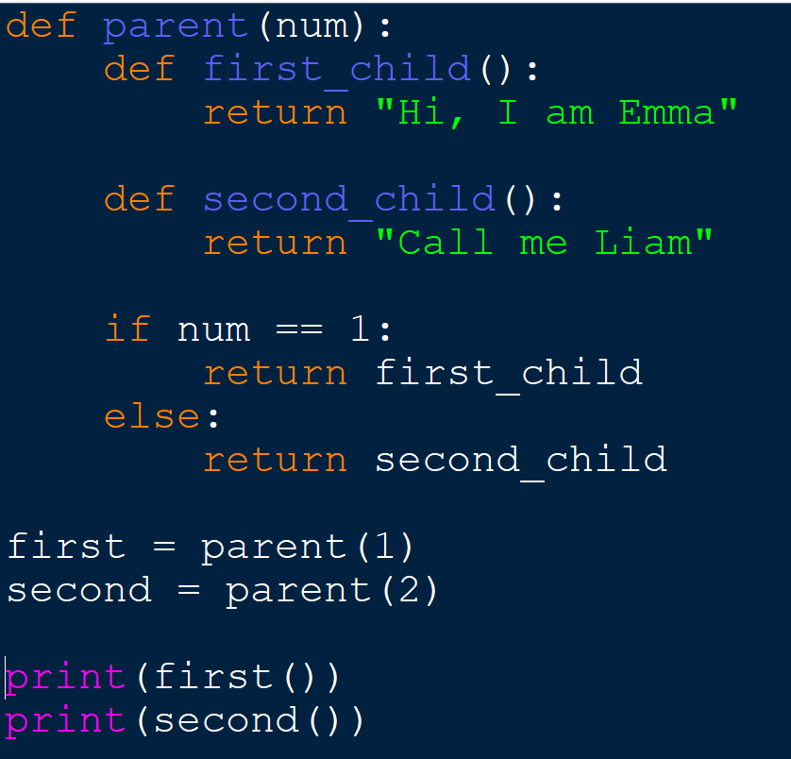
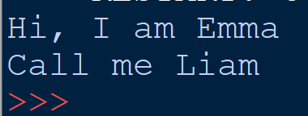
Returning Functions From Functions
Python also allows you to use functions as return values
Note that you are returning first_child without the parentheses.
Recall that this means that you are returning a reference to the function first_child
You can now use first and second
as if they are regular functions,
even though the functions they point to can’t be accessed directly

Slide 13
Recursion

Slide 14
Introduction to Recursion
You have seen instances of functions calling other functions. In a program, the main function might call function A, which then might call function B. It’s also possible for a function to call itself.
A function that calls itself is known as a recursive function.
Recursion is a common mathematical and programming concept The developer should be very careful with recursion as it can be quite easy to slip into writing a function which never terminates, or one that uses excess amounts of memory or processor power. However, when written correctly recursion can be a very efficient and mathematically-elegant approach to programming.

Slide 15
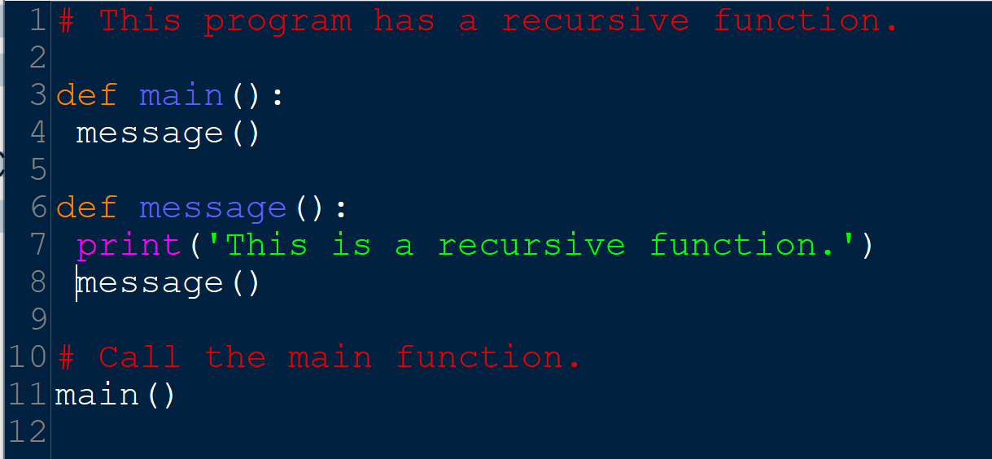
Introduction to Recursion
Example of endless recursion
There’s no way to stop the recursive calls. This function is like an infinite loop because there is no code to stop it from repeating
Like a loop, a recursive function must have some way to control the number of times it repeats.

Slide 16
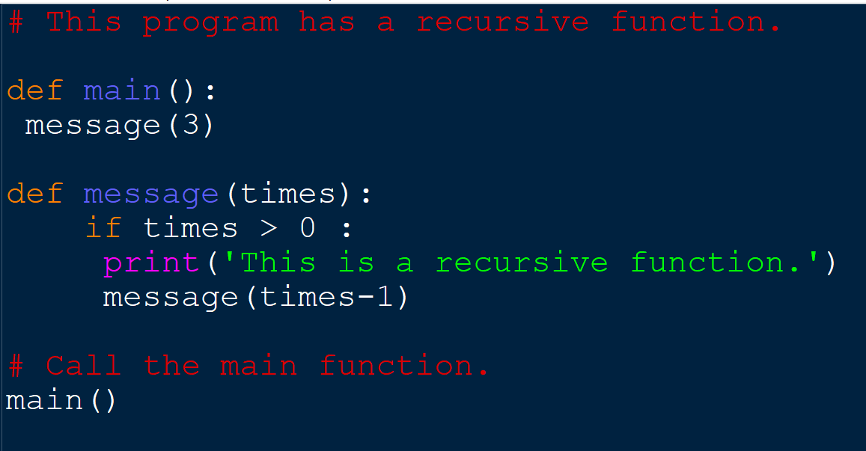
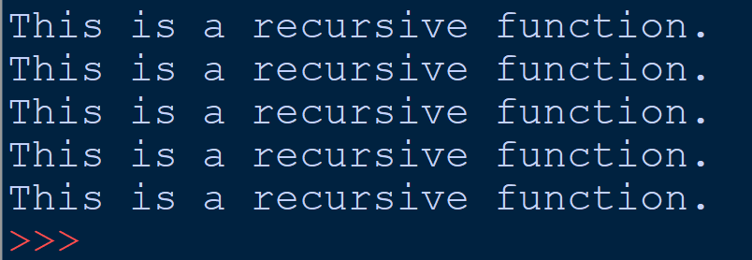
Introduction to Recursion
Example of end recursion

Slide 17
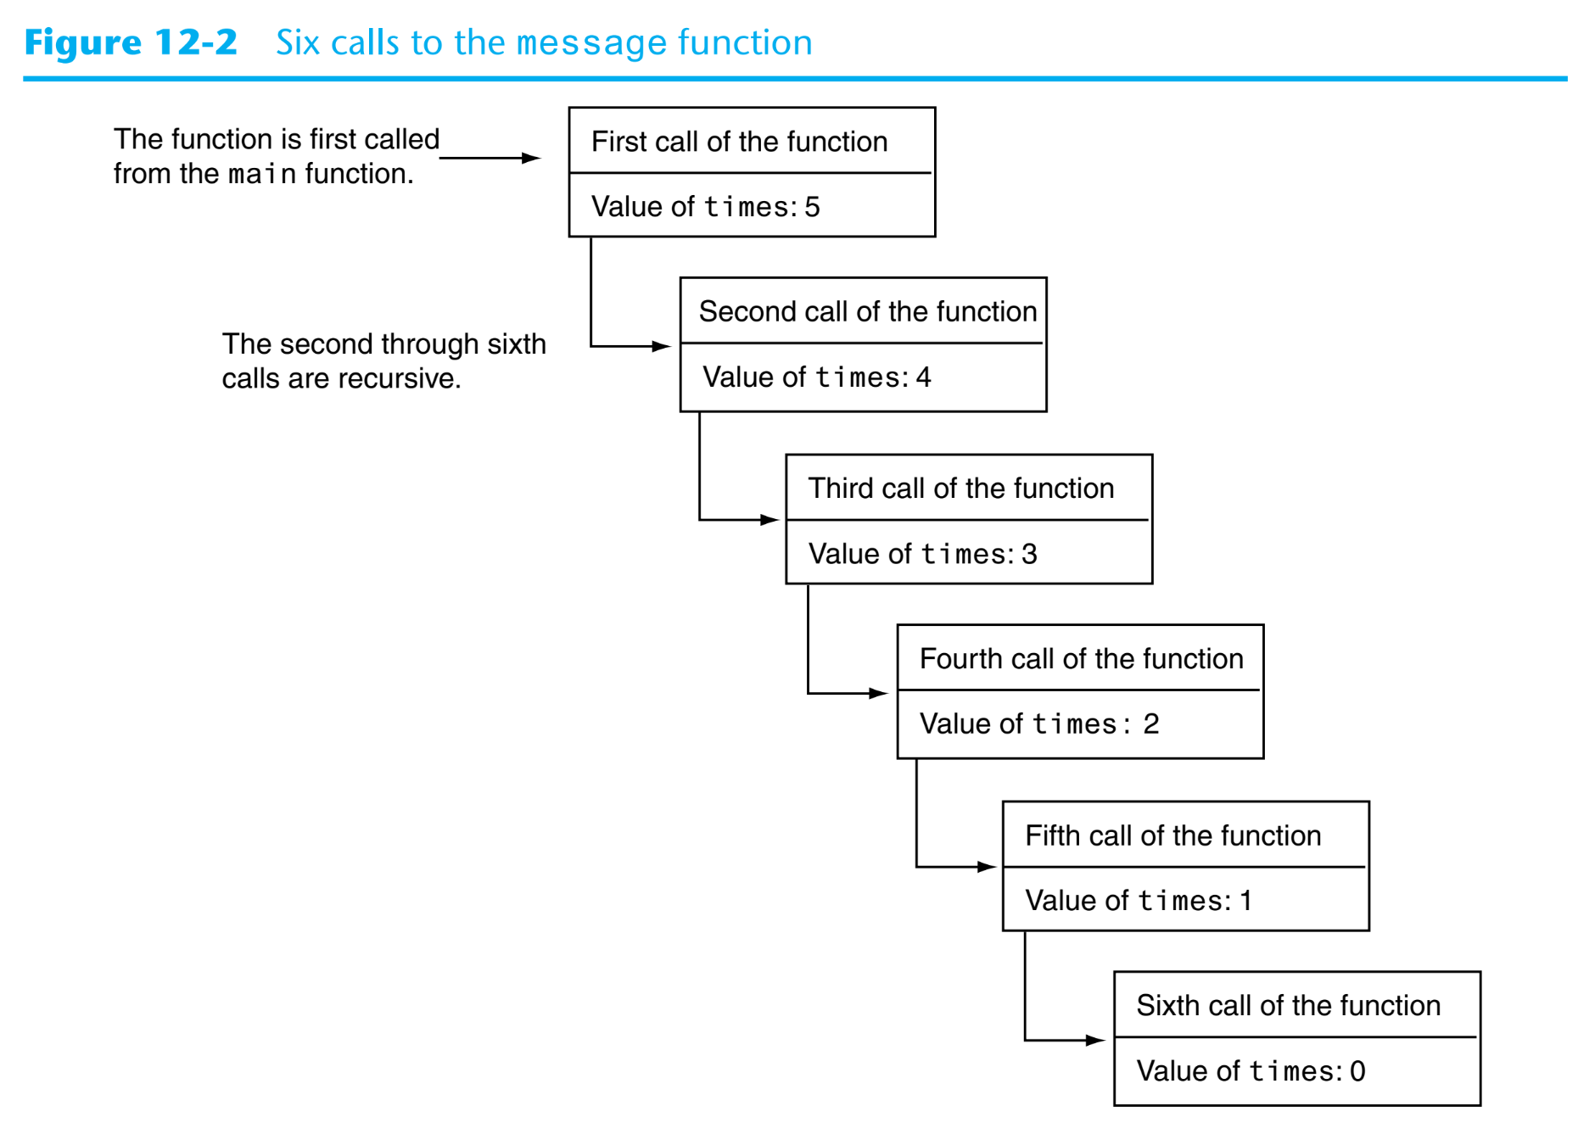

Slide 18
Example : print the 5 natural numbers
Rewrite the cod using recursion
Notes:
def printUptoN(n):
if n>1:
printUptoN(n-1)
print(n, end=" ")
n=int(input("Enter the upper limit="))
printUptoN(n)

Slide 19
Finding Factorial 5! = 5*4*3*2*1
5!
5!
Final value=120
5!=5*24=120 returned
5*4!
5*4!
4!=4*6=24 returned
4*3!
4*3!
3!=3*2=6 returned
3*2!
3*2!
2!=2*1=2 returned
2*1!
2*1!
1
1
1

Slide 20
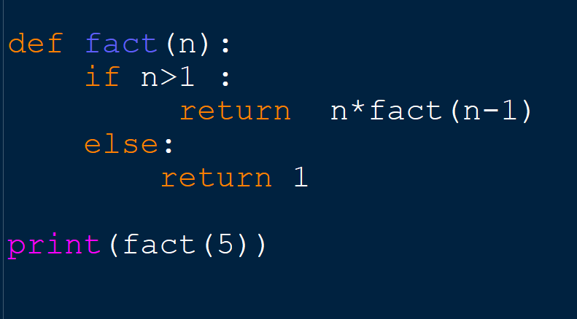

Slide 21
Examples of Recursive Algorithms
The Fibonacci Series :0, 1, 1, 2, 3, 5, 8, 13, 21, 34, 55, 89, 144, 233, . . .
Finding the Greatest Common Divisor

Slide 22
Examples of Recursive Algorithms
Finding the Greatest Common Divisor

Slide 23
References:
Tony Gaddis - Starting Out with Python, Global Edition (2018, Pearson Education)
https://www.geeksforgeeks.org/passing-function-as-an-argument-in-python/
https://www.programiz.com/python-programming/function-argument
https://www.programiz.com/python-programming/recursion

