Slide 1
Basics of Web Technologies

Slide 2
Learning Outcomes
The evolution of the Internet
difference between the Internet, intranets, and extranets.
The beginning of the World Wide Web.

Slide 3
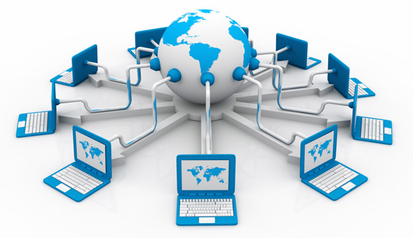
The Internet
Interconnected network of computer networks.
Internet is composed of collection of networks connecting millions of computers together.
Internet consists of hardware and software infrastructure that enables computers to communicate and exchange information.

Slide 4
The Evolution of the Internet
Internet
ARPAnet
Advanced Research Project Agency
1969 – four computers connected
NSFnet
National Science Foundation
Use of the Internet was originally limited to government, research and academic use
1991 Commercial ban lifted

Slide 5
Intranet & Extranets
Intranet
A private network contained within an organization or business used to share information and resources among coworkers.
Extranet
A private network that securely shares part of an organization’s information or operations with external partners

Slide 6
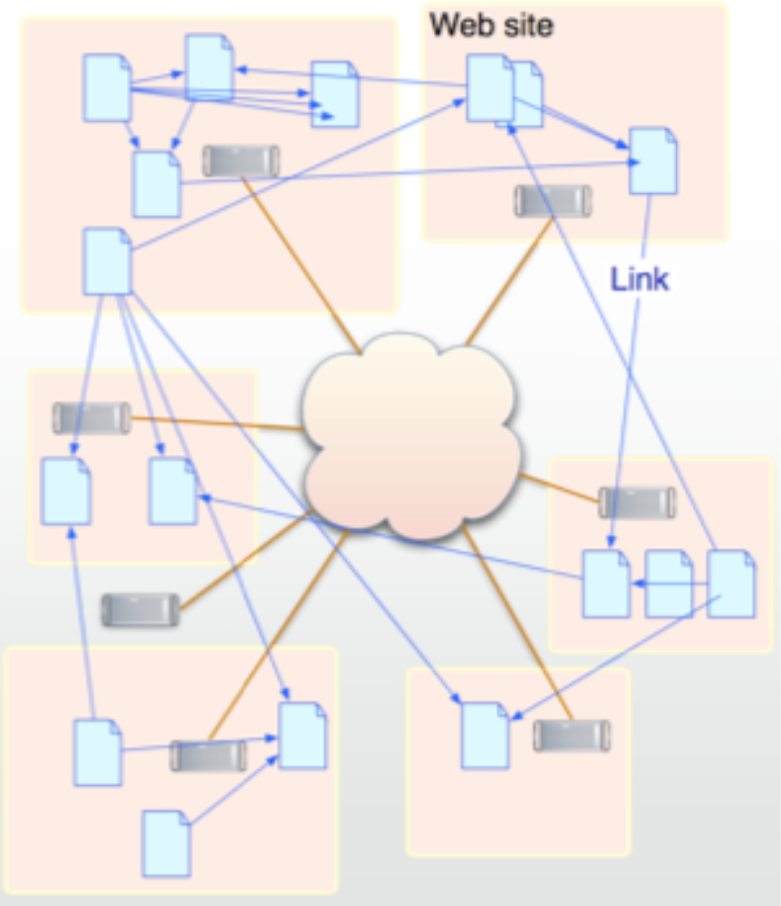
The World Wide Web
The World Wide Web (WWW) is a system of interlinked hypertext documents accessed via the Internet.
With a web browser, one can view web pages that may contain text, images, videos, and other multimedia and navigate between them by using hyperlinks.

Slide 7
WWW: The World Wide Web
The World Wide Web (WWW) was developed by Tim Berners-Lee and other research scientists at CERN, the European center for nuclear research, in the late 1980s and early 1990s.
WWW is a client-server model and uses TCP connections to transfer information or web pages from server to client.
WWW uses a Hypertext model. Hypertext allows interactive accesses to a collection of documents.
Documents can hold
Text (hypertext), Graphics, Sound, Animations, Video
Documents are linked together
Non-distributed – all documents stored locally (e.g on CD-Rom).
Distributed – documents stored at remote servers on the Internet.

Slide 8
WWW - Hyperlinks (or links)
Each document contains links (pointers) to other documents.
The link represented by "active area" on screen
Graphic - button
Text - highlighted
By selecting a particular link, the client fetches the referenced document from a server for display.
Links may become invalid.
Link is simply a text name for a remote document.
Remote document may be moved to a new location while name in link remains in place.

Slide 9
WWW – Document Representation
Each WWW document is called a page.
Initial page for individual or organization is called a home page.
Page can contain many different types of information; page must specify:
Content – The actual information
Type of content – The type of information, e.g. text, pictures etc
Links to other documents
Rather than having a fixed representation for every browser, pages are formatted with a mark up language.
This allows browser to format page to fit display.
Standard is called HyperText Markup Language (HTML).

Slide 10
Web Documents – Static Documents
Fixed-content documents that are created and stored in a server.
The client can get only a copy of the document.
The content of the file is determined when the file is created, not when it is used.
When a client accesses the document, a copy of the document is sent. The user can then use a browsing program to display the document.

Slide 11
Web Documents – Dynamic Documents
Created by a Web server whenever a browser requests the document.
When a request arrives, the Web server runs an application program or a script that creates a dynamic document.
The server returns the output of the program or script as a response to the browser that requested the document.

Slide 12
Basic Internet Protocols
TCP/IP is fundamental to the Internet
Email, web browsing, file downloads, accessing database are built on top of TCP and IP protocols
TCP is the Transmission Control Protocol
TCP extends IP to provide added functionality
However, only IP is fundamental to the definition of Internet
IP address:
Each device connected to the Internet has a unique numeric IP address.
32 bit number (sequence of 4 decimal numbers separated by dots, for example: http://74.125.224.72)
Other protocols: UDP, FTP, SMTP etc.

Slide 13
UDP- User Datagram Protocol
An alternative protocol to TCP
It builds on IP
Does not provide two-way connection
Does not provide guaranteed delivery unlike TCP
Faster than TCP for simple tasks
Used for tasks like downloading video, short message etc.

Slide 14
FTP: File Transfer Protocol
People required a protocol to reliably transfer files between any two computers connected to the Internet.
FTP is a client/server program
An FTP client program enables the user to interact with an ftp server in order to access files on the ftp server computer.
FTP provides similar services to those available on most filesystems: list directories, create new files, download files, delete files.
FTP uses TCP connections and the default server port for FTP is 21.

Slide 15
Web Standards and the W3C Consortium
W3C – World Wide Web Consortium
Develops recommendations and prototype technologies related to the Web
Produces specifications, called Recommendations, in an effort to standardize web technologies

Slide 16
Web Accessibility
WAI – Web Accessibility Initiative
Develops recommendations for
Web content developers,
Web authoring tool developers,
Developers of web browsers, and
Developers of other user agents to facilitate use of the web by those with special needs.
WCAG
Web Content Accessibility Guidelines http://www.w3.org/WAI/WCAG20/quickref/

Slide 17
Uniform Resource Locator (URL)
A client that wants to access a Web page needs the address to that page.
The Uniform Resource Locator (URL) is a standard for specifying any kind of information on the Internet.
The URL defines four things: protocol, host computer, port and path.
://
:
/
Protocol
Host
Port
Path

Slide 18
WWW – Identifying a web page
A web page is identified by:
The protocol used to access the web page.
The host is the computer on which the web page is stored.
The TCP port that the server is listening on to allow a client to access the web page.
The path is the directory pathname of web page on server (the file where the information is located).
Specific syntax for Uniform Resource Locator (URL): protocol://computer_name:port/document_name
Protocol can be http, UDP, SMTP, FTP, mailto.

Slide 19
Domain Name
What is “Domain Name”?
It is a unique name for your website. To get a domain name you have to register the name from domain name registration companies like eHost.com.
Example: www.google.com

Slide 20
Top-Level Domain Name (TLD)
A top-level domain (TLD) identifies the right-most label of the domain name.
Current generic TLDs:
.com, .org, .net, .mil, .gov, .edu, .int, .aero, .asia, .cat, .jobs, .name, .biz, .mobi, .museum, .info, .coop, .post, .pro, .tel, .travel.

Slide 21
WWW – Identifying a web page
Computer name can be DNS name or IP address.
TCP port is optional (http uses port 80 as its default port).
document_name is path on server to web page (file).
E.g. http://www.yahoo.com/Recreation/Sports/Soccer/index.html
Protocol is http
Computer name or DNS name is www.yahoo.com
Port number is the default port for http, i.e. port 80.
Document name is /Recreation/Sports/Soccer/index.html

Slide 22
The Web Experience
A user clicks on a link in a browser
The browser communicates with a web server using HTTP.
The server sends an HTML document back.
The browser displays the document.
The user clicks on another link and activates another URL.
Web client (browser)
Request
Reponse
Web server

Slide 23
Questions ?

Slide 24
Checkpoint 1.1
1. Describe the difference between the Internet and an intranet.
2. Describe the difference between the Internet and the Web.

