Slide 1
Chapter 2: The Project Management and Information Technology Context
Information Technology Project Management, Seventh Edition
Note: See the text itself for full citations.

Slide 2
Projects Cannot Be Run In Isolation
Projects must operate in a broad organizational environment
Project managers need to use systems thinking:
taking a holistic view of carrying out projects within the context of the organization
Senior managers must make sure projects continue to support current business needs

Slide 3
A Systems View of Project Management
A systems approach describe a more analytical approach to management and problem solving
Three parts include:
Systems philosophy: an overall model for thinking about things as systems (Systems are set of interacting components that work within an environment to fulfill some purpose (Ex. Human body is a system)
Systems analysis: problem-solving approach
Systems management: address business, technological, and organizational issues systems associated with creating, maintain and modifying a system.

Slide 4
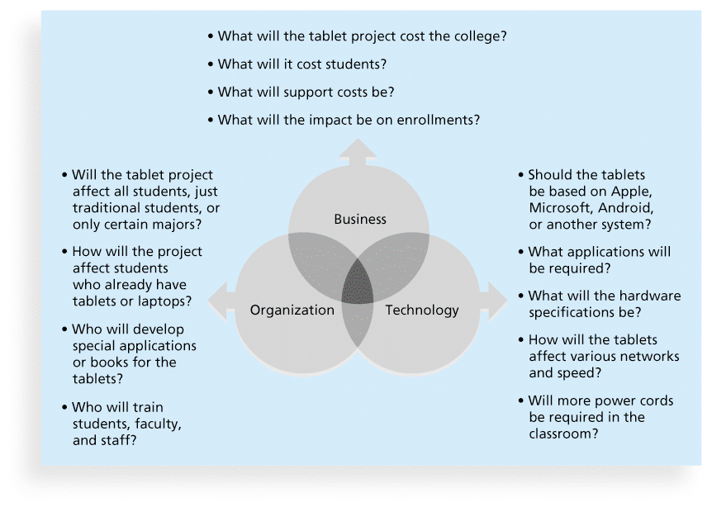
Figure 2-1. Three Sphere Model for Systems Management

Slide 5
Project Phases and the Project Life Cycle
A project life cycle is a collection of project phases that defines
what work will be performed in each phase
what deliverables will be produced and when
who is involved in each phase, and
how management will control and approve work produced in each phase
A deliverable is a product or service produced or provided as part of a project (ex. piece of hardware, a segment of software code)

Slide 6
More on Project Phases
In early phases of a project life cycle
resource needs are usually lowest
the level of uncertainty (risk) is highest
project stakeholders have the greatest opportunity to influence the project
In middle phases of a project life cycle
the certainty of completing a project improves
more resources are needed
The final phase of a project life cycle focuses on
ensuring that project requirements were met
the sponsor approves completion of the project

Slide 7
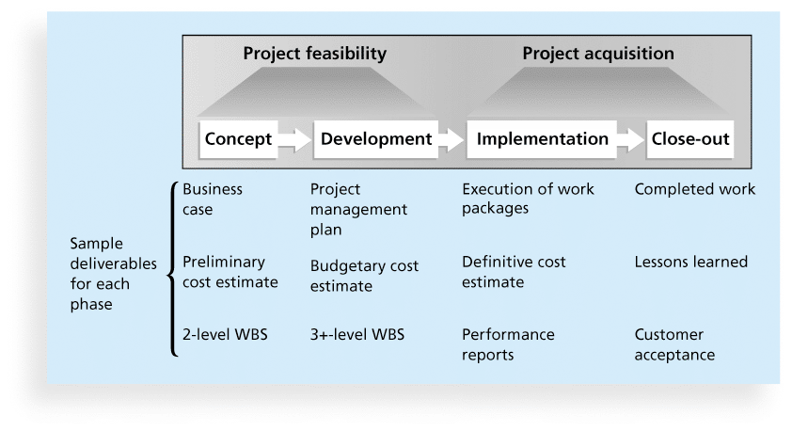
Figure 2-4. Phases of the Traditional Project Life Cycle
Notes:
Project vary by project or industry, but general phases in traditional project management are :concept, development, implementation and close-out
A Work Breakdown Structure (WBS) outlines project work by decomposing the work activities into different level of tasks

Slide 8
Product Life Cycles
Products also have life cycles
The Systems Development Life Cycle (SDLC) is a framework for describing the phases involved in developing and maintaining information systems
Systems development projects can follow
Predictive life cycle: the scope of the project can be clearly articulated and the schedule and cost can be predicted (waterfall)
Adaptive Software Development (ASD) life cycle: Stakeholders define and approve the detailed scope before the start of an iteration, producing a useable product at the end of each iteration. PMI also refers to adaptive life cycles as agile or change-driven. This approach works best when there is a high degree of change and a high frequency of delivery. (ex. Agile)

Slide 9
Product Life Cycles
Iterative life cycle: The scope is determined early, but time and cost estimates are modified as the understanding of the product increases. Iterations are used to develop the product through a series of repeated cycles to add to the functionality of the product. This approach works best when there is a high degree of change and a low frequency of delivery.
Incremental life cycle: Deliverables are produced through a series of iterations that add functionality within a set time frame. The deliverable is not complete until after the final iteration. This approach works best when there is a low degree of change and a high frequency of delivery.

Slide 10
Product Life Cycles
Hybrid life cycle: A combination of approaches is used based on the nature of the work. For example, some deliverables might have a low degree of change and low frequency of delivery such as weekly progress reports, a high degree of change and a high frequency of delivery such as certain software features, and so on

Slide 11
Predictive Life Cycle Models
Waterfall model: has well-defined, linear stages of systems development and support .The waterfall life cycle model is used when risk must be tightly controlled and when changes must be restricted after the requirements are defined.
The waterfall approach also makes sense for IT projects that do not involve software development, such as upgrading all the routers and switches in a company to support VoIP phones.

Slide 12
Predictive Life Cycle Models
Spiral model: shows that software is developed using an iterative or spiral approach rather than a linear approach
This approach is suitable for projects in which changes can be incorporated with reasonable cost increases or with acceptable time delays.

Slide 13
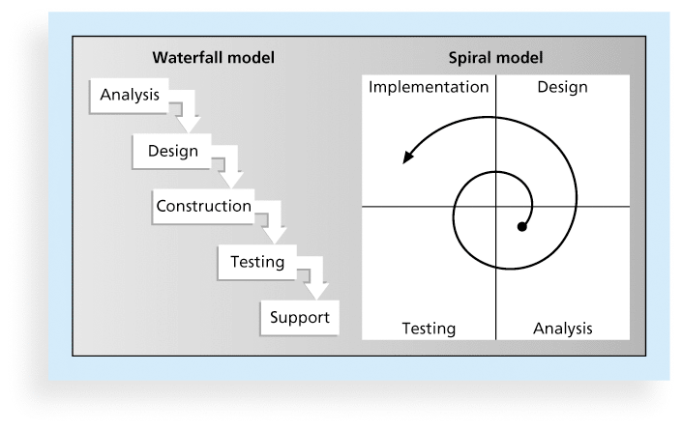
Figure 2-5. Waterfall and Spiral Life Cycle Models

Slide 14
Predictive Life Cycle Models
Prototyping model: used for developing prototypes to clarify user requirements. It requires heavy user involvement, and developers use a model to generate functional requirements and physical design specifications simultaneously. Developers can throw away or keep prototypes, depending on the project. This approach is often used in systems that involve a great deal of user interface design, such as website projects,
Rapid Application Development (RAD) model: used to produce systems quickly without sacrificing quality. Developers use RAD tools such as CASE (computer-aided software engineering), to facilitate rapid prototyping and code generation

Slide 15
The Importance of Project Phases and Management Reviews
A project should successfully pass through each of the project phases in order to continue on to the next
Management reviews, also called phase exits or kill points, should occur after each phase to evaluate the project’s progress, likely success, and continued compatibility with organizational goals

Slide 16
Recent Trends Affecting IT Project Management
Globalization: which has created a “flat” world where everyone is connected and the “playing field” is level for many more participants.
Outsourcing: Outsourcing is when an organization acquires goods and/or sources from an outside source. Offshoring is sometimes used to describe outsourcing from another country
Virtual teams: A virtual team is a group of individuals who work across time and space using communication technologies

Slide 17
Important Issues and Suggestions Related to Globalization
Issues
Communications
Trust
Common work practices
Tools (skype)

Slide 18
Virtual Teams Advantages
Increasing competiveness and responsiveness by having a team of workers available 24/7
Lowering costs because many virtual workers do not require office space or support beyond their home offices.
Providing more expertise and flexibility by having team members from across the globe working any time of day or night
Increasing the work/life balance for team members by eliminating fixed office hours and the need to travel to work.

Slide 19
Virtual Team Disadvantages
Isolating team members
Increasing the potential for communications problems
Reducing the ability for team members to network and transfer information informally
Increasing the dependence on technology to accomplish work
See text book for a list of factors that help virtual teams succeed, including team processes, trust/relationships, leadership style, and team member selection

Slide 20
Agile Project Management
Agile means being able to move quickly and easily, but some people feel that project management, as they have seen it used, does not allow people to work quickly or easily.
Early software development projects often used a waterfall approach, as defined earlier in this chapter. As technology and businesses became more complex, the approach was often difficult to use because requirements were unknown or continuously changing.
Agile today means using a method based on iterative and incremental development, in which requirements and solutions evolve through collaboration.
Notes:
Agile can be used for software development or in any environment in which the requirements are unknown or change quickly.

Slide 21
Manifesto for Agile Software Development
In February 2001, a group of 17 people that called itself the Agile Alliance developed and agreed on the Manifesto for Agile Software Development, as follows:
“We are uncovering better ways of developing software by doing it and helping others do it. Through this work we have come to value:
Individuals and interactions over processes and tools
Working software over comprehensive documentation
Customer collaboration over contract negotiation
Responding to change over following a plan”*
*Agile Manifesto, www.agilemanifesto.org.

Slide 22
Scrum
According to the Scrum Alliance, Scrum is the leading agile development method for completing projects with a complex, innovative scope of work.

Slide 23
Scrum
The basic Scrum framework is summarized in the following list and illustrated in the Figure next slide:
A product owner creates a prioritized wish list called a product backlog.
During sprint planning, the team pulls a small chunk from the top of that wish list, a sprint backlog, and decides how to implement those pieces.
The team has a certain amount of time, a sprint, to complete its work—usually two to four weeks—but meets each day to assess its progress (daily Scrum).

Slide 24
Scrum
Along the way, the ScrumMaster keeps the team focused on its goal.
At the end of the sprint, the work should be potentially shippable, as in ready to hand to a customer, put on a store shelf, or show to a stakeholder.
The sprint ends with a sprint review and retrospective.
As the next sprint begins, the team chooses another chunk of the product backlog and begins working again.
The cycle repeats until enough items in the product backlog have been completed, the budget is depleted, or a deadline arrives. Which of these milestones marks the end of the work is entirely specific to the project. No matter which of these reasons stops work, Scrum ensures that the most valuable work has been completed when the project ends.

Slide 25
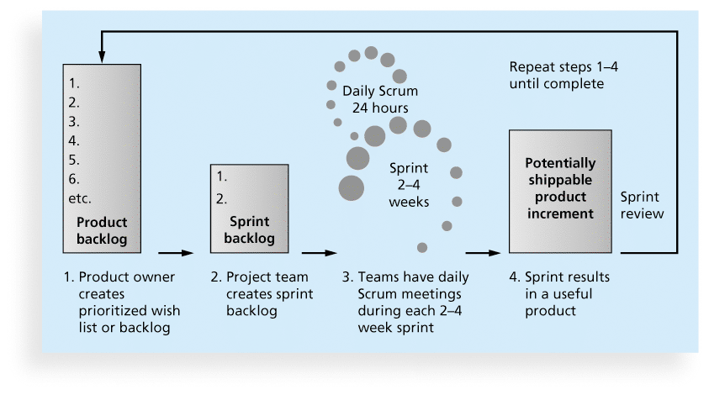
Figure 2-6. Scrum Framework

Slide 26
Chapter Summary
Project managers need to take a systems approach when working on projects
Organizations have four different frames: structural, human resources, political, and symbolic
Projects should successfully pass through each phase of the project life cycle
Project managers need to consider several factors due to the unique context of information technology projects
Recent trends affecting IT project management include globalization, outsourcing, virtual teams, and Agile

