Slide 1
Chapter 7: Project Cost Management
Information Technology Project Management, Seventh Edition
Note: See the text itself for full citations.

Slide 2
The Importance of Project Cost Management
IT projects have a poor track record for meeting budget goals
The CHAOS studies found the average cost overrun (the additional percentage or dollar amount by which actual costs exceed estimates) ranged from 180 percent in 1994 to 43 percent in 2010

Slide 3
What is Cost and Project Cost Management?
Cost is a resource sacrificed or foregone to achieve a specific objective or something given up in exchange
Costs are usually measured in monetary units like dollars
Project cost management includes the processes required to ensure that the project is completed within an approved budget
many IT professionals think that preparing cost estimates is a job for accountants. On the contrary, preparing good cost estimates is a demanding, important skill that many professionals need to acquire, including project managers.
Another perceived reason for cost overruns is that many IT projects involve new technology or business processes. Any new technology or business process is untested and has inherent risks. Thus, costs grow and failures are to be expected, right? Wrong. Using good project cost management can change this false perception.

Slide 4
Project Cost Management Processes
Planning cost management :determining the policies, procedures, and documentation that will be used for planning, executing, and controlling project cost.
Estimating costs: developing an approximation or estimate of the costs of the resources needed to complete a project
Determining the budget: allocating the overall cost estimate to individual work items to establish a baseline for measuring performance
Controlling costs: controlling changes to the project budget

Slide 5
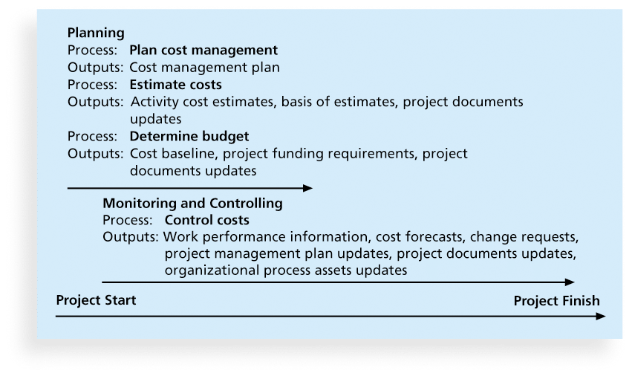
Figure 7-1. Project Cost Management Summary

Slide 6
Basic Principles of Cost Management
Most members of an executive board better understand and are more interested in financial terms than IT terms , so IT project managers must speak their language
Profits are revenues minus expenditures
Profit margin :is the ratio of revenues to profits (If revenues of $100 generate $2 in profits, there is a 2 percent profit margin. If the company loses $2 for every $100 in revenue, there is a −2 percent profit margin.)
Life cycle costing considers the total cost of ownership, or development plus support costs, for a project (For example, a company might complete a project to develop and implement a new customer service system in 1 or 2 years, but the new system could be in place for 10 years. Project managers, with assistance from financial experts in their organizations, should create estimates of the costs and benefits of the project for its entire life cycle (10 years in the preceding example)

Slide 7
Basic Principles of Cost Management
Cash flow analysis determines the estimated annual costs and benefits for a project and the resulting annual cash flow
Organizations have a history of not spending enough money in the early phases of projects, which affects total cost of ownership. For example, it is much more cost-effective to spend money on defining user requirements and doing early testing on IT projects than to wait for problems to appear after implementation. correcting a software defect late in a project costs much more than fixing the defect early.
When Facebook was down for 20 minutes on September 3, 2014, they lost a little more than $22,453 for every minute or more than $500,000.
On August 19, 2013, Amazon.com went down for about 30 minutes, costing them $66,240 per minute or nearly $2 million.

Slide 8
Types of Costs and Benefits
Tangible costs or benefits are those costs or benefits that an organization can easily measure in dollars
Intangible costs or benefits are costs or benefits that are difficult to measure in monetary terms (ex. Team members spent own personal time using government-owned computers, books, and other resources to research areas related to the project. Although their hours and the government-owned materials would not be billed to the project, they could be considered intangible costs. Intangible benefits for projects often include items like goodwill, prestige

Slide 9
Types of Costs and Benefits
Direct costs are costs that can be directly related to producing the products and services of the project (salaries)
Indirect costs are costs that are not directly related to the products or services of the project, but are indirectly related to performing the project(cost of electricity, paper)

Slide 10
More Basic Principles of Cost Management
Sunk cost is money that has been spent in the past; when deciding what projects to invest in or continue, you should not include sunk costs (For example, in the chapter’s opening case, suppose that Juan’s office had spent $1 million on a project over the past three years to create a geographic information system, but had never produced anything valuable. If his government were evaluating what projects to fund next year and an official suggested continuing to fund the geographic information system project because $1 million had been spent on it already, the official would incorrectly be making sunk cost a key factor in the project selection decision. Many people fall into the trap of continuing to spend money on a failing project because so much money has been spent on it already. This trap is similar to gamblers who continue betting because they have already lost money. Sunk costs should be forgotten, even though it is often difficult to think that way.)
Reserves are dollars included in a cost estimate to mitigate cost risk by allowing for future situations that are difficult to predict

Slide 11
1.Planning Cost Management
The project team uses expert judgment, analytical techniques, and meetings to develop the cost management plan
A cost management plan includes:
Level of accuracy
and units of measure
Organizational procedure links
Control thresholds
Rules of performance measurement
Reporting formats
Process descriptions

Slide 12
2.Estimating Costs
Project managers must take cost estimates seriously if they want to complete projects within budget constraints
It’s important to know the types of cost estimates, how to prepare cost estimates, and typical problems associated with IT cost estimates

Slide 13
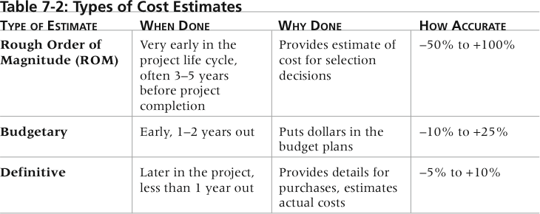
Table 7-2. Types of Cost Estimates

Slide 14
2.1 More on Cost Estimates
Estimates are usually done at various stages of a project and should become more accurate as time progresses
A large percentage of total project costs are often labor costs

Slide 15
2.2 Cost Estimation Tools and Techniques
Basic tools and techniques for cost estimates:
Analogous or top-down estimates: use the actual cost of a previous, similar project as the basis for estimating the cost of the current project . this technique requires a good deal of expert judgment and is generally less costly than other techniques, but it is also less accurate.
Bottom-up estimates: involve estimating individual work items or activities and summing them to get a project total
Three-point estimates involve estimating the most likely, optimistic, and pessimistic costs for items. You can use a formula like the PERT weighted average to calculate cost estimates
Parametric modeling uses project characteristics (parameters) in a mathematical model to estimate project costs

Slide 16
2.3 Typical Problems with IT Cost Estimates
Estimates are done too quickly
People lack estimating experience
Human beings are biased toward underestimation
Management desires accuracy

Slide 17
3.Determining the Budget
Cost budgeting involves allocating the project cost estimate to individual work items over time
The WBS is a required input to the cost budgeting process since it defines the work items
Important goal is to produce a cost baseline
a time-phased budget that project managers use to measure and monitor cost performance

Slide 18
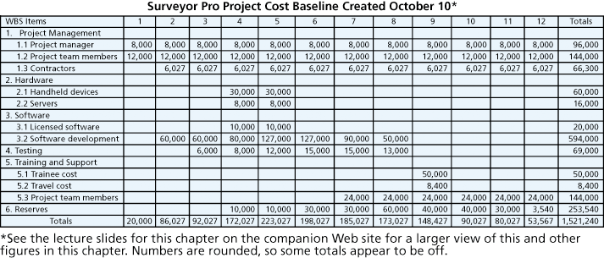
Figure 7-4. Surveyor Pro Project Cost Baseline

Slide 19
4. Controlling Costs
Project cost control includes
Monitoring cost performance
Ensuring that only appropriate project changes are included in a revised cost baseline
Informing project stakeholders of authorized changes to the project that will affect costs
Many organizations around the globe have problems with cost control

Slide 20
4.1Earned Value Management (EVM)
EVM is a project performance measurement technique that integrates scope, time, and cost data
Given a baseline (original plan plus approved changes), you can determine how well the project is meeting its goals
You must enter actual information periodically to use EVM
More and more organizations around the world are using EVM to help control project costs

Slide 21
Earned Value Management Terms
The planned value (PV),, also called the budget, is that portion of the approved total cost estimate planned to be spent on an activity during a given period
Actual cost (AC),, is the total of direct and indirect costs incurred in accomplishing work on an activity during a given period
The earned value (EV), is an estimate of the value of the physical work actually completed
EV is based on the original planned costs for the project or activity and the rate at which the team is completing work on the project or activity to date

Slide 22
Rate of Performance
Rate of performance (RP) is the ratio of actual work completed to the percentage of work planned to have been completed at any given time during the life of the project or activity
For example, suppose the server installation was halfway completed by the end of week 1. The rate of performance would be 50% because by the end of week 1, the planned schedule reflects that the task should be 100 percent complete and only 50 percent of that work has been completed

Slide 23
Cost variance (CV) is the earned value minus the actual cost. If cost variance is a negative number, it means that performing the work cost more than planned. If cost variance is a positive number, performing the work cost less than planned.
Schedule variance (SV) is the earned value minus the planned value. A negative schedule variance means that it took longer than planned to perform the work, and a positive schedule variance means that the work took less time than planned.

Slide 24
The cost performance index (CPI) is the ratio of earned value to actual cost; it can be used to estimate the projected cost of completing the project. If the CPI is equal to one, or 100 percent, then the planned and actual costs are equal—the costs are exactly as budgeted. If the CPI is less than one or less than 100 percent, the project is over budget. If the CPI is greater than one or more than 100 percent, the project is under budget.

Slide 25
The schedule performance index (SPI) is the ratio of earned value to planned value; it can be used to estimate the projected time to complete the project. Similar to the cost performance index, an SPI of one, or 100 percent, means the project is on schedule. If the SPI is greater than one or 100 percent, then the project is ahead of schedule. If the SPI is less than one or 100 percent, the project is behind schedule.

Slide 26
Rules of Thumb for Earned Value Numbers
Negative numbers for cost and schedule variance indicate problems in those areas
CPI and SPI less than 100% indicate problems
Problems mean the project is costing more than planned (over budget) or taking longer than planned (behind schedule)
The CPI can be used to calculate the estimate at completion (EAC)—an estimate of what it will cost to complete the project based on performance to date.
The budget at completion (BAC) is the original total budget for the project

Slide 27
Example
Suppose that a project included a summary activity of purchasing and installing a new web server. Suppose further that, according to the plan, it would take one week and cost a total of $10,000 for the labor hours, hardware, and software. Therefore, the planned value (PV) for the activity that week is $10,000
uppose that it actually took two weeks and cost $20,000 to purchase and install the new web server. Assume that $15,000 of these actual costs were incurred during Week 1 and $5,000 was incurred during Week 2. These amounts are the actual cost (AC) for the activity each week.
Total budget for the project is 100,000

Slide 28
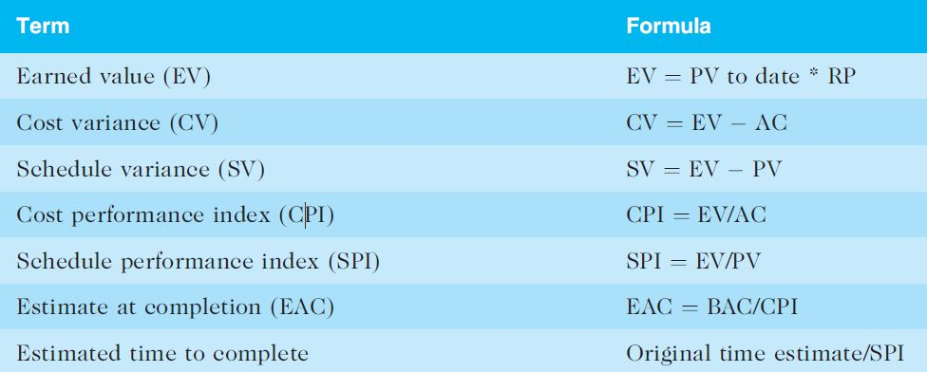
Table 7-5. Earned Value Formulas

Slide 29
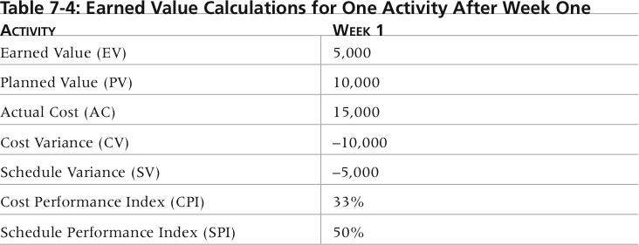
Table 7-4. Earned Value Calculations for One Activity After Week One

Slide 30
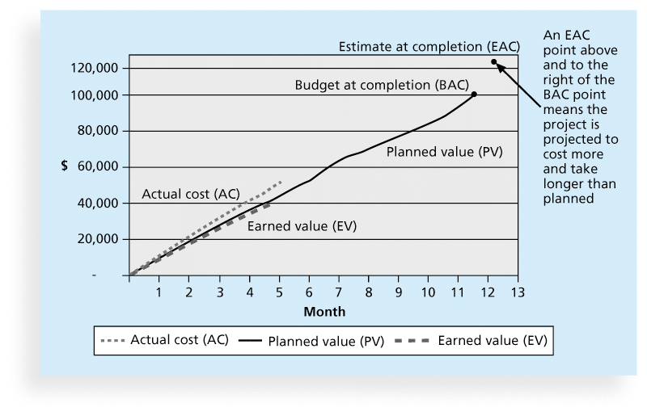
Figure 7-5. Earned Value Chart for Project after Five Months

Slide 31
Viewing earned value information in chart form helps you visualize how the project is performing. For example, you can see the planned performance by looking at the planned value line. If the project goes as planned, it will finish in 12 months and cost $100,000.
Notice in the example in Figure 7-5 that the actual cost line is always on or above the earned value line, which indicates that costs are equal to or more than planned. The planned value line is close to the earned value line and is slightly higher in the last month. This relationship means that the project has been on schedule until the last month, when the project fell behind schedule.

Slide 32
Top managers who oversee multiple projects often like to see performance information in a graphical form, such as the earned value chart in Figure 7-5. For example, in the opening case, the government officials were reviewing earned value charts and EACs for several different projects. Earned value charts allow you to see quickly how projects are performing. If there are serious cost and schedule performance problems, top management may decide to terminate projects or take other corrective action. The EACs are important inputs to budget decisions, especially if total funds are limited. Earned value management is an important technique when used effectively, because it helps top management and project managers evaluate progress and make sound management decisions.

Slide 33
If earned value management is such a powerful cost control tool, then why doesn’t every organization use it? Why do many government projects require it, but many commercial projects don’t? Two reasons :
are EVM’s focus on tracking actual performance versus planned performance and the importance of percentage completion data in making calculations. Many projects, particularly IT projects, do not have good planning information, so tracking performance against a plan might produce misleading information. Several cost estimates are usually made on IT projects, and keeping track of the most recent cost estimate and the associated actual costs could be cumbersome.
In addition, estimating percentage completion of tasks might produce misleading information. What does it mean to say that a task is actually 75 percent complete after three months? Such a statement is often not synonymous with saying the task will be finished in one more month or after spending an additional 25 percent of the planned budget.

Slide 34
Using Software to Assist in Cost Management
Spreadsheets are a common tool for resource planning, cost estimating, cost budgeting, and cost control
Many companies use more sophisticated and centralized financial applications software for cost information
Project management software has many cost-related features, especially enterprise PM software

Slide 35
Chapter Summary
Project cost management is a traditionally weak area of IT projects, and project managers must work to improve their ability to deliver projects within approved budgets
Main processes include
Plan cost management
Estimate costs
Determine the budget
Control costs

