Slide 1
Chapter 8: Project Quality Management
Information Technology Project Management, Seventh Edition
Note: See the text itself for full citations.

Slide 2
The Importance of Project Quality Management
People seem to accept systems being down occasionally or needing to reboot their PCs
But quality is very important in many IT projects (Many IT projects develop mission-critical systems that are used in life-and-death situations, such as navigation systems on aircraft and computer components built into medical equipment)

Slide 3
What Is Project Quality?
The International Organization for Standardization (ISO) defines quality as “the degree to which a set of inherent characteristics fulfils requirements” Other experts define quality based on:
Conformance to requirements: The project’s processes and products meet written specifications
Fitness for use: A product can be used as it was intended

Slide 4
What Is Project Quality Management?
Project quality management ensures that the project will satisfy the needs for which it was undertaken
The project team must develop good relationships with key stakeholders, especially the main customer for the project, to understand what quality means to them. After all, the customer ultimately decides if quality is acceptable. Many technical projects fail because the project team focuses only on meeting the written requirements for the main products being created and ignores other stakeholder needs and expectations for the project.
Quality, therefore, must be on an equal level with project scope, time, and cost. If a project’s stakeholders are not satisfied with the quality of the project management or the resulting products of the project, the project team will need to adjust scope, time, and cost to satisfy the stakeholder. Meeting only written requirements for scope, time, and cost is not sufficient.

Slide 5
What Is Project Quality Management?
Processes include:
Planning quality management: Identifying which quality standards are relevant to the project and how to satisfy them; a metric is a standard of measurement
Performing quality assurance: Periodically evaluating overall project performance to ensure the project will satisfy the relevant quality standards
Performing quality control: Monitoring specific project results to ensure that they comply with the relevant quality standards

Slide 6
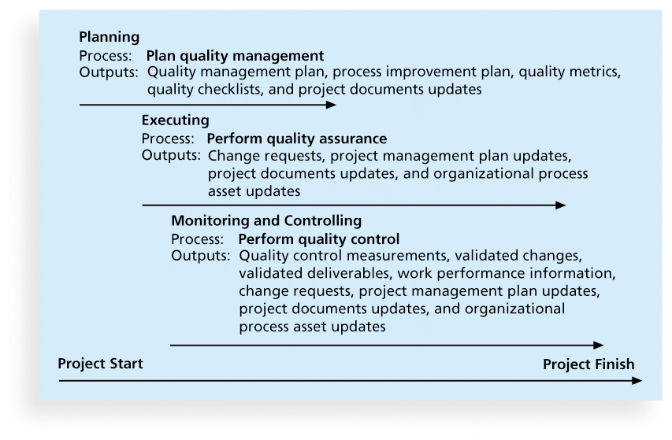
Figure 8-1. Project Quality Management Summary

Slide 7
1 Planning Quality
Implies the ability to anticipate situations and prepare actions to bring about the desired outcome
it is important to identify relevant quality standards for each unique project and to design quality into the products of the project and the processes involved in managing the project.

Slide 8
1 Planning Quality
Several tools and techniques are available for planning quality management. For example, design of experiments is a technique that helps identify which variables have the most influence on the overall outcome of a process. Understanding which variables affect outcome is a very important part of quality planning. For example, computer chip designers might want to determine which combination of materials and equipment will produce the most reliable chips at a reasonable cost.

Slide 9
Scope Aspects of IT Projects affects quality
Functionality is the degree to which a system performs its intended function
Features are the system’s special characteristics that appeal to users
System outputs are the screens and reports the system generates
Performance addresses how well a product or service performs the customer’s intended use
Reliability is the ability of a product or service to perform as expected under normal conditions
Maintainability addresses the ease of performing maintenance on a product

Slide 10
Who’s Responsible for the Quality of Projects?
Project managers are ultimately responsible for quality management on their projects
Several organizations and references can help project managers and their teams understand quality
International Organization for Standardization (www.iso.org)
IEEE (www.ieee.org)

Slide 11
2. Performing Quality Assurance
Quality assurance includes all the activities related to satisfying the relevant quality standards for a project
Another goal of quality assurance is continuous quality improvement
Benchmarking generates ideas for quality improvements by comparing specific project practices or product characteristics to those of other projects or products within or outside the performing organization For example, if a competitor has an EIS with an average downtime of only one hour a week, that might be a benchmark for which to strive.
A quality audit is a structured review of specific quality management activities that help identify lessons learned that could improve performance on current or future projects

Slide 12
3. Controlling Quality
The main outputs of quality control are:
Acceptance decisions: determine if the products or services produced as part of the project will be accepted or rejected. If they are accepted, they are considered to be validated deliverables. If project stakeholders reject some of the project’s products or services, there must be rework.
Rework: is action taken to bring rejected items into compliance with product requirements, specifications, or other stakeholder expectations.
Process adjustments: correct or prevent further quality problems based on quality control measurements. Process adjustments often result in updates to organization process assets and the project management plan.

Slide 13
Tools of Quality that help in performing quality control
Cause-and-effect diagrams trace complaints about quality problems back to the responsible production operations
They help you find the root cause of a problem
Also known as fishbone or Ishikawa diagrams
Can also use the 5 whys technique where you repeated ask the question “Why” (five is a good rule of thumb) to peel away the layers of symptoms that can lead to the root cause

Slide 14
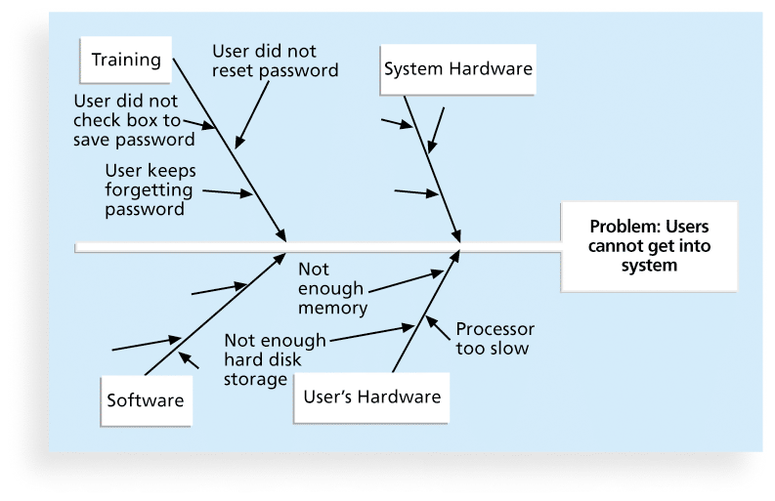
Figure 8-2. Sample Cause-and-Effect Diagram

Slide 15
Checksheet
A checksheet is used to collect and analyze data
It is sometimes called a tally sheet or checklist, depending on its format
In the example in Figure 8-4, most complaints arrive via text message, and there are more complaints on Monday and Tuesday than on other days of the week
This information might be useful in improving the process for handling complaints

Slide 16
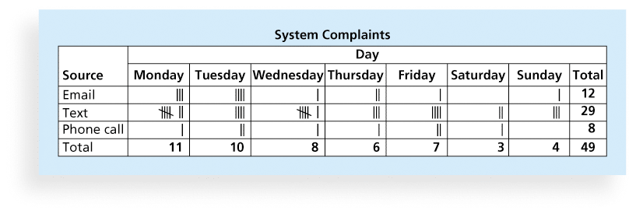
Figure 8-4. Sample Checksheet

Slide 17
Six Sigma
Six Sigma is “a comprehensive and flexible system for achieving, sustaining, and maximizing business success. Six Sigma is uniquely driven by close understanding of customer needs, disciplined use of facts, data, and statistical analysis, and diligent attention to managing, improving, and reinventing business processes”*
*Pande, Peter S., Robert P. Neuman, and Roland R. Cavanagh, The
Six Sigma Way, New York: McGraw-Hill, 2000, p. xi.

Slide 18
Basic Information on Six Sigma
The principles can apply to a wide variety of processes (help desk or design and production of a product)
Six Sigma projects normally follow a five-phase improvement process called DMAIC

Slide 19
DMAIC
DMAIC is a systematic, closed-loop process for continued improvement that is scientific and fact based
DMAIC stands for:
Define: Define the problem/opportunity, process, and customer requirements. Important tools used in this phase include a project charter, a description of customer requirements,
Measure: Define measures, then collect, compile, and display data
Analyze: Scrutinize process details to find improvement opportunities An important tool in this phase is the fishbone or Ishikawa diagram
Improve: Generate solutions and ideas for improving the problem. A final solution is verified with the project sponsor, and the Six Sigma team develops a plan to pilot test the solution. The Six Sigma team reviews the results of the pilot test to refine the solution, if needed, and then implements the solution where appropriate.
Control: Track and verify the stability of the improvements and the predictability of the solution

Slide 20
Six Sigma and Project Management
It’s important to select projects carefully and apply higher quality where it makes sense; companies that use Six Sigma do not always boost their stock values
As Mikel Harry puts it, “I could genetically engineer a Six Sigma goat, but if a rodeo is the marketplace, people are still going to buy a Four Sigma horse.”**
Six Sigma projects must focus on a quality problem or gap between the current and desired performance and not have a clearly understood problem or a predetermined solution
*“What You Need to Know About Six Sigma,” Productivity Digest (December 2001), p. 38.
**Clifford, Lee, “Why You Can Safely Ignore Six Sigma,” Fortune (January 22, 2001), p. 140.

Slide 21
Testing
Many IT professionals think of testing as a stage that comes near the end of IT product development
Testing should be done during almost every phase of the IT product development life cycle

Slide 22
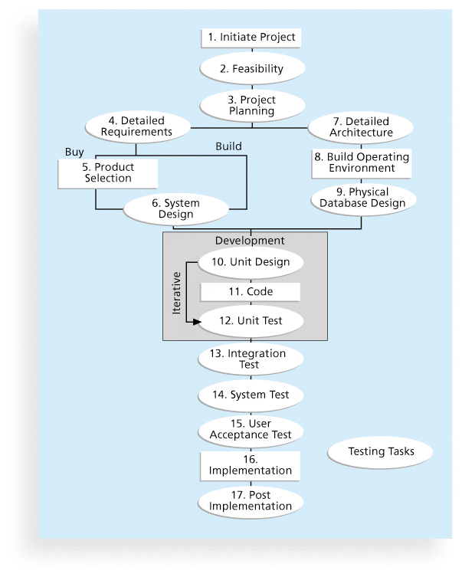
Figure 8-11. Testing Tasks in the Software Development Life Cycle

Slide 23
Types of Tests
Unit testing tests each individual component (often a program) to ensure it is as defect-free as possible
Integration testing occurs between unit and system testing to test functionally grouped components. It ensures that a subset or subsets of the entire system work together.
System testing tests the entire system as one entity. It focuses on the big picture to ensure that the entire system is working properly.
User acceptance testing is an independent test performed by end users prior to accepting the delivered system. It focuses on the business fit of the system to the organization, rather than technical issues.

Slide 24
Testing Alone Is Not Enough
Watts S. Humphrey, a renowned expert on software quality, defines a software defect as anything that must be changed before delivery of the program
Testing does not sufficiently prevent software defects because:
The number of ways to test a complex system is huge
Users will continue to invent new ways to use a system that its developers never considered

Slide 25
ISO Standards
ISO 9000 is a quality system standard that: Is a three-part, continuous cycle of planning, controlling, and documenting quality in an organization
in January 2018, “The ISO 9000 family addresses various aspects of quality management and contains some of ISO’s best known standards. The standards provide guidance and tools for companies and organizations who want to ensure that their products and services consistently meet customer’s requirements, and that quality is consistently improved.” The ISO quality management standards and guidelines have earned a global reputation as the basis for establishing quality management systems.
ISO continues to offer standards to provide a framework for the assessment of software processes. The overall goals of a standard are to encourage organizations that are interested in improving quality of software products to employ proven, consistent, and reliable methods for assessing the state of their software development processes.

Slide 26
Improving Information Technology Project Quality
Several suggestions for improving quality for IT projects include:
Establish leadership that promotes quality
Understand the cost of quality
Focus on organizational influences and workplace factors that affect quality
Follow maturity models

Slide 27
Leadership
As Joseph M. Juran said in 1945, “It is most important that top management be quality-minded. In the absence of sincere manifestation of interest at the top, little will happen below”*
A large percentage of quality problems are associated with management, not technical issues.
*American Society for Quality (ASQ), (www.asqc.org/about/history/juran.html).

Slide 28
The Cost of Quality
The cost of quality is the cost of conformance plus the cost of nonconformance
Conformance means delivering products that meet requirements and fitness for use
Cost of nonconformance means taking responsibility for failures or not meeting quality expectations
A study reported that software bugs cost the U.S. economy $59.6 billion each year and that one third of the bugs could be eliminated by an improved testing infrastructure

Slide 29
Five Cost Categories Related to Quality
Prevention cost: Cost of planning and executing a project so it is error-free or within an acceptable error range
Appraisal cost: Cost of evaluating processes and their outputs to ensure quality
Internal failure cost: Cost incurred to correct an identified defect before the customer receives the product
External failure cost: Cost that relates to all errors not detected and corrected before delivery to the customer
Measurement and test equipment costs: Capital cost of equipment used to perform prevention and appraisal activities

Slide 30
Organizational Influences, Workplace Factors, and Quality
Study by DeMarco and Lister showed that organizational issues had a much greater influence on programmer productivity than the technical environment or programming languages
Study found no correlation between productivity and programming language, years of experience, or salary.
A dedicated workspace and a quiet work environment were key factors to improving programmer productivity

Slide 31
Expectations and Cultural Differences in Quality
Project managers must understand and manage stakeholder expectations.
Expectations also vary by:
Organization’s culture
Geographic regions

Slide 32
Maturity Models
Maturity models are frameworks for helping organizations improve their processes and systems
The Software Quality Function Deployment Model is an adaptation of the quality function deployment model suggested in 1986 as an implementation vehicle for Total Quality Management (TQM). SQFD focuses on defining user requirements and planning software projects. The result of SQFD is a set of measurable technical product specifications and their priorities. Having clearer requirements can lead to fewer design changes, increased productivity, and, ultimately, software products that are more likely to satisfy stakeholder requirements. The idea of introducing quality early in the design stage was based on Taguchi’s emphasis on Robust Design methods.*

Slide 33
Using Software to Assist in Project Quality Management
Spreadsheet and charting software helps create Pareto diagrams, fishbone diagrams, and so on
Statistical software packages help perform statistical analysis
Specialized software products help manage Six Sigma projects or create quality control charts
Project management software helps create Gantt charts and other tools to help plan and track work related to quality management

Slide 34
Chapter Summary
Project quality management ensures that the project will satisfy the needs for which it was undertaken
Main processes include:
Plan quality
Perform quality assurance
Perform quality control

