Slide 1
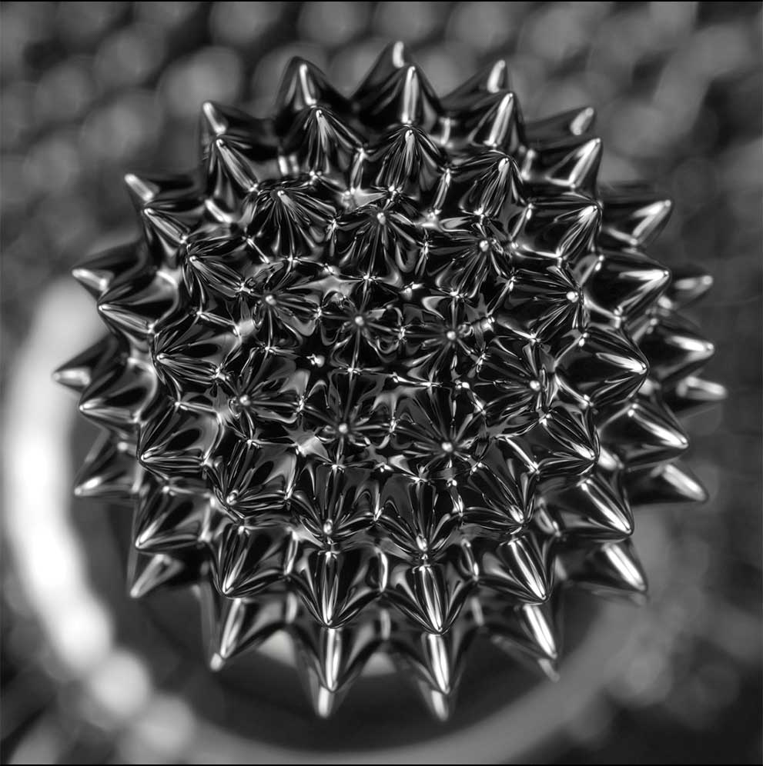
Chapter 12
Physical Properties
of Solutions
MADDRAT/Shutterstock
Copyright 2022 © McGraw Hill LLC. All rights reserved. No reproduction or distribution without the prior written consent of McGraw Hill LLC.

Slide 2
Solutions
A solution is a homogenous mixture of 2 or more substances.
The solute is(are) the substance(s) present in the smaller amount(s).
The solvent is the substance present in the larger amount.
Table 12.1 Types of Solutions
Component 1 | Component 2 | State of Resulting Solution | Examples
Gas | Gas | Gas | Air
Gas | Liquid | Liquid | Soda water (CO₂ in water)
Gas | Solid | Solid | H₂ gas in palladium
Liquid | Liquid | Liquid | Ethanol in water
Solid | Liquid | Liquid | NaCl in water
Solid | Solid | Solid | Brass (Cu/Zn), solder (Sn/Pb)
Table divided into 4 columns summarizes types of solutions. The column headers are marked from left to right as: Component 1, component 2, state of resulting solution, and examples.

Slide 3
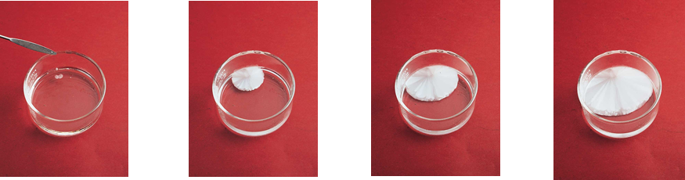
Saturation
A saturated solution contains the maximum amount of a solute that will dissolve in a given solvent at a specific temperature.
An unsaturated solution contains less solute than the solvent has the capacity to dissolve at a specific temperature.
A supersaturated solution contains more solute than is present in a saturated solution at a specific temperature.
Sodium acetate crystals rapidly form when a seed crystal is added to a supersaturated solution of sodium acetate.
Access the text alternative for slide images.
Ken Karp/McGraw-Hill

Slide 4
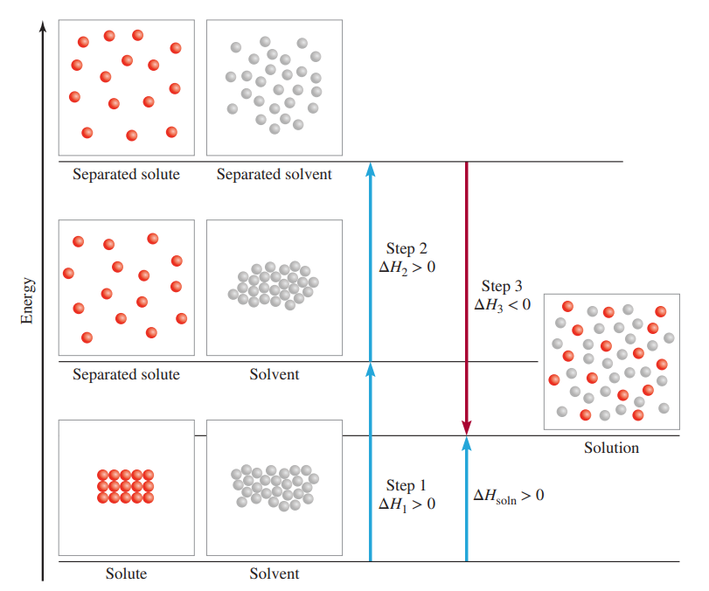
Formation of a Solution
Three types of interactions in the solution process:
solvent-solvent interaction
solute-solute interaction
solvent-solute interaction
Molecular view of the formation of solution
Access the text alternative for slide images.

Slide 5
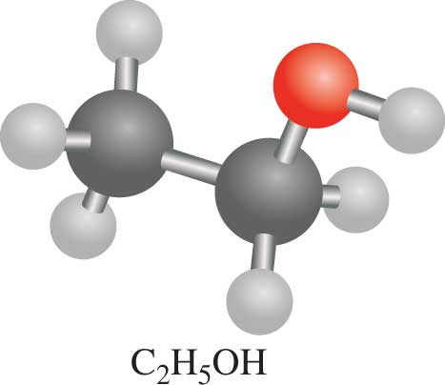
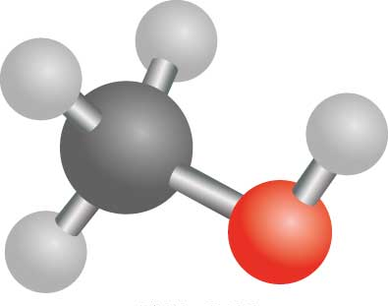
“Like Dissolves Like”
C₂H₅OH
CH₃OH
Two substances with similar intermolecular forces are likely to be soluble in each other.
non-polar molecules are soluble in non-polar solvents
CCl₄ in C₆H₆
polar molecules are soluble in polar solvents
C₂H₅OH in H₂O
ionic compounds are more soluble in polar solvents
NaCl in H₂O or NH₃ (l)

Slide 6
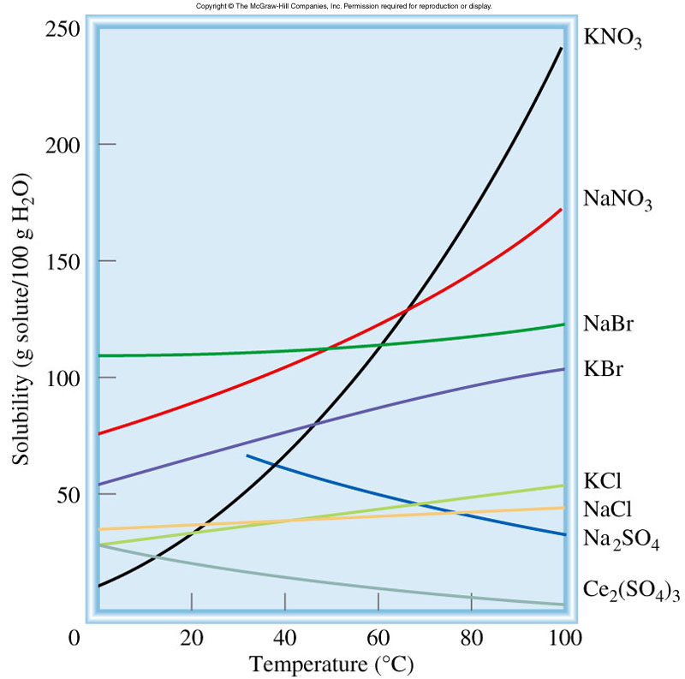
Temperature and Solubility
Solid solubility and temperature
solubility increases with increasing temperature
solubility decreases with increasing temperature

Slide 7
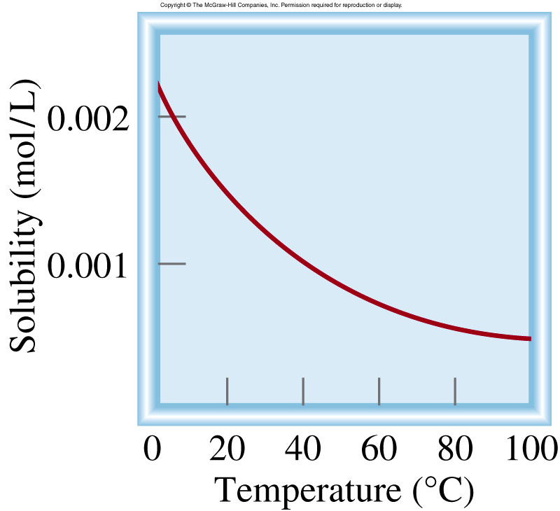
Temperature and Solubility
O₂ gas solubility and temperature
Gas solubility usually decreases with increasing temperature

Slide 8
Concentration Units
The concentration of a solution is the amount of solute present in a given quantity of solvent or solution.
Molarity (M) or molar concentration, which is the number of moles of solute per liter of solution.
moles of solute
M =
liters of solution
Molality (m) is the number of moles of solute dissolved in 1 kg (1000 g) of solvent
moles of solute
m =
mass of solvent (kg)

Slide 9
Comparison of Concentration Units
The advantage of molarity is that it is generally easier to measure the volume of a solution.
For this reason, molarity is often preferred over molality.
Molality is independent of temperature, because the concentration is expressed in number of moles of solute and mass of solvent.
The volume of a solution typically increases with increasing temperature, so that a solution that is 1.0 M at 25 °C may become 0.97 M at 45 °C because of the increase in volume on warming.
This concentration dependence on temperature can significantly affect the accuracy of an experiment. Therefore, it is sometimes preferable to use molality instead of molarity.

Slide 10
What mass of KI is required to make 500 mL of a 2.80 M KI solution?
M KI
M KI
volume of KI solution
moles KI
grams KI
1 L
2.80 mol KI
166 g KI
500 mL
x
x
x
= 232 g KI
1000 mL
1 L soln
1 mol KI

Slide 11
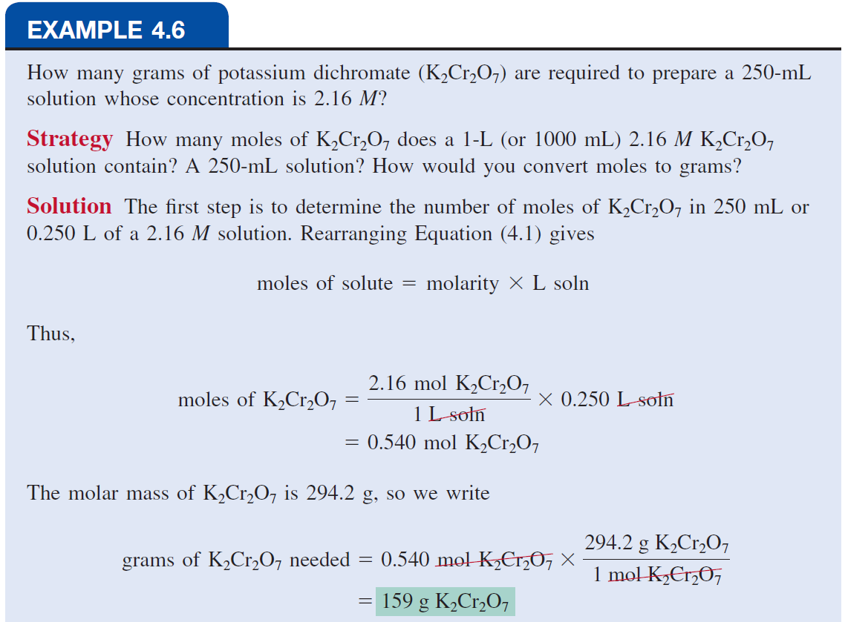

Slide 12
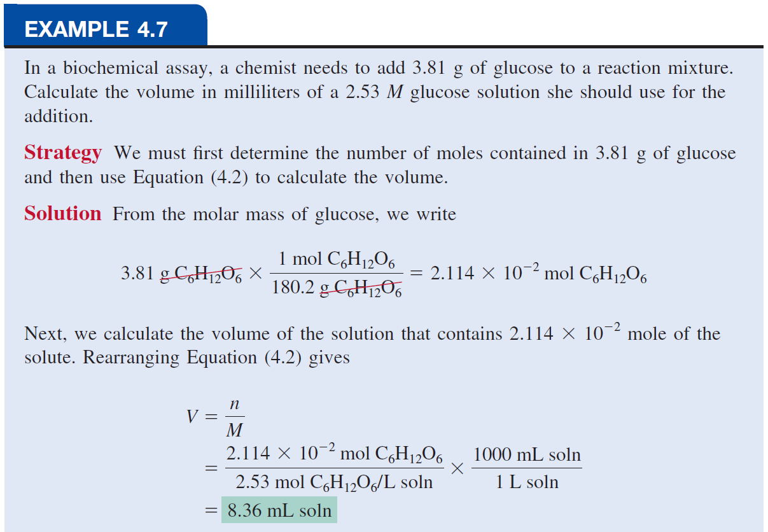

Slide 13
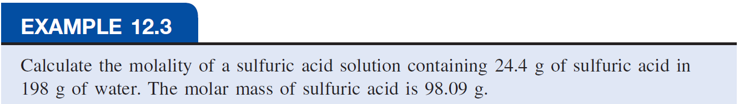
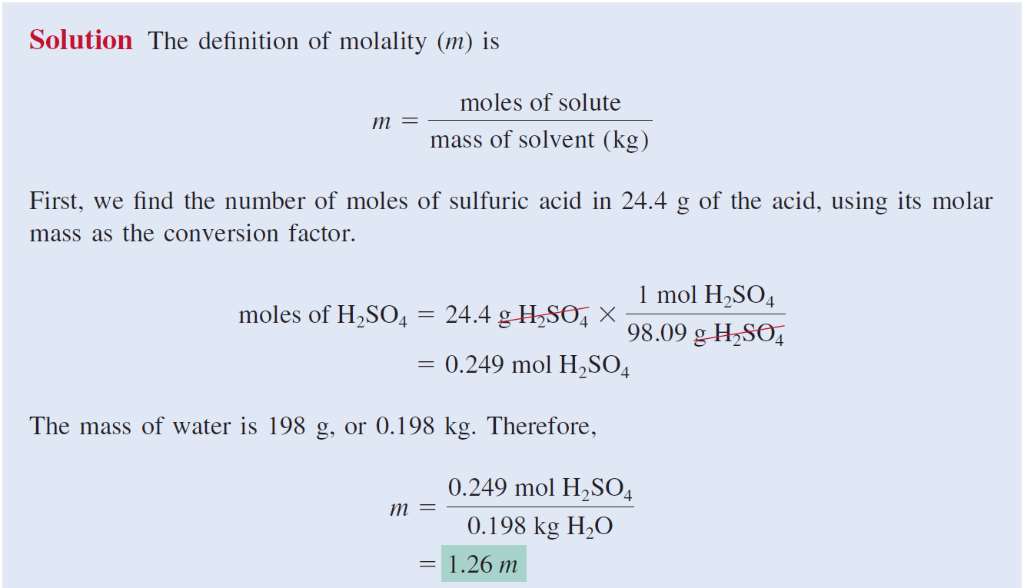

Slide 14
Concentration Units
The Percent by Mass: (also called percent by weight or weight percent) is the ratio of the mass of a solute to the mass of the solution, multiplied by 100 percent:
mass of solute
% by mass =
x 100%
mass of solute + mass of solvent
mass of solute
=
x 100%
mass of solution
Mole Fraction (X): The mole fraction of a component of a solution, say, component A, is written X_{A} and is defined as
moles of A
X_{A} =
sum of moles of all components

Slide 15
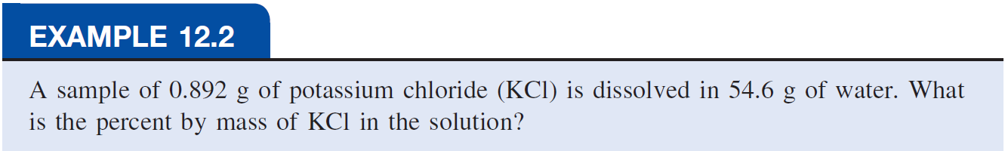
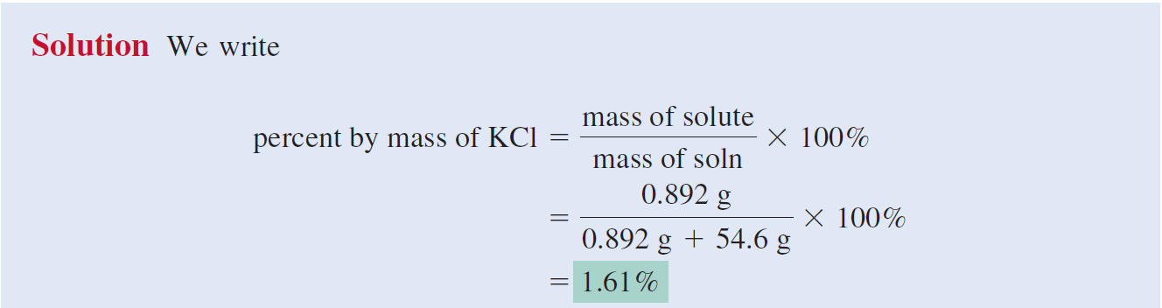

Slide 16
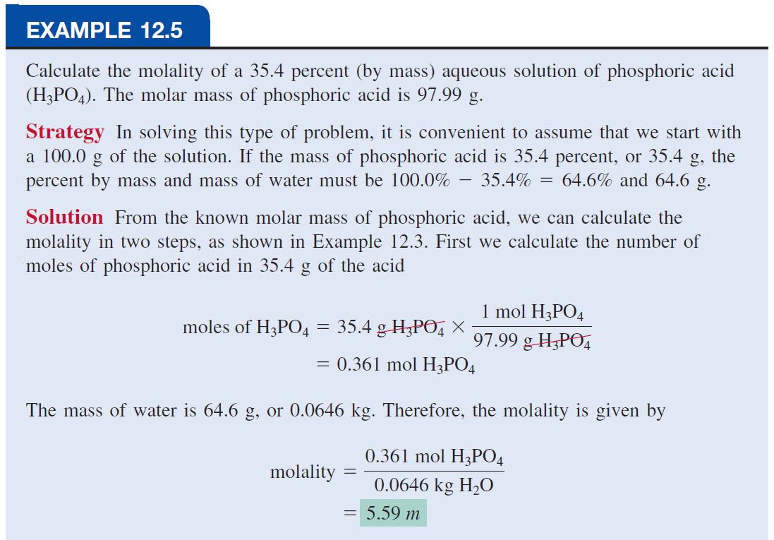

Slide 17
To convert one concentration unit of a solution to another
Example:
Express the concentration of a 0.396 m glucose (C₆H₁₂O₆) solution in molarity? (density of solution = 1.16 g/mL)
0.396 m glucose (C₆H₁₂O₆)
i.e., there is 0.396 mole of glucose in 1000 g of the solvent.
To calculate molarity; we need to determine the volume of this solution.
First, we calculate the mass of the solution from the molar mass of glucose:

Slide 18
The density of the solution is 1.16 g/mL
We can now calculate the volume of the solution in liters
The molarity of the solution is given by

Slide 19
What is the molality of a 5.86 M ethanol (C₂H₅OH) solution whose density is 0.927 g/mL?
moles of solute
moles of solute
m =
M =
mass of solvent (kg)
liters of solution
Assume 1 L of solution:
  5.86 moles ethanol = 270 g ethanol
  927 g of solution (1000 mL x 0.927 g/mL)
mass of solvent = mass of solution – mass of solute
= 927 g – 270 g = 657 g = 0.657 kg
moles of solute
5.86 moles C₂H₅OH
m =
=
= 8.92 m
mass of solvent (kg)
0.657 kg solvent

Slide 20
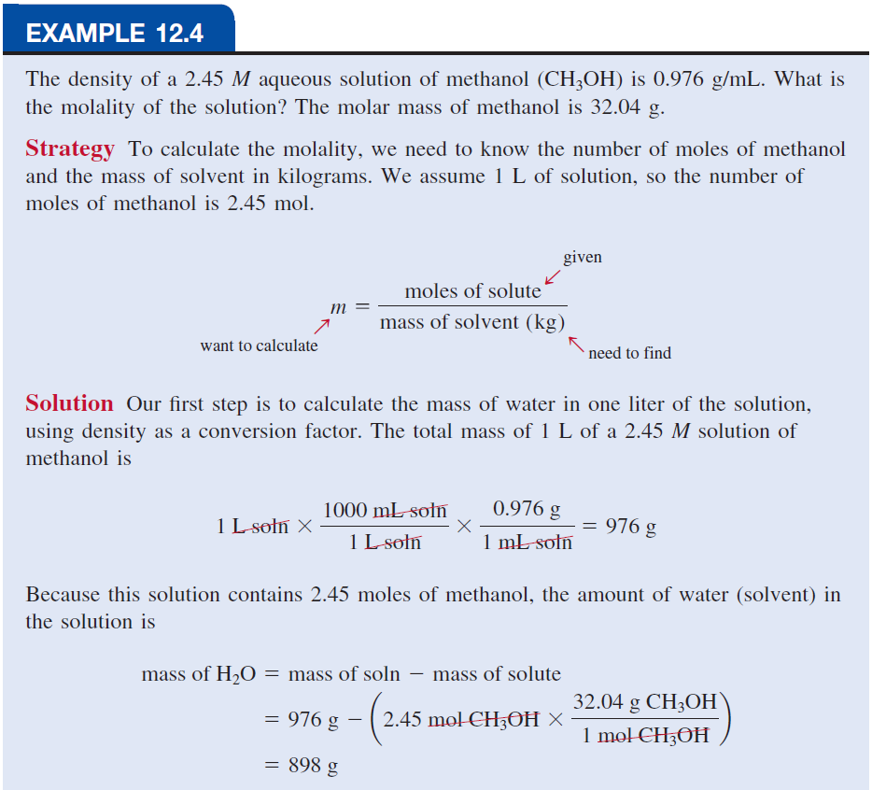
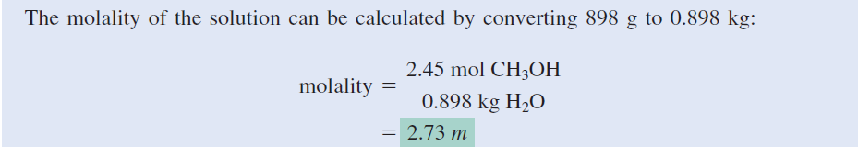

Slide 21
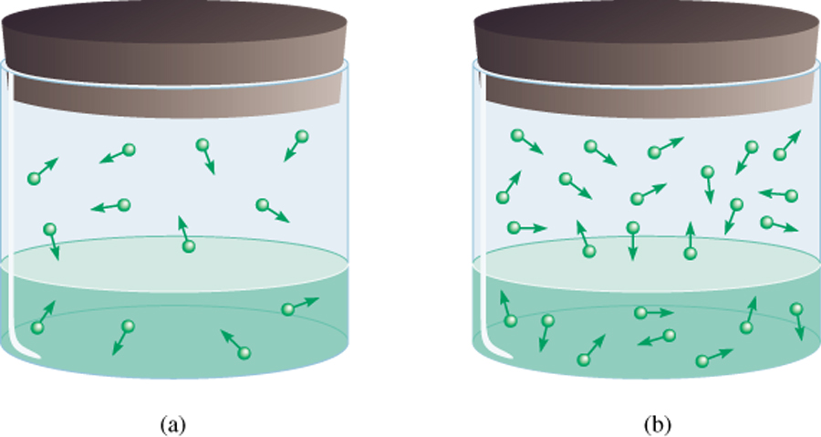
Pressure and Solubility of Gases
The solubility of a gas in a liquid is proportional to the pressure of the gas over the solution (Henry’s law).
c is the concentration (M) of the dissolved gas
c = k_{H} P
P is the pressure of the gas over the solution
k_{H} is a constant for each gas (mol/L•atm) that depends only on temperature
low P
high P
low c
high c

Slide 22
Most gases obey Henry’s law, but there are some important exceptions:
For example, if the dissolved gas reacts with water, higher solubilities can result.
The solubility of ammonia is much higher than expected because of the reaction
Carbon dioxide also reacts with water, as follows:
Another interesting example is the dissolution of molecular oxygen in blood.

Slide 23
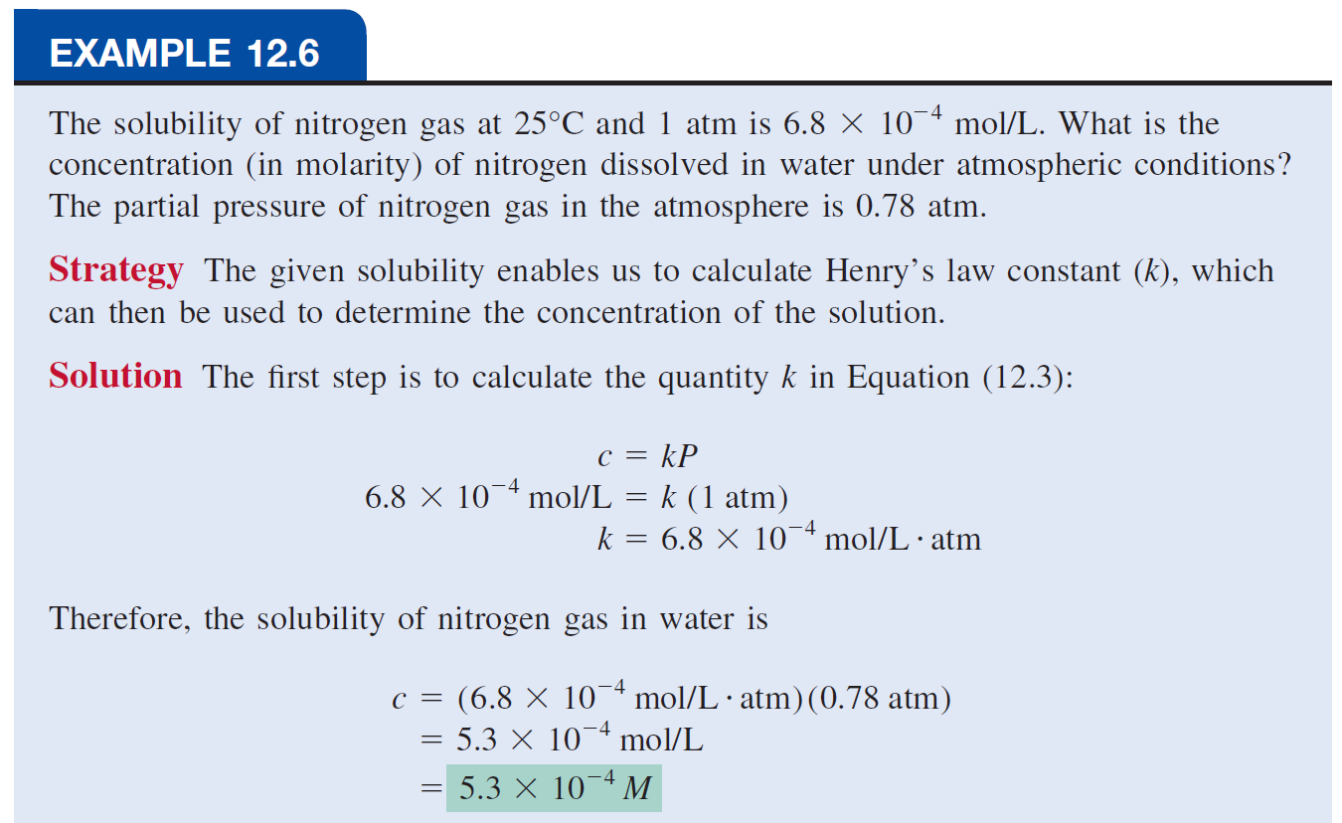

Slide 24
Colligative Properties of Nonelectrolyte Solutions
Colligative properties are properties that depend only on the number of solute particles in solution and not on the nature of the solute particles.
The colligative properties are
vapor-pressure lowering,
boiling-point elevation,
freezing-point depression,
osmotic pressure.

Slide 25
Vapor-Pressure Lowering
0
P₁ = X₁ P₁
0
P₁
= vapor pressure of pure solvent
Raoult’s law
X₁ = mole fraction of the solvent
If the solution contains only one solute:
X₁ = 1 – X₂
0
- P₁ = ΔP = X₂
0
X₂ = mole fraction of the solute
P₁
P₁
We see that the decrease in vapor pressure, ΔP, is directly proportional to the solute concentration (measured in mole fraction).

Slide 26
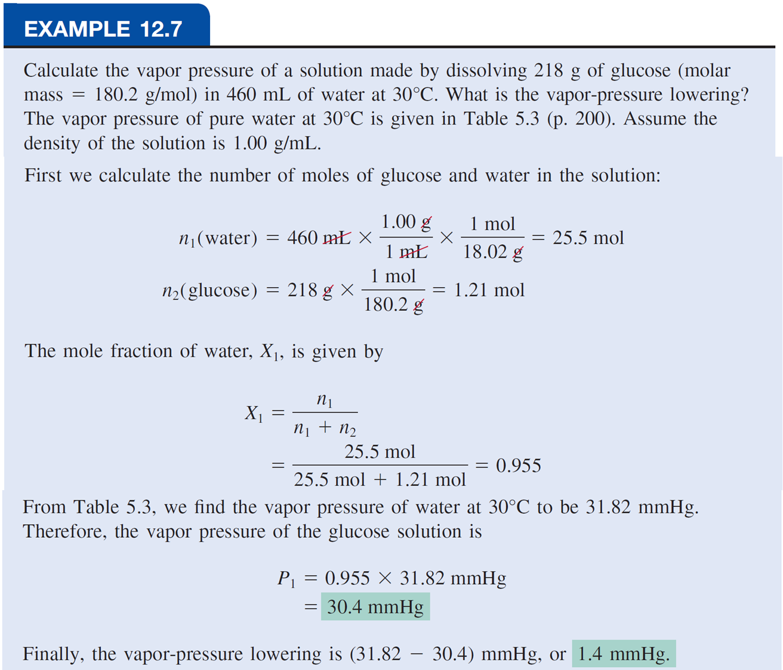

Slide 27
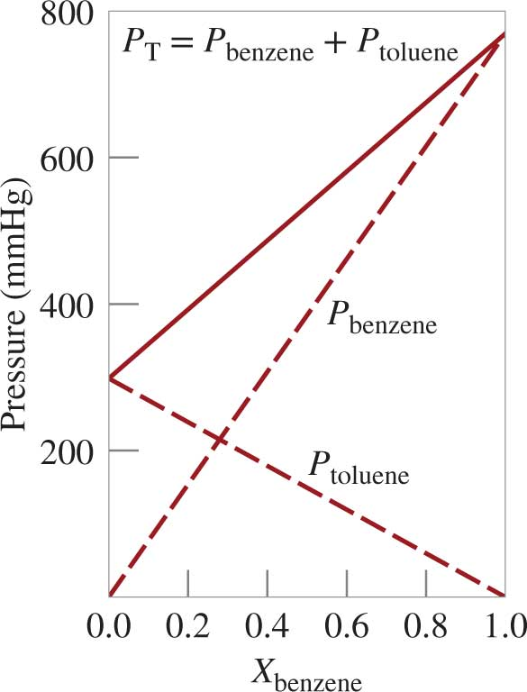
Partial Pressure and Mole Fraction
Access the text alternative for slide images.

Slide 28
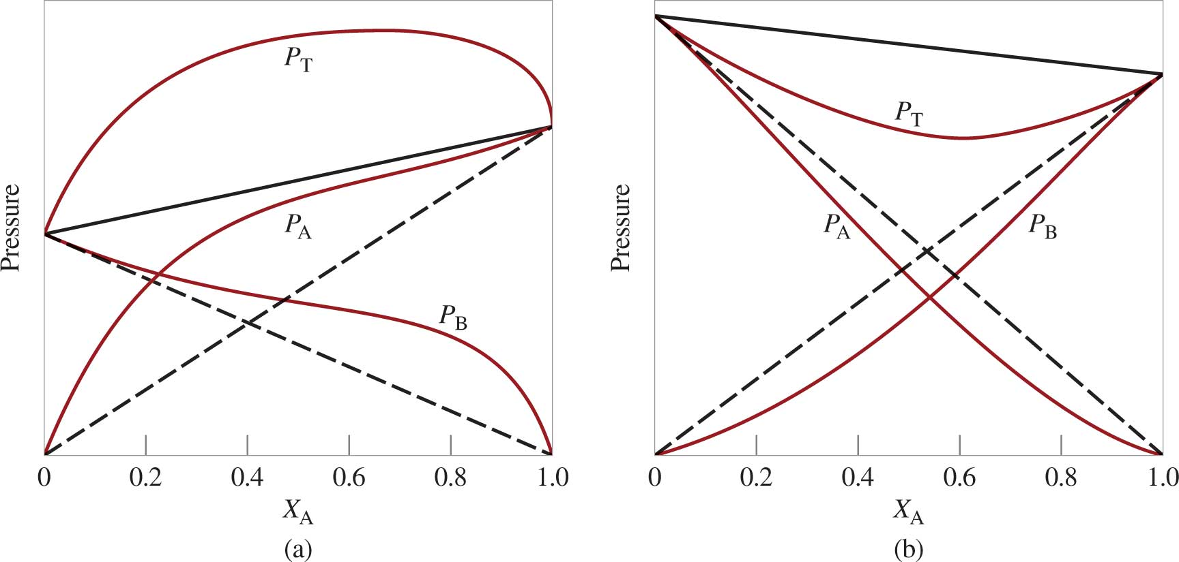
Raoult’s Law
is greater than predicted by Raoult’s law
is less than predicted by Raoult’s law
Access the text alternative for slide images.

Slide 29
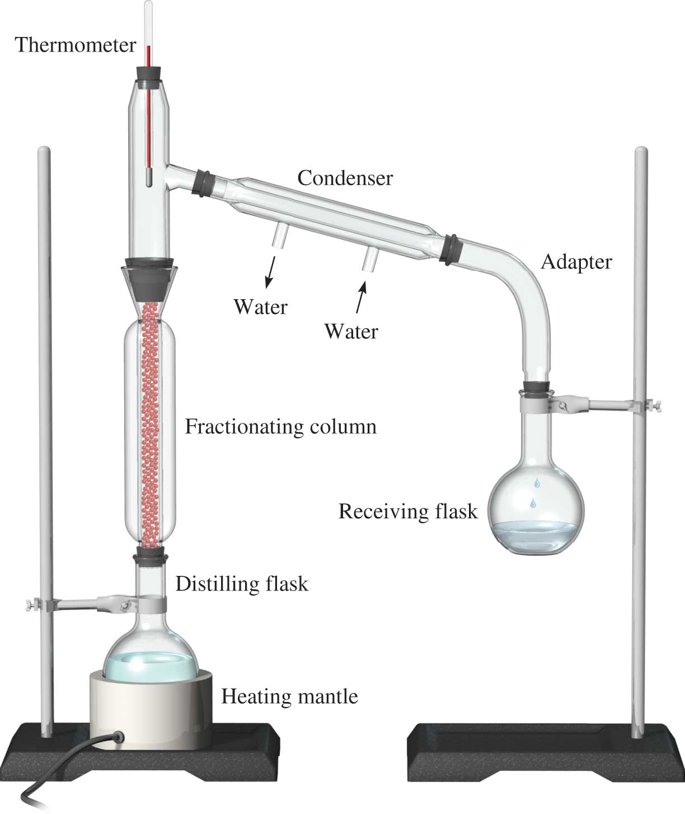
Fractional Distillation Apparatus
Access the text alternative for slide images.

Slide 30
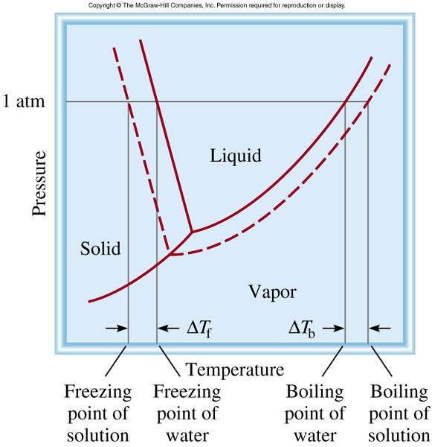
Boiling-Point Elevation
0
ΔT_{b} = T_{b} – T _{b}
0
T _{b} is the boiling point of the pure solvent
T _{b} is the boiling point of the solution
0
ΔT_{b} > 0
T_{b} > T _{b}
ΔT_{b} = K_{b} m
m is the molality of the solution
K_{b} is the molal boiling-point
elevation constant (⁰C/m)
for a given solvent

Slide 31
Freezing-Point Depression
0
ΔT_{f} = T _{f} – T_{f}
0
T _{f} is the freezing point of
the pure solvent
T _{f} is the freezing point of
the solution
0
ΔT_{f} > 0
T _{f} > T_{f}
ΔT_{f} = K_{f} m
m is the molality of the solution
K_{f} is the molal freezing-point
depression constant (⁰C/m)
for a given solvent

Slide 32
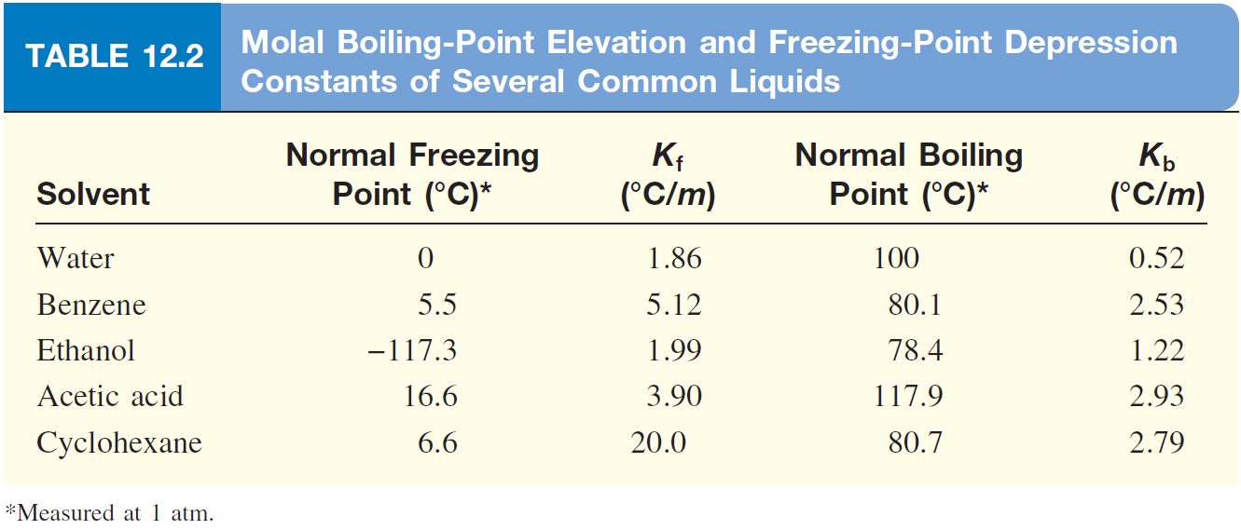

Slide 33
What is the freezing point of a solution containing 478 g of ethylene glycol (antifreeze) in 3202 g of water? The molar mass of ethylene glycol is 62.01 g/mol.
ΔT_{f} = K_{f} m
K_{f} water = 1.86 ⁰C/m
1 mol
478 g x
moles of solute
62.01 g
m =
=
= 2.41 m
mass of solvent (kg)
3.202 kg solvent
ΔT_{f} = K_{f} m
= 1.86 ⁰C/m x 2.41 m = 4.48 ⁰C
ΔT_{f} = T _{f}⁰ – T_{f}
T_{f} = T _{f}⁰ – ΔT_{f}
= 0.00 ⁰C – 4.48 ⁰C = -4.48 ⁰C

Slide 34
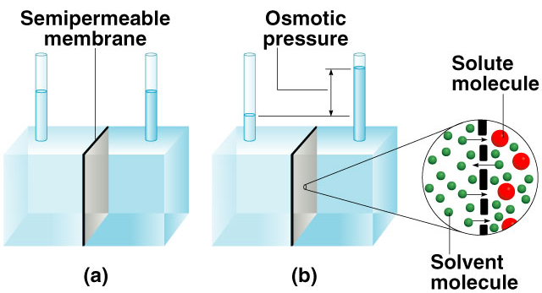
Osmotic Pressure (π)
Osmosis is the selective passage of solvent molecules through a porous membrane from a dilute solution to a more concentrated one.
A semipermeable membrane allows the passage of solvent molecules but blocks the passage of solute molecules.
Osmotic pressure (π) is the pressure required to stop osmosis.
dilute
more
concentrated

Slide 35
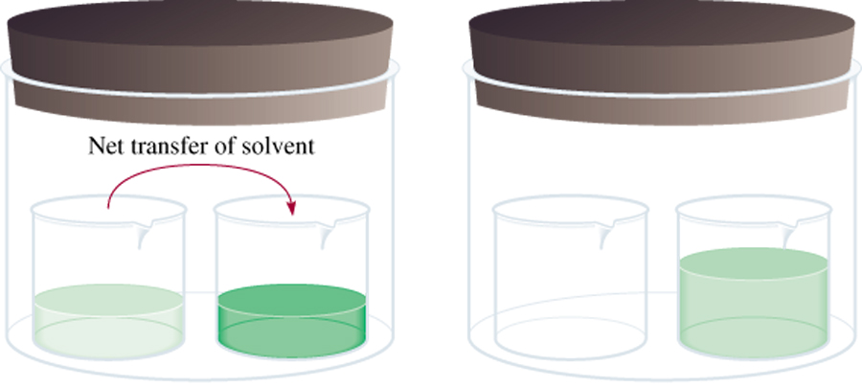
Osmotic Pressure (π)
High
P
Low
P
M is the molarity of the solution
π = MRT
R is the gas constant
T is the temperature (in K)

Slide 36
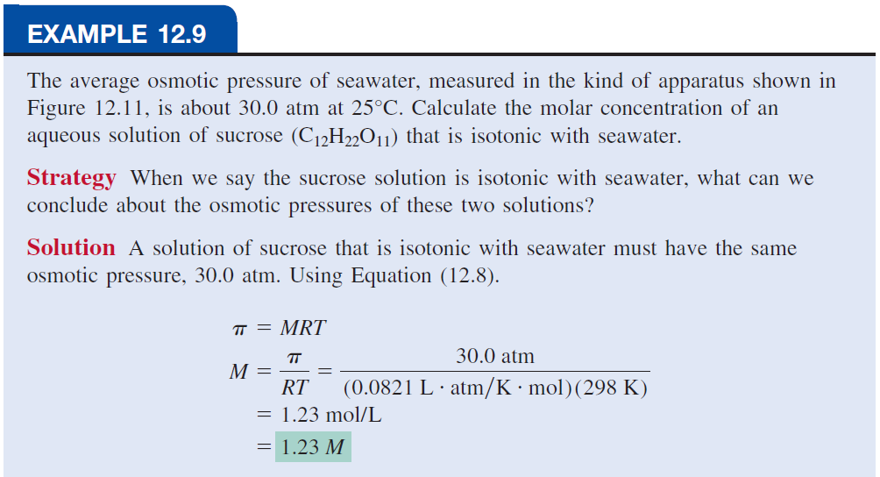

Slide 37
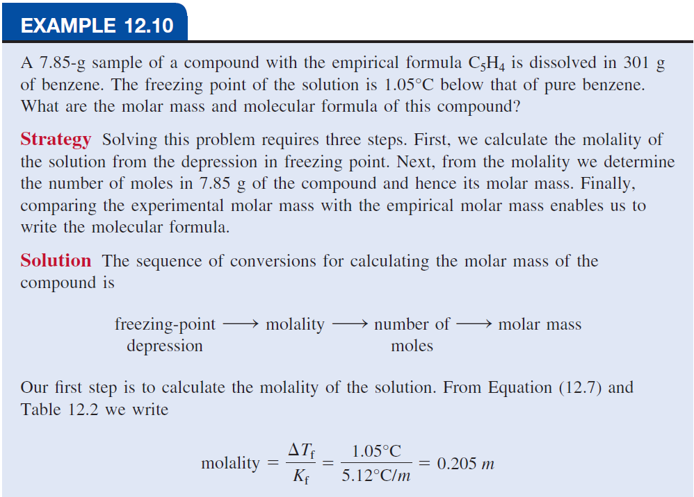
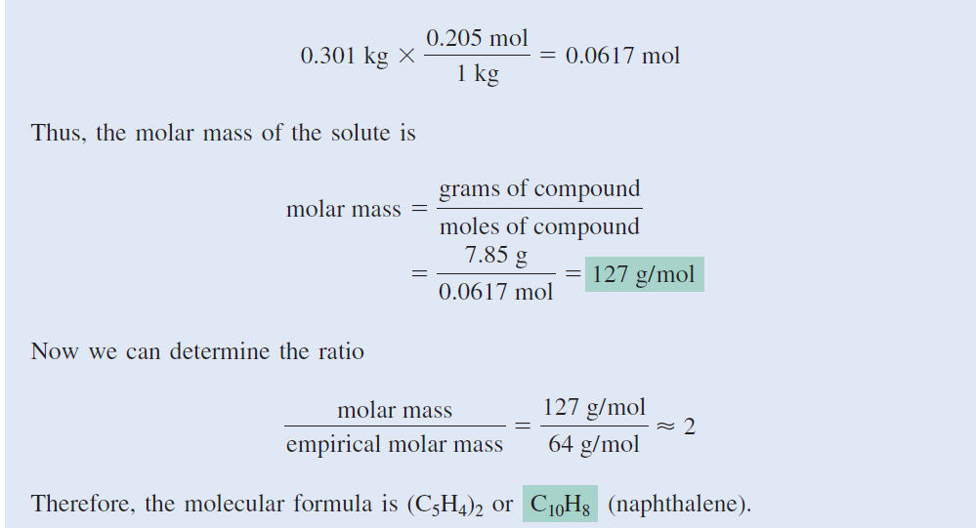

Slide 38
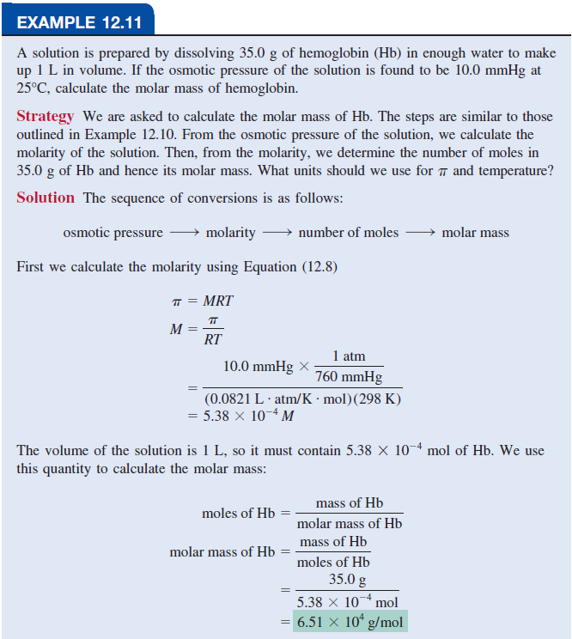

Slide 39
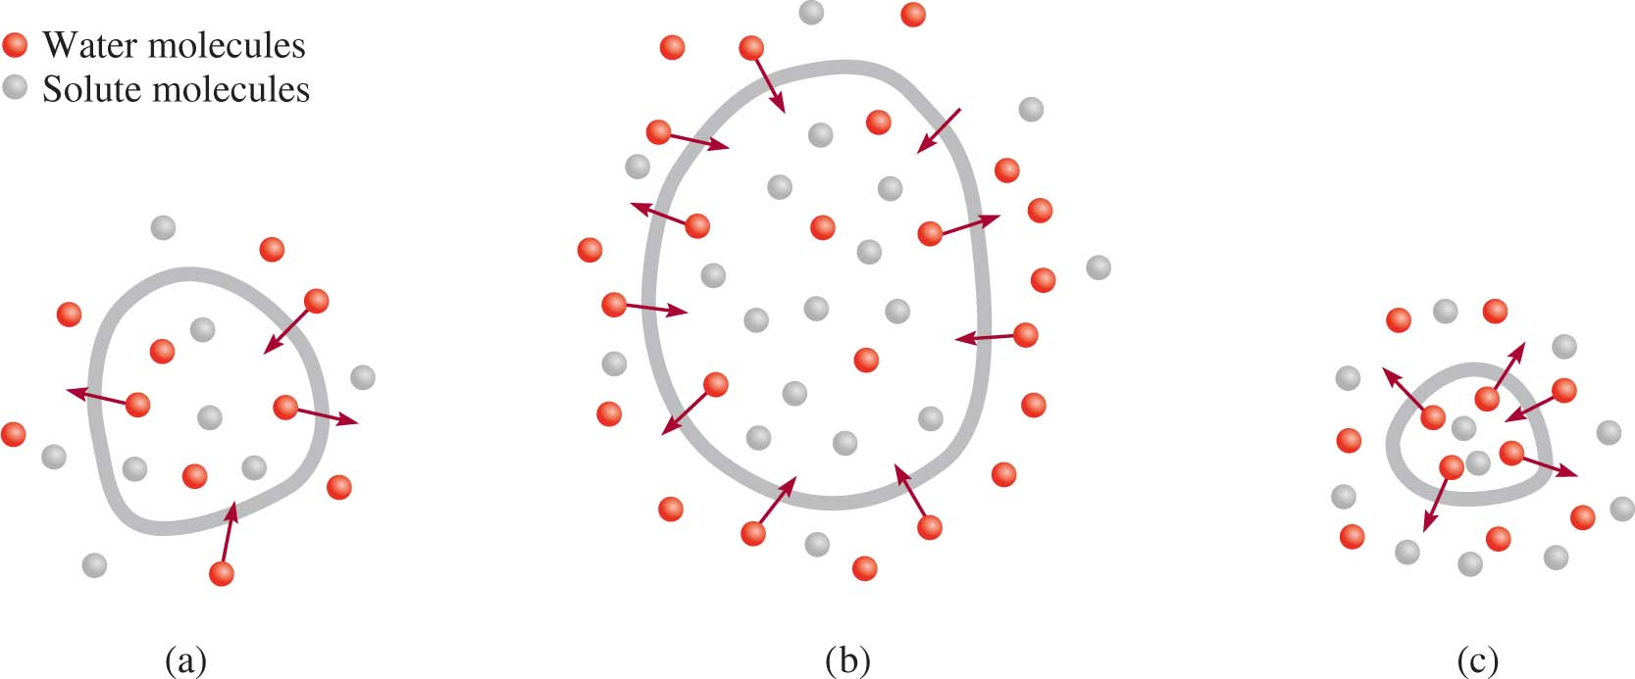
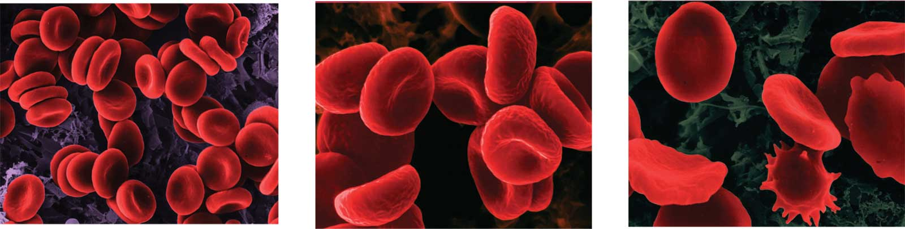
A cell in an:
Dennis Kunkel Microscopy/Science Source

Slide 40
Summary - Colligative Properties of Nonelectrolyte Solutions
Colligative properties are properties that depend only on the number of solute particles in solution and not on the nature of the solute particles.
0
Vapor-Pressure Lowering
P₁ = X₁ P ₁
Boiling-Point Elevation
ΔT_{b} = K_{b} m
Freezing-Point Depression
ΔT_{f} = K_{f} m
Osmotic Pressure (π)
π = MRT
Using Colligative Properties to Determine Molar Mass
From the experimentally determined freezing-point depression or osmotic pressure, We can calculate the molality or molarity of the solution. Knowing the mass of the solute, we can readily determine its molar mass.

Slide 41
Colligative Properties of Electrolyte Solutions 1
Colligative properties are properties that depend only on the number of solute particles in solution and not on the nature of the solute particles.
0.1 m NaCl solution → 0.2 m ions in solution
 | i should be
nonelectrolytes | 1
NaCl | 2
CaCl₂ | 3
Table summary

Slide 42
Colligative Properties of Electrolyte Solutions 2
Boiling-Point Elevation
Boiling-Point Depression
Osmotic Pressure
Table 12.3 The van’t Hoff Factor of 0.0500 M Electrolyte Solutions at 25°C
Electrolyte | i (Measured) | i (Calculated)
Surcose* | 1.0 | 1.0
HCl | 1.9 | 2.0
NaCl | 1.9 | 2.0
MgSO₄ | 1.3 | 2.0
MgCl₂ | 2.7 | 3.0
FeCl₃ | 3.4 | 4.0
Table divided into 3 columns summarizes the Van’t Hoff factor of 0.0500 M electrolyte solutions at 25 degree Celsius. The column headers are marked from left to right as: Electrolyte, i (measured), and i calculated.
*Source is a nonelectrolyte. It is listed here for comparison only.

Slide 43
