Slide 1
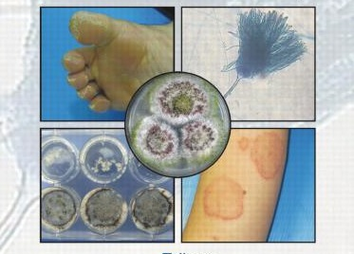
Medical Mycology
470 MIC

Slide 2
Medical Mycology
In this course we will focus on understanding the principle of some clinical techniques used for the identification and diagnosis of fungal infection.

Slide 3
* Basic steps will be addressed before moving to the diagnostic techniques
How to prepare fungus media (CZA and SDA)
Isolation

Slide 4
Fungus media
1-Czapek’s Agar (CZA)
* This is a defined medium primarily for the cultivation of fungi (saprophytic fungi) that are capable of using Sodium Nitrate as their sole source of nitrogen
Composition of the (CZA)
Ingredients | Benefits | Grams/L
Sucrose | a carbohydrate source | 30
Sodium nitrate | Inorganic source of nitrogen | 2
Dipotassium phosphate |  | 1
Magnesium sulfate |  | 0.5
Potassium chloride |  | 0.5
Ferrous sulfate |  | 0.01
Final pH
Final pH (at 25°C) 7.3±0.2
Agar | added as the solidifying agent | 15
Distilled Water |  | 1000

Slide 5
Fungus media
2- Sabouraud agar or Sabouraud dextrose agar (SDA)
*Type of agar growth medium containing peptones
*Commonly used for research and clinical diagnosis
Composition of the (SDA)
Ingredients | Benefits | Grams/L
Peptone | (Enzymatic Digest of Casein and Enzymatic Digest of Animal Tissue) **provide the nitrogen and vitamin source required for fungal growth | 10
Dextrose | a carbohydrate source which serves as a growth stimulant | 40
Agar | added as the solidifying agent | 15
Distilled Water |  | 1000 ml
Final pH
( at 25°C)
5.6±0.2

Slide 6
Fungus media
3-Potato dextrose agar (PDA)
* A general-purpose media for yeasts and fungus
* Can be supplemented with antibiotics to inhibit bacterial growth
* Use a specified amount of sterile tartaric acid (10%) to lower the pH of this medium which inhibits bacterial growth.
Composition of the (PDA)
Ingredients | Benefits | Grams/L
Potatoes infusion | provides a nutrient base for the growth of most fungi | 200
Dextrose | a carbohydrate source which serves as a growth stimulant | 20
Agar | added as the solidifying agent | 15
Distilled Water |  | 1000 ml
Final pH
( at 25°C)
5.6±0.2

Slide 7
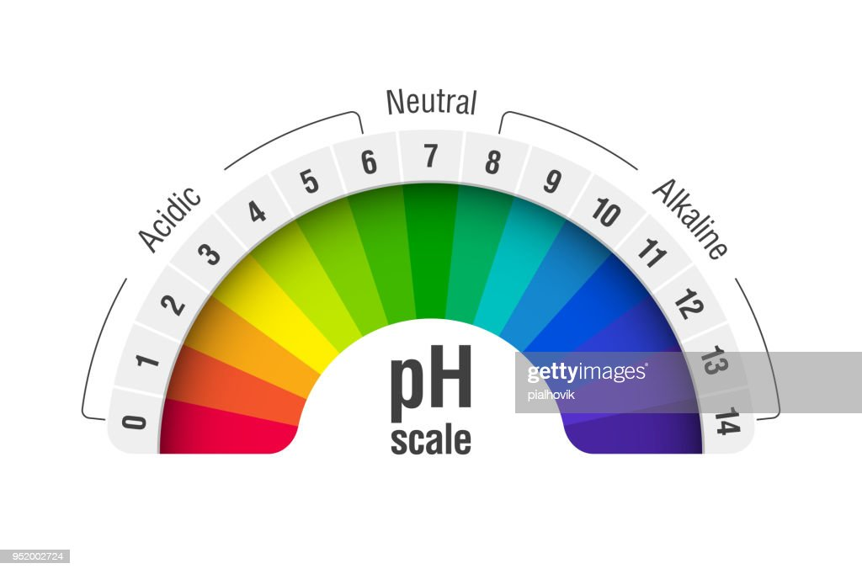
Weigh all the ingredients (gram/L)
Suspend all the ingredients in 1000 ml distilled water.
Even though we follow a precise protocol (recipe) to make any media, we still need to make sure that the of this media is suitable for fungal growth.
How to adjust the pH?
Determine the pH level you have using pH Meter.
Add either an acidic or alkaline substance to the media
To increase the pH use few drops of (0.1 M) Sodium Hydroxide(NaOH)
To lower the pH use few drops of (0.1 M) hydrochloric acid (HCL)
PH Adjustment - YouTube

Slide 8
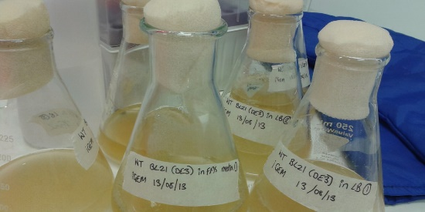
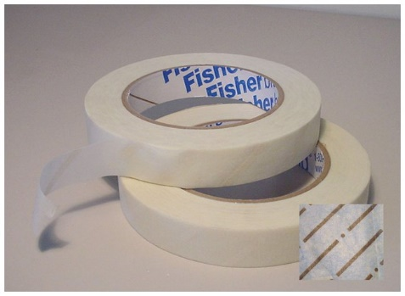
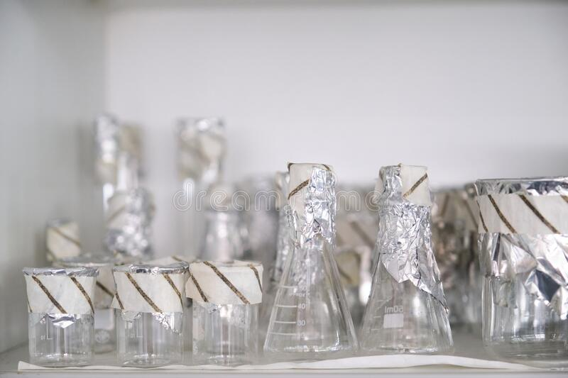
After adjusting the pH
Use cotton plug and foil to close the flask (you can use Bottle with cap)
Label your flask with:
Tape that has (your name- media type- date)
Autoclave tape that changes color upon appropriate
sterilization
If necessary, use warm water bath to dissolve the medium completely.
Sterilize by autoclaving at 15 lbs pressure (121°C) for 20 minutes.

Slide 9
In specific clinical work, when pH 3.5 is required, the medium should be acidified with sterile 10% tartaric acid
Antibiotics can be added to create selective culture
In this case:
Prepare the media as described , autoclave , then add acid/antibiotics
And finally pour the media immediately.
DO NOT heat the media after adding the acid/antibiotics.

Slide 10
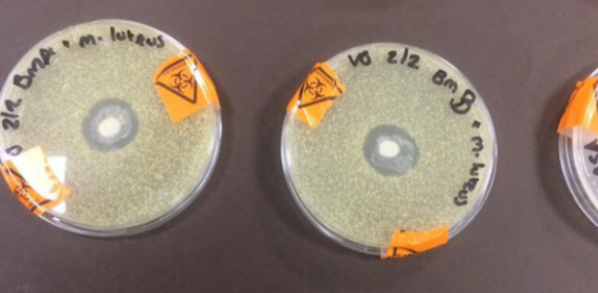
Use a marker to briefly label the edge of petri dishes (name-date- experiment)
Example; Haya, 3/9, isolation/ or purification…etc
** label the bottom of the plate only, NEVER label the lid
Pour the sterile media in petri dishes and wait until the media is completely solidify.

Slide 11
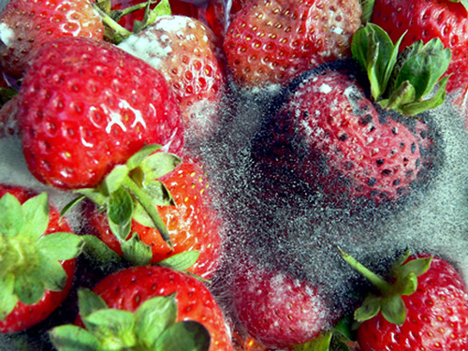
Isolation (from plants/fruits)
Under sterile conditions, use the appropriate tools to inoculate part of the fungal growth in suitable media
In Microbiology labs, the most common tools used for this purpose is the inoculating needles.
Needles can be used if there is visible mycelium/ spores

Slide 12
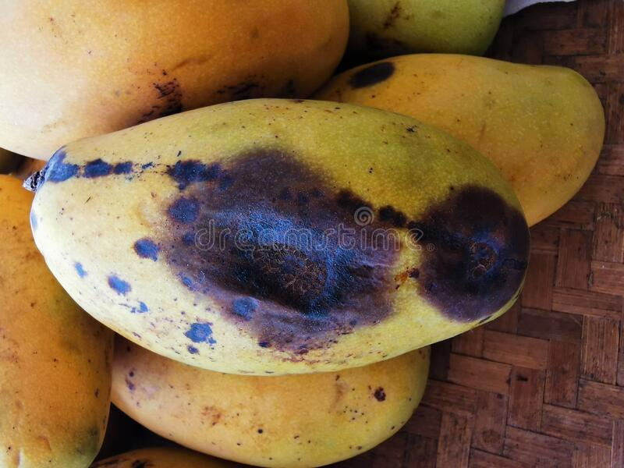
If you don’t see visible mycelium/spores, use sterile scalpel and forceps to cut small section of the rotten tissue and plate it.
Incubate at 25-28ºC for several days (keep tracking incubated plates to avoid overgrowth).

