Slide 1
Medical Mycology
470 MIC

Slide 2
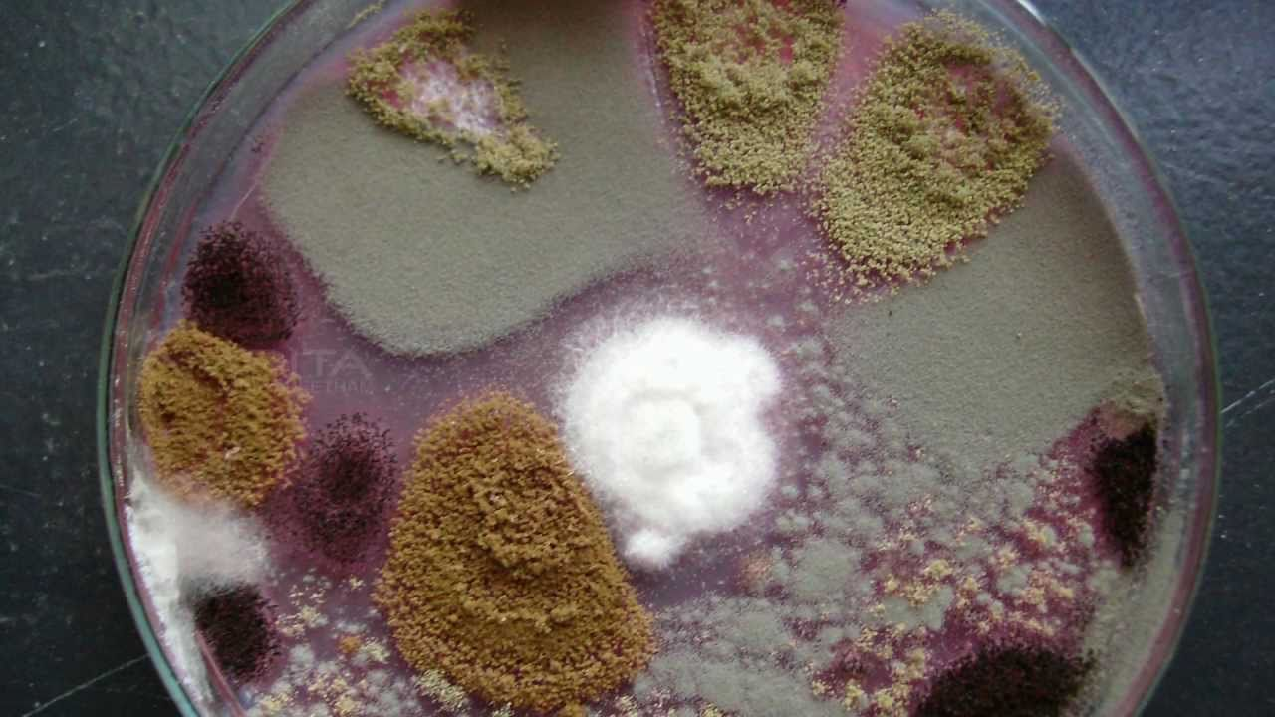
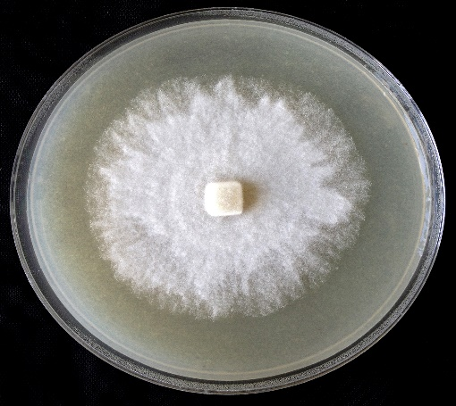
Fungus culture Purification
Disk method
Label your plate ( as you can’t invert it post the purification process)
Use sterilized glass Pasteur pipettes to cut out a disk from the margin of the fungal colony
Use sterile forceps to invert the disk at the center of new plate (growth side should face the media)
** to make sure the fungus has access to all the nutrition required for an ideal growth
Incubate as required

Slide 3
What is the purpose of the purification process (sometimes known as subculturing process)
A)-Characteristics (identification) of an infectious agent
1. Colony morphology (shape, margin, color)
** It has limited value in identification of fungal growth because most fungus show different morphological features on different media.
2. Microscopic observation
using common staining reagent : Lactophenol cotton blue and use 40X objective to describe (septate /aseptate (non-septate hyphae), conidia shape
B)-To maintain viability.

Slide 4
(2) How to prepare a Scotch tape slide for fungal micromorphology assessment - YouTube
Notes:
septate /aseptate (Non-septate hyphae, spores/ conidia shape

Slide 5
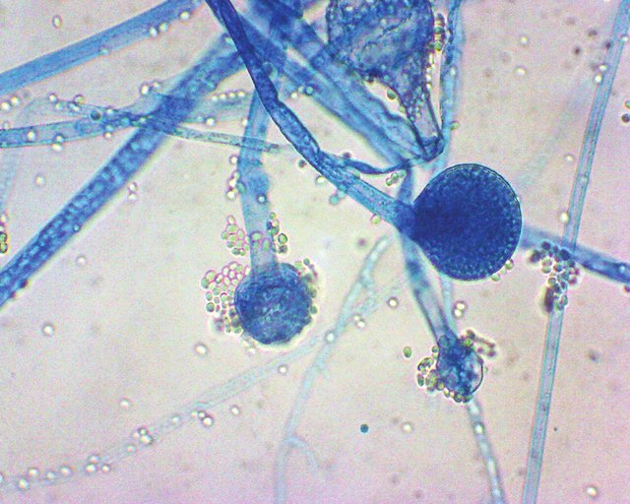
The following microscopic criteria are used to make a genus/species identification of the fungal isolate
Determine the structure of the hyphae. Are they : Septate or aseptate
Branching or not branching
Pigmented or not pigmented
The size, shape, and arrangement of the spores

Slide 6
For the next lab

Slide 7
Isolation of human samples for laboratory diagnosis of fungal infections
1-Specimens collection:
* Use sterile tools (forceps, scissors, nail clipper, swaps)
Skin scrapings, nail clippings and hairs can be collected and transported to the lab in an envelope (dark color card- Why?)
To dry out the sample which can help to reduce the level of bacterial contamination
For easy visualization
- The card then, must be folded, sealed, and labeled.

Slide 8
1-Specimens collection:
*Petri dish, or plastic containers can be used ( also need to be sealed and labeled)
* Use parafilm to seal Petri dish and the plastic containers
2. Specimens from mucous membrane (ex. mouth) may be directly inoculated in culture medium or smeared on clean slide by swab or culture loop.
** collect the samples 24h before the lab

Slide 9
Mycology Specimen Collection Part 2 - YouTube
Skin Scraping for Fungal identification - YouTube

