Slide 1



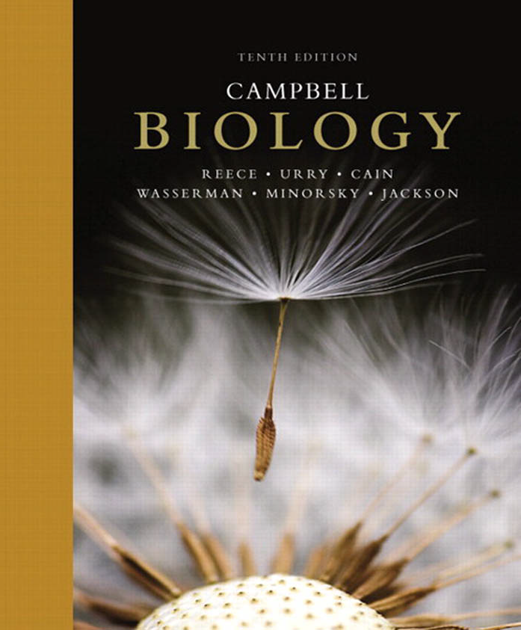
علم الأحياء
College of Science,
Zoology Department

Slide 2
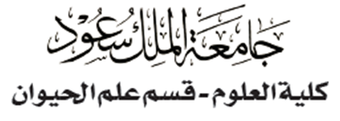


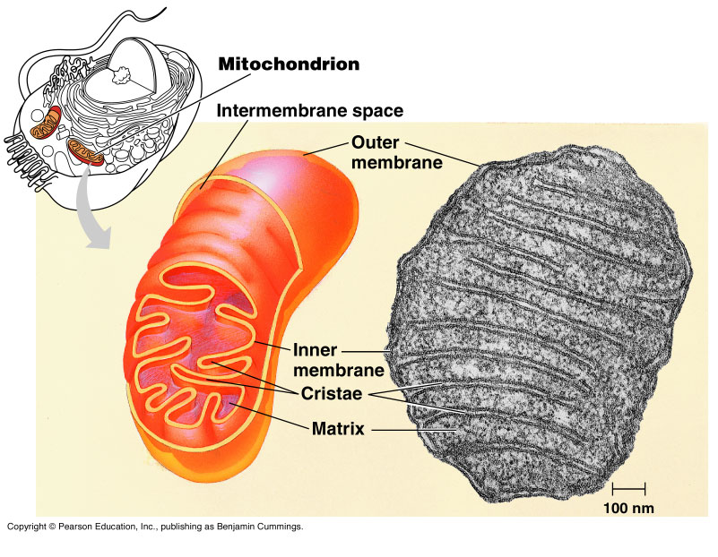
CELLULAR RESPIRATION: Oxidative Phosphorylation and the Electron Transport Chain
Copyright © 2002 Pearson Education, Inc., publishing as Benjamin Cummings

Slide 3


Objectives
Oxidative Phosphorylation and the Electron Transport Chain
  Electron transport chain (The Pathway of Electron Transport).
  Chemiosmosis (the Oxidative Phosphorylation)
Fermentation and anaerobic respiration: enable cells to produce ATP without the use of oxygen:
  Types of Fermentation.
Comparing Fermentation (Anaerobic Respiration) with Aerobic Respiration
The catabolism of various molecules from food

Slide 4
3- Electron transport chain: (oxidative phosphorelation)
Only 4 of 38 ATP ultimately produced by respiration of glucose are derived from substrate-level phosphorylation: 2 from glycolysis (in the cytoplasm) and 2 from Krebs Cycle (in the mitochondrial matrix).
The vast majority of the ATP (90%) comes from the energy in the electrons carried by NADH and FADH₂.
The energy in these electrons is used in the electron transport chain to power لتدعم ATP synthesis.
Thousands of copies of the electron transport chain are found in the extensive surface of the cristae (the inner membrane of the mitochondrion).
Electrons drop in free energy as they pass down the electron transport chain.
Copyright © 2002 Pearson Education, Inc., publishing as Benjamin Cummings

Slide 5
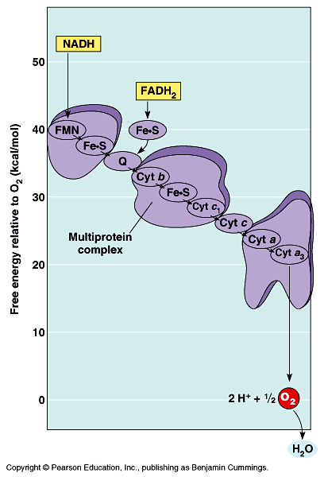
Electron transport chain
Electrons carried by NADH are transferred to the first molecule in the electron transport chain (the flavoprotein; FMN).
The electrons continue along the chain which includes several Cytochrome proteins and one lipid carrier.
The electrons carried by FADH₂ have lower free energy and are added to a later point in the chain.
Electrons from NADH or FADH₂ ultimately pass to oxygen.
The electron transport chain generates no ATP directly. Rather, its function is to break the large free energy drop from food to oxygen into a series of smaller steps that release energy in manageable amounts كميات مناسبة.
Fig. 9.13

Slide 6
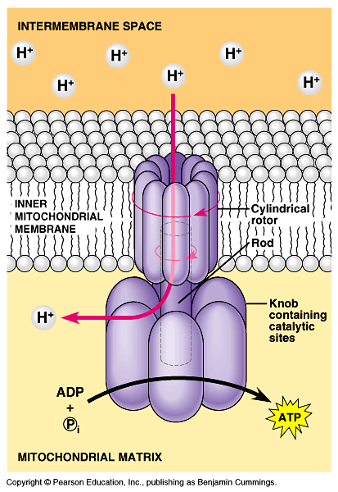
Electron transport chain
ATP-synthase, in the cristae actually makes ATP from ADP and P_{i}.
It uses the energy of an existing proton gradient to power ATP synthesis.
  This proton gradient develops between the inter-membrane space and the matrix.
  This concentration of H⁺ is called: proton-motive force.
The ATP synthase molecules are the only place that will allow H⁺ to diffuse back to the matrix (exergonic flow of H⁺).
This flow of H⁺ is used by the enzyme to generate ATP in a process called “Chemiosmosis”.
Chemiosmosis: (osmos = puch)
It is the oxidative phosphorelation that results in ATP production in the inner membrane of mitochondria.

Slide 7
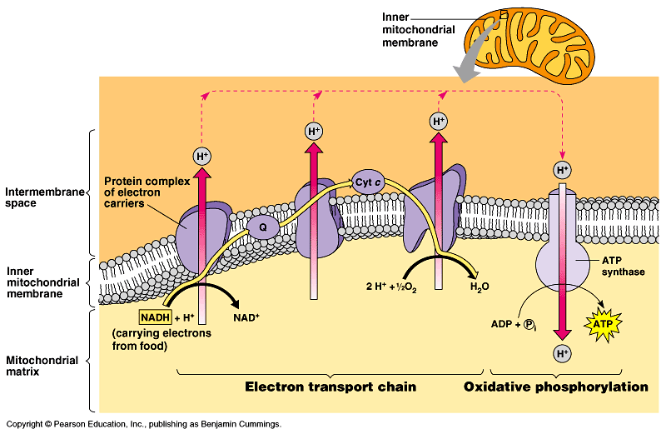
Energy carried by NADH and FADH₂ give a maximum yield of 34 ATP is produced by oxidative phosphorylation.

Slide 8
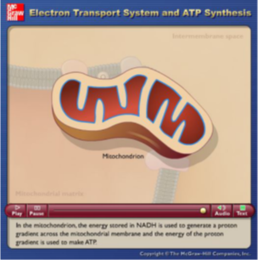
Video: plays in LMS

Slide 9
Summary: Cellular respiration generates many ATP molecules for each sugar molecule it oxidizes
During respiration, most energy flows from glucose NADH electron transport chain proton-motive force ATP.
Some ATP is produced by substrate-level phosphorylation during glycolysis and the Krebs cycle, but most ATP comes from oxidative phosphorylation (through electron transport chain).
Energy produced in Glycolysis and Krebs cycle gives a maximum yield of 4 ATP by substrate-level phosphorylation.
Energy produced in electron transport chain gives a maximum yield of 34 ATP by oxidative phosphorylation via ATP-synthase.
Substrate-level phosphorylation and oxidative phosphorylation give a bottom line of 38 ATP.

Slide 10
Summary of Cellular Respiration
- Glycolysis occurs in the cytosol and breaks glucose into two pyruvates
- Krebs Cycle takes place within the mitochondrial matrix, and breaks
a pyruvate into CO₂ and produce some ATP and NADH.
- Some steps of Glycolysis and Krebs Cycle are Redox in which
dehydrogenase enzyme reduces NAD⁺ into NADH.
- Some of ATP is produced at these two steps via (substrate-level-
phosphorylation).
- Electron Transport Chain accepts e⁻ from NADH and passes these e⁻
from one protein molecule to another.
- At the end of the chain, e⁻ combine with both H⁺ and O₂ to form H₂O
and release energy.
- These energy are used by mitochondria to synthesis 90% of the cellular
ATP via ATP-synthase, a process called Oxidative Phosphorylation, in
the inner membrane of mitochondria.

Slide 11
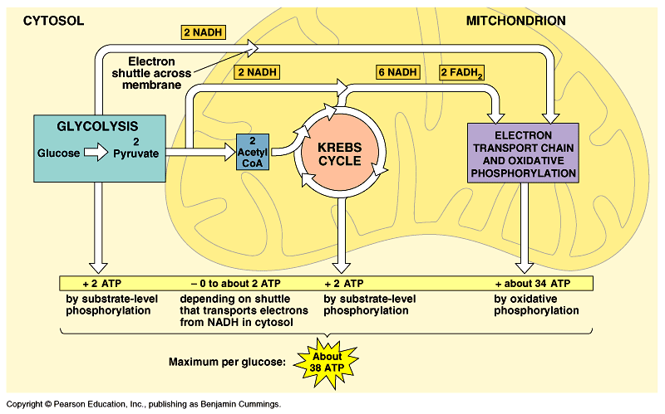
Summary of cell respiration

Slide 12
Summary of cell respiration
Video: plays in LMS

Slide 13
Definitions: تعريفات
Chemiosmosis: a process via which oxidative phosphorylation
takes place at the end of the Electron Transport Chain to produce 90% of ATP via ATP-synthase.
Or, is the process in which ATP synthesis powered by the flow of H+ back across ATP synthase.
ATP-synthase: an enzyme presents in the inner mitochondrial
membrane and used in making ATP by using H+ (protons).
NAD⁺: Nicotinamide adenine dinucleotide, which is a co-enzyme that helps electron transfer during redox reactions in cellular respiration.
FAD: Flavin adenine dinucleotide, which is an electron acceptor that helps electron transfer during Krebs Cycle and Electron Transport Chain in cellular respiration.

Slide 14
Fermentation: Enables يُمَكِن some cells to produce ATP without the help of oxygen
Oxidation refers to the loss of electrons to any electron acceptor, not just to oxygen.
  In glycolysis, glucose is oxidized to 2 pyruvate molecules with NAD⁺ as the oxidizing agent (not O₂).
  Some energy from this oxidation produce 2 ATP.
  If oxygen is present, additional ATP can be generated when NADH delivers its electrons to the electron transport chain.
Glycolysis generates 2 ATP when oxygen is absent (anaerobic لاهوائي).
Anaerobic catabolism of sugars can occur by fermentation.
Fermentation can generate ATP from glucose by substrate-level phosphorylation as long as there is a supply of NAD⁺ (the oxidizing agent) to accept electrons.
  If the NAD⁺ pool is exhausted إسـتـُنفـِذ, glycolysis shuts down.
  Under aerobic هوائى conditions, NADH transfers its electrons to the electron transfer chain, recycling NAD⁺.
Under anaerobic conditions, various fermentation pathways generate ATP by glycolysis and recycle NAD⁺ by transferring electrons from NADH to pyruvate.

Slide 15
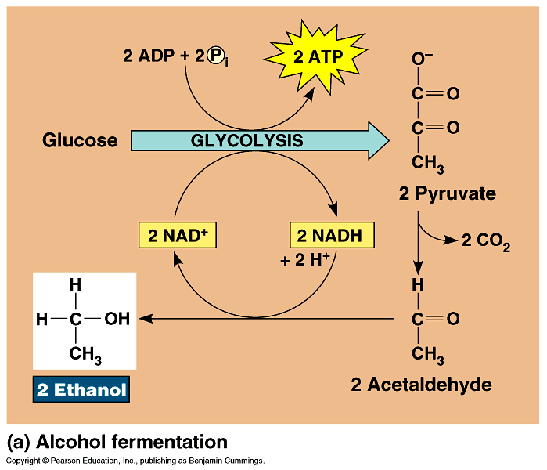
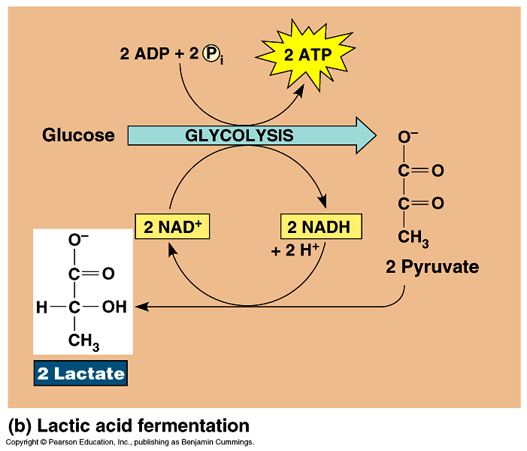
Fermentation
Alcohol fermentation: the pyruvate is converted to ethanol in two steps.
  First, pyruvate is converted to acetaldehyde by the removal of CO₂.
  Second, acetaldehyde is reduced by NADH to ethanol.
  Alcohol fermentation by yeast is used in
  wine-making.
Lactic acid fermentation: the pyruvate is reduced directly by NADH to form lactate (ionized form of lactic acid).
  Lactic acid fermentation by some fungi and bacteria is used to make cheese and yogurt.
  Muscle cells switch from aerobic respiration to lactic acid fermentation to generate ATP when lack of O₂ (O₂ is scarce نادر)
    The waste product, lactate, may cause
    muscle fatigue, but ultimately it is
    converted back to pyruvate in the liver.

Slide 16
Examples of anaerobic respiration:
A)- During exercise our bodies require a lot of energy
  The body can only supply a limited amount of oxygen for cellular respiration.
  Energy is not produced at the rate required.
  Cells will use anaerobic respiration to release extra energy
  This produces lactic acid (a waste product).
B)- We use yeast to make bread
CO₂ produced causes bread to rise by creating air pockets
The ethanol (alcohol) produced is evaporating during baking

Slide 17
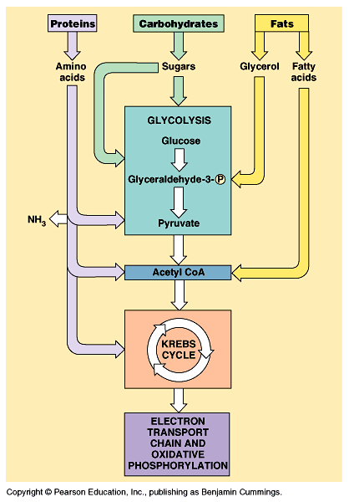
Fat and Protein Breakdown
Fats
have more energy per gram than carbohydrates or proteins.
fatty acid chains are oxidized and broken into smaller 2 carbon chains.
the 2 carbon chains are converted into acetyl CoA to enter the Kreb’s cycle.
Proteins
must be converted into individual amino acids.
excess amino acids are converted by enzymes into intermediated of glycolysis and Krebs cycle.
amino acids go through deamination (amino groups are removed)
nitrogenous wastes from the amino groups are released as wastes.
new compounds enter glycolysis or Krebs.

Slide 18
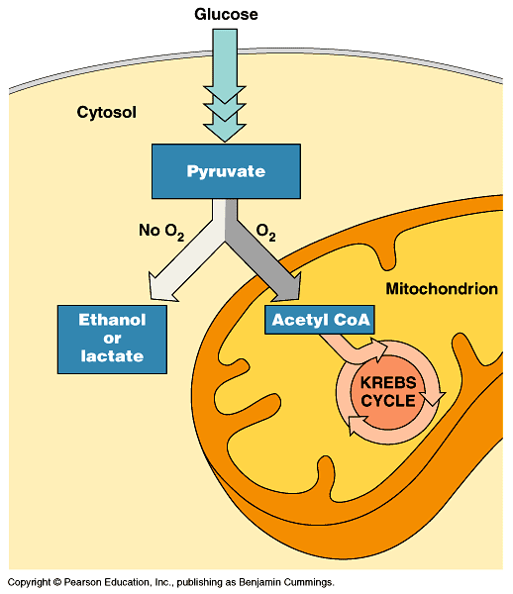
Some organisms (facultative anaerobes اللاهوائية اختياريا), including yeast and many bacteria, can survive using either fermentation or respiration.
At a cellular level, human muscle cells can behave as facultative anaerobes, but nerve cells cannot.
Proteins and fats, can also enter the respiratory pathways, including glycolysis and the Krebs cycle, like carbohydrates.

Slide 19


College of Science,
Zoology Department
General Animal Biology
(Zoo-109)
Zoology Department

