Slide 1
The following are names and descriptions of some fish that have the above characteristics and are known internationally for their suitability for culture
Carp fish
Carp fish is one of the most popular and widely cultured fish in the world, and it ranks first according to (FAO, 2014) statistics. It may even be considered an ideal fish for farming, due to its following characteristics:
1- It has a high growth rate
2- Ease of spawning in ponds naturally, where they spawn and give a pretext
throughout the year
3- They can be hatching artificially if this does not happen naturally
4- They adapt to changes in the temperature range, and therefore they are raised in
warm and cold waters
5- Adapt to water pH level changes
6- Resists many fish diseases
7- Fish of a variety of nutrition
8- It has the ability to live in turbid and stagnant waters
9- Suitable for the producer or breeder who starts the fish farming process for the first
time

Slide 2
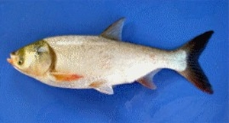
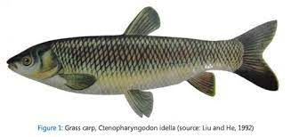
There are three main groups or types of carp: common, Chinese and Indian carp. However, the latter is not preferred in aquaculture because it is easily infected with diseases or has poor resistance to them
First: the common carp (Cyprinus carpio).
It is spread all over the world, but its original habitat is Southeast Asia, and it is a carnivorous fish, as it eats everything available to it at the bottom of the aquarium, and it also feeds on insect larvae and snails.
Second: Chinese carp
It is a group of carp fish native to China, but it has spread
all over the world, including the following species:
A- Silver carp, Hypophthalmichthys molitrix
Silvery fish with small scales scattered over the body, it
feeds on algae and plankton Vegetables and organic
matter suspended in the water. It also accepts ground or
soft processed food only
It reaches large sizes in fish farms (15 kg) and reaches a
length of about a meter, it may not be cast
Popular in some markets due to the large number of
thorns that permeate its muscles
B- grass carp, Ctenopharyngodon idellus
Grass carp fish is considered a dual-use fish, as it is raised for the production of animal protein and at the same time it is used to control aquatic plants and weeds and to purify water channels because of its ability to devour more than half of its weight in weeds.

Slide 3
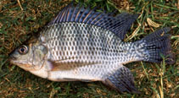
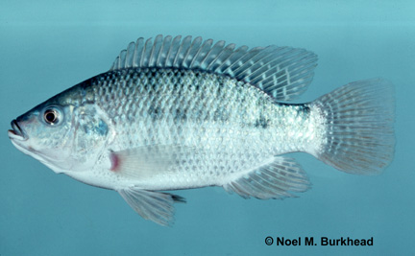
Tilapia fish
It is considered one of the most important cultured fish in the world and is second only to carp, according to statistics (FAO 2014). Although tilapia fish are of African origin, they have achieved great success in farming and spreading all over the world.
This is due to their following characteristics:
1- Easy to raise and fatten, and accept processed foods
2- fast growing
3- They reproduce easily and at high rates, and take good
care of eggs and fry
4- Resist diseases as you don't get them easily
5- It can adapt and live in a large temperature range
6- It tolerates poor aquatic environmental conditions
7- It is characterized by the quality of its meat and the
consumer’s preference for it and its demand for it in all
sizes, small and large, and therefore There is no
problem with marketing it
Tilapia fish includes a wide range of species, the most
important of which are:
A- Nile tilapia Oreochromis niloticus
It is considered a saprotrophic fish and has the ability to
digest green and blue algae. It is receptive to feeding
On manufactured diets in the form of granules
B- Blue Tilapia (Oreochromis aureus)
Blue tilapia can be reared successfully in brackish waters
as they are more resistant to salinity than Nile tilapia
It also withstands low temperatures up to 8C
Oreochromis niloticus
Oreochromis aureus

Slide 4
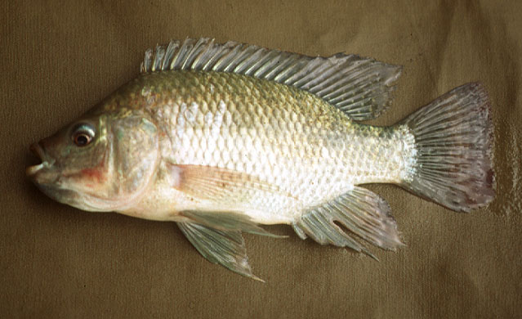
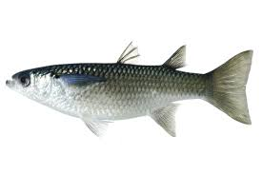
Tilapia and mullet
C- The black tilapia, Oreochromis spilurus
Black tilapia can be successfully bred in brackish water
D- Mozambican tilapia, Oreochromis mossambicus
Mozambique can be successfully bred in brackish water
► Fish of the family Mullet or Bayah (Arabian)
Mugilidae
The fish of the mullet family are marine fish that are
characterized by rapid adaptation to salinity
It can also live in fresh water, but it does not reproduce
or spawn during the mating season
Except in marine waters. The fish of the mullet family
have the following advantages:
1- It can be successfully reared in fresh, brackish or
brackish waters, as it adapts to different degrees of
water salinity
2- It is characterized by a wide thermal range, and
therefore it is widespread in Russia, where the waters
are relatively low temperature
And also in Africa, where the waters are warm and the
temperatures are relatively high

Slide 5
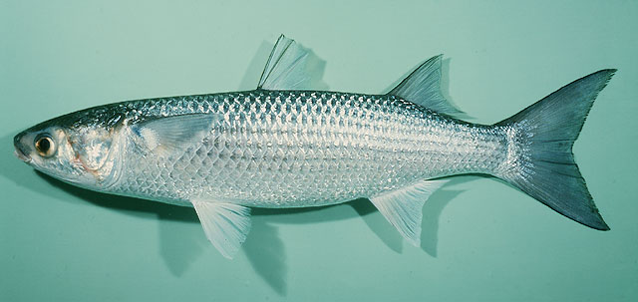
3- It can feed on microplankton and organic matter suspended in the water or on the bottom. It also feeds on microalgae attached to stones and grass, so its breeding may be low the cost
4- It can be successfully reared with Nile tilapia fish, as well as with shrimp
It happens in India
5- The meat of the wild fish family is characterized by the quality of its taste and
the variety of cooking methods, so the consumer accepts it
One of the most important fish of the mullet family
A - Mugil cephalus free mullet B - Tobara Liza ramada (Mugil capito)

Slide 6
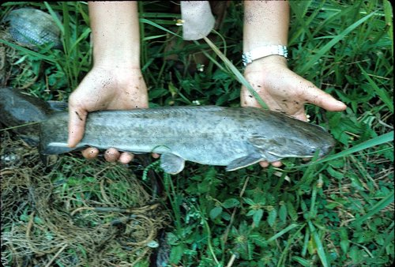
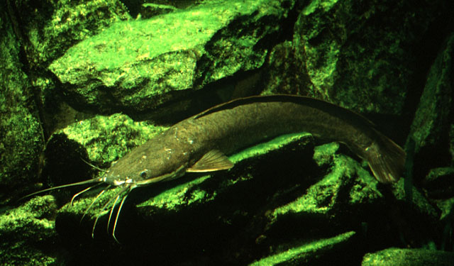
catfish
► Catfishes (Catfishes) of the Clariidae family
They are warm freshwater fish and are
called catfishes because they have long
mustaches.
The body is smooth, elongated, free of scales
in general, and most of its types are
carnivores, and the most famous of them
Clarias lazera Clarias gariepinus
The following are the most important features of catfish:
1- Characterized by high growth rates and
good food conversion factor
2- It can withstand a wide range of
temperature changes
3- It can be easily bred naturally or artificially
4- It is characterized by its great resistance to
diseases
5- It has the ability to withstand environmental
conditions that are not good and can live in
small amounts of water
6- Its meat has an acceptable taste and has few
thorns compared to other fish

Slide 7
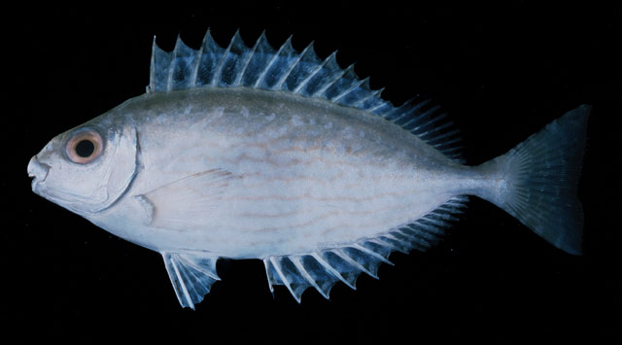
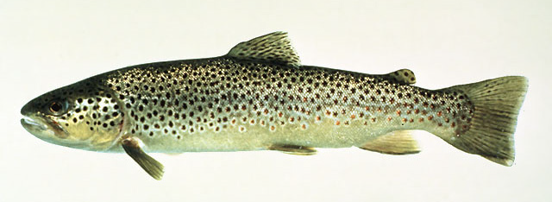
Sea bream
► Sparus auratus bream fish
One of the excellent marine fish spread all over the world and preferred by many consumers
They can be reared in ponds or in floating cages and can be acclimated to processed food in the form of granules. Grow at good rates when reared in cages Bream can be bred with other fish
► Rabbit fish
Sigan fish are considered migratory fish of the Red Sea. They live in groups near the shores and feed on microorganisms as well as seaweed. Low cost of cultivation
► Salmon fish
Cold water fish, for example:
أسماك السلمون المرقط البني(Brown Trout ) Salmo trutta fario

