Slide 1
Nerve Compression
Abdulaziz Alomar, MD, MSc, FRCSC

Slide 2
Introduction
Risk factors
Female
Pregnancy
Diabetes mellitus
Hypothyroid disease
Rheumatoid arthritis (many mcqs)
No motor deficit in mild compression
Sensory changes are earliest signs

Slide 3
Test autonomous zones
Median and ulna reproducable
Radial nerve is not as reliable (mcq)
Double crush phenomena
Entrapment and damage more proximal may lead to symptoms presenting or worsening at a level of compression distal
Nutritional and oxygen theories, delivery of

Slide 4
Median Nerve
First branch to pronator teres
Last branch to lumbricals D2, D3
3 types
Carpal Tunnel
Pronator Syndrome
AIN compression / Kiloh-Nevin

Slide 5
Carpal Tunnel
D1 to D3 numbness and pain, night, weakness and thenar wasting later on
Durkin’s compression test
Most sensitive
Neutral wrist and even pressure x 60 seconds
Recreate symptoms = +
Tinel’s
Phalen’s

Slide 6
Pronator Syndrome
Median nerve compression as it passes through the 2 heads of pronator
Proximal, anterior forearm pain
Palmar cutaneous numbness
Proximal Tinel’s may be positive
Specific tests for individual causes

Slide 7
Supracondylar process – xray (1%)
Ligament of Struthers – pain at medial epicondyle
Lacertus fibrosis – resisted flexion / supination
Deep pronator head – resisted pronation with elbow in full extension
FDS origin – isolated PIP flexion, long finger

Slide 8
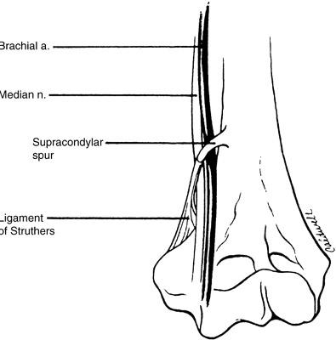

Slide 9
AIN Compression
AKA Kiloh-Nevin syndrome
No sensory, just motor
Causes are similar to pronator plus FDS arcade, enlarged biceps bursa, accessory head of FPL (Gantzer’s muscle)
Presents as weakness of “OK” sign, showing FPL and FDP weakness
Pronator quadratus – weakness with resisted pronation while elbow is flexed

Slide 10
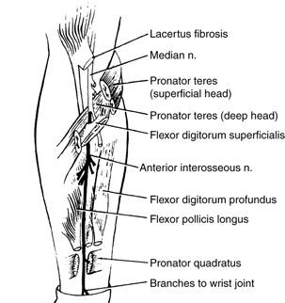

Slide 11
Ulnar Nerve
First branch is FCU
Last is lumbricals D4 and D5
Cubital tunnel syndrome
Ulnar tunnel syndrome

Slide 12
Cubital Tunnel Syndrome
Areas causing
Arcade of struthers (not the ligaMent – Median)
Intramuscular septum
Arcuate ligament (roof)
Anconeous
Osbourne’s fascia (FCU head band)
Mass effect
Numbness and parasthesias in ulnar digits

Slide 13
Froment’s sign – FPL compensation for thumb adductor, hyperflexion of IP during pinch
Jeanne’s sign – compensatory hyperextension of thumb MCP
Pollock’s test – 2 ulnar FDPs weak
Tinel’s over the cubital tunnel
Elbow flexion test – flex over 90, extend wrist and supinate forearm 60 sec, recreate = +

Slide 14
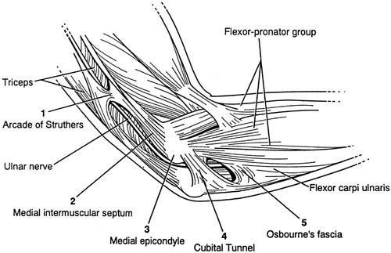

Slide 15
Ulnar Tunnel Syndrome
Guyon’s Canal
Between pisiform and hamate hook
Pisohamate ligament and volar carpal ligament superiorly
Ulnar nerve and artery
Causes
Ganglion, hook non union, artery thrombosis, anomalous muscle, palmaris brevis hypertrophy

Slide 16
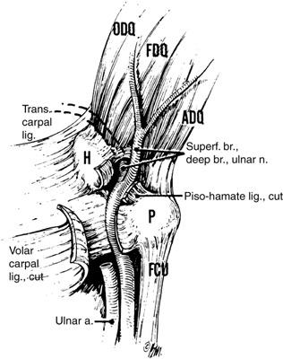

Slide 17
Presents as mixed motor or sensory depending on location of compression
Before bifurcation is both
Deep is motor
Superficial is sensory

Slide 18
Radial Nerve
First branch to long head of triceps, brachioradialis in forearm
Last to EIP
4 major types
Radial Compression (Arm)
PIN
Radial Tunnel Syndrome
Wartenburg’s Syndrome

Slide 19
Radial Compression
Fibrous arch of lateral head of triceps
Holstein-Lewis fragment
Presents as extensor weakness WITHOUT radial drift as ECRL is involved (see PIN)
Mobile was weakness
Radial sensation distribution loss

Slide 20
PIN Compression
Causes
Fibrous bands (radiocapitellar fascia)
Leash of Henry (rad. a. branch)
ECRB prox edge
Supinator distal edge
Arcade of Frohse
Mass effect
Hypertrophied synovium in RA (mcq)

Slide 21
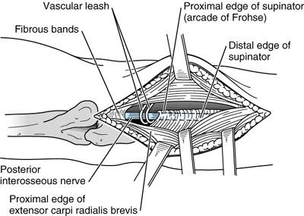
Presents as pain at the lateral elbow
Pain with resisted supination
Weakness of extensors with radial drift
ECRL normal

Slide 22
Radial Tunnel Syndrome
Just like PIN, except primarily just pain
No weakness
Pain is at lateral forearm 2 to 3 cm distal to radial head
Test with long finger extension and resisted supination, should recreate pain at site above

Slide 23
Wartenberg’s Syndrome
AKA Cheiralgia paresthetica
Sensory branch of radial nerve compression
No motor
Pain and numbness, paresthesias over radio dorsal wrist and hand
Test with forceful pronation
+ Tinel with tapping over nerve

