Slide 1
Adrenal gland radiology
OSCE

Slide 2
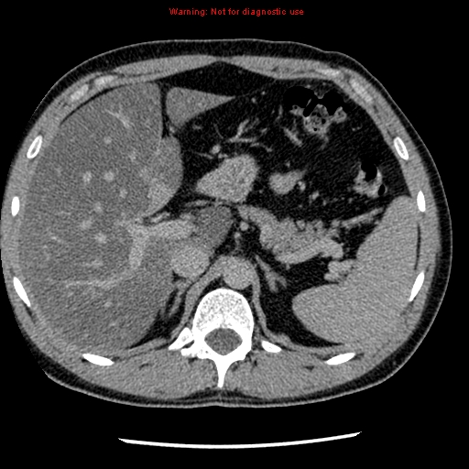
1
3
7
6
2
5
4
8

Slide 3
1- Liver
2-Spleen
3- Pancreas
4- Left adrenal gland
5- Right adrenal gland
6- Aorta
7- IVC
8- left crus of the diaphragm.
1
3
7
6
2
5
8
4

Slide 4
3
4
6
5
1
2

Slide 5
3
4
6
5
1- Right kidney
2- Left kidney
3- Right adrenal gland
4- Left adrenal gland
5- Spleen
6- Liver
2
1

Slide 6
What is the common radiological modality used for adrenal pathology?
Ultrasound.
X ray.
CT.
Nuclear medicine.
Fluoroscopy.

Slide 7
What is the common radiological modality used for adrenal pathology?
Ultrasound.
X ray.
CT.
Nuclear medicine.
Fluoroscopy.

Slide 8
The right adrenal gland is located:
Anterior to the inferior vena cava.
Superior to the inferior vena cava.
Inferior to the inferior vena cava.
To the right side of the inferior vena cava.
Posterior to the inferior vena cava.

Slide 9
The right adrenal gland is located:
Anterior to the inferior vena cava.
Superior to the inferior vena cava.
Inferior to the inferior vena cava.
To the right side of the inferior vena cava.
Posterior to the inferior vena cava.

Slide 10
The blood supply of the adrenal gland are derived from:
The abdominal aorta.
The renal artery.
The inferior phrenic artery.
All of the above.
Non of the above.

Slide 11
The blood supply of the adrenal gland are derived from:
The abdominal aorta.
The renal artery.
The inferior phrenic artery.
All of the above.
Non of the above.

