Slide 1
Obstetric Ultrasound
By .Alaa malki

Slide 2
1- Is usually obtained twice during the normal
pregnancy:
(18-24 weeks) , (32-38 weeks).
2- It can be done before 18 weeks:
-to confirm intra-uterine pregnancy .
-estimation of G.A.
-exclude abnormal pregnancy (molar or ectopic ).
-multiple pregnancy .

Slide 3
QUSTION ALWAYS SHOULD BE ASKED TO THE PREGNANCY
WOMEN BEFROE SCANNING:
- LMP.
- any cardiac problems.
- any previous abnormal baby .
- bleeding?
- any abnormal pain ?
- medication ??
- diabetic ??
SCANNING :
-Transvaginal : for early pregnancy on the first 9 wk
-Transabdomenal .

Slide 4
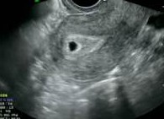
GESTATIONAL SAC :
-its usually visualized from 31 days (4+3 wks) =(2-3 mm)or (5+3 wks).
-it will appear as circle area surrounding by thick bright ring at fundal
area.
-it grow approx. (1mm/day)
-at (8 weeks) amniotic cavity expands rapidly .
-at the end of the first trimester, the amniotic and chorionic
membrane becomes fused .

Slide 5
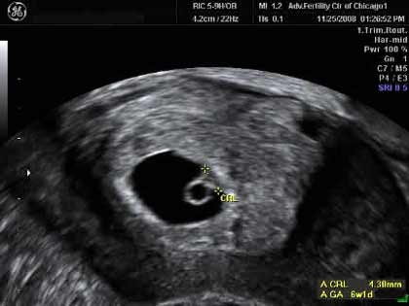
YOLK SAC:
-appear as circle mass with the G.S.
-it can be identified at (35 days).
-it grow slowly until reach a maximum of (6 mm)at (10 wks).
-the identification of the yolk sac will be very difficult after
(12 wks).

Slide 6
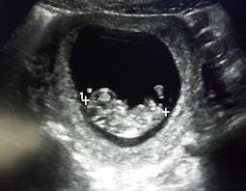
EMBRYO:
-(4-9) wks (embryo).
-(10-40) wks (fetus ).
-it can be visualized from (5 wks) ,on this stage CROWN-RUMP-LENGTH
(CRL) can be measured.
-the embryo grow (1 mm/day )
-cardiac activity (heart rate ) seen (6-9 wks )
-about ( 9 wks ) placenta can be seen
-at ( 8 wks ) upper + lower lumb
can be seen more clearly .

Slide 7
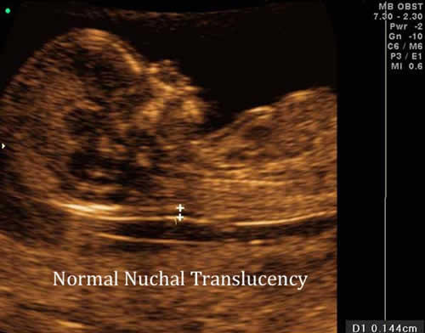
NUCHAL TRANSLUCENCY (NT):
Seen between ( 11-14 ) weeks.

Slide 8
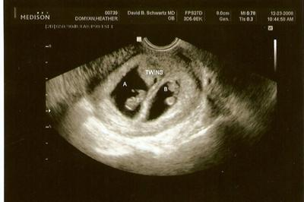
MULTIPLE PREGANCY:

Slide 9
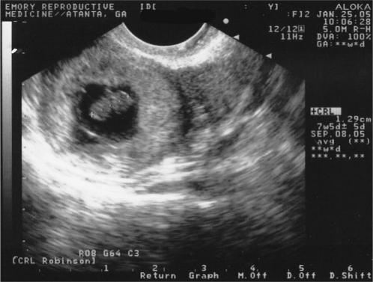
ECTOPIC PREGNANCY

Slide 10
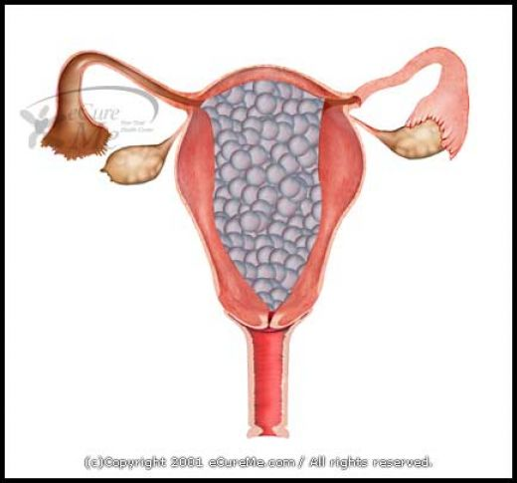
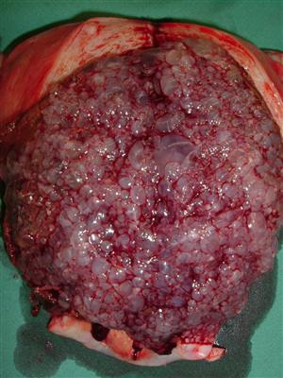
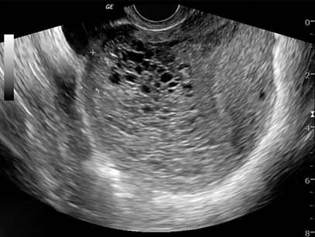
Molar pregnancy :

Slide 11
Second trimester
-it called ( routine anomaly scan ) (18-24 wks ).
-optimal time to examine fetal heart at
(23-24 wks).
-fetal anatomy ,placenta ,amount of amniotic volume ,fetal movement ,measurements ,ovary ,uterus , both adnexa .

Slide 12
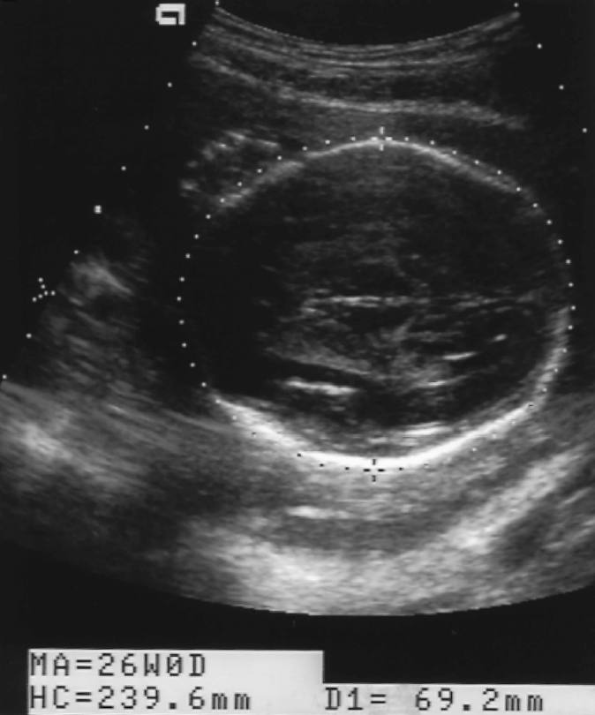
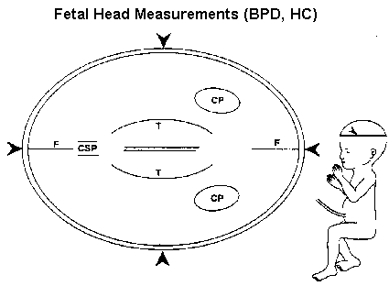
1- Biparital diameter (BPD)
2- Head circumference (HC)

Slide 13
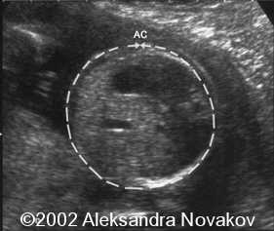
3- Abdominal circumference (AC)

Slide 14
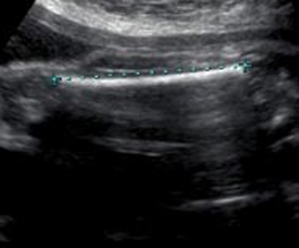
4- Femoral length(FL)

Slide 15
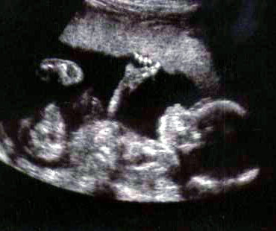
5- FETAL POSITION:(cephalic-breach)
6- PLACENA SITE

Slide 16
Thank you

