Slide 4
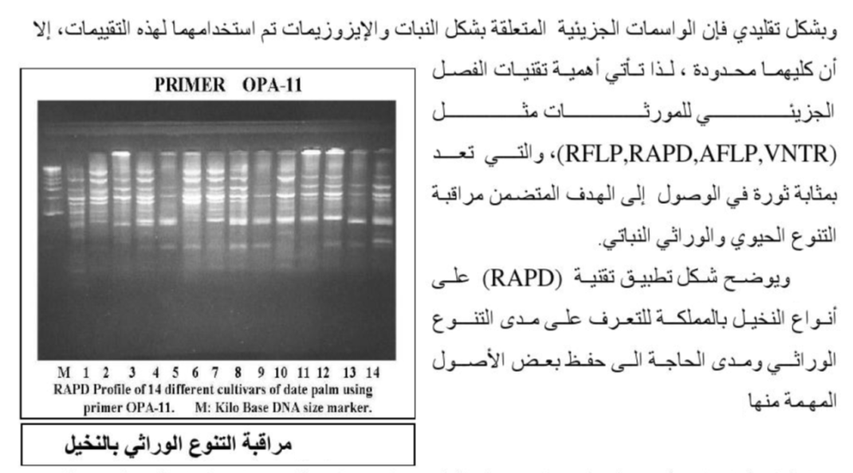

Slide 5

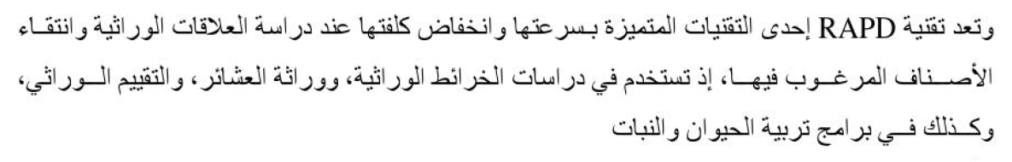

Slide 18
THE END
ANY QUESTION?

