Slide 1
RNA Quality Assessment
Botany and Microbiology Department

Slide 2
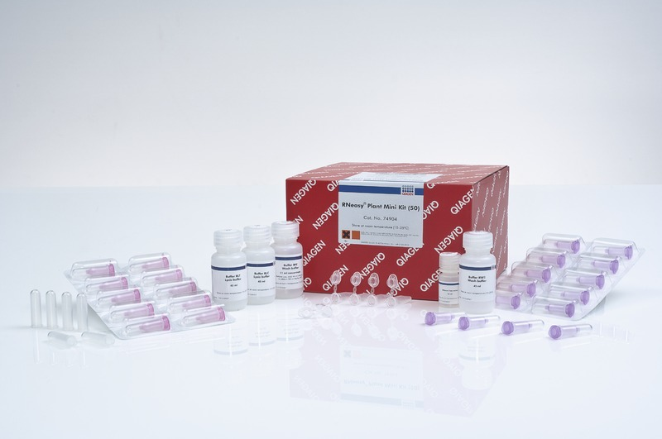
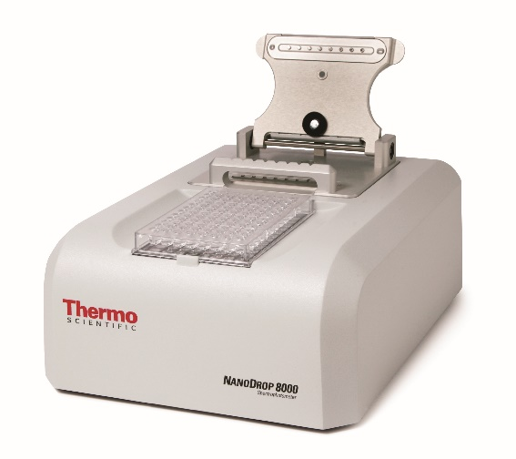
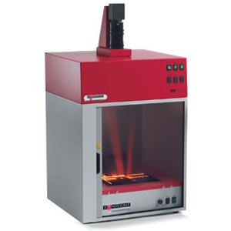
1. Extraction and purification of total RNA.
Qiagen RNeasy® Plant Mini Kit
2. RNA concentration and quality
Ingenius Syngene Bio-imaging gel documentation system
Nanodrop 8000 spectrophotometer

Slide 3
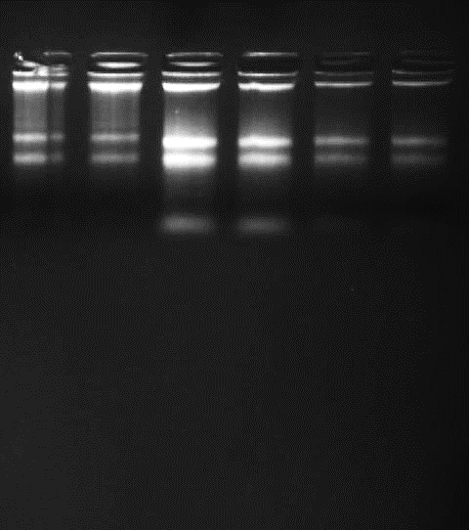
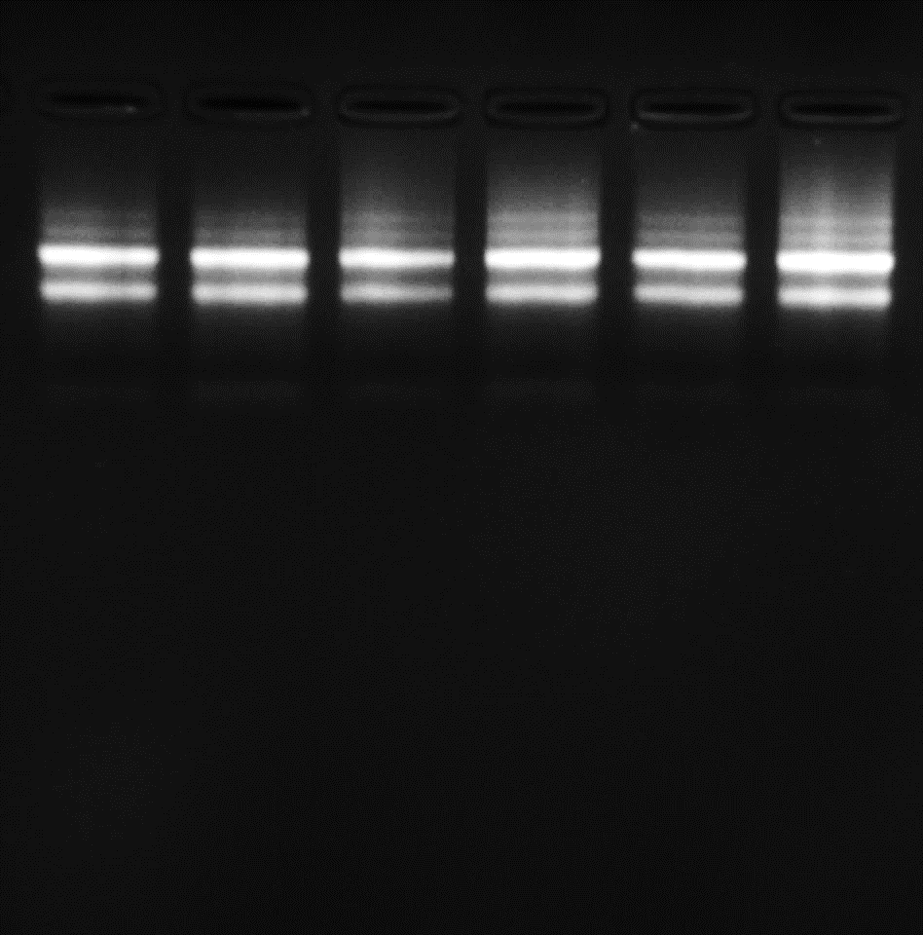
Concentration and purity of total extracted DNA as shown by Nanodrop
# | Sample Name | Conc. (ng/µl) | Volume (µl) | Purity (A260/A280)
1 | CC1 | 120.96 | 90 | 2.01
2 | CC2 | 107.41 | 90 | 1.95
3 | CC3 | 115.90 | 90 | 1.91
4 | CD1 | 100.5 | 90 | 2.05
5 | CD2 | 95.44 | 90 | 1.94
6 | CD3 | 89.69 | 90 | 2.18
The integrity and purity of total extracted RNA as shown by agarose gel

Slide 4
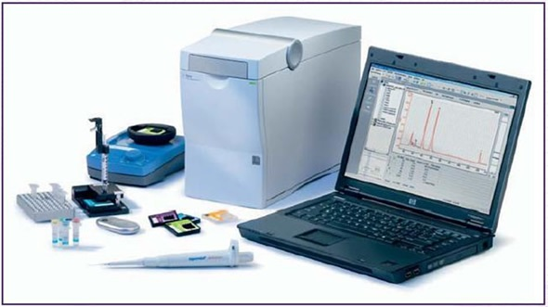
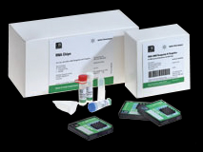
3. RNA concentration and quality
RNA integrity number (RIN) assessment
RNA 6000 Nano Kit
Agilent 2100 Bioanalyzer instrument

Slide 5
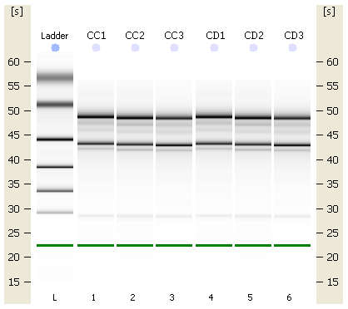
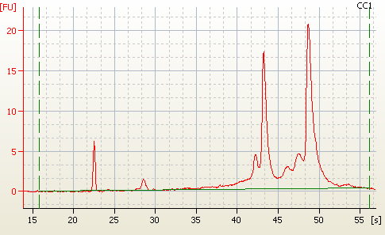
Quality & Quantity Check of RNA using 2100 Bioanalyzer
# | Sample Name | Conc. (ng/µl) | Volume (µl) | Total Amount (µg) | Purity (A260/A280) | RIN
1 | CC1 | 567.251 | 50 | 28.363 | 1.96 | 8.1
2 | CC2 | 566.733 | 50 | 28.337 | 1.85 | 7.2
3 | CC3 | 408.699 | 50 | 20.435 | 1.91 | 8.3
4 | CD1 | 425.009 | 50 | 21.250 | 1.82 | 8.2
5 | CD2 | 512.736 | 50 | 25.637 | 1.99 | 7.5
6 | CD3 | 570.428 | 50 | 28.521 | 1.87 | 7.8
Bioanalyzer virtual gel image of the RNA samples & Electropherogram of the RNA sample

Slide 6
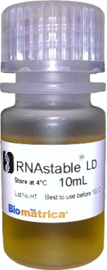
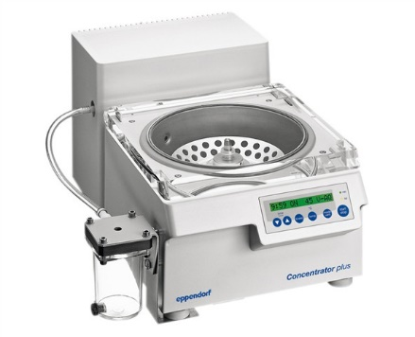
4. Stabilization of Samples for Storage and delivery
RNAstable LD & Eppendorf® centrifugal vacuum concentrator

Slide 7
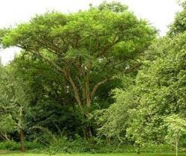
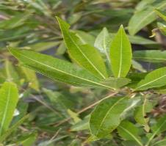
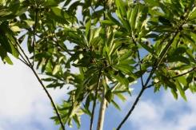
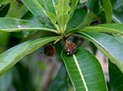
Thanks

