Slide 1
Roots
A Root word - (linguistics) is the form of a word after all affixes are removed.

Slide 2
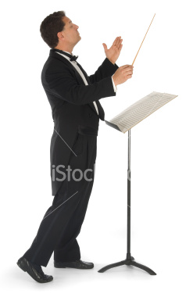
1- Duc , Duct:
meaning: to lead.
Examples:
Education has improved a lot with the new technology. (leading to knowledge)
He wants to major in music and conduct an orchestra someday. (to lead musicians in playing music)

Slide 3
2-Pone,Pose:
Meaning: place , put.
Examples:
-our flight has been postponed .
-He is in his studio composing.
3-Port:
Meaning: carry, take.
Example:
- Coffee beans and fruits are major exports for the South American countries.

Slide 4
4-Press:
Meaning: press, push.
Example:
-I was really impressed by his paintings.
5-Spect:
Meaning: see, look.
Example:
- Respect must be earned, not demanded.
6-Vert:
Meaning: turn.
Example:
Many people nowadays convert to Islam.

