Slide 1
Scale ,Ratio &Proportion
Prepared by Dr. Ahmed Azmy

Slide 2
scale
These two design principles go hand in hand, since both relate to size and shape.
Scale concerns itself with the size of one object compared to another.
Scale relates to the size of a design element in comparing to the height and width of size of an refrence element (human size).

Slide 3
scale
Dimensional element's defined by other elements of design- relative to other art, its or in relation to human size.

Slide 4
scale
A building scale can be recognize comparing with the normal size of a human

Slide 5
scale
Unusual or even unexpected scale can certainly be used as a attention grabber.

Slide 6
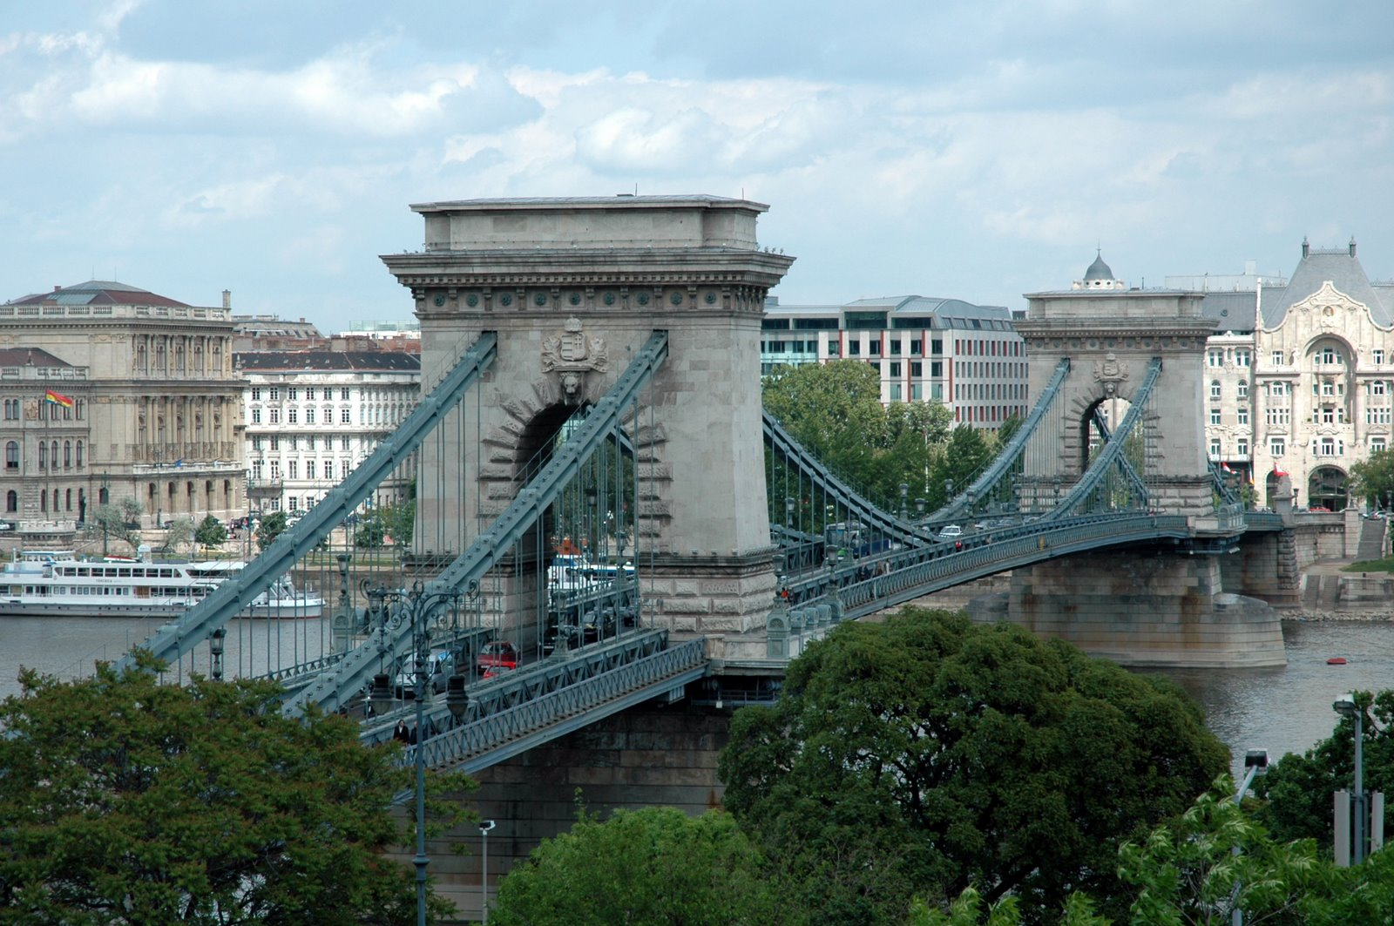
scale
Another consideration for size and scale is to look at the elements within the creation itself.

Slide 7
scale
Scale can attract in different ways. It can be use to draw attention to the unexpected or exaggerated - this is often the case in advertising.

Slide 8
scale
Scale of government buildings, theatres and religious buildings is often meant to impress and dwarf the viewer, while the proportions in a private home are usually more according to human measure.

Slide 9
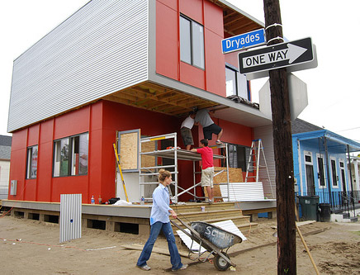
scale
Scale of government buildings, theatres and religious buildings is often ment to impress and dwarf the viewer, while the proportions in a private home are usually more according to human measure.

Slide 10
scale
Changing the natural scale is certainly unusual. It is frequently used in historical and religious painting.

Slide 11
scale
Scale in landscape is commonly perceived in two different ways Pedestrian and Vehicular.
Pedestrian scale elements differ from vehicular scale elements. A pedestrian on a sidewalk will only require a small sign to direct him to his destination. This sign may be more detailed and embellished.
A driver travelling at 30 miles per hour will require a larger, simple sign. In this case, the driver has a short time span to see the sign and make a decision. Scale, therefore, plays an important role in his safety.

Slide 12
Ratio
The relationship of one part to another.
Proportion of interior space, furniture, and accessories should be harmonious.
Spatial division and set-ups can change the appearance of the same amount of space.

Slide 13
RATIO
The Golden Mean
The division of a line or form so that the smaller portion has the same ratio to the larger as the larger has to the whole.

Slide 14
RATIO
Square is the least pleasing shape.
Rectangles are more pleasing, especially with a ratio of 2:3.
Effective Ratios are 2:3, 3:5, 5:8, 4:7, etc

Slide 15
RATIO
The golden mean 1:1.618

Slide 16
RATIO
The golden mean 1:1.618

Slide 17
Proportion
Proportion has to do with the ratio of one design element to another, or one element to the whole.
Proportion relates to the parts of the object and how one part relates to another.

Slide 18
PROPORTION

Slide 19
PROPORTION

Slide 20
PROPORTION

Slide 21
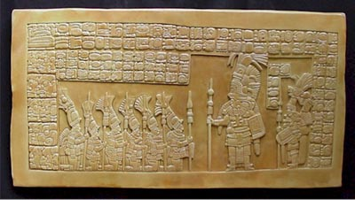
PROPORTION

Slide 22
PROPORTION

Slide 23
PROPORTION

Slide 24
PROPORTION

Slide 25
PROPORTION

Slide 26
PROPORTION

Slide 27
PROPORTION
When comparing the size of the objects in the composition, you see that the objects are not too large or too small for each other. They are of a realistic size.

Slide 28
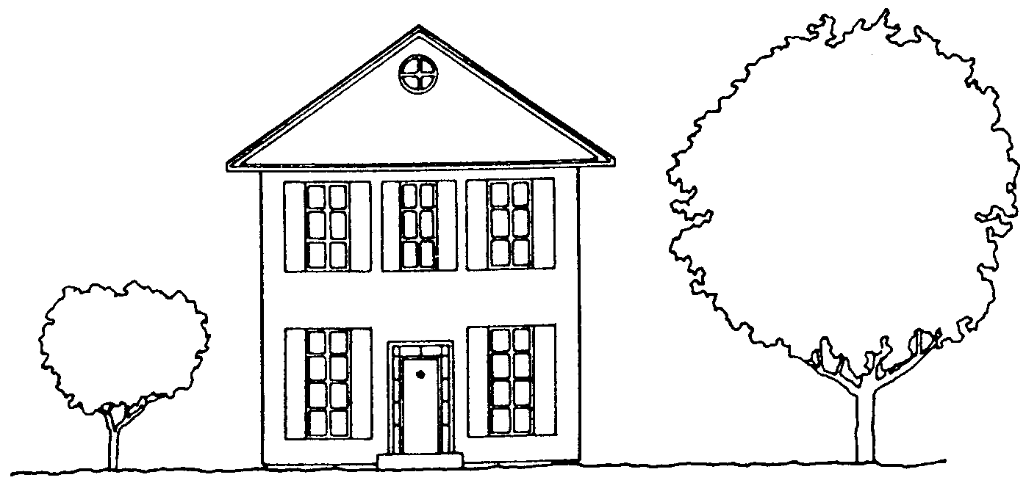
PROPORTION
Disproportionate Proportionate

Slide 29
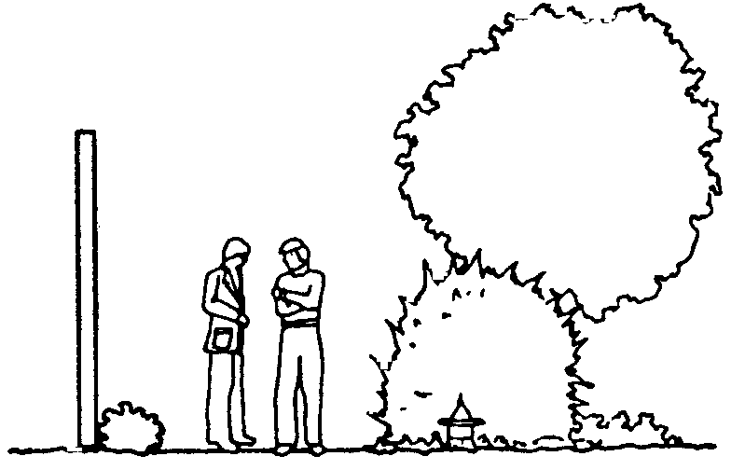
PROPORTION
Proportionate
Disproportionate

Slide 30
PROPORTION
Proportion is usually not even noticed until something is out of proportion

Slide 31
PROPORTION
Proportion is usually not even noticed until something is out of proportion

Slide 32
PROPORTION
When the relative size of two elements being compared seems wrong or out of balance it is said to be "out of proportion".

Slide 33
SCALE & PROPORTION Too Big, Too Small, Just Right
This chairs massive scale diminishes everything around it.

Slide 34
Too Small.
The chairs light palate accentuates its skinny scale.

Slide 35
Just Right.
This club chair matches the scale of the sofa.

Slide 36
Too Big.
Coffee table is over-scaled for the sofa.

Slide 37
Too Small.
Table not only looks out of proportion, it functions poorly as well.

Slide 38
Just Right.
The table is substantial enough to anchor the furniture grouping, yet it leaves room for traffic flow around both ends.

Slide 39
Too Tall.
Used as an end table, this wood pedestal towers over the sofa, making the sofa appear small and the pairing awkward.

Slide 40
Too Short.
The lamp would need to be fully stretched to offer good illumination from this low point.

Slide 41
Just Right.
The perfect pairing, visually and physically, is a tabletop that is a couple of inches shorter than the sofa arm.

Slide 42
Too Big.
The large-scale motif and strong colors of this floral wallpaper overpower the petite powder room as well as the fixtures and furniture in it.

Slide 43
Too Small.
The pattern is so small and pale that it almost disappears.

Slide 44
Just Right.
The narrow contrasting stripes provide the ideal balance for the clean-lined pedestal sink and oversize pine mirror.

Slide 45
Too Big.
This rug covers too much of the floor beyond the conversation area to define it as a discrete space.

Slide 46
Too Small.
Instead of creating intimacy, the rug only increases the appearance of isolation.

Slide 47
Just Right.
Choose an area rug that’s about as long and wide as the furnishings in the space.

Slide 48
Too Little.
Too much space between objects makes the candlesticks and the too-small frame look lonely, the bare wall yawning above.

Slide 49
Too Much.
There’s no time to pause to consider any single object, since they are all stepping on one another’s toes in a jostle for space.

Slide 50
Just Right.
The weight now shifted to the left side, fewer items are needed there for balance.

Slide 51
Too Big.
There’s no breathing room in this are-to-sofa match.

Slide 52
Too Little.
This picture is tall enough, roughly matching the height of the sofa. But it ends up looking leggy and lost because it’s too skinny in proportion to the sofa’s width.

Slide 53
Just Right.
To size a single picture, choose one that’s nearly the same height as the sofa and between half and two-thirds its width.

Slide 54
Too Big.
This tall lamp towers above the nearby sofa and chair. It is also several inches taller than the table it rests on, throwing the balance off there as well.

Slide 55
Too Small.
This lamp is overwhelmed by the high-back sofa and stocky chair that surround it.

Slide 56
Just Right.
For the best fit, an end-table lamp should be tall enough to clear the top of the sofa with a little room to spare, yet not so tall that it dwarfs the table it rests on.

Slide 57
Too Big.
This 5-foot-wide double pendant chandelier overpowers the table.

Slide 58
Too Small.
The fixture is too small to adequately light the table.

Slide 59
Just Right.
In general, a chandelier’s width or diameter should be at least 2 feet narrower than the table length.

Slide 60
End of Lecture

