Slide 1
Suffixes

Slide 2
Definition of suffixes:
A suffix is a letter or a group of letters added to the end of a word or root to change its meaning or change it into a different word group ( e.g. from verb to noun, etc..)
teach (verb)+ er (suffix)= teacher (noun)

Slide 3
Common noun suffixes:
-er ( writer, painter, worker , shopper ,teacher)
-or ( actor , operator , sailor , supervisor)
Both can be used for things which do a particular job:
(pencil-sharpener , bottle opener , grater , projector)
-er and –ee: (employer-employee , sender-addressee, payee (of a cheque )

Slide 4
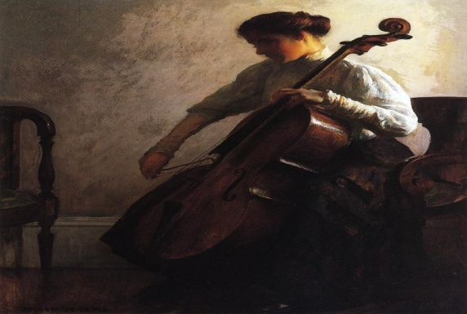
-tion / -sion / -ion: (complication , pollution , reduction , alteration , donation , promotion , admission)
-ist / -ism: ( Buddhism , journalism , Marxist , typist , physicist , terrorist)
( pianist , violinist , cellist )
-ness: (goodness , readiness , forgetfulness , happiness , sadness , weakness)
Happy + ness = happiness

Slide 5
Adjective suffixes:
-they change verbs into adjectives.
-able / -ible:
(drinkable, washable , readable , forgivable , edible , flexible)

Slide 6
Verbs suffixes:
They change adjectives into verbs.
-ise or –ize:
( modernise , commercialise , industrlise )

