Slide 1
Water Quality Parameters and Measurements

Slide 2
Water Quality Parameters
Physical Water Quality
Turbidity
Total Solids (TS) and Suspended Solids (SS)
Colour
Chemical Water Quality
Hydrogen Ion Concentration and pH
Total Dissolved Solids
Alkalinity
Hardness
Fe and Manganese
Etc.

Slide 3
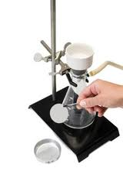
Physical Water Quality Total Solids (TS) and Suspended Solids (SS)
Total Solids in water and wastewater include suspended solids (> about 1.0 microns) and dissolved solids (< 0.001 micron in size). (In the LAB Course)
Suspended Solids include colloids (0.001 – 1 microns), supra-colloids ( 1 – 100 microns) and settleable solids (> 100 microns). (In the LAB Course)

Slide 4
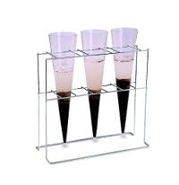
Physical Water Quality Total Solids (TS) and Suspended Solids (SS)
Volatile Solids (volatile SS, VSS and total volatile solids TVS)
VS are determined by igniting the residue on evaporation of the filtered solids at 500 º C ± 50 º C for 15 – 20 minutes in an electric muffle furnace.
It is used as a measure of the organic content.
Settleable Solids
Measured by the Imhoff Cone.

Slide 5
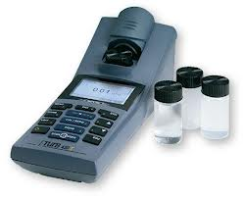
Physical Water Quality Turbidity
Turbidity is a physical characteristic of water that makes water appears cloudy.
Turbidity is caused by colloidal materials (e.g. clay, silt, metal oxides, micro-organisms, fibers, oils and soaps)
Turbidity measures the clarity of water containing colloidal material that can not be measured by suspended solids measurement, and of water that contains low level of SS.
Measured by Turbidimeter (nephelometer)
Units:
Nephlometric Turbidimeter

Slide 6
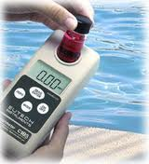
Physical Water Quality Color
Types
True color: caused by dissolved solids
Apparent color: caused by suspended solids and includes true color.
Sources
Natural Minerals (e.g. iron and manganese brown and tan color)
Decay of Organic Matter (e.g. leaves, woods)
Colored industrial wastes (e.g. wastes from textile and dying industries).
Measurement
Visual Comparison with standard platinum-cobalt solution.
Colorimeters or spectrophotometers.
True Color Unit (TCU).

Slide 7
Chemical Water Quality Hydrogen Ion Concentration and pH
Water (H₂O) dissociate slightly to H⁺ and OH⁻:
H₂O ↔ H⁺ + OH⁻
The Hydrogen ion concentration [H⁺] for pure water at 25 ºC is about 10⁻⁷ mol/L (molar concentration), and the hydroxide ion concentration [OH⁻] is 10⁻⁷ mol/L.
[H⁺] + [OH⁻] = 10⁻¹⁴
pH + pOH = 14

Slide 8
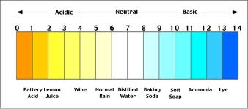
Chemical Water Quality Hydrogen Ion Concentration and pH
pH = - log [H⁺] = negative logarithm of hydrogen ion concentration.
if [H⁺] = 10⁻⁷ then pH= 7 and pOH = 8
pH is a measure of the hydrogen ion concentration and is an indicator of the strength of an acid or base.
Note: pH does not measure total alkalinity or total acidity of water.
The pH scale ranges from 0 to 14
Adding an acid to water causes additional H+ ion to be released so that the H+ ion concentration goes up and the pH value goes down:
HCL --------------------> H⁺ + Cl⁻

Slide 9
Chemical Water Quality Hydrogen Ion Concentration and pH
Strong inorganic acids (e.g. HCl, H₂SO4) ionize completely in water, and the concentration of H⁺ then equals the molar concentration of the acid.
Weak acids (e.g. Acetic acid, hypochlorous acid) and inorganic acids are poorly ionized in water.
Measurement by pH meter with an electrode.
Significance of pH
Important in chemical and biological treatment processes of water and wastewater (pH must be controlled within an appropriate range)
Important in corrosion control.

Slide 10
Chemical Water Quality Total Dissolved Solids (TDS)
Dissolved Solids are the solids that can be recovered from water by evaporating the water after filtering the suspended solids (they are less than 0.001 micron in size)
Method of Measurement
Filtration
TDS = TS – SS
Conductivity can be used as a rough measure of the concentration of the total dissolved salts (Conductivity Meter), units 1.0 μS/m = 10 μmhos/cm
Conductivity of tap water = 70 – 150 μS/m

Slide 11
Chemical Water Quality Alkalinity
Water alkalinity is a measure of the water ability to resist changes in pH when a strong acid is added (i.e. Ability of water to neutralize acids; buffering capacity of water).
Water alkalinity results from the presence of bicarbonate (HCO₃⁻), carbonate (CO₃⁻⁻), and hydroxide (OH⁻) of elements such as calcium, magnesium, sodium, potassium or ammonia.
These compounds originate from
Chemical compounds dissolved from rocks and soil, and
CO₂ from the atmosphere and microbial decomposition of organic matter.
CO₂ + H₂O <--> H₂CO₃ carbonic acid <--> H⁺ + HCO₃
Measured by titration

Slide 12
Chemical Water Quality Alkalinity
Alkalinity of water either high or low has no ill effects on humans.
Highly alkaline waters are unpalatable (bitter taste)
CO3= and HCO3- alkalinity complex some heavy metals and thus reduces their toxicity
Highly alkaline water often has a high pH and generally contains high levels of dissolved solids (harmful for water to be used in boilers, food processing and municipal water systems).
Alkalinity is important for proper chemical treatment of water and wastewater (e.g. Coagulation, softening), and corrosion control.

Slide 13
Chemical Water Quality Hardness
Hardness is a characteristics of water that prevents that lathering of soap and produces scale in hot water pipes, heaters and other units due to the presence of divalent metallic ions (calcium, magnesium, ferrous ions, manganous ion, and strontium).
Hardness in water results from the contact with soil and rocks (limestone) in the presence of CO₂
Types of hardness
Carbonate hardness (temporary hardness): caused by the presence of carbonate and bicarbonate of Ca ⁺⁺ and Mg⁺⁺.
Ca(HCO₃)₂ → CaCO₃ + CO₂ + H₂O
Mg(H CO₃)₂ → Mg(OH)₂ + 2 CO₂
Non-carbonate hardness (permanent hardness): caused by the presence of chlorides, sulfate and nitrates of calcium, magnesium, and iron.

Slide 14
Chemical Water Quality Hardness
Calculation Method
This method is used when complete chemical analyses are available.
Hardness (mg/L as caCO3) =
Where M⁺⁺ represents any divalent metallic ion.
Example
EDTA Titri-meteric Method (In LAB Course)

Slide 15
Chemical Water Quality Hardness
Classification of Water According to its Hardness.
Classification | Hardness Level
Soft | ≤ 50 mg/L CaCO₃
Moderately Soft | 50 – 150 mg/L CaCO₃
Hard | 150 – 300 mg/L CaCO₃
Very Hard | > 300 mg/L CaCO₃

Slide 16
Chemical Water Quality Hardness
Impact of Hardness
Mg hardness associated with SO₄= has laxative effect on persons unaccustomed to it.
Excessive hardness is problematic from the economical point of view (scale formation, high soap consumption)
Water Softer than 30 – 50 mg/L as CaCo₃ tends to be corrosive.

Slide 17
Chemical Water Quality Iron (Fe) and Manganese (Mn)
They are present in soil and rocks in insoluble forms (i.e. Ferric oxide, iron sulfide and manganese dioxide).
Ground waters that are devoid of dissolved oxygen and high of CO₂ content can contain appreciable amounts of fessous ion (Fe⁺⁺) and manganese ion (Mn⁺⁺). [Iron ≈ 10 mg/L and Manganese ≈ 2 mg/L].
Measurements
Using colorimeters (adding chemical agent to water)
Using Atomic Absorption Spectophotometer.
Significance of Iron and Manganese
Contribute to hardness
They are oxidized upon exposure to air causing: metallic taste, staining of clothes and pluming fixture, precipitates in pipes, growth of slime in pipes producing odor and taste problems.

Slide 18
Chemical Water Quality Trace Metals
Trace metals include those metals that are harmful and toxic in relatively small amounts.
The main source of these metals is the discharges of domestic, agricultural, or industrial waste water.
Examples of trace metals: arsenic, cadmium, chromium, mercury, lead, silver and barium.
Measurement: Atomic adsorption spectophotometer.

Slide 19
Chemical Water Quality Nitrogen
Nitrogen compounds
Inorganic: Ammonia NH₃, Nitrite NO₂, Nitrate NO₃
Organic: Protein, amino acids
Main Sources
Discharge of domestic, agricultural (fertilizers), industrial waste water.
Animal wastes
Decomposition of dead plants, animal and oragincs by micro-oragnisms
Protein → Amino Acid→ Ammonia→ Nitrite→ Nitrate

Slide 20
Chemical Water Quality Nitrogen
Significance of Nitrogen Compounds
Ammonia is very toxic to aquatic life
NH₃ + H⁺ <- -> NH₄⁺
Decreasing the pH will shift the reaction to the right (NH₄⁺). Ammonium ions (NH₄⁺) are highly soluble in water but are not toxic.
Oxidation of NH₃, NO₂⁻, NO₃⁻, and NH₄⁺ by micro-organisms lowers dissolved oxygen concentration in water causing harm to aquatic life.
Presence of nitrogen compounds along with phosphorus in water bodies their eutrophication (excessive growth of algae and green plants) which in turn:
Lowers dissolved oxygen level in water
Changes color of water
Changes taste and odor of water
Makes water bodies unfit for recreational purposes.

Slide 21
Chemical Water Quality Nitrogen
Significance of Nitrogen Compounds
Drinking of water with high nitrate content (NO₃⁻) causes:
Blue-baby disease in infants (methemoglobinemia): bacteria in infants’ intestines (less than 6 month old) reduce NO₃⁻ to NO₂⁻ that oxidizes hemoglobin (containing Fe⁺⁺) to methemoglobin (containing Fe⁺⁺⁺), which is incapable of transporting O₂ in the blood stream. This causes a bluish discoloration of infants, and serious health problems and even death.
Nitrite (NO₂⁻) can combine with various amines in the gastrointestinial tract to form nitosamines, many of which are known to be carcinogenic. Nitrite is used in cured meat (hotdogs, prepared meats) to retard bacterial growth.

Slide 22
Chemical Water Quality Nitrogen
Measurement
Ammonia Nitrogen (NH3-N)
By titration method
Organic Nitrogen
Digestion then measure NH4+
Total Kjeldahl Nitrogen (TKN) = organic nitrogen + ammonia nitrogen
Nitrate-Nitrogen and Nitrite-Nitrogen
By Colorimetrical method.

Slide 23
Chemical Water Quality Organic Matter
Organic compounds are composed mainly of carbon and hydrogen along with other elements such as oxygen, nitrogen, phosphorus, and sulfur.
Organics can be classified on the basis of their origin into
Natural organics (e.g. plants and animal tissues, human feces)
Synthetic organics (e.g. plastics, rubber)
Based on their microbial degradation, organics can be:
Biodegradable
Non-biodegradable
Organics in wastewater
Organic s in domestic wastewater include carbohydrates, proteins, fats and oils, and synthetic organics.
About 20% to 40% of the organics in sanitary wastewater is non-biodegradable.

Slide 24
Chemical Water Quality Organic Matter
Measurement of Organic Concentration in Water
Methods to measure concentrations> 1 mg/L
Biochemical oxygen demand, BOD
Chemical oxygen demand, COD
Total organic carbon, TOC
Methods to measure concentrations 10⁻¹² to 10⁻³ mg/L
Gas chromatograph, GC
Mass spectroscopy, MS

Slide 25
Chemical Water Quality Biochemical Oxygen Demand
BOD is the amount of oxygen required (consumed) by microorganisms to biologically degrade organic matter in a water sample under aerobic conditions during a 5-day period at 20 ºC.
Organics + Microorganisms + O₂ → CO₂ + H₂O + new cells
BOD is expressed in mg O₂/L of water sample (mg/L).
BOD is used to:
Measure the organic strength of water/wastewater.
Determine the relative oxygen requirements for the biological treatment of wastewater.

Slide 26
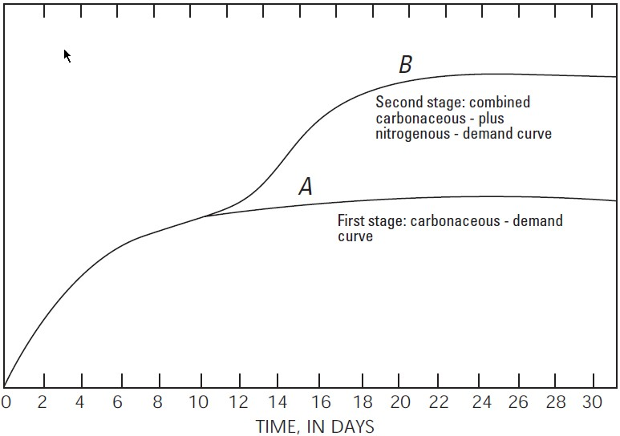
Chemical Water Quality Biochemical Oxygen Demand
The BOD Curve
Ultimate carbonaceous BOD
5-day BOD

Slide 27
Chemical Water Quality Biochemical Oxygen Demand
The Shape of BOD curve can be expressed mathematically as:
BOD_{t} = BOD _{ultimate} (1 – e^{-tK})
BOD_{t} = BOD _{ultimate} (1 – 10^{-tk})
BOD₅ = BOD _{ultimate} (1 – e^{-5K})
BOD₅ = BOD _{ultimate} (1 – 10^{-5k})
Note:
K (base e) = 2.303 k (base 10)

Slide 28
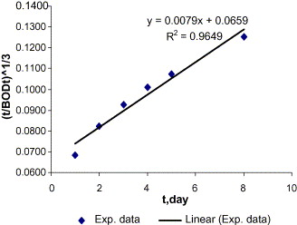
Chemical Water Quality Biochemical Oxygen Demand
Thomas Method to Determine k (base 10)
Plot values of [t/BOD_{t}]^{1/3} as ordinate (y) against time (t) as abscissa (x).
k = 2.61 B/A
k = reaction rate constant, day⁻¹ (base 10)
A = intercept of the line on the y-axis
B = intercept of the line

Slide 29
Chemical Water Quality Biochemical Oxygen Demand
Remarks on K (the reaction-rate constant)
K determines the speed of the biological reaction.
K is function of type of waste, temperature, ability of micro-organisms.
Temperature: K value increases with increasing temperature because micro-organisms are move active at higher temperatures
K_{T} = K₂₀ Ѳ^{(T – 20)} Ѳ = 1.047
Types of waste : simple compunds such as sugar are easily degraded by micro-organisms and have high K values. Complex compounds such as phenols are difficult to degrade and have low K values
Example
In a BOD determination, 40 mL of wastewater containing 2 mg/L DO, are mixed with 260 mL of dilution water containing 9 mg/L of DO. After 5 days of incubation the DO content of the mixture is 2.74 mg/L. Estimate the BOD5 of the wastewater.
Example
For the wastewater of the previous example, estimate the oxidation rate of the waste if the ultimate BOD is 100 mg/L. Estimate also the remaining oxygen demand after 5 days.

Slide 30
Chemical Water Quality Chemical Oxygen Demand
COD is the amount of oxygen required to chemically oxidize organics in water.
Measurement
The Dichromate Reflux Method.
For domestic wastewater, COD>BOD₅ because:
COD includes both biodegradable and non-biodegradable organics.
BOD₅ ≠ BOD_{ultimate} sfs
The BOD/COD ratio varies from 0.4 to 0.8 for raw sanitary wastewater.

Slide 31
Chemical Water Quality Total Organic Carbon (TOC)
TOC measures the organically bound carbon in the waste.
Measurement
Using a TOC analyzer.
For raw domestic wastewater:
BOD ≈ 220 mg/L COD ≈ 500 mg/L TOC ≈ 160mg/L

Slide 32
Microbiological Water Quality
Pathogens: disease causing microorganisms
Sanitary wastewater is an ideal environment for microorganisms (MOs) because it is rich in the organic and inorganic nutrients needed for their growth.
Most of these MOs are harmless, but sanitary wastewater may also contain pathogens from the excreta of people with infectious diseases that can be transmitted by contaminated water.
MOs found in water and wastewater include:
Bacteria
Protozoa (10 – 300 μm)
Algae (single cells to visible branched forms)
Fungi (yeasts and mold)
Worms (herminths)
Viruses ( 20 – 100 nanometers

Slide 33
Microbiological Water Quality
Waterborne Diseases
Diseases transmitted by water are almost of intestine (enteric) origin.
Bacterial Diseases
Cholera
Dysentery
Typhoid
Gastroenteritis or diarrheal (E-coli)
Protozoan Diseases
Amebic dysentery
Giardiasis
Helminthic Diseases
Bilharziasis
Ascariasis
Hookworm
Viral Diseases
Infectious hepatitis (type A)
Meningitis and heart anomalies
Diarrheal

Slide 34
Microbiological Water Quality
Indicator Organisms for Water Quality
Testing water for pathogens is not feasible because:
The absence of pathogens does not mean that others are not present.
Pathogens present in polluted water are few and therefore are difficult to isolate and identify.
Coliform bacteria or coliforms (non-pathogens bacteria) inhibit the intestines in large numbers and always present in faeces together with any pathogens, are used as indicators of faecal contamination.
Some genera of the coliform bacteria are not faecal origin but grow and reproduce on organic matter outside the intestines of humans and animals.
The term Total Colifom used in laboratory testing referring to all coliform bacteria from faeces, soils or other origin.
The term Faecal Coliform refers to coliform bacteria originating from human or animal faeces.

Slide 35
Microbiological Water Quality
Enumeration of Colifrom
The Multiple-Tube Fermentation Technique (the most probable number, MPN)
It involves three steps (gas fromation within 48 hr at 35C):
The presumptive test: the ability of coliform bacteria to ferment lactose broth
The confirmed test: growing cultures of coliforms from presumptive test on a medium that suppresses the growth of other bacteria
The completed test:the ability for the coliform growth in the conifrmed test to agin ferment lactose broth
The Membrane Filter Technique (MF)

Slide 36
Microbiological Water Quality
The Membrane-Filter Technique:
The test steps are:
Filter certain amount of water sample (e.g. 100 mL) under vacuum through a membrane filter,.
Place the filter in a plastic petri dish containing the growth medium and incubate at 35ºC for 24 hours for total coliforms and at 44.5oC for 24 hr for fecal coliforms. [Medium for total coliform: M-Endo, for fecal coliform: M-FC]
Count the number of colonies. A typical coliform colony is pink to dark red with green metallic surface sheen.
Colifrom density (colony/100 mL) =
(coliform colonies counted/mL sample filtered) x 100

Slide 37
Microbiological Water Quality
Number of colonies: a range of 20 – 200 colonies is preferred. But for water of good quality (e.g. tap water), disregard the lower limit of 20 colonies.
Sample Size: governed by the expected bacterial density.
Standard volume for drinking water: 100 mL
Main advantages of MF technique over the MPN:
The MF enables large volumes of samples to be examined
The MF gives a direct count of coliforms rather than an a statistical estimate.
The MF is faster than the MPN (within 24 hours).

Slide 38
Microbiological Water Quality
Example
The MF technique was used to test a drinking water for coliform group. 50 mL, 25 mL and 10 mL portions were filtered and the counts were 15, 6, 0 coliform colonies, respectively. Calculate the coliform density.
Example
The MF technique was used to test polluted water for total coliform. Three different water sample volumes (5 mL, 50 mL, and 500 mL) were filtered through five filter membranes. The colonies counts were as follows:
5 mL portions: 7, 9, 11, 5, 4
50 mL portions: 26, 32, 27, 30, 32
500 ml portions: TNTC (too numerous to conunt) (i.e. > 200 colonies)
Calculate the coliform density for this water using the mst valid data.

