Slide 1
Serology AGGLUTINATION TESTS and IMMUNOASSYS BASICS Saud AbdUllah Almasri 434104889

Slide 2
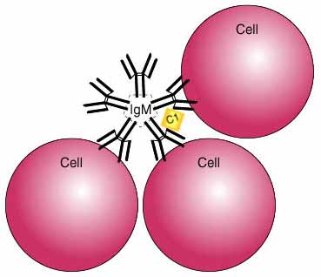
Methods for Ag-Ab detection
Precipitation
Agglutination
Hemagglutination and Hemagglutination inhibition
Viral neutralization test
Radio-immunoassays
ELISA
Immunofluorescence
Immmunoblotting
Immunochromatography

Slide 3
Agglutination
Agglutinins
Antibodies that produce such reactions
Involves two-step process:
Sensitization or initial binding
Lattice formation or formation of large aggregates

Slide 4
Agglutination
- Types of particles that participate in such reactions:
Erythrocytes
Bacterial cells
Inert carriers such as latex particles

Slide 5
Agglutination tests
Antibodies can agglutinate multivalent particulate antigens, such as Red Blood Cells (RBCs) or bacteria
Some viruses also have the ability to agglutinate with RBCs.
This behavior is called agglutination.
Serological tests based on agglutination are usually more sensitive than those based on precipitation

Slide 6
Examples
Slide Agglutination Test
Plate Agglutination Test
Tube Agglutination Test
Passive Agglutination Test
Microscopic Agglutination Test
Haemagglutination test (HAT)

Slide 7
Steps in Agglutination
Primary phenomenon (SENSITIZATION)
First reaction involving Ag-Ab combination
Single antigenic determinant on the surface particle
Initial reaction: rapid and reversible
Cross link formation → visible aggregates (stabilization)

Slide 8
Secondary phenomenon:
LATTICE FORMATION
Ab + multivalent Ag → stable network (visible reaction)
conc. of Ag and Ab
Governed by physiochemical factors:
Ionic strength of milieu
pH
temperature

Slide 9
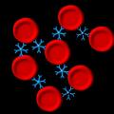
Secondary Phenomenon
Lattice Formation
The Fab portion of the Ig molecule attaches to antigens on 2 adjacent cells-visible results in agglutination
If both antigen and antibody are SOLUBLE reaction will become visible over time, ie, precipitation

Slide 10
DIRECT AGGLUTINATION
- Test patient serum against large, cellular antigens to screen for the presence of antibodies.
Antigen is naturally present on the surface of the cells.
In this case, the Ag-Ab reaction forms an agglutination, which is directly visible.

Slide 11
DIRECT AGGLUTINATION
The particle antigen may be a bacterium.
e.g.: Serotyping of E. coli, Salmonella using a specific antiserum
The particle antigen may be a parasite.
e.g.: Serodiagnosis of Toxoplasmosis
The particle antigen may be a red blood cell.
e.g.: Determination of blood groups

Slide 13
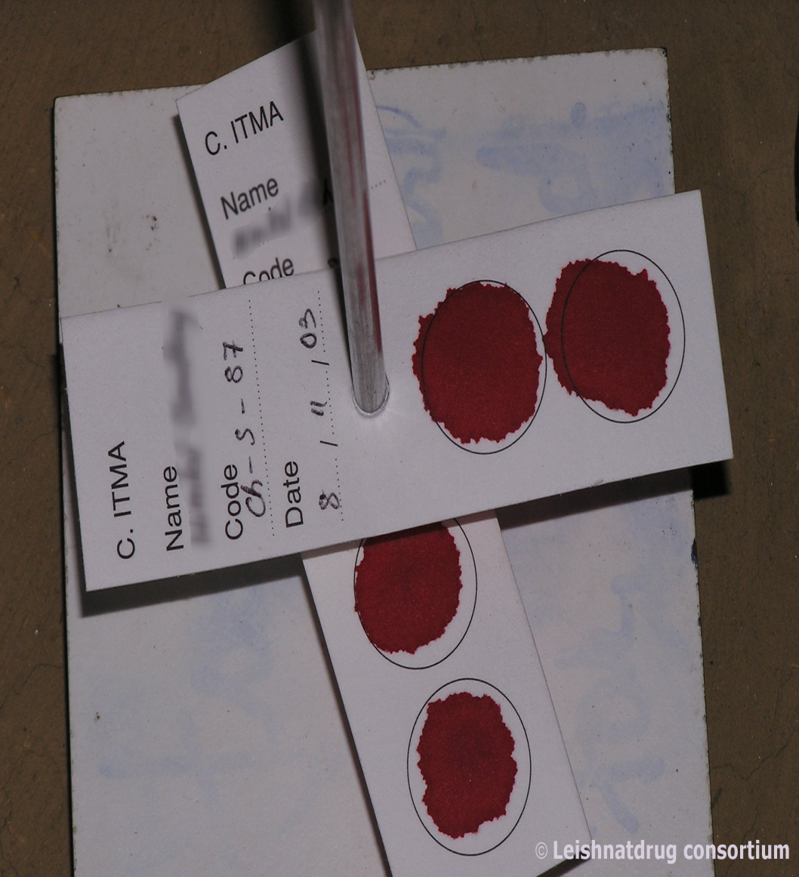
DIRECT AGGLUTINATION
These reactions can be performed on slides (rapid tests) or on microliter plates or tubes for Antibody titration if required.

Slide 14
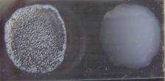
Direct agglutination
Principle
combination of an insoluble particulate antigen with its soluble antibody
- forms antigen-antibody complex.
- particles clump/agglutinate
used for antigen detection
Examples
- bacterial agglutination tests for sero-typing and sero-grouping e.g., Vibrio cholerae, Salmonella spp
Ag-Ab complex
Positive Negative
Notes:
Pictures public domain

Slide 15
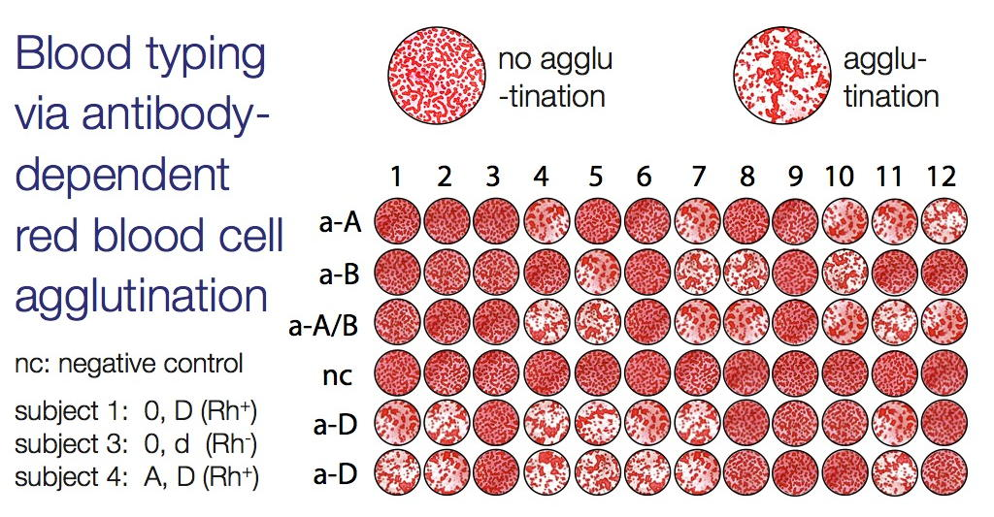

Slide 16
Slide Agglutination Test
Used for serotyping (e.g. Salmonella)
Antigen: isolated Salmonella in suspension
Antibody: specific antisera against Salmonella
Place test Salmonella in a drop of saline on a slide
Add a drop of antiserum, mix and rock slide for approx. 1 minute
Examine for agglutination

Slide 18
Direct agglutination
Principle
combination of an insoluble particulate antigen with its soluble antibody
forms antigen-antibody complex
particles clump/agglutinate
used for antigen detection
Examples
bacterial agglutination tests for sero-typing and sero-grouping e.g., Vibrio cholerae, Salmonella spp
Ag-Ab complex
Positive Negative
Notes:
Pictures public domain

Slide 19
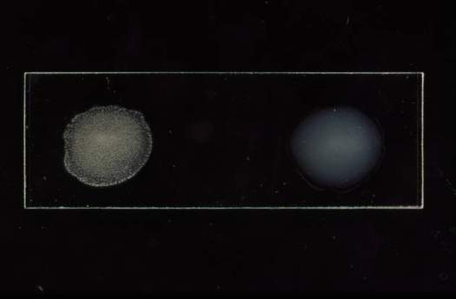
Slide Agglutination Test

Slide 20
Tube Agglutination Test
Also known as the standard agglutination test or serum agglutination test (SAT)
Test serum is diluted in a series of tubes (doubling dilutions)
Constant defined amount of antigen is then added to each tube and tubes incubated for ~20h @37°C
Particular antigen clumps at the bottom of the test tube
Test is read at 50% agglutination
Quantitative
Confirmatory test for ELISA reactors
Example: Brucellosis screening , Widal Testing

Slide 21
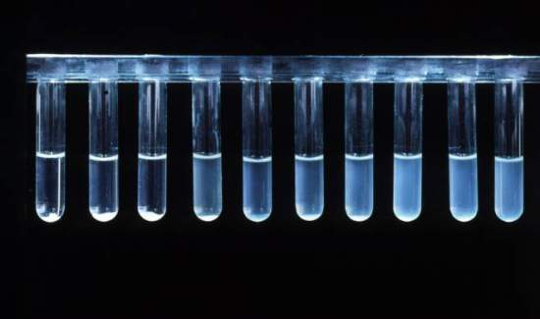
Tube Agglutination Test

Slide 22
Tube Agglutination Test
Agglutination
No agglutination
1/10
1/20
1/40
1/80
1/160
1/320
Neg. ctrl
In this case, the titre is 1/40

Slide 23
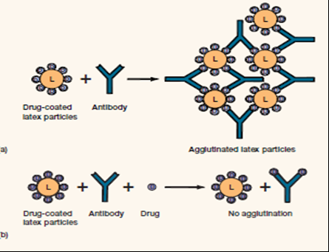
Passive Agglutination
An agglutination reaction that employs particles that are coated with antigens not normally found in the cell surfaces
Particle carriers include:
Red blood cells
Polystyrene latex
Bentonite
charcoal

Slide 24
Passive Agglutination
Passive agglutination has been used in the detection of :
- Rheumatoid factor
- Antinuclear antibody in LE
- Ab to group A streptococcus antigens
- Ab to Trichinella spiralis

Slide 25
Passive Agglutination Test
Converting a precipitating test to an agglutinating test
Chemically link soluble antigen to inert particles such as LATEX or RBC
Addition of specific antibody will cause the particles to agglutinate
Reverse PAT: antibody linked to LATEX
e.g. Lancefield grouping in Streptococci.

Slide 26
Reverse passive agglutination
Principle
- antigen binds to soluble antibody coated on carrier particles and results in agglutination
- detects antigens
Example
- detecting cholera toxin

Slide 27
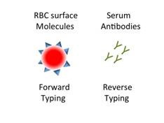
REVERSE PASSIVE Agglutination Tests
Antibody rather than antigen is attached to a carrier particle
For the detection of microbial antigens such as:
Group A and B streptococcus
Staphylococcus aureus
Neisseria meningitides
Haemophilus influenza
Rotavirus
Cryptococcus neoformans
Mycoplasma pneumoniae
Candida albicans

