Slide 1
Agglutination test
It is one of important laboratory method to detect antigen antibody reaction.
It provides flexible and useful method for semi quantitating of either antigen or antibody concentration.
The reaction occurs between insoluble antigen and appropriate antibody.

Slide 2
Agglutination test
Involves two-step process:
-Sensitization or initial binding
- Lattice formation or formation of large aggregates

Slide 3
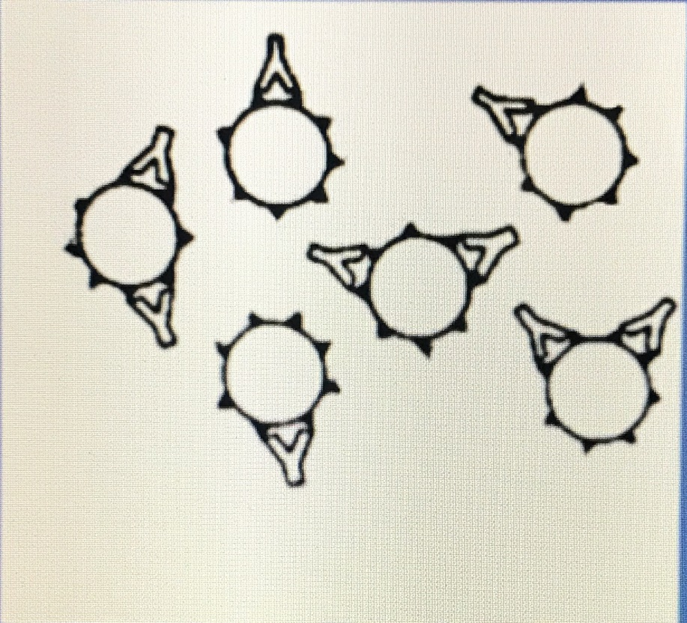
Step one :
This represents what occurs during stage one of agglutination : Sensitization
Antibody molecules attach to their corresponding Antigenic site (epitope) on the red blood cell membrane. There is no visible clumping.

Slide 4
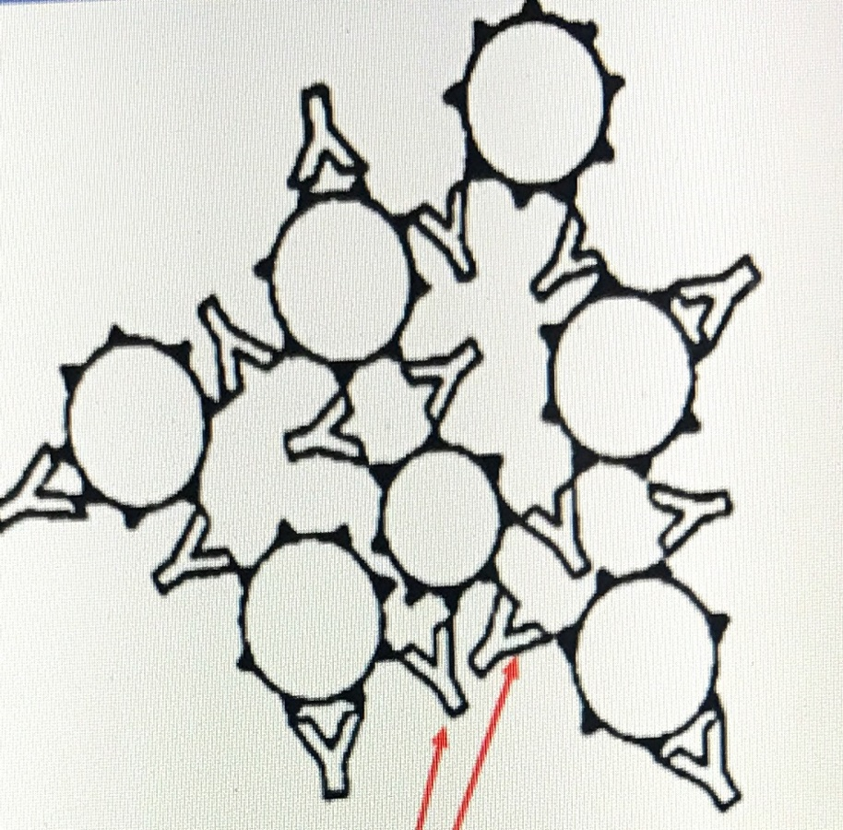
Step two:
This represents what occurs during stage two of agglutination: Lattic Formation
Antibody molecules crosslink RBCs forming a lattice that results in visible clumping or agglutination.

Slide 5
Agglutination test
-Antibodies can agglutinate multivalent particulate antigens, such as Red Blood Cells (RBCs) or bacteria.
-Some viruses also have the ability to agglutinate with RBCs.
-This behavior is called agglutination.
-Serological tests based on agglutination are usually more sensitive .

Slide 6
Examples
•Slide Agglutination Test
•Plate Agglutination Test
•Tube Agglutination Test
•Passive Agglutination Test
•Microscopic Agglutination
•Test Haemagglutination Test

Slide 7
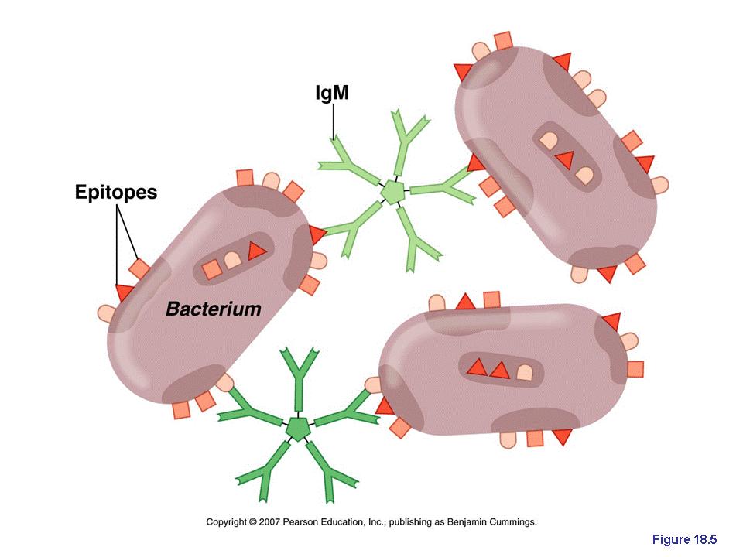
Types of agglutination reaction
1. Direct agglutination.
To test patient’s sera (contain antibody) against large antigen.
Direct agglutination can be used to determine antibody titer.

Slide 8
Slide Agglutination Test
•Used for serotyping (e.g. Salmonella)
•Antigen: isolated Salmonella in suspension Antibody: specific antisera against Salmonella .
•Place test Salmonella in a drop of saline on a slide .
•Add a drop of antiserum, mix and rock slide for approx. 1 minute .
•Examine for agglutination

Slide 9
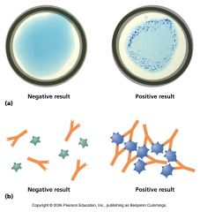

Slide 10
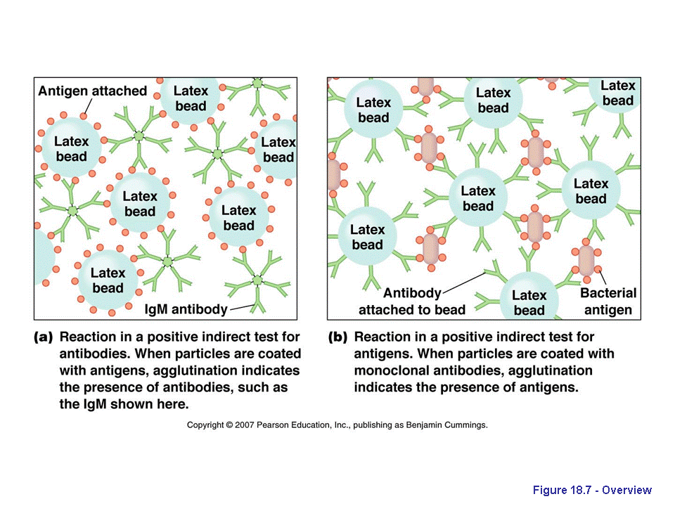
Types of agglutination reaction
2. Indirect agglutination
serum is mixed with latex spheres (inert substance) with the soluble antigens attached.
Antibodies will then cause visible agglutination of the latex spheres with the soluble antigens attached.

Slide 11
advantages of agglutination methods
ease of performance.
speed of performance, usually requiring few minutes.
high degree of sensitivity.

Slide 12
Disadvantages of agglutination methods
the reaction are only semi quantitative.
the occurrence of the prozone phenomenon, in which agglutination is inhibited by extreme antibody excess as a result of poor lattic formation.

Slide 13
Any Questions ?

