Slide 1
BCH 471
Determination of non-functional plasma enzymes in serum

Slide 2
Objectives
To determine the level of alanine transaminase (ALT) in serum.
To evaluate the presence of tissue damage.

Slide 3
Most clinical enzyme measurements using serum or plasma, occasionally other fluids, such as urine and gut secretions, are investigated.
Plasma Enzymes
Functional Plasma Enzymes
Nonfunctional Plasma Enzymes
Enzymes that are always present in the circulation and preform a function in the blood
Enzymes that preforms no known function in blood

Slide 4
Differences of Functional and Nonfunctional plasma enzymes
 | Functional plasma enzymes | Nonfunctional plasma enzymes
Their substrate | Always present in the blood | Absent from the blood
Site of synthesis | Liver | Different organs e.g. liver, heart, muscles, and brain
Effect of diseases | Decrease in liver diseases | Different enzymes increase in different organ diseases
Examples | Clotting factors Lipoprotein Lipase | ALT LDH Acid Phosphatase Amylase

Slide 5
Sources of Nonfunctional Plasma Enzyme
Cell damage with the release of its content of enzymes into blood e.g. Myocardial infarction and viral hepatitis
Obstruction of normal pathways e.g. Obstruction of bile duct increases alkaline phosphatase
Increase of the enzyme synthesis e.g. bilirubin increases the rate of synthesis of alkaline phosphatase in obstructive liver disease
Increased permeability of cell membrane as in hypoxia

Slide 6
Medical Importance of Non Functional Plasma Enzymes
Measurement of non functional enzymes is important for:
Diagnosis of diseases
Prognosis of the disease: following up of the treatment by measuring plasma enzymes before and after treatment.

Slide 7
Alanine transaminase
ALT is an enzyme that catalyzes a type of reaction (transamination) between an amino acid and α-keto acid.
It is important in the production of various amino acids.

Slide 8
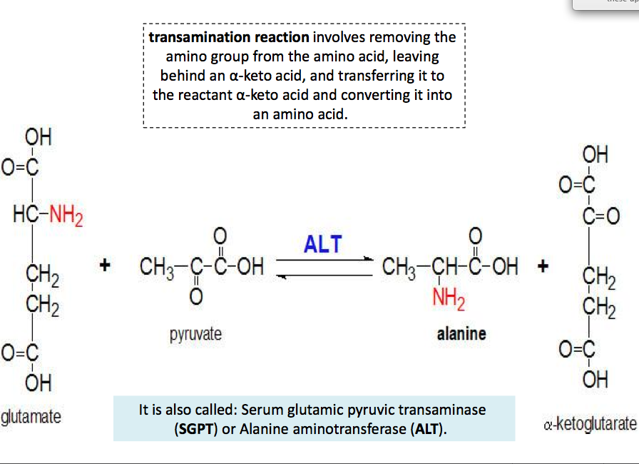

Slide 9
ALT diagnostic importance
ALT is found in serum (at low level) but is most commonly associated with the liver.
thus , an elevated level ALT is a sensitive index of acute hepatocellular injury.
Elevated serum ALT (SGPT) level are found in hepatitis, cirrhosis , and obstructive jaundice. Levels of ALT are only slightly elevated in patient following a myocardial infraction.

Slide 10
Method
 | Tube
ALT reagent | 3 ml
Pre-warm at 37 ºC for 3 minutes and add
Sample (serum) | 200 µl
Mix and incubate at 37 ºC for 1 minutes, then read the absorbance at 340 nm against distilled water (blank) every minute for 3 minutes and determine ΔA/min.
2) Applications → 2) Simple Kinetics → wave length (340 nm) → 1) Seconds → Duration (120 sec = 2 min) → Intervals (60 sec= 1 min) → Print Data Table (off) → Press start (2 times)

Slide 11
Results
 | Time (min) | Absorbance at 340 nm
A1 | 1
A2 | 2
A3 | 3

Slide 12
Calculations
ΔA₁, = A₁ – A₂
# ΔA/min = ( ΔA₁ + ΔA₂) / 2
ΔA₂ = A₂– A₃
ALT(U/L) =
ΔA x 1768
Normal Values
Males: up to 42( U/L)
Female: up to 32( U/L)

