Slide 1
Experiment 3 Separation of proteins by Anion exchange chromatography
The objective
1-to learn the principles of ion exchange chromatography by separating the charged molecules using a salt gradient.
2- Identification of the factors influencing ion exchange chromatography.
3- Importance of ion exchange chromatography and procedures in purification.
Column Packing:
Ion exchange chromatography is the reversible adsorption of charged molecules to immobilized ion groups on a matrix of an opposite charge. Separation can be selectively achieved by adsorption and release of samples from the matrix. Ion exchange starts with the equilibration of the exchanger using pH, and ionic strength. During equilibration the exchangable groups are associated with counter ions. Once equilibrium is reached and the sample added the molecules undergo addition and adsorption with an appropriate charge displace the counter ions and bind reversibly to the matrix. The unbound materials will pass through the column with the void volume. In the third stage, substances are removed from the column by increasing the ionic strength of the eluting buffer.
Iman Alshehri

Slide 2
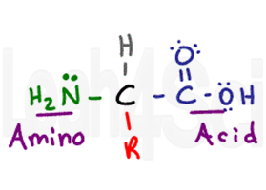
principle:
Separation and purification of proteins using ion exchange chromatography is based primarily on differences in the ionic properties of surface amino acids.
Exposed arginine, histidine, and lysine residues are generally positively charged and aspartic acid and glutamic acid residues possess a negative charge at neutral pH.
Thus at a given ph, a protein will possess an overall net charge.
At a lower pH, the net charge will be more positive +
At a higher pH, the net charge will be more negative - The pH at which the positive charges equal the negative charges (in other words, the net charge of the protein is zero) defines that protein’s isoelectric point (PI).
For IEC, a good rule to follow when separating a protein whose isoelectric point is known is to select a working pH which is 1 unit away from the PI of the protein. At this pH, the protein will possess a high enough net charge to bind well to the ion exchange column.

Slide 3
Stages
Set up column – pour column
Load ample on to column – adsorption
Wash unbounded off column
Elution

