Slide 1
Example 1
The following figure shows a view of the driver's seat of a truck cab, with dimensions corresponding to the letters below. The figure of the person indicate 36 different body dimensions. For each cab dimension below, indicate (first column) the important (limiting) body dimension number, and (second column) whether a 5th or 95th percentile anthropometric dimension should be used.

Slide 2
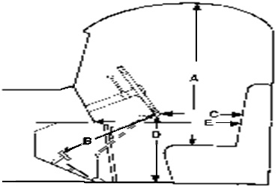
Example 1

Slide 3
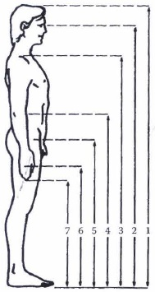
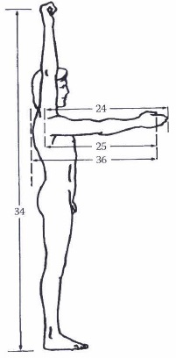
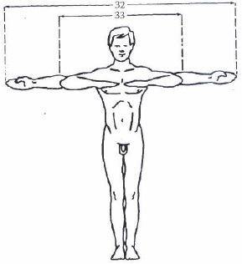
Standard Standing Posture – cont.

Slide 4
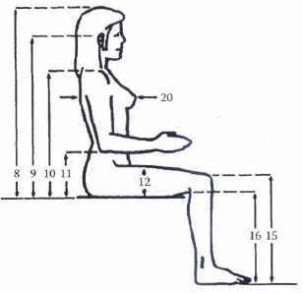
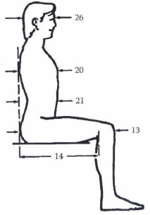
Standard Sitting Posture – cont.

Slide 5
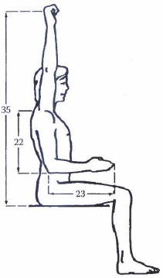
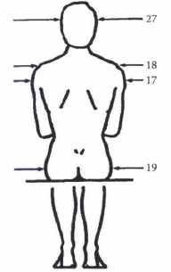
Standard Sitting Posture – cont.

Slide 6
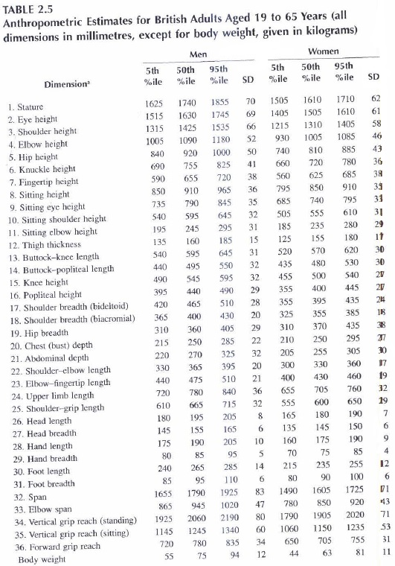

Slide 7
Example 1
Cab Dimension (from figure) | Limiting Body Dimension (from figure of person) | Design Dimension to Use (5th or 95th)
A. Distance from seat to roof | 8 Seated Height | 95th
B. Distance from top of foot pedals to lower edge of steering wheel | 15 Knee Height | 95th
C. Horizontal distance from lower edge of steering wheel to seat back (this is really a clearance issue) | 21 Abdomen Depth | 95th
D. Vertical distance from lower edge of steering wheel to floor (again, a clearance issue) | 15 Knee Height | 95th
E. Distance between dashboard and seat back (reach to dashboard) | 24 Arm Length (forward grip 36) | 5th

