Slide 1
Anti-Infective Agents
Antibiotics
Medications used to treat bacterial infections
Ideally, before beginning antibiotic therapy, the suspected areas of infection should be cultured to identify the causative organism and potential antibiotic susceptibilities.

Slide 2
Antibiotics
Empiric therapy: treatment of an infection before specific culture information has been reported or obtained
Prophylactic therapy: treatment with antibiotics to prevent an infection, as in intra-abdominal surgery

Slide 3
Antibiotics
Bactericidal: kill bacteria
Bacteriostatic: inhibit growth of susceptible bacteria, rather than killing them immediately; will eventually lead to bacterial death

Slide 4
Antibiotics: Nursing Implications
Before beginning therapy, assess drug allergies; hepatic, liver, and cardiac function; and other lab studies.
Be sure to obtain thorough patient health history, including immune status.
Assess for conditions that may be contraindications to antibiotic use, or that may indicate cautious use.
Assess for potential drug interactions.

Slide 5
Antibiotics: Nursing Implications
It is ESSENTIAL to obtain cultures from appropriate sites BEFORE beginning antibiotic therapy.

Slide 6
Antibiotics: Nursing Implications
Patients should be instructed to take antibiotics exactly as prescribed and for the length of time prescribed; they should not stop taking the medication early when they feel better.
Assess for signs and symptoms of superinfection: fever, perineal itching, cough, lethargy, or any unusual discharge.

Slide 7
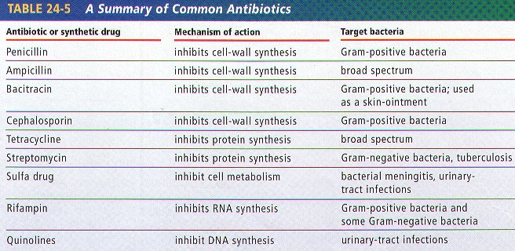
Antibiotics: Nursing Implications
Each class of antibiotics has specific side effects and drug interactions that must be carefully assessed and monitored.

Slide 8
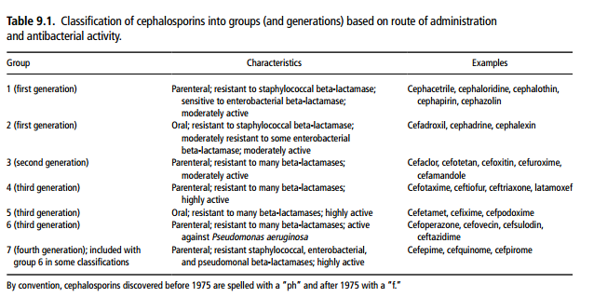
Antibiotics: Nursing Implications
The most common side effects of antibiotics are nausea, vomiting, and diarrhea.
All oral antibiotics are absorbed better if taken with at least 6 to 8 ounces of water.

