Slide 1
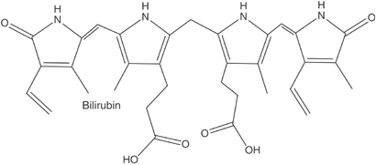
Estimation of Serum Bilirubin (Total & Direct)

Slide 2
Objective
To estimate the amount of bilirubin in serum.

Slide 3
Bilirubin
It is a by-product of the breakdown of hemoglobin.
(Yellow color)

Slide 4
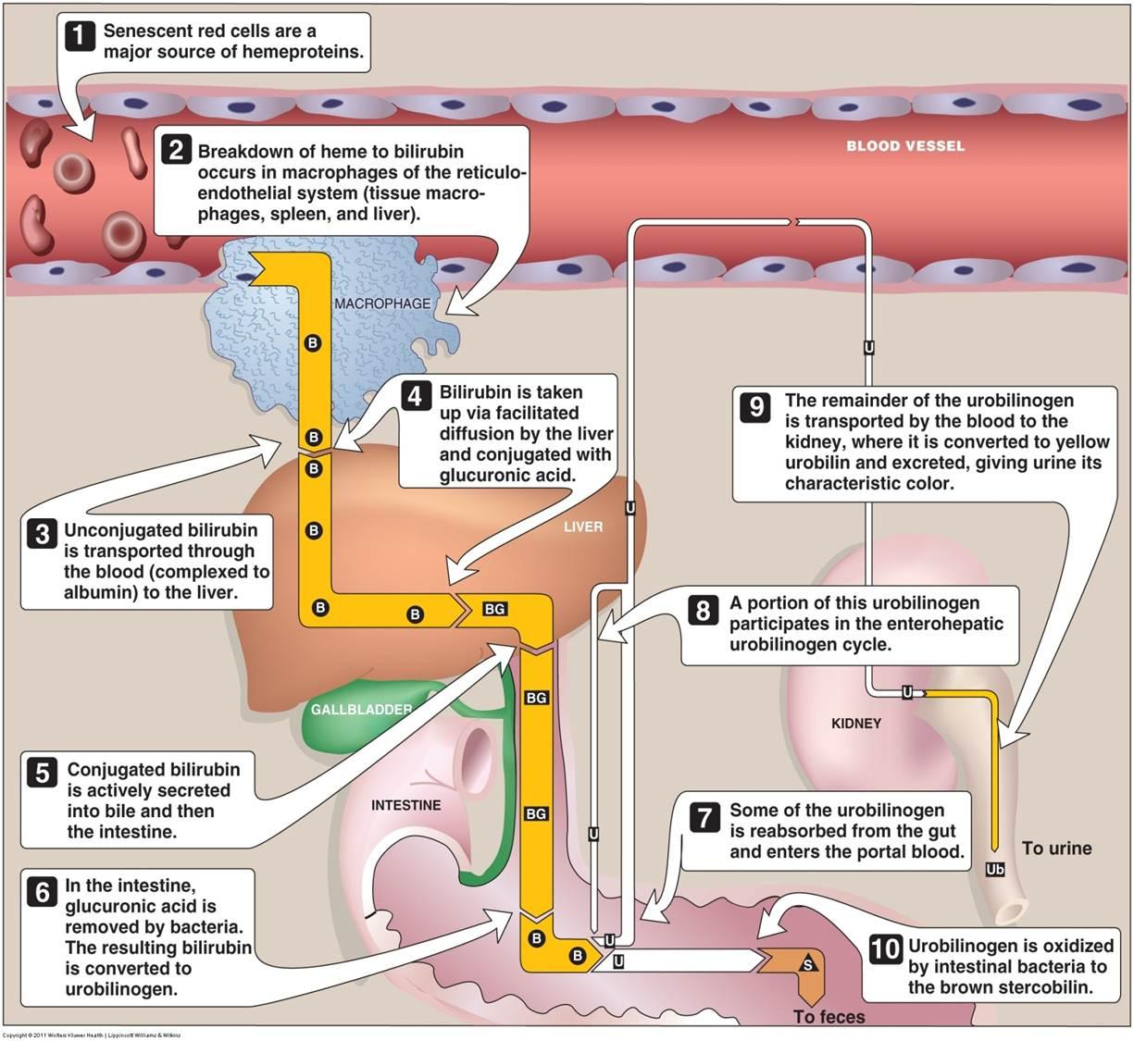
Bilirubin

Slide 5
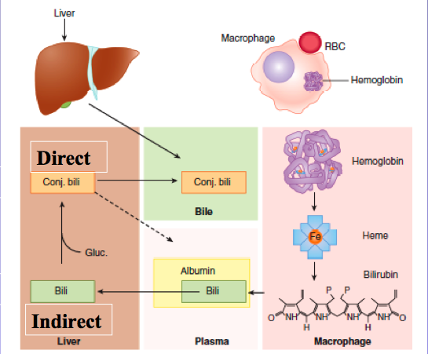
Types of Bilirubin
Direct bilirubin: Conjugated with glucoronic acid
Indirect bilirubin: unconjugated, insoluble in water
Total bilirubin: sum of the direct and indirect of bilirubin.
Notes:
-About 200 mg per day of unconjugated bilirubin are transported to the liver
-Disturbances in the powers of conjugated and/or excretion of the liver of this yellow compound will lead to raised levels in serum.
Above about 2 mg/dl in the blood, leads to disease called Jaundice.

Slide 6
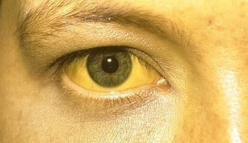
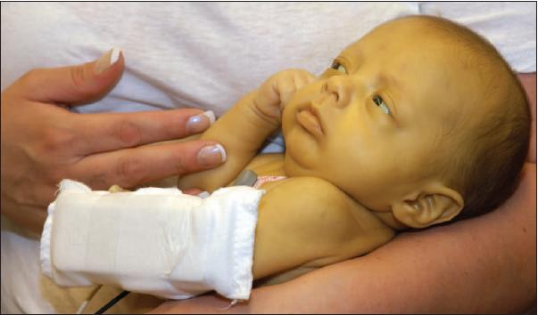
Bilirubin and jaundice
Jaundice is caused by a build-up of bilirubin (yellow color) in the blood and tissues of the body.
Jaundice is the discoloration of skin and sclera of the eye caused by high concentration of bilirubin.

Slide 7
The causes of jaundice may be classified as:
Types of jaundice
Pre-Hepatic Jaundice
Post-Hepatic Jaundice
Hepatic Jaundice
Hemolytic disease
-Cirrhosis of the liver
-Infective Hepatitis
-Neonatal Jaundice
Cholecystitis.

Slide 8
1-Pre-Hepatic Jaundice
Hemolytic disease (excess hemolysis)
The production of un-conjugated bilirubin may exceed the conjugating capacity of the liver and hence the serum levels of indirect (and of total) bilirubin will be raised and that of direct in the upper normal range or just a little elevated.
The other liver function tests will usually give normal results
excess
hemolysis
⬆ unconjugated bilirubin
(in blood)
upper normal range conjugated bilirubin (released to bile duct)

Slide 9
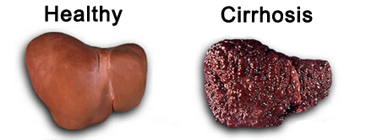
2-Hepatic Jaundice
Cirrhosis (in the absence of infection)
Destruction of liver cells will lead to a reduced conjugating capacity with a:
Raised serum level of indirect (and of total) bilirubin,
with a low level of direct bilirubin
and an abnormally high release, into the blood, of the enzymes: AST, ALT and ALP.
Synthesizing power of liver will be diminished and hence low levels of total protein, albumin and cholesterol

Slide 10
2-Hepatic Jaundice
Hepatitis (in the presense of infection)
The conjugative capacity of the liver is approximately normal, but there is the inability to transport the conjugated bilirubin from the liver cells to the biliary system, and it will be regurgitated back into the blood.
→ Hence:
The serum level of unconjugated bilirubin will be normal
and that of conjugated (and total) bilirubin will be raised.
Synthesizing power is diminished leading to low serum levels of proteins but the raising of antibodies to infection usually leads to raised total proteins level.
Normal unconjugated bilirubin (in blood)
⬆ conjugated bilirubin
(in blood)

Slide 11
2-Hepatic Jaundice
Neonatal Jaundice
Conjugating enzymes in the liver are often absent at birth.
→Hence:
Raised serum level of indirect (and total) bilirubin is to be expected
Low level of direct bilirubin.
The other liver functions are normal.
The indirect bilirubin level will rise for the first few days after birth until the conjugating enzymes begin to synthesize.
If the conjugation process is delayed and the serum level of indirect bilirubin rises towards 20 mg/dl, an ultraviolet therapy or an exchange blood transfusion should be carried out owing to the danger of deposition of the insoluble unconjugated bilirubin in the basal ganglia of the brain leading permanent Brain Damage.

Slide 12
3-Post-Hepatic Jaundice
Cholecystitis
The bile duct is blocked.
→Hence:
The indirect bilirubin level is normal but conjugated bilirubin is regurgitated into the blood and excreted into the urine (raised conjugated and total bilirubin).
Enzymes will be regurgitated into the blood giving raised levels.
The other liver function tests are normal
Normal unconjugated bilirubin (in blood)
⬆ conjugated bilirubin
(in blood)

Slide 13
Principle
Bilirubin in serum is coupled with diazotized sulphanilic acid to form azobilirubin .
The water soluble conjugated bilirubin (direct bilirubin) reacts easily with reagents such as diazotized sulphanilic acid.
while the water insoluble unconjugated bilirubin (indirect bilirubin) requires a solubilizing reagent, such as Caffeine, in order to react with the diazotized sulphanilic acid.
In this experiment, the direct bilirubin is estimated in the absence of the solubilizing agent and then further bilirubin estimation in the presence of the solubilizing agent will give the total bilirubin level.
The indirect or unconjugated bilirubin is then found by difference.

Slide 14
Method
Label 4 tubes as TT (total test), TB ( total Blank), DT (direct test), DB (direct Blank).
DB | DT | TB | TT
0.20 ml | 0.20 ml | 0.20 ml | 0.20 ml | Solution 1 (sulphanilic acid + HCl)
- | (0.05 ml) | - | (0.05 ml) | Solution 2 (Sodium nitrate)
_ | _ | 1.00 ml | 1.00 ml | Solution 3 (Caffeine + Sodium benzoate)
2.00 ml | 2.00 ml | _ | _ | NaCl solution 0.9%
0.20 ml | 0.20 ml | 0.20 ml | 0.20 ml | Sample
Mix, let stand for 5 min. at 20-25ºC. Read absorbance of test against blank (A_{DB}) for direct only at 546 nm. FOR TOTAL stand for 30 min at 20-25ºC.
- | - | 1.00 ml | 1.00 ml | For total bilirubin Solution 4 ( NaOH + tartarate)
Mix and let stand for 15 min and read the absorbance at 578 nm against blank (A_{TB}).

Slide 15
Calculation
Concentration of direct bilirubin = (abs. DT - abs. DB) X 14.4 = mg /dl
Normal range: Up to: 0.25 mg/dl
Concentration of total bilirubin = (abs. TT - abs. TB)X 10.8 = mg /dl
Normal range: Up to 1 mg/dl
Concentration of indirect bilirubin = Conc of total bilirubin – Conc of direct bilirubin= mg /dl
Normal range: 0.1-0.4 mg/dl

