Slide 1
Botnets Threats And Botnets DETECTION
Mona Aldakheel
434920317

Slide 2
Outline
BOTS AND BOTNETS
BOTNET CREATION AND PROPOGATION
BOTNET COMMAND AND CONTROL (C&C) TECHNIQUES
Rallying Mechanisms
Communication Protocols
SECURITY THREATS FROM BOTNET
BOTNET DETECTION

Slide 3
BOTS AND BOTNETS
The term “Bot” is derived from the word “Robot
Bots are designed to perform some predefined functions in automated way.
Botnet is a network of infected machines which are under the control of a human operator commonly known as botmaster.

Slide 4
Example illustrates how a botnet is created and used to send spam.

Slide 5
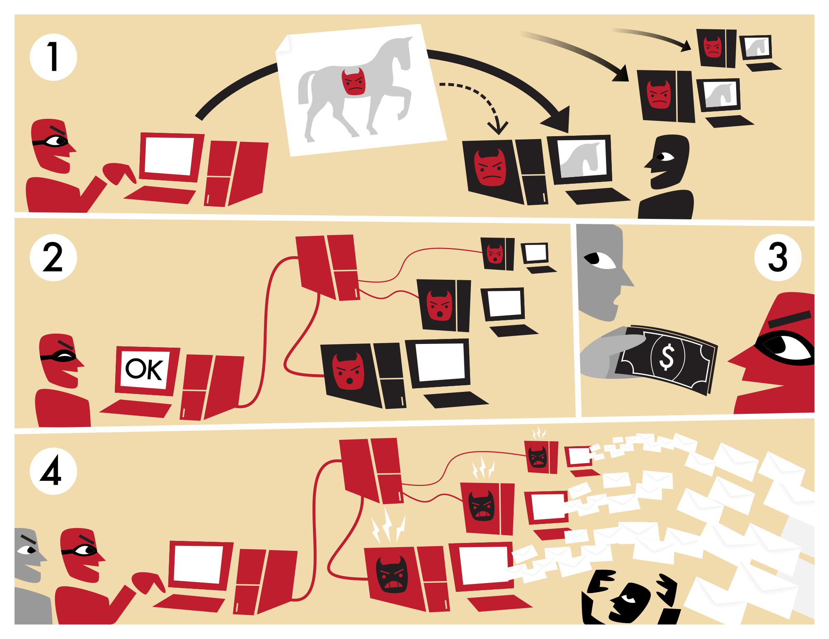

Slide 6
BOTNET CREATION AND PROPOGATION
Methods to create bot:
write code
extend or customize an existing bot.
Methods to propagate:
exploit vulnerabilities
sending out email messages
setting up Web sites

Slide 7
BOTNET COMMAND AND CONTROL (C&C) TECHNIQUES
Centralized Command & Control (C&C) Technique
P2P Command & Control (C&C) Technique
Random Command & Control (C&C) Technique

Slide 8
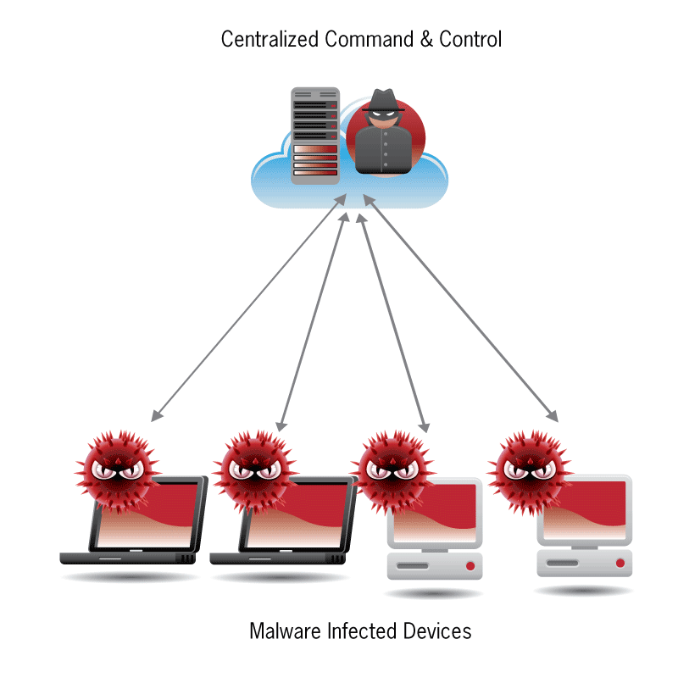
Centralized Command & Control (C&C) Technique

Slide 9
Centralized Command & Control (C&C) Technique
Advantages of using centralized C&C techniques
A great amount of resources are available online to create a C&C based botnet
Allows controlling of as many bots as possible and thus maximizes the profit of the botmaster.
Small message latency
Disadvantages of using centralized C&C techniques
Easy to shutdown.

Slide 10
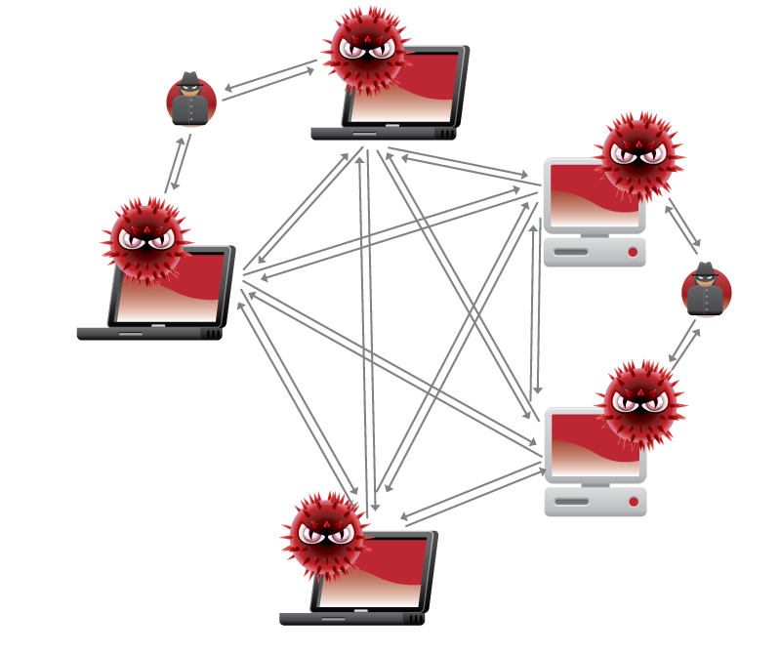
P2P Command & Control (C&C) Technique

Slide 11
P2P Command & Control (C&C) Technique
Advantages of using P2P Command & Control (C&C) Technique
Harder to locate, shutdown, monitor, and hijack
Propagation latency is lacking in P2P systems
Disadvantages of using P2P Command & Control (C&C) Technique
Hard to launch large scale attacks

Slide 12
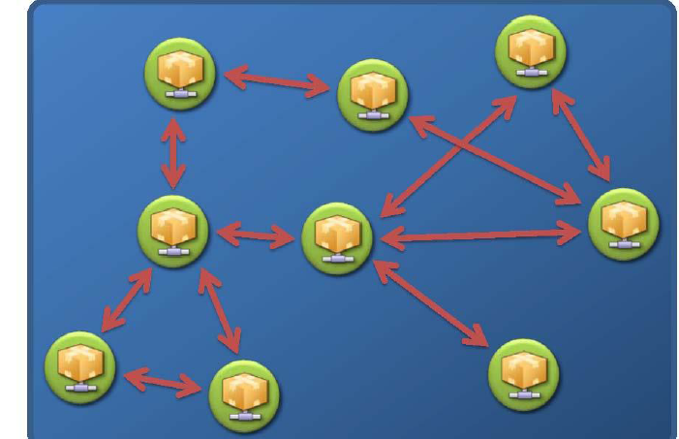
Random Command & Control (C&C) Technique

Slide 13
Random Command & Control (C&C) Technique
Advantage:
Easy implementation
Resilient to discovery and destruction
Disadvantage
Hard to launch large scale attacks
Propagation latency is very high.

Slide 14
Rallying Mechanisms
Rallying mechanisms used for:
Discover new bots
Rally them under their botmasters.
Rallying Mechanisms:
Hard-coded IP Address
Dynamic DNS Domain Name

Slide 15
Hard-coded IP Address
A common method used to rally new bots works like this:
A bot includes hard-coded C&C server IP addresses in its binary.
When the bot initially infects a computer, the computer will connect back to the C&C server using the hard-coded server IP address.

Slide 16
Drawbacks of Hard-coded IP Address
The problem with using hard-coded IP addresses is that
The C&C server can be easily detected
The communication channel can be easily blocked.

Slide 17
Dynamic DNS Domain Name
The bots today often include hard-coded domain names, assigned by dynamical DNS providers.

Slide 18
Benefit of Dynamic DNS Domain Name
if a C&C server is shutdown by authorities, the botmaster can easily resume his/her control by creating a new C&C server.

Slide 19
Communication Protocols
IRC Protocol
HTTP Protocol
P2P Protocol

Slide 20
SECURITY THREATS FROM BOTNET
Distributed Denial of Services (DDoS)
Spamming
Phishing and Identity Theft
Click Fraud
Hosting illegal material and disseminating malicious code

Slide 21
Distributed Denial of Services (DDoS)
Distributed Denial of Services (DDoS) attack is direct attempt of attackers to prevent legitimate users from using a specific service using multiple compromised systems.
Two main variants of DDoS attacks
Bandwidth depletion (Flooding and reflection attacks )
Resource depletion.

Slide 22
Spamming
Spamming is any message or posting, regardless of its content, that is sent to multiple recipients who have not specifically requested the message

Slide 23
Phishing and Identity Theft
Phishing and Identity Theft is a fraudulent activity defined as the creation of a replica of an existing Web page or other online resource to deceive a user into submitting personal, financial, or password data

Slide 24
Click Fraud
its fake clicks to maximize the revenue of certain users from the ads they publish on their websites.

Slide 25
Hosting illegal material and disseminating malicious code
Illegal material can be stored as a dynamic repository on a bot compromised computer by the botmaster.

Slide 26
BOTNET DETECTION
Honeypot
passive network traffic monitoring and analysis.
Signature-based Detection
Anomaly-based detection techniques
DNS-based detection techniques
Mining-based Detection

Slide 27
Signature-based Detection
Useful way for botnet detection based on Knowledge of useful signatures and behavior of existing botnets.
For example, Snort

Slide 28
Anomaly-based detection techniques
Attempt to detect botnets based on several network traffic anomalies such as high network latency.

Slide 29
DNS-based detection techniques
Detect botnets based on several DNS traffic anomalies

Slide 30
Mining-based Detection
One of effective technique for botnet detection to identify botnet C&C traffic.
Several data mining techniques including machine learning, classification, and clustering can be used efficiently to detect botnet C&C traffic.

Slide 31
Thanks

