Slide 1
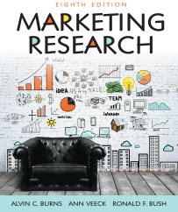
Chapter 2
The Marketing Research Industry

Slide 3
Evolution: Earliest Known Studies
Charles Coolidge Parlin, known as the “father of marketing research”, conducted the first continuous marketing research in the early 1900s for the Curtis Publishing Company.
The purpose of Parlin’s research was to increase advertising for Saturday Evening Post magazine.

Slide 4
Industry Growth
The Industrial Revolution led to manufacturers producing goods for distant markets.
Manufacturers needed to know about faraway consumers, which led to the growing need for marketing research.

Slide 5
20th Century Led to a “Mature Industry”
The 1900s saw the birth of firms and methods
A.C. Nielsen and Gallup
Alfred Politz – statistical sampling theory
Robert Merton – focus groups
Computers revolutionized the industry beginning in the 1950s
Data analysis
Tracking data
Online services

Slide 6
Who Conducts Marketing Research?
Client-side research: organizations that supply their own marketing research information.
Internal suppliers: Formal departments or individuals conduct research internally.
DYI research: facilitated by Internet, firms have access to secondary data, online survey platforms and better knowledge of data analysis software such as SPSS.

Slide 7
Who Conducts Marketing Research?
Supply-side research: External suppliers hired to fulfill a company’s marketing research needs.
Supplier or agency: firm specializing in marketing research that offers its services to buyers needing information to make more informed decisions.

Slide 8
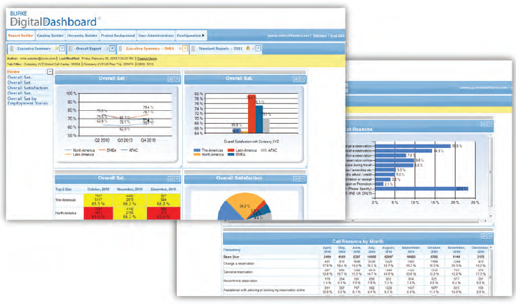

Slide 9
Industry Structure
Firms in the marketing research industry differ by:
Size
Type and specialty

Slide 10
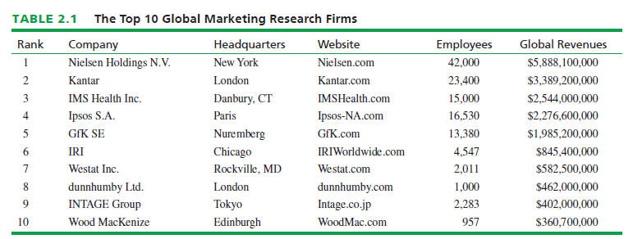

Slide 11
Industry Structure
Types of firms and their specialties
Full-service supplier firms: have the capability to conduct the entire marketing research project for buyer firms.
Limited-service supplier firms: specialize in one or, at most, a few marketing research activities.

Slide 12
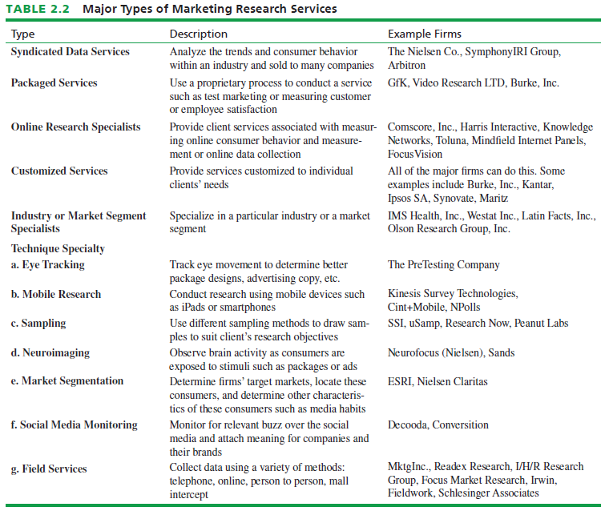

Slide 13
Industry Performance: Industry Revenues and Profits
ESOMAR estimates worldwide revenues for the marketing research industry at $43 billion.
Top 50 firms generated more than $28 billion, led by Nielsen Inc.
The largest marketing research companies are truly international.
Revenues vary around the world.

Slide 14
Challenges Facing Marketing Research
Three major challenges are:
New and evolving sources of data and methodologies
Need for the effective communication of results
Need for talented and skilled employees

Slide 15
Industry Initiatives
Industry initiatives to address these challenges include:
Establishing “best practices”
Maintaining public credibility of research
Monitoring industry trends
Improving ethical conduct

Slide 16
Marketing Research Codes of Conduct
Codes of conduct involve:
Fair Dealings with Respondents
Fair Dealings with Clients and Subcontractors
Maintaining Research Integrity
Concern for Society

Slide 17
Fair Dealings with Respondents
Participation is always voluntary
Respondent confidentiality must be maintained
Respondents will be treated professionally.
Respondents will not be given dishonest statements to secure their cooperation
Special provisions are required for doing research on minors

Slide 18
Fair Dealings with Clients and Subcontractors
All information obtained from clients shall remain confidential.
All research will be carried out according to the agreement with the client.
Client identity will not be revealed without proper authorization.
Secondary research will not be presented to the client as primary research.
Research results are the sole property of the client and will never be shared with other clients.

Slide 19
Fair Dealings with Clients and Subcontractors
Researchers will not collect information for more than one client at the same time without explicit permission from the clients involved.
Clients will be provided the opportunity to monitor studies in progress to ensure research integrity.
Researchers will not ask subcontractors to engage in any activity that does not adhere to professional codes, applicable laws, or regulations.

Slide 20
Maintaining Research Integrity
Data will never be falsified or omitted.
Research results will be reported accurately and honestly.
Researchers will not misrepresent the impact of the sampling method and its impact on sample data.

Slide 21
Concern for Society
Research released for public information will contain information to ensure transparency.
Researchers will not abuse public confidence in research.
Researchers will not represent a non-research activity to be research for the purpose of gaining respondent cooperation.

Slide 22
Qualified Research Professionals
Professionalism has been improved through:
Professional Researcher Certification (PRC)
Continuing education programs

Slide 23
All rights reserved. No part of this publication may be reproduced, stored in a retrieval system, or transmitted, in any form or by any means, electronic, mechanical, photocopying, recording, or otherwise, without the prior written permission of the publisher. Printed in the United States of America.

