Slide 1
Chapter 15
Understanding Regression Analysis Basics

Slide 2
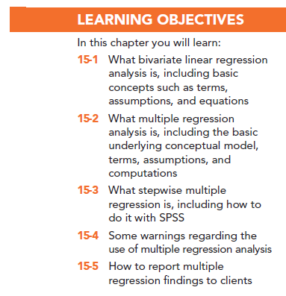

Slide 3
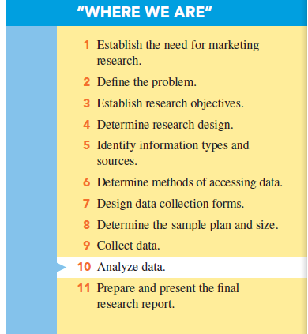

Slide 4
Bivariate Linear Regression Analysis
Regression analysis is a predictive analysis technique in which one or more variables are used to predict the level of another by use of the straight-line formula.
Bivariate regression means only two variables are being analyzed, and researchers sometimes refer to this case as “simple regression”.

Slide 5
Bivariate Linear Regression Analysis
With bivariate analysis, one variable is used to predict another variable.
The straight-line equation is the basis of regression analysis.

Slide 6
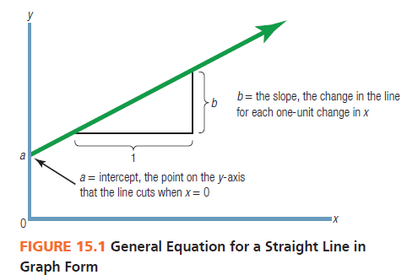
Bivariate Linear Regression Analysis

Slide 7
Basic Regression Analysis Concepts
Independent variable: used to predict the independent variable (x in the regression straight-line equation)
Dependent variable: that which is predicted (y in the regression straight-line equation)

Slide 8
Improving Regression Analysis
Identify any outlier -- a data point that is substantially outside the normal range of the data points being analyzed.

Slide 9
Computing the Slope and the Intercept
Least squares criterion: used in regression analysis; guarantees that the “best” straight-line slope and intercept will be calculated

Slide 10
Multiple Regression Analysis
Multiple regression analysis uses the same concepts as bivariate regression analysis, but uses more than one independent variable.
A general conceptual model identifies independent and dependent variables and shows their basic relationships to one another.

Slide 11
Multiple Regression Analysis: A Conceptual Model

Slide 12
Multiple Regression Analysis Described
Multiple regression means that you have more than one independent variable to predict a single dependent variable.
With multiple regression, the regression plane is the shape of the dependent variables.

Slide 13
Basic Assumptions in Multiple Regression

Slide 14
Example of Multiple Regression
We wish to predict customers’ intentions to purchase a Lexus automobile.
We performed a survey that included an attitude-toward-Lexus variable, a word-of-mouth variable and an income variable.

Slide 15
Example of Multiple Regression
The resultant equation:

Slide 16
Example of Multiple Regression
This multiple regression equation means that we can predict a consumer’s intention to buy a Lexus level if you know three variables:
Attitude toward Lexus
Friends’ negative comments about Lexus
Income level using a scale with 10 income levels.

Slide 17
Example of Multiple Regression
Calculation of one buyer’s Lexus purchase intention using the multiple regression equation:

Slide 18
Example of Multiple Regression
Multiple regression is a powerful tool because it tells us:
Which factors predict the dependent variable
Which way (the sign) each factor influences the dependent variable
How much (the size of bi) each factor influences it

Slide 19
Multiple R
Multiple R: also called the coefficient of determination, is a measure of the strength of the overall linear relationship in multiple regression.
It indicates how well the independent variables can predict the dependent variable.

Slide 20
Multiple R
Multiple R ranges from 0 to +1 and represents the amount of the dependent variable that is “explained,” or accounted for, by the combined independent variables.

Slide 21
Multiple R
Researchers convert the Multiple R into a percentage: Multiple R of .75 means that the regression findings will explain 75% of the dependent variable.

Slide 22
Basic Assumptions of Multiple Regression
Independence assumption: the independent variables must be statistically independent and uncorrelated with one another (the presence of strong correlations among independent variables is called multicollinearity)

Slide 23
Basic Assumptions of Multiple Regression
Variance inflation factor (VIF): can be used to assess and eliminate multicollinearity
VIF is a statistical value that identifies what independent variable(s) contribute to multicollinearity and should be removed
Any variable with VIF of greater than 10 should be removed

Slide 24
Basic Assumptions in Multiple Regression
The inclusion of each independent variable preserves the straight-line assumptions of multiple regression analysis. This is sometimes known as additivity because each new independent variable is added to the regression equation.

Slide 25
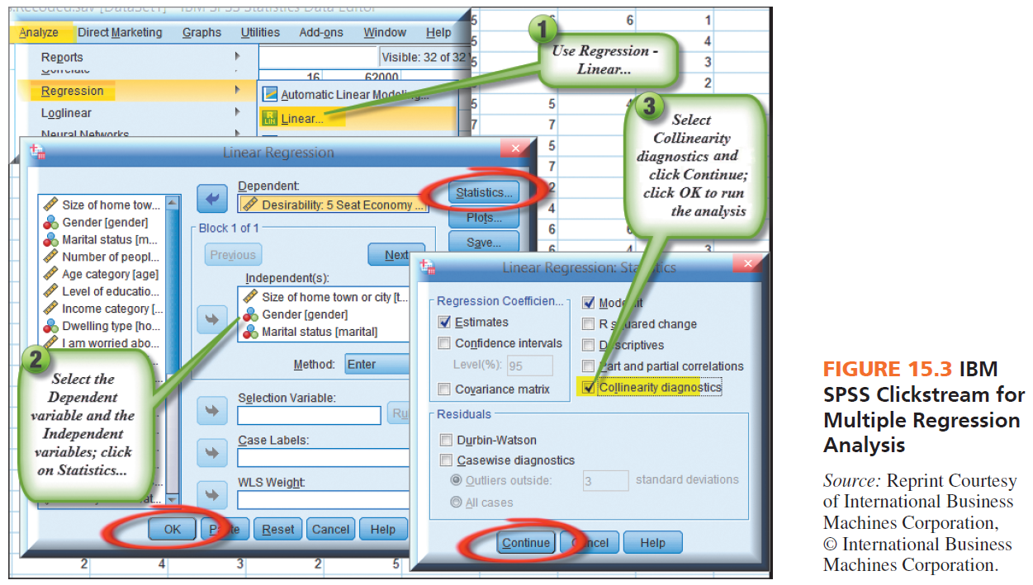

Slide 26
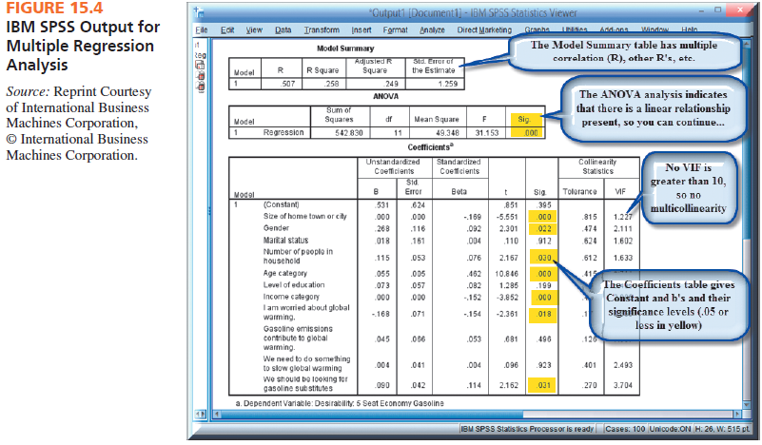

Slide 27
“Trimming” the Regression
A trimmed regression means that you eliminate the nonsignificant independent variables and, then, rerun the regression.
Run trimmed regressions iteratively until all betas are significant.
The resultant regression model expresses the salient independent variables.

Slide 28
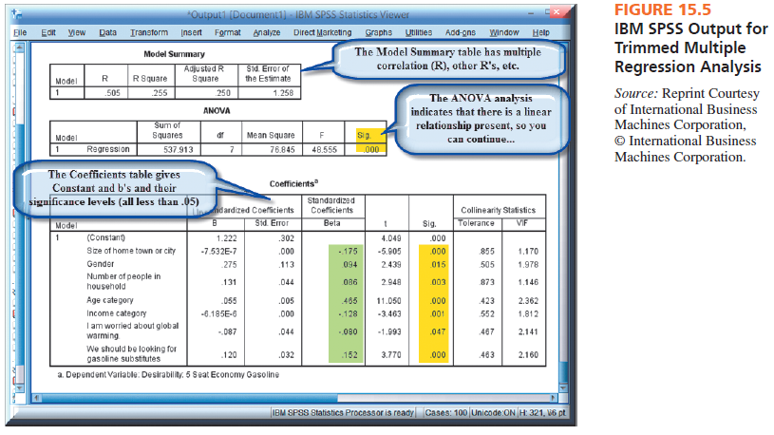

Slide 29
Special Uses of Multiple Regression
Dummy independent variable: scales with a nominal 0-versus-1 coding scheme
Using standardized betas to compare independent variables: allows direct comparison of each independent value
Using multiple regression as a screening device: identify variables to exclude

Slide 30
Stepwise Multiple Regression
Stepwise regression is useful when there are many independent variables, and a researcher wants to narrow the set down to a smaller number of statistically significant variables.

Slide 31
Stepwise Multiple Regression
The one independent variable that is statistically significant and explains the most variance is entered first into the multiple regression equation.
Then, each statistically significant independent variable is added in order of variance explained.
All insignificant independent variables are excluded.

Slide 32
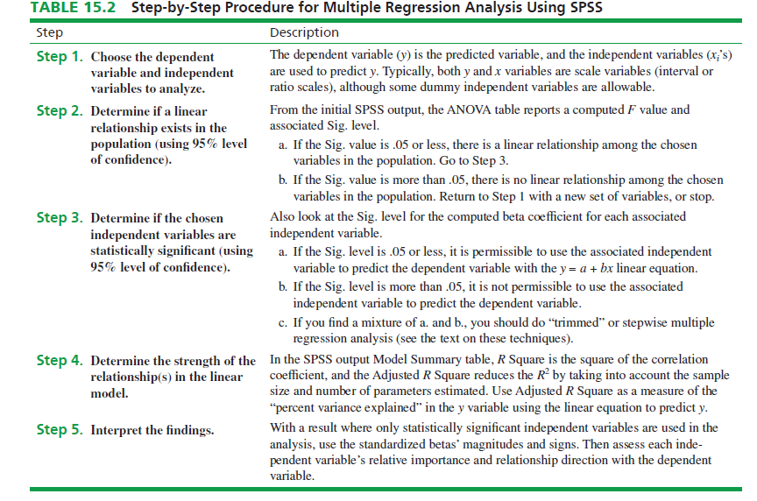

Slide 33
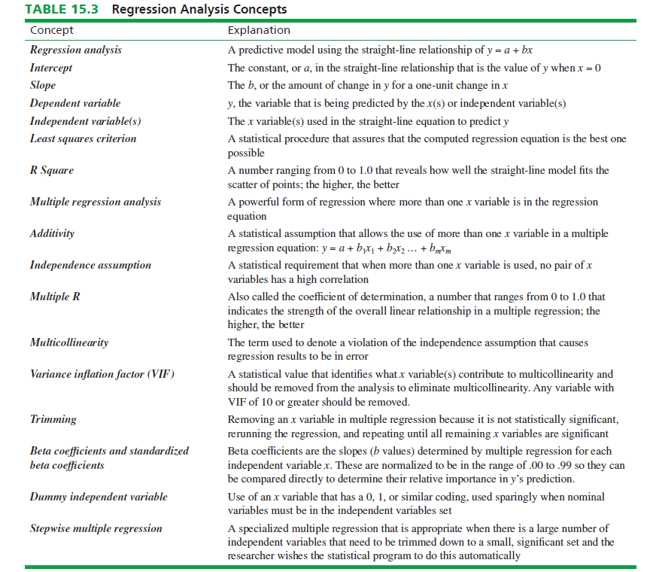

Slide 34
Three Warnings Regarding Multiple Regression Analysis
Regression is a statistical tool, not a cause-and-effect statement.
Regression analysis should not be applied outside the boundaries of data used to develop the regression model.
Chapter 15 is simplified…regression analysis is complex and requires additional study.

Slide 35
Reporting Findings to Clients
Most important when used as a screening devise:
Dependent variable
Statistically significant independent variables
Signs of beta coefficients
Standardized bets coefficients for significant variables

Slide 36
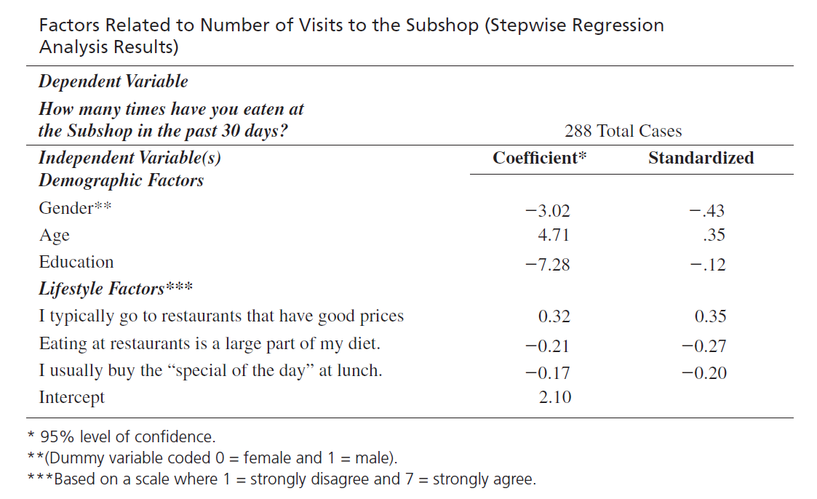
Example

Slide 37
All rights reserved. No part of this publication may be reproduced, stored in a retrieval system, or transmitted, in any form or by any means, electronic, mechanical, photocopying, recording, or otherwise, without the prior written permission of the publisher. Printed in the United States of America.

