Slide 1
N. Gregory Mankiw & Mohamed H. Rashwan
Principles of
Economics
Arab World Edition

Slide 2
In this chapter, look for the answers to these questions:
How much inequality and poverty exist in our society?
What are the problems measuring inequality?
What are some of the leading philosophies on the proper role of government in altering the distribution of income?
What policies are used to fight poverty? What are the problems with these policies?

Slide 3
Introduction
0
From the previous two chapters:
Equilibrium wages equal the value of workers’ marginal products.
Differences in equilibrium wages result from differences in
worker characteristics: education, experience, talent, effort
job characteristics: extent to which a job is pleasant and safe
Some earnings differences due to discrimination.
Notes:
2

Slide 4
Introduction
0
Even in the absence of discrimination, the income distribution in a market economy may not be equitable or otherwise desirable.
In this chapter, we examine:
indicators of inequality and poverty
philosophies about income redistribution
policies designed to help the poor.
Notes:
3

Slide 5
Income inequality by quintile
0
Country | Lowest 20 percent | Lowest 20 percent | Lowest 20 percent | Lowest 20 percent | Lowest 20 percent
Egypt | 9 | 21 | 16 | 13 | 40
Iran | 6 | 22 | 16 | 11 | 45
Jordan | 8 | 21 | 16 | 11 | 44
Morocco | 8 | 21 | 15 | 10 | 48
Tunisia | 6 | 23 | 16 | 11 | 48
Yemen | 7 | 21 | 15 | 11 | 45
Notes:
4
Table 1 from text book

Slide 6
Income inequality by decile
0
Country | Lowest 10 percent | First 10 percent
Egypt | 4 | 27
Iran | 3 | 30
Jordan | 3 | 29
Morocco | 3 | 33
Qatar | 1 | 36
Tunisia | 3 | 28
Yemen | 3 | 31
Notes:
5
Table 2 from text

Slide 7
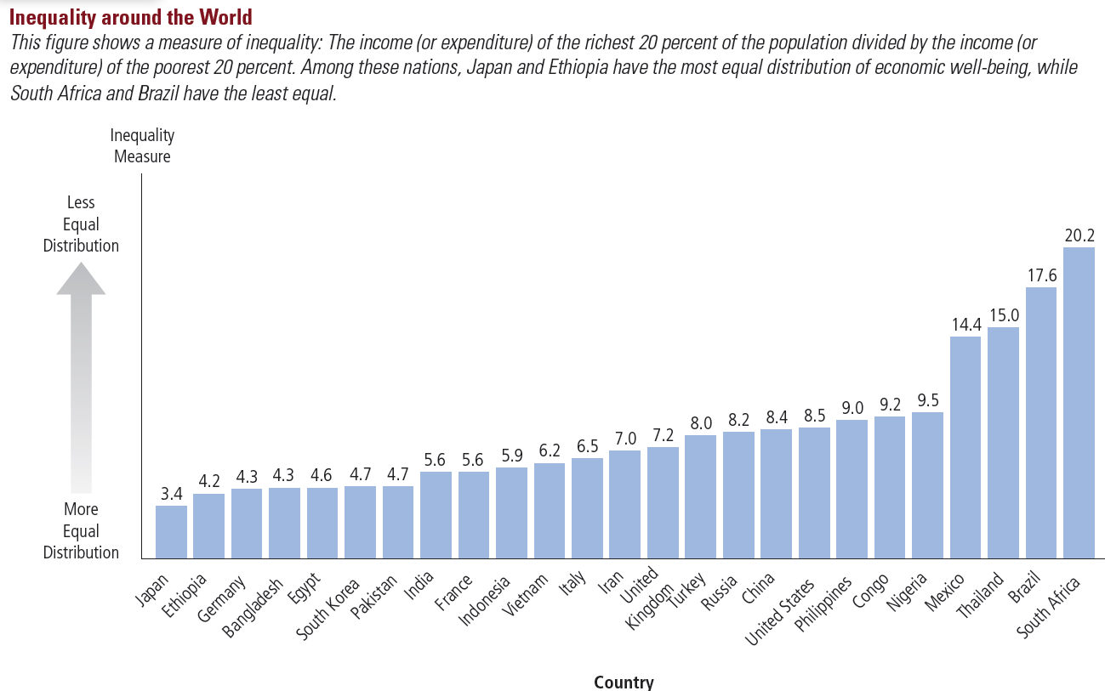
Inequality Around the World
0
The income of the richest 20% has been divided by the income of the poorest 20% or population.
Notes:
6
Source: Figure 1, Chapter 20.

Slide 8
Poverty
0
Poverty line: an absolute level of income set by the govt for each family size below which a family is deemed to be in poverty
Poverty rate: the percentage of the population whose family income falls below the poverty line
Notes:
7
See text book for table of percentage population living under poverty line in middle east countries

Slide 9
Population below the poverty line
0
Country | Population below the poverty line %
Egypt | 22 (2008)
Gaza Strip | 38 (2010 est)
Iran | 19 (2007 est)
Iraq | 25 (2008 est)
Jordan | 14 (2002)
Lebanon | 28 (1999)
Morocco | 9 (2007 est)
Syria | 12 (2006 est)
UAE | 19 (2003 est)
Yemen | 54 (2013)
Notes:
8
Table 4 from text book

Slide 10
Problems Measuring Inequality
0
1. In-kind transfers: assistance that takes the form of goods and services rather than cash.
Omitted from measures of inequality and poverty, biasing them upward.
2. The Life Cycle: the regular pattern of income variation over a person’s life.
People can borrow and save to offset life-cycle changes in income (e.g., saving for retirement).
Life-cycle income variation causes inequality in income but not inequality in living standards.
Notes:
9

Slide 11
Problems Measuring Inequality
0
3. Transitory versus permanent Income:
People can borrow and save to smooth out transitory income fluctuations.
A better measure of inequality in living standards would be based not on current income, but on permanent income, a person’s normal income.
4. Economic mobility:
Many people move among income classes.
The poverty and inequality measures discussed above do not distinguish between the temporarily poor and the persistently poor.
Notes:
10

Slide 12
The Political Philosophy of Redistributing Income
0
We consider three philosophies:
Utilitarianism
Liberalism
Libertarianism
Notes:
11

Slide 13
Utilitarianism
0
Utility: A measure of happiness or satisfaction
Utilitarianism: Argues that government should choose policies to maximize society’s total utility
Founders: Jeremy Bentham, John Stuart Mill
Because of diminishing marginal utility, redistributing income from rich to poor increases utility of the poor more than it reduces utility of the rich.
Yet, utilitarians do not advocate equalizing incomes – would reduce total income of everyone due to incentive effects and efficiency losses.
Notes:
12

Slide 14
Liberalism
0
Liberalism: Argues that government should choose policies deemed to be just by an impartial observer behind a “veil of ignorance”
Founder: John Rawls
Maximin criterion: Government should aim to maximize the well-being of society’s worst-off person.
Calls for more redistribution than utilitarianism (though still not complete equalization of incomes).
Income redistribution is a form of social insurance, a government policy aimed at protecting people against the risk of adverse events.
Notes:
13

Slide 15
Libertarianism
0
Libertarianism: Argues that government should punish crimes and enforce voluntary agreements but not redistribute income.
Advocate: Robert Nozick
Instead of focusing on outcomes, libertarians focus on the process.
Government should enforce individual rights, should try to equalize opportunities.
If the income distribution is achieved fairly, government should not interfere, even if unequal.
Notes:
14

Slide 16
Policies to Reduce Poverty
0
Poor families more likely to experience
homelessness
drug dependence
health problems
teen pregnancy
illiteracy
Unemployment.
Most people believe government should provide a “safety net.”
We now consider a few such policies…
Notes:
15

Slide 17
1. Minimum-Wage Laws
0
Arguments for:
Helps the poor without any cost to the government.
Little impact on employment if demand for unskilled labor is relatively inelastic.
Arguments against:
In the long run, demand for unskilled labor is likely elastic, so minimum wage causes substantial unemployment among the unskilled.
Those helped by minimum wage are more likely to be teens from middle-income families than low-income adult workers.
Notes:
16
Students will recall the effects of the minimum wage from Chapter 6, which covered price floors and ceilings.
A few additional notes about the minimum wage:
Yes, it helps the poor at no cost to the government. But there’s no such thing as a free lunch. The minimum wage transfers income to workers from firms (or rather, their owners) and from consumers, who will end up paying higher prices for goods made with unskilled labor.

Slide 18
2. Welfare
0
Welfare: Government programs that supplement the incomes of the needy.
Critics argue that such programs create incentives to become or remain needy, argue that welfare contributed to the rise of the single-parent family.
However, the severity of such incentive problems is unknown.
Proponents note that inflation-adjusted welfare benefits fell as single-parent families increased.
Notes:
17

Slide 19
3. Negative Income Tax
0
Negative income tax: A tax system that collects revenue from high-income households and gives transfers to low-income households
Example: Taxes owed = (1/3 of income) – $10,000
If earnings = $90,000, taxes owed = $20,000
If earnings = $60,000, taxes owed = $10,000
If earnings = $30,000, taxes owed = $0
If earnings = $15,000, taxes “owed” = –$5,000 i.e., would receive $5,000 payment from government.
Notes:
18
With a negative income tax, the marginal tax rate is as low for low income persons as it is for high income persons. This is in sharp contrast to other welfare-type programs, which take away benefits as income rises, thus creating very high effective marginal tax rates for the poor.

Slide 20
4. In-Kind Transfers
0
In-kind transfers are goods or services provided to the needy. Examples:
homeless shelters
soup kitchens
food stamps, government vouchers redeemable for food at grocery stores
Government provided healthcare for the poor.
An alternative: Cash payments-
would allow people to buy what they most need
but critics argue could be used for other items such as illegal drugs.
Notes:
19
A cash payment would let workers buy whatever they think they most need. Many economists believe that the government cannot know what people need better than the people themselves.
Regarding the argument that the recipients could spend the money on drugs:
Suppose the choice is giving the person $50 cash or $50 worth of food. If you give them $50 cash, they could buy drugs. If you give them $50 worth of food, they spend $50 less of their own money on food, and can now spend this $50 on drugs. The outcome is the same in either case.

Slide 21
Anti-Poverty Programs and Work Incentives
0
Assistance from anti-poverty programs declines as income rises.
The result: Poor families face high effective marginal tax rates (exceeding 100% in some cases).
Such policies therefore discourage the poor from escaping poverty on their own.
One possible solution: “Workfare,” a system requiring people to accept government jobs while collecting benefits.
Notes:
20

Slide 22
CONCLUSION
0
Poverty is one of society’s most serious problems.
One of the Ten Principles from Chapter 1:
Governments can sometimes improve market outcomes.
Public policy can help reduce poverty and inequality.
Another principle: People face trade-offs.
Policies designed to improve equity often sacrifice efficiency, so the proper scope of policy is the subject of ongoing controversy.
Notes:
21

Slide 23
SUMMARY
Data on the distribution of income show a wide disparity in many Arab World countries. The richest fifth of families earns far more income than the poorest fifth.
Problems in measuring inequality arise from in-kind transfers, the economic life cycle, transitory income, and economic mobility. When these factors are taken into account, the distribution of well-being is probably less unequal than the distribution of annual income.
© 2015 Cengage Learning. All Rights Reserved. May not be copied, scanned, or duplicated, in whole or in part, except for use as permitted in a license distributed with a certain product or service or otherwise on a password-protected website for classroom use.

Slide 24
SUMMARY
Political philosophers differ in their views of the proper role of government in altering the income distribution. Utilitarians believe that income distribution should maximize the sum of everyone’s utility. Liberals believe the government should aim to maximize the well-being of the worst-off person in society. Libertarians believe the government should aim for equality of opportunity, not equality of income.
© 2015 Cengage Learning. All Rights Reserved. May not be copied, scanned, or duplicated, in whole or in part, except for use as permitted in a license distributed with a certain product or service or otherwise on a password-protected website for classroom use.

Slide 25
SUMMARY
Policies such as welfare, minimum-wage laws, negative income taxes, and in-kind transfers can help the poor.
Since financial assistance falls as income rises, the poor face high effective marginal tax rates, discouraging them from escaping poverty on their own.
© 2015 Cengage Learning. All Rights Reserved. May not be copied, scanned, or duplicated, in whole or in part, except for use as permitted in a license distributed with a certain product or service or otherwise on a password-protected website for classroom use.

