Slide 1
N. Gregory Mankiw & Mohamed H. Rashwan
Principles of
Economics
Arab World Edition

Slide 2
In this chapter, look for the answers to these questions:
What is the Consumer Price Index (CPI)? How is it calculated? What’s it used for?
What are the problems with the CPI? How serious are they?
How does the CPI differ from the GDP deflator?
How can we use the CPI to compare dollar amounts from different years? Why would we want to do this, anyway?
How can we correct interest rates for inflation?

Slide 3
The Consumer Price Index (CPI)
0
The CPI measures the typical consumer’s cost of living.
It is the basis of cost of living adjustments (COLAs) in many contracts and in welfare payments .
Notes:
2

Slide 4
How the CPI Is Calculated
0
Fix the “basket.” The national statistics service in a country surveys consumers to determine what’s in the typical consumer’s “shopping basket.”
Find the prices. They collect data on the prices of all the goods in the basket.
Compute the basket’s cost. Use the prices to compute the total cost of the basket.
Notes:
3

Slide 5
How the CPI Is Calculated
0
Choose a base year and compute the index. The CPI in any year equals…
100 x
cost of basket in current year
cost of basket in base year
Compute the inflation rate. The percentage change in the CPI from the preceding period.
Inflation rate
CPI this year – CPI last year
=
x 100%
CPI last year
Notes:
4

Slide 6
EXAMPLE
0
basket: {4 baklawa, 10 teas}
year
price of Baklawa
price of tea
cost of basket
2012
$10
$2.00
$10 x 4 + $2 x 10 = $60
2013
$11
$2.50
$11 x 4 + $2.5 x 10 = $69
2014
$12
$3.00
$12 x 4 + $3 x 10 = $78
Compute CPI in each year
2012: 100 x ($60/$60) = 100
2013: 100 x ($69/$60) = 115
2014: 100 x ($78/$60) = 130
Inflation rate:
using 2012 base year:
115 – 100
15%
=
x 100%
100
130 – 115
13%
=
x 100%
115
Notes:
5

Slide 7
ACTIVE LEARNING ₁ Calculate the CPI
 | price of lamb | price of chicken
2012 | $4 | $4
2013 | $5 | $5
2014 | $9 | $6
CPI basket: {10 lbs lamb, 20 lbs chicken}
The CPI basket cost $120 in 2012, the base year.
A. Compute the CPI in 2013.
B. What was the CPI inflation rate from 2013–2014?
© 2015 Cengage Learning. EMEA All Rights Reserved. May not be copied, scanned, or duplicated, in whole or in part, except for use as permitted in a license distributed with a certain product or service or otherwise on a password-protected website for classroom use.
Notes:
Part A is not difficult but requires an intermediate step: students must compute the cost of the basket in 2011 to find the CPI in 2011.
Part B has two intermediate steps: computing the cost of the basket in 2012, then computing the CPI in 2012.

Slide 8
ACTIVE LEARNING ₁ Answers
 | price of lamb | price of chicken
2012 | $4 | $4
2013 | $5 | $5
2014 | $9 | $6
CPI basket: {10 lbs lamb, 20 lbs chicken}
The CPI basket cost $120 in 2012, the base year.
A. Compute the CPI in 2013:
Cost of CPI basket in 2013 = ($5 x 10) + ($5 x 20) = $150
CPI in 2013 = 100 x ($150/$120) = 125
© 2012 Cengage Learning EMEA. All Rights Reserved. May not be copied, scanned, or duplicated, in whole or in part, except for use as permitted in a license distributed with a certain product or service or otherwise on a password-protected website for classroom use.

Slide 9
ACTIVE LEARNING ₁ Answers
 | price of lamb | price of chicken
2012 | $4 | $4
2013 | $5 | $5
2014 | $9 | $6
CPI basket: {10 lbs lamb, 20 lbs chicken}
The CPI basket cost $120 in 2012, the base year.
B. What was the inflation rate from 2013–2014?
Cost of CPI basket in 2014 = ($9 x 10) + ($6 x 20) = $210
CPI in 2014 = 100 x ($210/$120) = 175
CPI inflation rate = (175 – 125)/125 = 40%
© 2015 Cengage Learning. EMEA All Rights Reserved. May not be copied, scanned, or duplicated, in whole or in part, except for use as permitted in a license distributed with a certain product or service or otherwise on a password-protected website for classroom use.

Slide 10
What’s in the CPI’s Basket?
0
The basket will vary from country to country. The
following is an example of the basket in Lebanon.
Food and beverages
Tobacco
Clothing and footwear
Housing
Water & fuels
Furnishings and house repairs
Health
Transportation
Communication
Leisure
Education
Restaurant & hotels
Miscellaneous.
Notes:
9

Slide 11
ACTIVE LEARNING ₂ Substitution bias
CPI basket: {10# lamb, 20# chicken}
2012–13: Households bought CPI basket.
2014: Households bought {5 lbs lamb, 25 lbs chicken}.
 | lamb | chicken | cost of CPI basket
2012 | $4 | $4 | $120
2013 | $5 | $5 | $150
2014 | $9 | $6 | $210
A. Compute cost of the 2014 household basket.
B. Compute % increase in cost of household basket over 2013–14, compare to CPI inflation rate.
© 2015 Cengage Learning. EMEA All Rights Reserved. May not be copied, scanned, or duplicated, in whole or in part, except for use as permitted in a license distributed with a certain product or service or otherwise on a password-protected website for classroom use.
Notes:
Students understand substitution bias better if they work a concrete example like the one on this slide.
Before displaying the questions (A + B), you might want to ask your class why households bought different quantities of lamb and chicken in 2012 than they did in 2011.
Or if that seems too easy, just mention before displaying questions A and B that households are responding to the change in relative prices: lamb has become a lot more expensive relative to chicken, so households buy less lamb and more chicken.

Slide 12
ACTIVE LEARNING ₂ Answers
CPI basket: {10# lamb, 20# chicken}
Household basket in 2014: {5# lamb, 25# chicken}
 | lamb | chicken | cost of CPI basket
2012 | $4 | $4 | $120
2013 | $5 | $5 | $150
2014 | $9 | $6 | $210
A. Compute cost of the 2014 household basket.
($9 x 5) + ($6 x 25) = $195
© 2012 Cengage Learning EMEA. All Rights Reserved. May not be copied, scanned, or duplicated, in whole or in part, except for use as permitted in a license distributed with a certain product or service or otherwise on a password-protected website for classroom use.
Notes:
This is just a straightforward calculation.

Slide 13
ACTIVE LEARNING ₂ Answers
CPI basket: {10# lamb, 20# chicken}
Household basket in 2014: {5# lamb, 25# chicken}
 | lamb | chicken | cost of CPI basket
2012 | $4 | $4 | $120
2013 | $5 | $5 | $150
2014 | $9 | $6 | $210
B. Compute % increase in cost of household basket over 2013–14, compare to CPI inflation rate.
Rate of increase: ($195 – $150)/$150 = 30%
CPI inflation rate from previous problem = 40%
© 2015 Cengage Learning. EMEA All Rights Reserved. May not be copied, scanned, or duplicated, in whole or in part, except for use as permitted in a license distributed with a certain product or service or otherwise on a password-protected website for classroom use.
Notes:
Ask students which inflation rate (30% or 40%) they think more accurately measures the true increase in the cost of living for this example.
Most students will correctly say “30%.” Ask them to explain their reasoning. You are guiding them to figure out substitution bias and why it’s a problem.

Slide 14
Problems with the CPI: Substitution Bias
0
Over time, some prices rise faster than others.
Consumers substitute toward goods that become relatively cheaper, mitigating the effects of price increases.
The CPI misses this substitution because it uses a fixed basket of goods.
Thus, the CPI overstates increases in the cost of living.
Notes:
13

Slide 15
Problems with the CPI: Introduction of New Goods
0
The introduction of new goods increases variety, allows consumers to find products that more closely meet their needs.
In effect, dollars become more valuable.
The CPI misses this effect because it uses a fixed basket of goods.
Thus, the CPI overstates increases in the cost of living.
Notes:
14

Slide 16
Problems with the CPI: Unmeasured Quality Change
0
Improvements in the quality of goods in the basket increase the value of each dollar.
National statistical services try to account for quality changes but probably misses some, as quality is hard to measure.
Thus, the CPI overstates increases in the cost of living.
Notes:
15

Slide 17
Problems with the CPI
0
Each of these problems causes the CPI to overstate cost of living increases.
National statistical services make technical adjustments, but the CPI probably still overstates inflation.
This is important because welfare payments and contracts may have COLAs tied to the CPI.
Notes:
16
In the 1990s, it was estimated that the CPI’s bias cost taxpayers $1 trillion every 12 years in unnecessary COLAs in Social Security and government pension payments!!!

Slide 18
Two Measures of Inflation, U.S. 1950–2010
0
Percent per year
Notes:
17
This figure shows the inflation rate—the percentage change in the level of prices—as measured by the GDP deflator and the Consumer Price Index.
Notice that the two measures of inflation generally move together. There are a few years when they diverge a bit. The reasons for this are on the next slide.
Sources:
GDP deflator – Bureau of Economic Analysis, U.S. Dept. of Commerce
CPI – Bureau of Labor Statistics, U.S. Dept. of Labor
Both series are quarterly and the inflation rate is calculated as the percentage change from one year earlier. The monthly CPI is aggregated into quarters by averaging monthly values.
I used the series CPIAUS and GDPDEF from the Federal Reserve Bank of St. Louis “Fred” database:
http://research.stlouisfed.org/fred2/

Slide 19
Contrasting the CPI and GDP Deflator
0
Imported consumer goods:
included in CPI
excluded from GDP deflator
Capital goods:
excluded from CPI
included in GDP deflator (if produced domestically)
The basket:
CPI uses fixed basket
GDP deflator uses basket of currently produced goods & services
This matters if different prices are changing by different amounts.
Notes:
18

Slide 20
ACTIVE LEARNING ₃ CPI vs. GDP deflator
In each scenario, determine the effects on the CPI and the GDP deflator.
A. Starbucks raises the price of Frappuccinos.
B. A local manufacturer raises the price of the industrial tractors it produces.
C. Armani raises the price of the Italian jeans it sells (in your own country).
© 2015 Cengage Learning. EMEA All Rights Reserved. May not be copied, scanned, or duplicated, in whole or in part, except for use as permitted in a license distributed with a certain product or service or otherwise on a password-protected website for classroom use.
Notes:
To make this exercise more challenging, move the preceding slide so that it appears immediately after the answers to this exercise.

Slide 21
ACTIVE LEARNING ₃ Answers
A. Starbucks raises the price of Frappuccinos.
The CPI and GDP deflator both rise.
B. A local manufacturer raises the price of the industrial tractors it produces.
The GDP deflator rises, the CPI does not.
C. Armani raises the price of the Italian jeans it sells (in your own country).
The CPI rises, the GDP deflator does not.
© 2015 Cengage Learning. EMEA All Rights Reserved. May not be copied, scanned, or duplicated, in whole or in part, except for use as permitted in a license distributed with a certain product or service or otherwise on a password-protected website for classroom use.
Notes:
Explanations:
A. Frappuccinos are produced in the U.S., so their prices are part of the GDP deflator. They are purchased by consumers, so their prices are part of the CPI. Hence, an increase in the price of Frappuccinos causes both the CPI and GDP deflator to increase.
B. Since the tractors are produced here in the U.S., the price increase causes the GDP deflator to rise. However, industrial tractors are a capital good, not a consumer good, so the CPI is unaffected.
C. Italian jeans appear in the U.S. consumer’s shopping basket, and hence the increase in their price causes the CPI to rise. However, the GDP deflator is unchanged because it only includes prices of domestically produced goods and excludes the prices of imports.

Slide 22
Correcting Variables for Inflation: Comparing Dollar Figures from Different Times
0
Inflation makes it harder to compare dollar amounts from different times.
Example: the minimum wage
$1.15 in December 1964
$7.25 in December 2014
Did minimum wage have more purchasing power in December 1964 or December 2014?
To compare, use CPI to convert 1964 figure into “today’s dollars”…
Notes:
21

Slide 23
Correcting Variables for Inflation: Comparing Dollar Figures from Different Times
0
Amount in today’s dollars
Amount in year T dollars
Price level today
=
x
Price level in year T
0
In our example,
“year T” is 1964, “today” is 2014
Min wage was $1.15 in year T
CPI = 31.3 in year T, CPI = 220.3 today
The minimum wage in 1964 was $8.09 in today’s (2014) dollars.
220.3
$8.09
=
$1.15
x
31.3
Notes:
22
Note: the ratio of price levels = 220.3/31.3 = 7.04. This means that the cost of living has increased by a factor of 7.04. We multiply this factor by the 1964 wage figure to convert the latter into “today’s dollars.”
Interpreting the result: The $1.15 minimum wage in December 1964 could have purchased $8.09 worth of goods and services if prices in 1964 equaled their December 2010 levels.
Source of data: Bureau of Labor Statistics, www.bls.gov

Slide 24
Correcting Variables for Inflation: Comparing Dollar Figures from Different Times
0
Researchers, business analysts, and policymakers often use this technique to convert a time series of current-dollar (nominal) figures into constant-dollar (real) figures.
They can then see how a variable has changed over time after correcting for inflation.
Example: the minimum wage, from December 1964 to December 2014…
Notes:
23

Slide 25
The U.S. Minimum Wage in Current Dollars and Today’s Dollars, 1960–2010
2010 dollars
Dollars per hour
current dollars
Notes:
DISCLAIMER: The material on this slide is not supported with test bank or study guide questions.
The sawtooth pattern of the real minimum wage series arises because the nominal minimum wage is raised, then remains constant until it’s raised again. During the time between minimum wage hikes, inflation erodes the purchasing power of the minimum wage.
The long-run trend in the real minimum wage:
Rising during the 1960s, then begins a long, slow fall from the 1970s to the mid-2000s. A series of increases in the late 2000s lift the real minimum wage. But, as of December 2010, the real minimum wage is still lower than it was in the 1960s to the early 1980s.
Source of minimum wage data:
http://www.dol.gov/whd/minwage/chart.htm
Source of CPI data:
http://www.bls.gov,
retrieved from FRED
To express the minimum wage (from time t) in December 2010 dollars, multiply the minimum wage (from time t) in current dollars by the ratio of the CPI in December 2010 to the CPI in time t.

Slide 26
Correcting Variables for Inflation: Indexation
0
A dollar amount is indexed for inflation if it is automatically corrected for inflation by law or in a contract.
For example, in the U.S. the increase in the CPI automatically determines:
the COLA in many multi-year labor contracts.
adjustments in Social Security payments and federal income tax brackets.
Notes:
25

Slide 27
Correcting Variables for Inflation: Real vs. Nominal Interest Rates
0
The nominal interest rate:
the interest rate not corrected for inflation.
the rate of growth in the dollar value of a deposit or debt.
The real interest rate:
corrected for inflation.
the rate of growth in the purchasing power of a deposit or debt.
Real interest rate = (nominal interest rate) – (inflation rate)
Notes:
26

Slide 28
Correcting Variables for Inflation: Real vs. Nominal Interest Rates
0
Example:
Deposit $1,000 for one year.
Nominal interest rate is 9%.
During that year, inflation is 3.5%.
Real interest rate = Nominal interest rate – Inflation
= 9.0% – 3.5% = 5.5%
The purchasing power of the $1000 deposit has grown 5.5%.
Notes:
27
31

Slide 29
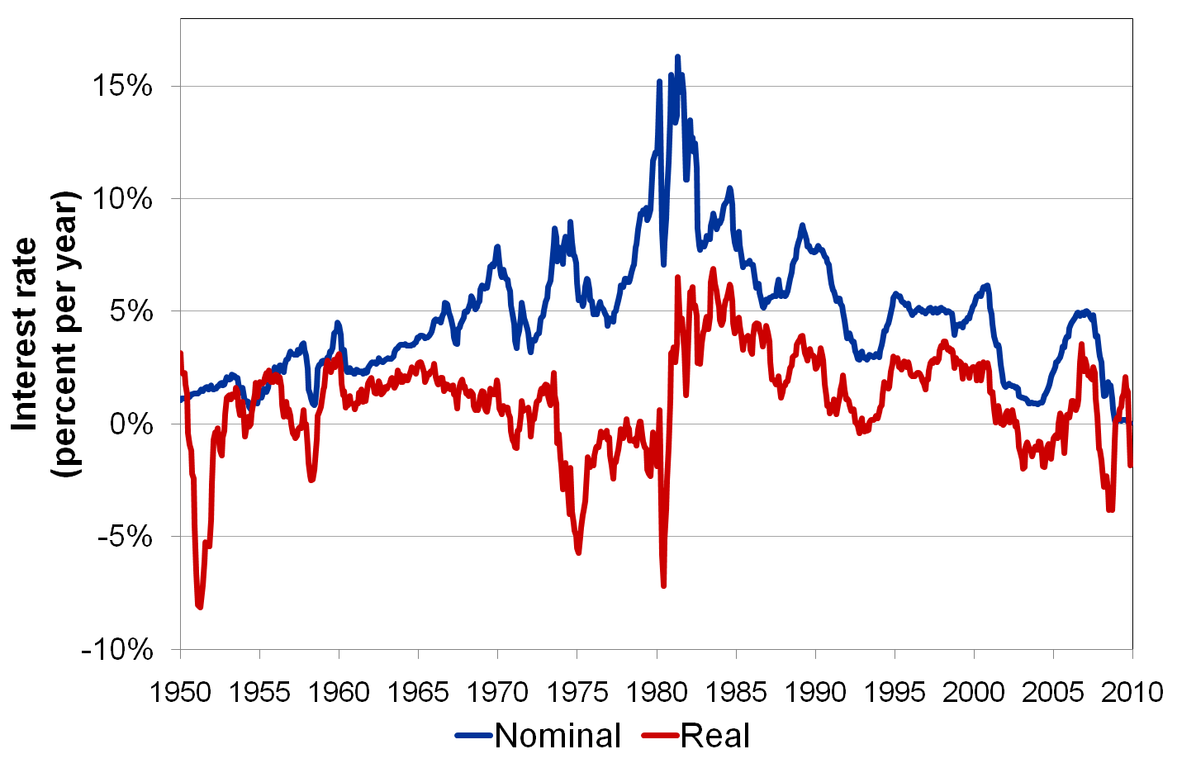
Real and Nominal Interest Rates in the U.S., 1950–2010
0
Notes:
28

Slide 30
SUMMARY
The Consumer Price Index is a measure of the cost of living. The CPI tracks the cost of the typical consumer’s “basket” of goods & services.
The CPI is used to make Cost of Living Adjustments and to correct economic variables for the effects of inflation.
The real interest rate is corrected for inflation and is computed by subtracting the inflation rate from the nominal interest rate.
© 2015 Cengage Learning. EMEA All Rights Reserved. May not be copied, scanned, or duplicated, in whole or in part, except for use as permitted in a license distributed with a certain product or service or otherwise on a password-protected website for classroom use.

