Slide 1
N. Gregory Mankiw & Mohamed H. Rashwan
Principles of
Economics
Arab World Edition

Slide 2
In this chapter, look for the answers to these questions:
What are the facts about living standards and growth rates around the world?
Why does productivity matter for living standards?
What determines productivity and its growth rate?
How can public policy affect growth and living standards?

Slide 3
A typical family in the Arab World
Following on the heels of the research by Fogel, other economists have looked at links between nutrition and standards of living.
Notes:
2

Slide 4
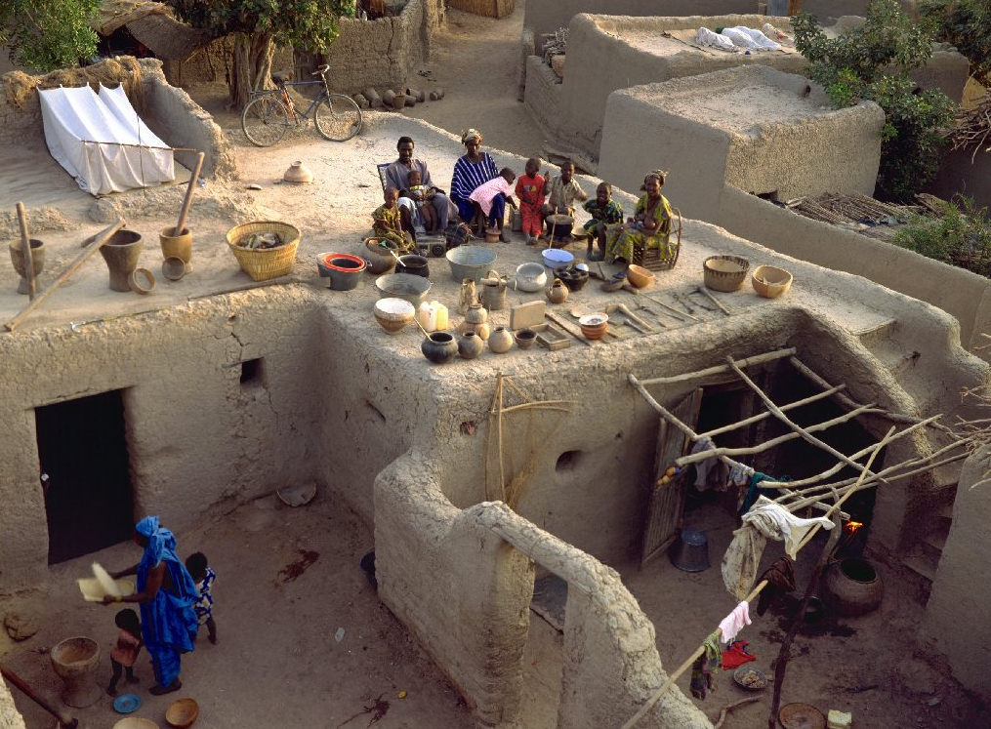
A typical family with all their possessions in Mali, a poor country
GDP per capita: $1,090
Life expectancy: 52 years
Adult literacy: 46%
Notes:
3
Here, the photo really is worth a thousand words. Look at the family’s possessions. Pottery, a few sticks, some clothing, and a dwelling that does not appear to have running water or climate control. That’s it. No sailboat, no upholstered furniture, no bicycles. This family is very poor.
Now look at the statistics - $1130 income per capita. Life expectancy is frighteningly low. And less than half the population can read or write their own language – most students can readily grasp that it’s hard to grow out of poverty if over half of the population is illiterate.
Data sources:
GDP per capita, 2008: Same as textbook.
Life expectancy at birth, 2010 estimate. Source: U.S. Census Bureau, International Database.
http://www.census.gov/ipc/www/idb/idbprint.html
Adult literacy, 2003 estimate. Source: CIA World Factbook.
https://www.cia.gov/library/publications/the-world-factbook/

Slide 5
Incomes and Growth Around the World
 | GDP per capita, 2010 | Growth rate, 1970–2009
China | $6,828 | 7.4%
Singapore | $50,633 | 4.7%
India | $3,296 | 3.3%
Japan | $32,418 | 2.2%
Spain | $32,150 | 2.1%
Colombia | $8,959 | 1.9%
United States | $45,989 | 1.8%
Canada | $37,808 | 1.7%
Philippines | $3,542 | 1.3%
Rwanda | $1,136 | 1.1%
New Zealand | $28,993 | 1.1%
Argentina | $14,538 | 1.0%
Saudi Arabia | $23,480 | 0.6%
Chad | $1,300 | 0.4%
FACT 1:
There are vast differences in living standards around the world.
Notes:
4
Source: World Development Indicators, World Bank, and my calculations.
GDP per capita is in PPP$. “Growth rate” is the average annual growth rate of real GDP per capita (local currency), computed as
{ln(2009 value)−ln(1970 value)}/39

Slide 6
Incomes and Growth Around the World
 | GDP per capita, 2009 | Growth rate, 1970–2009
China | $6,828 | 7.4%
Singapore | $50,633 | 4.7%
India | $3,296 | 3.3%
Japan | $32,418 | 2.2%
Spain | $32,150 | 2.1%
Colombia | $8,959 | 1.9%
United States | $45,989 | 1.8%
Canada | $37,808 | 1.7%
Philippines | $3,542 | 1.3%
Rwanda | $1,136 | 1.1%
New Zealand | $28,993 | 1.1%
Argentina | $14,538 | 1.0%
Saudi Arabia | $23,480 | 0.6%
Chad | $1,300 | 0.4%
FACT 2:
There is also great variation in growth rates across countries.
Notes:
5

Slide 7
Incomes and Growth Around the World
Since growth rates vary, the country rankings can change over time:
Poor countries are not necessarily doomed to poverty forever, e.g. Singapore incomes were low in 1960 and are quite high now.
Rich countries can’t take their status for granted: They may be overtaken by poorer but faster-growing countries.
Notes:
6

Slide 8
Incomes and Growth Around the World
Questions:
Why are some countries richer than others?
Why do some countries grow quickly while others seem stuck in a poverty trap?
What policies may help raise growth rates and long-run living standards?
Notes:
7
The preceding data gives rise to these important questions, which this chapter addresses next.

Slide 9
Productivity
Recall one of the Ten Principles from Chap. 1: A country’s standard of living depends on its ability to produce goods and services.
This ability depends on productivity, the average quantity of goods and services produced per unit of labor input.
Y = real GDP = quantity of output produced L = quantity of labor so productivity = Y/L (output per worker)
Notes:
As in previous chapters, “goods and services” is short for “goods and services.”

Slide 10
Why Productivity Is So Important
When a nation’s workers are very productive, real GDP is large and incomes are high.
When productivity grows rapidly, so do living standards.
What, then, determines productivity and its growth rate?
Notes:
9

Slide 11
Physical Capital Per Worker
Recall: The stock of equipment and structures used to produce goods and services is called [physical] capital, denoted K.
K/L = capital per worker.
Productivity is higher when the average worker has more capital (machines, equipment, etc.).
i.e., an increase in K/L causes an increase in Y/L.
Notes:
10
It is common to refer to physical capital as just “capital,” hence the brackets around “physical.” Here, though, the distinction is important, because the following slide discusses human capital.

Slide 12
Human Capital Per Worker
Human capital (H): the knowledge and skills workers acquire through education, training, and experience
H/L = the average worker’s human capital
Productivity is higher when the average worker has more human capital (education, skills, etc.).
i.e., an increase in H/L causes an increase in Y/L.
Notes:
11

Slide 13
Natural Resources Per Worker
Natural resources (N): the inputs into production that nature provides, e.g., land, mineral deposits.
Other things equal, more N allows a country to produce more Y.
In per-worker terms, an increase in N/L causes an increase in Y/L.
Some countries are rich because they have abundant natural resources.
e.g., Saudi Arabia has lots of oil.
But countries need not have much N to be rich
e.g., Japan imports the N it needs.
Notes:
12

Slide 14
Technological Knowledge
Technological knowledge: society’s understanding of the best ways to produce goods and services.
Technological progress does not only mean a faster computer, a higher-definition TV, or a smaller cell phone.
It means any advance in knowledge that boosts productivity (allows society to get more output from its resources).
e.g., Henry Ford and the assembly line.
Notes:
13
This definition of technology is more broad than what most people think of as technology. To most people, improvements in technology mean a smaller cell phone, a faster computer, a higher-definition television set, an MP3 player that can hold more songs, and so forth.
But “technology” doesn’t just mean computer-related stuff. Technology refers to the knowledge that allows producers to transform inputs into output.
Here’s an important example of technological progress that doesn’t involve computers at all: Henry Ford discovered that he could boost productivity in his auto factory simply by rearranging the workers and machines, and reassigning the workers’ tasks.
(Interesting trivia: While Henry Ford is famous for introducing the assembly line in 1913, did you know that the idea was already over 100 years old? In 1799, Eli Whitney introduced assembly line production into the manufacture of muskets for the U.S. Government. Whitney was famous for inventing the cotton gin, but his discovery of the assembly line has had a far greater impact on productivity and living standards in the U.S.)

Slide 15
Tech. Knowledge vs. Human Capital
Technological knowledge refers to society’s understanding of how to produce goods and services.
Human capital results from the effort people expend to acquire this knowledge.
Both are important for productivity.
Notes:
14

Slide 16
The Production Function
The production function is a graph or equation showing the relation between output and inputs:
Y = A F(L, K, H, N)
F( ) is a function that shows how inputs are combined to produce output.
“A” is the level of technology.
“A” multiplies the function F( ), so improvements in technology (increases in “A”) allow more output (Y) to be produced from any given combination of inputs.
Notes:
15

Slide 17
The Production Function
Y = A F(L, K, H, N)
The production function has the property constant returns to scale: Changing all inputs by the same percentage causes output to change by that percentage. For example,
Doubling all inputs (multiplying each by 2) causes output to double:
2Y = A F(2L, 2K, 2H, 2N)
Increasing all inputs 10% (multiplying each by 1.1) causes output to increase by 10%:
1.1Y = A F(1.1L, 1.1K, 1.1H, 1.1N)
Notes:
16

Slide 18
The Production Function
Y = A F(L, K, H, N)
If we multiply each input by 1/L, then output is multiplied by 1/L:
Y/L = A F(1, K/L, H/L, N/L)
This equation shows that productivity (output per worker) depends on:
the level of technology (A).
physical capital per worker.
human capital per worker.
natural resources per worker.
Notes:
17
Why “1” is inside the production function:
Students may wonder what the number “1” is doing inside the F( ) function. On the preceding slide, the aggregate production function was written as Y = A F(L, K, H, N). We multiplied all of the inputs by 1/L, and because of constant returns to scale, output is also multiplied by 1/L:
Y/L = A F(L/L, K/L, H/L, N/L)
The first term in the F( ) function is L/L, which just equals 1.
Read literally, this equation says that output per worker depends on technology, the number of workers per worker, the amount of physical and human capital per worker, and natural resources per worker. But the number of workers per worker is always 1.
Why “A” is outside the production function:
What matters for productivity is not “technical knowledge per worker” but simply “technological knowledge.” Unlike physical capital or other resources, technological knowledge can be freely shared among all workers. If the number of workers increases, you must purchase new capital for the new workers (or spread the existing capital more thinly), but technological knowledge can be freely shared with the new workers.

Slide 19
ACTIVE LEARNING ₁ Discussion Question
Which of the following policies do you think would be most effective at boosting growth and living standards in a poor country over the long run?
a. Offer tax incentives for investment by local firms.
b. Offer tax incentives for investment by foreign firms.
c. Give cash payments for good school attendance.
d. Crack down on government corruption.
e. Restrict imports to protect domestic industries.
f. Allow free trade.
© 2015 Cengage Learning. All Rights Reserved. May not be copied, scanned, or duplicated, in whole or in part, except for use as permitted in a license distributed with a certain product or service or otherwise on a password-protected website for classroom use.

Slide 20
ECONOMIC GROWTH AND PUBLIC POLICY
Next, we look at the ways public policy can affect long-run growth in productivity and living standards.
Notes:
19

Slide 21
Saving and Investment
We can boost productivity by increasing K, which requires investment.
Since resources scarce, producing more capital requires producing fewer consumption goods.
Reducing consumption = increasing saving. This extra saving funds the production of investment goods. (More details in the next chapter.)
Hence, a tradeoff between current and future consumption.
Notes:
20

Slide 22
Diminishing Returns and the Catch-Up Effect
The government can implement policies that raise saving and investment. (Details in next chapter.) Then K will rise, causing productivity and living standards to rise.
But this faster growth is temporary, due to diminishing returns to capital: As K rises, the extra output from an additional unit of K falls….
Notes:
21

Slide 23
The Production Function & Diminishing Returns
Y/L
If workers have little K, giving them more increases their productivity a lot.
Output per worker (productivity)
If workers already have a lot of K, giving them more increases productivity fairly little.
K/L
Capital per worker
Notes:
22

Slide 24
The catch-up effect:
the property whereby poor countries tend to grow more rapidly than rich ones
Y/L
Rich country’s growth
Poor country’s growth
K/L
Poor country starts here
Rich country starts here
Notes:
23

Slide 25
Example of the Catch-Up Effect
Over 1960–1990, the U.S. and S. Korea devoted a similar share of GDP to investment, so you might expect they would have similar growth performance.
But growth was >6% in Korea and only 2% in the U.S.
Explanation: the catch-up effect. In 1960, K/L was far smaller in Korea than in the U.S., hence Korea grew faster.
Notes:
24

Slide 26
Investment from Abroad
To raise K/L and hence productivity, wages, and living standards, the government can also encourage…
foreign direct investment: a capital investment (e.g., a factory) that is owned and operated by a foreign entity.
foreign portfolio investment: a capital investment financed with foreign money but operated by domestic residents.
Some of the returns from these investments flow back to the foreign countries that supplied the funds.
Notes:
25

Slide 27
Investment from Abroad
Especially beneficial in poor countries that cannot generate enough saving to fund investment projects themselves.
Also helps poor countries learn state-of-the-art technologies developed in other countries.
Notes:
26

Slide 28
Education
Government can increase productivity by promoting education–investment in human capital (H).
Public schools, subsidized loans for college.
Education has significant effects:
In the U.S., each year of schooling raises a worker’s wage by 10%.
But investing in H also involves a tradeoff between the present & future:
Spending a year in school requires sacrificing a year’s wages now to have higher wages later.
Notes:
27
Brazil has implemented a policy which gives families cash payments if their children attend school faithfully. Other developing countries have similar policies, which experts predict will raise productivity and living standards in the long run.
This is from an “In The News” box entitled “Promoting Human Capital” appearing in this chapter.

Slide 29
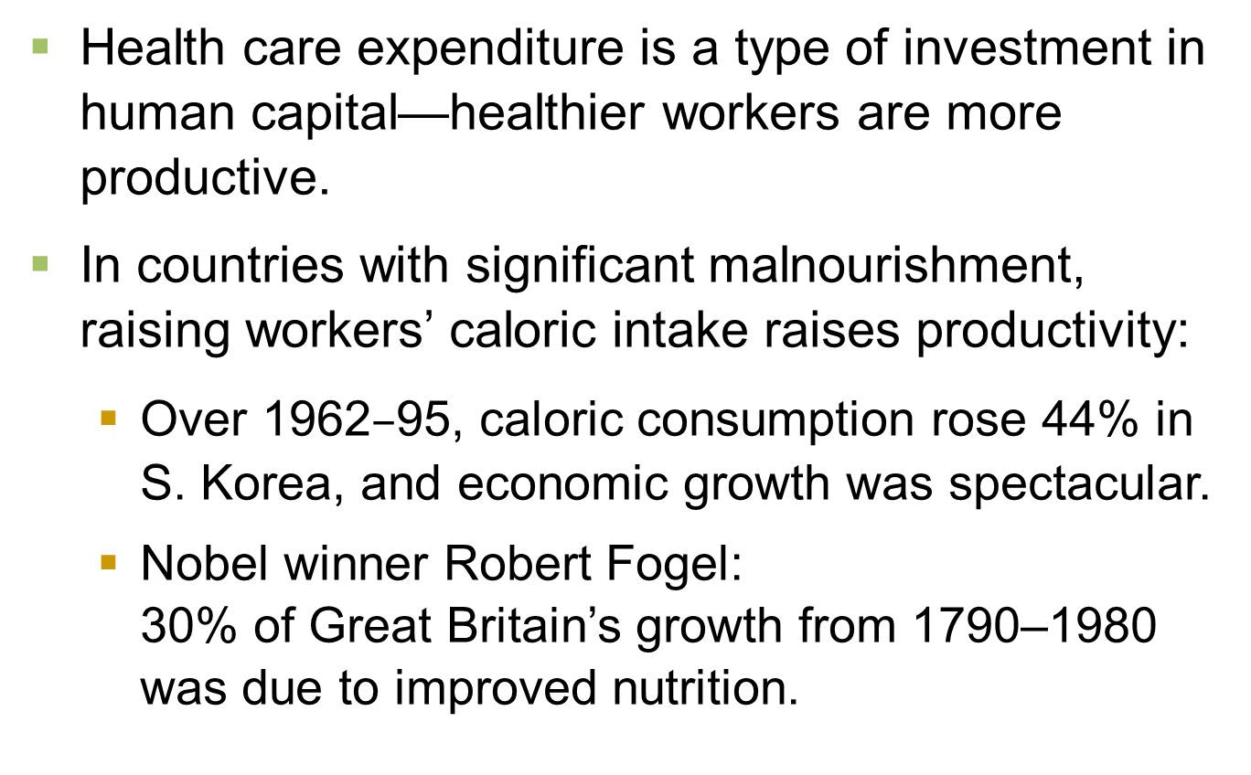
Health and Nutrition
Notes:
28

Slide 30
Property Rights and Political Stability
Recall:
Markets are usually a good way to organize economic activity.
The price system allocates resources to their most efficient uses.
This requires respect for property rights, the ability of people to exercise authority over the resources they own.
Notes:
29

Slide 31
Property Rights and Political Stability
In many poor countries, the justice system doesn’t work very well:
Contracts aren’t always enforced.
Fraud, corruption often go unpunished.
In some, firms must bribe government officials for permits.
Political instability (e.g., frequent coups) creates uncertainty over whether property rights will be protected in the future.
Notes:
30

Slide 32
Property Rights and Political Stability
When people fear their capital may be stolen by criminals or confiscated by a corrupt government, there is less investment, including from abroad, and the economy functions less efficiently. Result: lower living standards.
Economic stability, efficiency, and healthy growth require law enforcement, effective courts, a stable constitution, and honest government officials.
Notes:
31

Slide 33
Free Trade
Inward-oriented policies (e.g., tariffs, limits on investment from abroad) aim to raise living standards by avoiding interaction with other countries.
Outward-oriented policies (e.g., the elimination of restrictions on trade or foreign investment) promote integration with the world economy.
Notes:
32

Slide 34
Free Trade
Recall: Trade can make everyone better off.
Trade has similar effects as discovering new technologies—it improves productivity and living standards.
Countries with inward-oriented policies have generally failed to create growth.
e.g., Argentina during the 20th century.
Countries with outward-oriented policies have often succeeded.
e.g., South Korea, Singapore, Taiwan after 1960.

Slide 35
Research and Development
Technological progress is the main reason why living standards rise over the long run.
One reason is that knowledge is a public good: Ideas can be shared freely, increasing the productivity of many.
Policies to promote tech. progress:
Patent laws.
Tax incentives or direct support for private sector research and development.
Grants for basic research at universities.
Notes:
34

Slide 36
Population Growth
…may affect living standards in 3 different ways:
1. Stretching natural resources
200 years ago, Malthus argued that population growth would strain society’s ability to provide for itself.
Since then, the world population has increased sixfold. If Malthus was right, living standards would have fallen. Instead, they’ve risen.
Malthus failed to account for technological progress and productivity growth.
Notes:
35

Slide 37
Population Growth
2. Diluting the capital stock
Bigger population = higher L = lower K/L = lower productivity & living standards.
This applies to H as well as K: fast population growth = more children = greater strain on educational system.
Countries with fast pop. growth tend to have lower educational attainment.
Notes:
36

Slide 38
Population Growth
2. Diluting the capital stock
To combat this, many developing countries use policy to control population growth.
China’s one child per family laws.
Birth control education & availability.
Promote female literacy - tends to lead to fewer children.
Notes:
37

Slide 39
Population Growth
3. Promoting tech. progress
More people
= more scientists, inventors, engineers.
= more frequent discoveries.
= faster technological progress & economic growth.
Evidence from Michael Kremer: Over the course of human history,
growth rates increased as the world’s population increased.
more populated regions grew faster than less populated ones.
Notes:
38

Slide 40
ACTIVE LEARNING ₂ Review productivity concepts
List the determinants of productivity.
List three policies that attempt to raise living standards by increasing one of the determinants of productivity.
© 2015 Cengage Learning. All Rights Reserved. May not be copied, scanned, or duplicated, in whole or in part, except for use as permitted in a license distributed with a certain product or service or otherwise on a password-protected website for classroom use.

Slide 41
ACTIVE LEARNING ₂ Answers
Determinants of productivity: K/L, physical capital per worker. H/L, human capital per worker. N/L, natural resources per worker. A, technological knowledge.
Policies to boost productivity:
Encourage saving and investment, to raise K/L.
Encourage investment from abroad, to raise K/L.
Provide public education, to raise H/L.
© 2012 Cengage Learning. All Rights Reserved. May not be copied, scanned, or duplicated, in whole or in part, except for use as permitted in a license distributed with a certain product or service or otherwise on a password-protected website for classroom use.

Slide 42
ACTIVE LEARNING ₂ Answers
Determinants of productivity: K/L, physical capital per worker . H/L, human capital per worker. N/L, natural resources per worker. A, technological knowledge.
Policies to boost productivity:
Patent laws or grants, to increase A.
Control population growth, to increase K/L.
© 2015 Cengage Learning. EMEA All Rights Reserved. May not be copied, scanned, or duplicated, in whole or in part, except for use as permitted in a license distributed with a certain product or service or otherwise on a password-protected website for classroom use.

Slide 43
Are Natural Resources a Limit to Growth?
Some argue that population growth is depleting the Earth’s non-renewable resources, and thus will limit growth in living standards.
But technological progress often yields ways to avoid these limits:
Hybrid cars use less gas.
Better insulation in homes reduces the energy required to heat or cool them.
As a resource becomes scarcer, its market price rises, which increases the incentive to conserve it and develop alternatives.
Notes:
42

Slide 44
CONCLUSION
In the long run, living standards are determined by productivity.
Policies that affect the determinants of productivity will therefore affect the next generation’s living standards.
One of these determinants is saving and investment.
In the next chapter, we will learn how saving and investment are determined, and how policies can affect them.
Notes:
43

Slide 45
SUMMARY
There are great differences across countries in living standards and growth rates.
Productivity (output per unit of labor) is the main determinant of living standards in the long run.
Productivity depends on physical and human capital per worker, natural resources per worker, and technological knowledge.
Growth in these factors—especially technological progress—causes growth in living standards over the long run.
© 2015 Cengage Learning. All Rights Reserved. May not be copied, scanned, or duplicated, in whole or in part, except for use as permitted in a license distributed with a certain product or service or otherwise on a password-protected website for classroom use.

Slide 46
SUMMARY
Policies can affect the following, each of which has important effects on growth:
Saving and investment.
International trade.
Education, health & nutrition.
Property rights and political stability.
Research and development.
Population growth.
Because of diminishing returns to capital, growth from investment eventually slows down, and poor countries may “catch up” to rich ones.
© 2015 Cengage Learning. All Rights Reserved. May not be copied, scanned, or duplicated, in whole or in part, except for use as permitted in a license distributed with a certain product or service or otherwise on a password-protected website for classroom use.

