Slide 1
Game Playing: Adversarial Search
University of Berkeley, USA
http://www.aima.cs.berkeley.edu

Slide 2
Outline
- Game Playing: Adversarial Search
- Minimax Algorithm
- α-β Pruning Algorithm
- Games of chance
- State of the art

Slide 3
Game Playing: Adversarial Search
Introduction
So far, in problem solving, single agent search
  The machine is “exploring” the search space by itself.
  No opponents or collaborators.
Games require generally multiagent (MA) environments:
  Any given agent need to consider the actions of the other agent and to know how do they affect its success?
  Distinction should be made between cooperative and competitive MA environments.
  Competitive environments: give rise to adversarial search: playing a game with an opponent.

Slide 4
Game Playing: Adversarial Search
Introduction
Why study games?
  Game playing is fun and is also an interesting meeting point for human and computational intelligence.
  They are hard.
  Easy to represent.
  Agents are restricted to small number of actions.
Interesting question:
Does winning a game absolutely require human intelligence?

Slide 5
Game Playing: Adversarial Search
Introduction
Different kinds of games:
 | Deterministic | Chance
Perfect Information | Chess, Checkers Go, Othello | Backgammon, Monopoly
Imperfect Information | Battleship | Bridge, Poker, Scrabble,
  Games with perfect information. No randomness is involved.
  Games with imperfect information. Random factors are part of the game.

Slide 6
Searching in a two player game
  Traditional (single agent) search methods only consider how close the agent is to the goal state (e.g. best first search).
  In two player games, decisions of both agents have to be taken into account: a decision made by one agent will affect the resulting search space that the other agent would need to explore.
  Question: Do we have randomness here since the decision made by the opponent is NOT known in advance?
  ☺ No. Not if all the moves or choices that the opponent can make are finite and can be known in advance.

Slide 7
Searching in a two player game
To formalize a two player game as a search problem an agent can be called MAX and the opponent can be called MIN.
Problem Formulation:
Initial state: board configurations and the player to move.
Successor function: list of pairs (move, state) specifying legal moves and their resulting states. (moves + initial state = game tree)
A terminal test: decide if the game has finished.
A utility function: produces a numerical value for (only) the terminal states. Example: In chess, outcome = win/loss/draw, with values +1, -1, 0 respectively.
Players need search tree to determine next move.

Slide 8
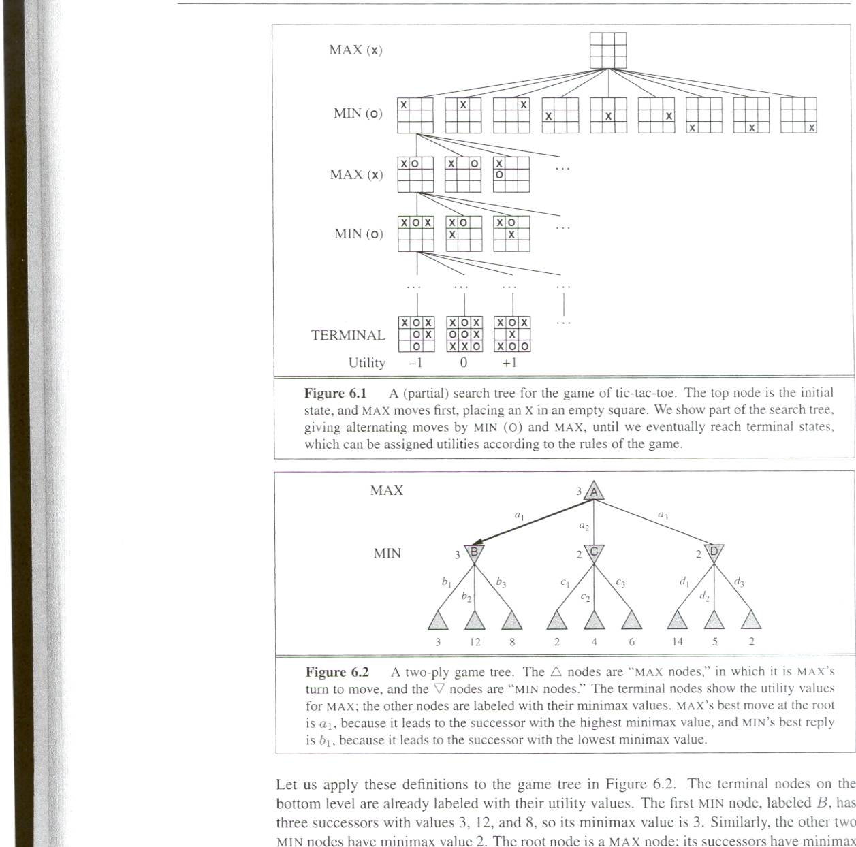
Partial game tree for Tic-Tac-Toe
Each level of search nodes in the tree corresponds to all possible board configurations for a particular player MAX or MIN.
Utility values found at the end can be returned back to their parent nodes.
Idea: MAX chooses the board with the max utility value, MIN the minimum.

Slide 9
MinMax search on Tic-Tac-Toe
Evaluation function Eval(n) for A
  infinity if n is a win state for A (Max)
  -infinity if n is a win state for B (Min)
  (# of 3-moves for A) -- (# of 3-moves for B) a 3-move is an open row, column, diagonal
A is X
Eval(s) = 6 - 4

Slide 10
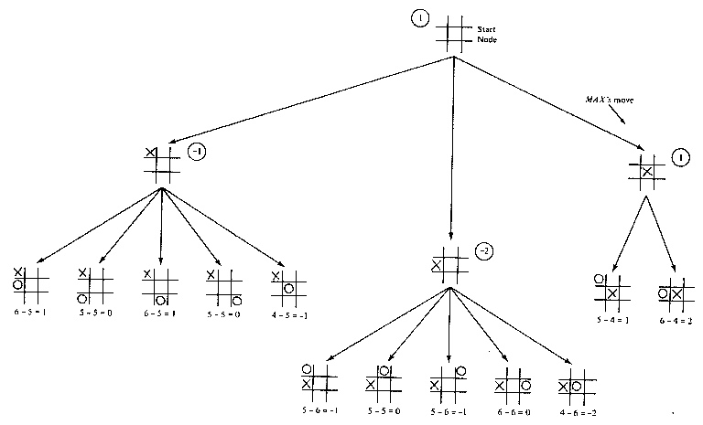
Tic-Tac-Toe MinMax search, d=2

Slide 11
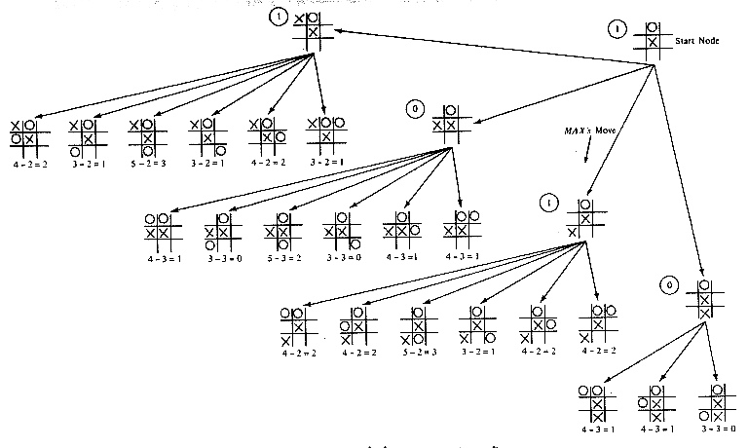
Tic-Tac-Toe MinMax search, d=4

Slide 12
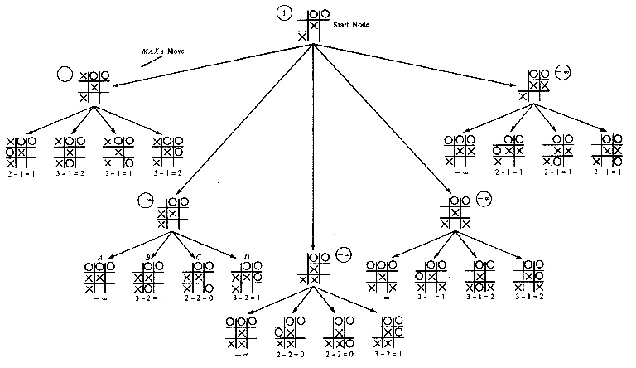
Tic-Tac-Toe MinMax search, d=6

Slide 13
Searching in a two player game
The search space in game playing is potentially very huge: Need for optimal strategies.
The goal is to find the sequence of moves that will lead to the winning for MAX.
How to find the best trategy for MAX assuming that MIN is an infaillible opponent.
Given a game tree, the optimal strategy can be determined by the MINIMAX-VALUE for each node. It returns:
  Utility value of n if n is the terminal state.
  Maximum of the utility values of all the successor nodes s of n : n is a MAX’s current node.
  Minimum of the utility values of the successor node s of n : n is a MIN’s current node.

Slide 14
Minimax Algorithm
Minimax algorithm
  Perfect for deterministic, 2-player game
  One opponent tries to maximize score (Max)
  One opponent tries to minimize score (Min)
  Goal: move to position of highest minimax value
  Identify best achievable payoff against best play

Slide 15
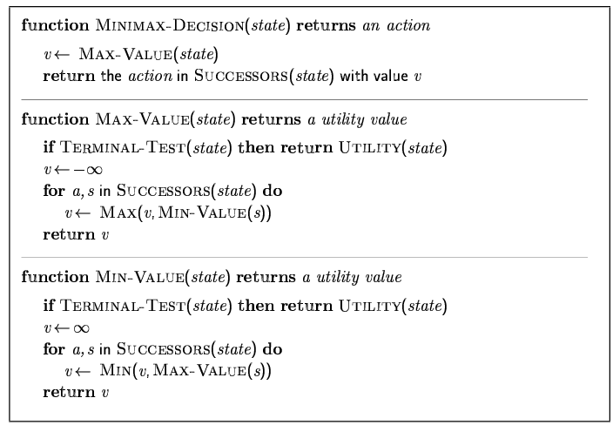
Minimax Algorithm (cont’d)

Slide 16
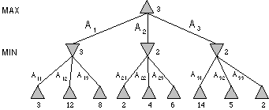
Minimax Algorithm (cont’d)
Max node
Min node
MAX node
MIN node
value computed
by minimax
Utility value

Slide 17
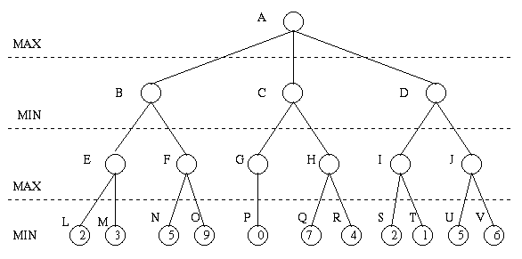
Minimax Algorithm (cont’d)

Slide 18
Minimax Algorithm (cont’d)
3
9
0
7
2
6

Slide 19
Minimax Algorithm (cont’d)
3
0
2
3
9
0
7
2
6

Slide 20
Minimax Algorithm (cont’d)
3
3
0
2
3
9
0
7
2
6

Slide 21
Minimax Algorithm (cont’d)
Properties of minimax algorithm:
  Complete? Yes (if tree is finite)
  Optimal? Yes (against an optimal opponent)
  Time complexity? O(b^{m})
  Space complexity? O(bm) (depth-first exploration)
Note: For chess, b = 35, m = 100 for a “reasonable game.”
  Solution is completely infeasible
Actually only 10⁴⁰ board positions, not 35¹⁰⁰

Slide 22
Minimax Algorithm (cont’d)
Limitations
  Not always feasible to traverse entire tree
  Time limitations
Improvements
  Depth-first search improves speed
  Use evaluation function instead of utility
    Evaluation function provides estimate of utility at given position
Notes:
Similar to heuristic function

Slide 23
Problem of Minimax search
Number of games states is exponential to the number of moves.
  Solution: Do not examine every node
  ==> Alpha-beta pruning
    Alpha = value of best choice found so far at any choice point along the MAX path.
    Beta = value of best choice found so far at any choice point along the MIN path.
☺

Slide 24
Alpha-beta Game Playing
Basic idea:
If you have an idea that is surely bad, don't take the time to see how truly awful it is.” -- Pat Winston
Some branches will never be played by rational players since
they include sub-optimal decisions (for either player).
>=2
We don’t need to compute the value at this node.
No matter what it is, it can’t effect the value of the root node.
=2
<=1
2
7
1
?

Slide 25
α-β Pruning Algorithm
Principle
  If a move is determined worse than another move already examined, then further examination deemed pointless

Slide 26
Alpha-Beta Pruning (αβ prune)
Rules of Thumb
  α is the highest max found so far
  β is the lowest min value found so far
  If Min is on top Alpha prune
  If Max is on top Beta prune
  You will only have alpha prune’s at Min level
  You will only have beta prunes at Max level

Slide 27
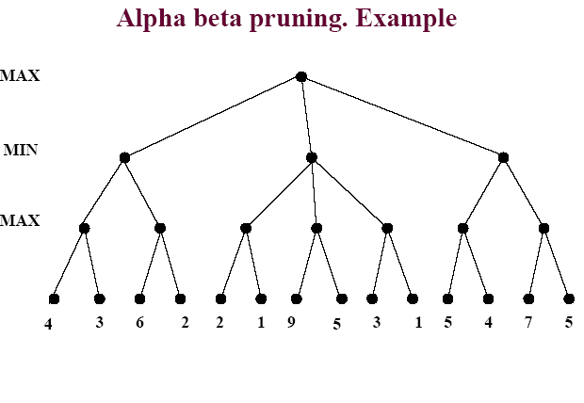

Slide 28
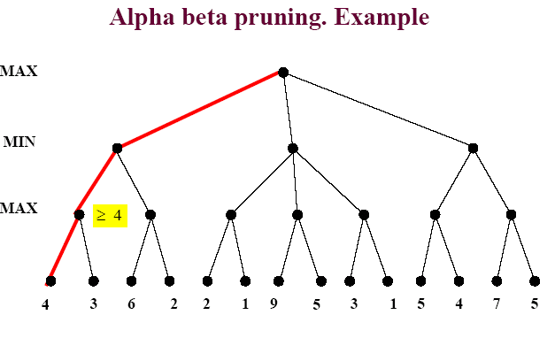
Game Playing: Adversarial Search

Slide 29
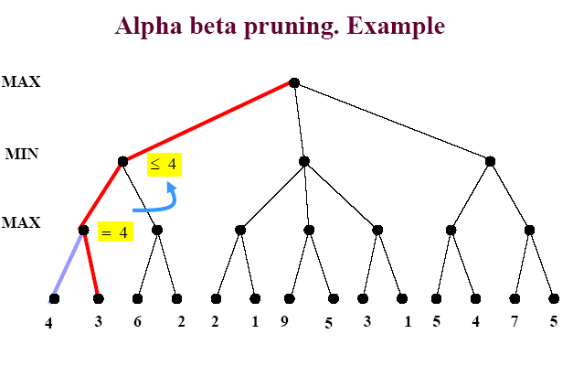
Game Playing: Adversarial Search

Slide 30
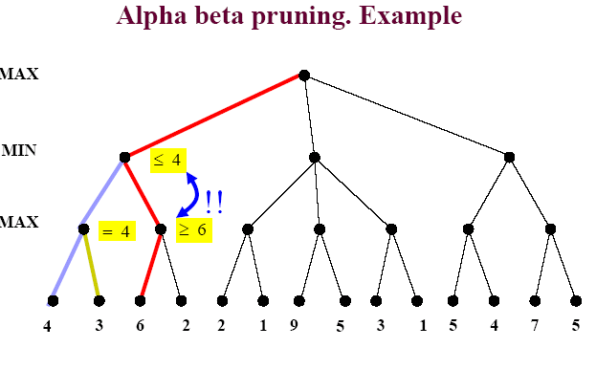
Game Playing: Adversarial Search

Slide 31
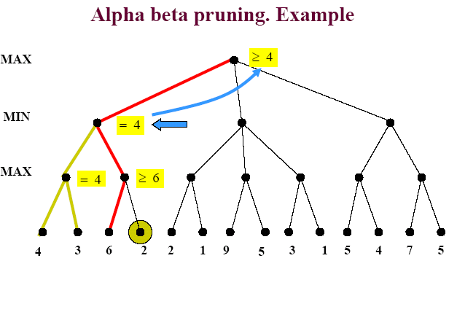
Game Playing: Adversarial Search

Slide 32
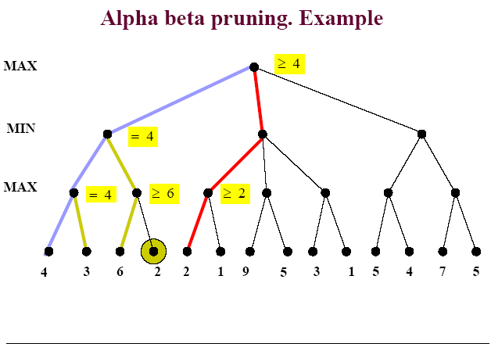
Game Playing: Adversarial Search

Slide 33
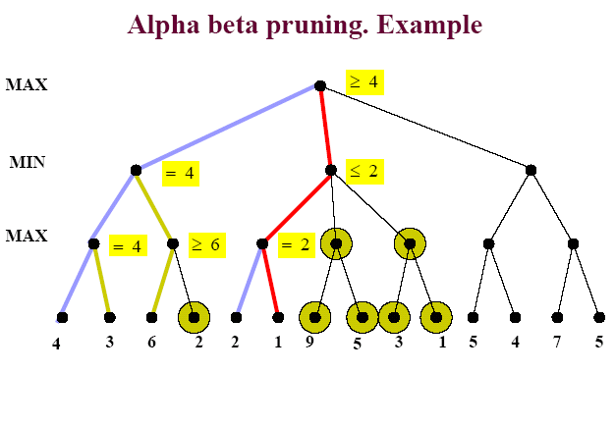
Game Playing: Adversarial Search

Slide 34
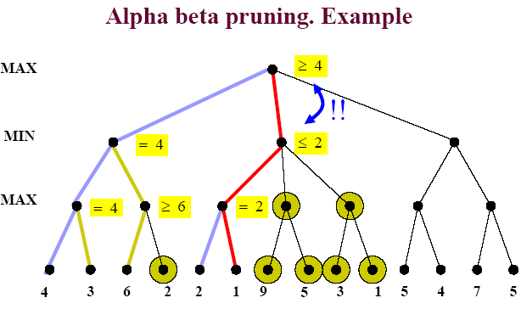
Game Playing: Adversarial Search

Slide 35
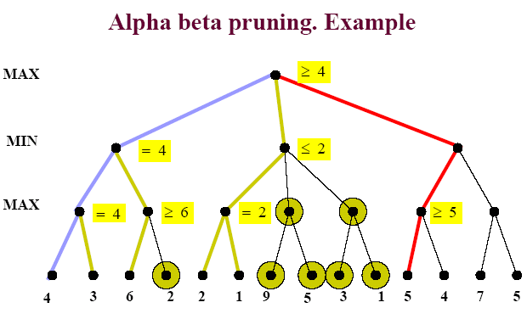
Game Playing: Adversarial Search

Slide 36
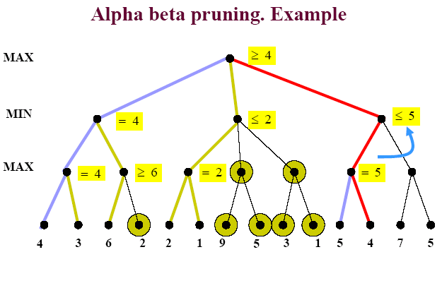
Game Playing: Adversarial Search

Slide 37
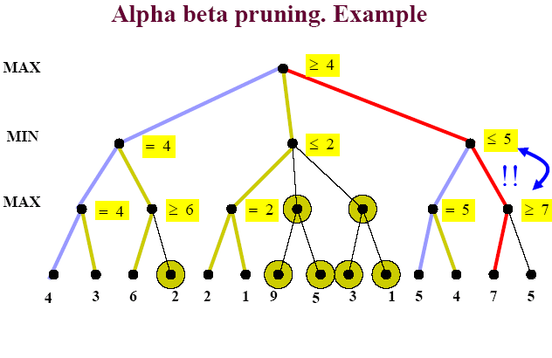
Game Playing: Adversarial Search

Slide 38
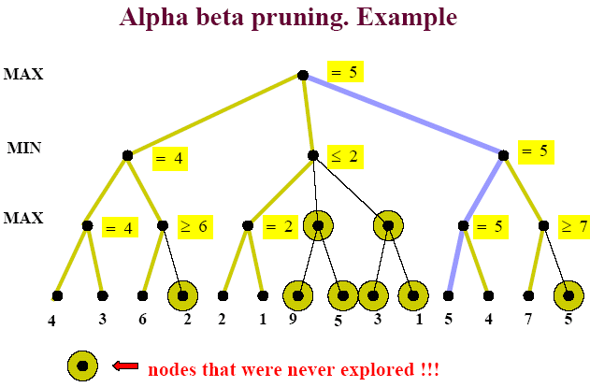
Game Playing: Adversarial Search

Slide 39
Properties of α-β Prune
Pruning does not affect final result
Good move ordering improves effectiveness of pruning
With "perfect ordering," time complexity = O(b^{m/2})
  → doubles depth of search

Slide 40
General description of α-β pruning algorithm
Traverse the search tree in depth-first order
At each Max node n, alpha(n) = maximum value found so far
  Start with - infinity and only increase.
  Increases if a child of n returns a value greater than the current alpha.
  Serve as a tentative lower bound of the final pay-off.
At each Min node n, beta(n) = minimum value found so far
  Start with infinity and only decrease.
  Decreases if a child of n returns a value less than the current beta.
  Serve as a tentative upper bound of the final pay-off.
beta(n) for MAX node n: smallest beta value of its MIN ancestors.
alpha(n) for MIN node n: greatest alpha value of its MAX ancestors

Slide 41
General description of α-β pruning algorithm
Carry alpha and beta values down during search
  alpha can be changed only at MAX nodes
  beta can be changed only at MIN nodes
  Pruning occurs whenever alpha >= beta
alpha cutoff:
  Given a Max node n, cutoff the search below n (i.e., don't generate any more of n's children) if alpha(n) >= beta(n)
  (alpha increases and passes beta from below)
beta cutoff:
  Given a Min node n, cutoff the search below n (i.e., don't generate any more of n's children) if beta(n) <= alpha(n)
  (beta decreases and passes alpha from above)

Slide 42
α-β Pruning Algorithm
function ALPHA-BETA-SEARCH(state) returns an action
inputs: state, current state in game
v← MAX-VALUE(state, - ∞ , +∞)
return the action in SUCCESSORS(state) with value v
function MAX-value (n, alpha, beta) return utility value
if n is a leaf node then return f(n);
for each child n’ of n do
alpha :=max{alpha, MIN-value(n’, alpha, beta)};
if alpha >= beta then return beta /* pruning */
end{do}
return alpha
function MIN-value (n, alpha, beta) return utility value
if n is a leaf node then return f(n);
for each child n’ of n do
beta :=min{beta, MAX-value(n’, alpha, beta)};
if beta <= alpha then return alpha /* pruning */
end{do}
return beta

Slide 43
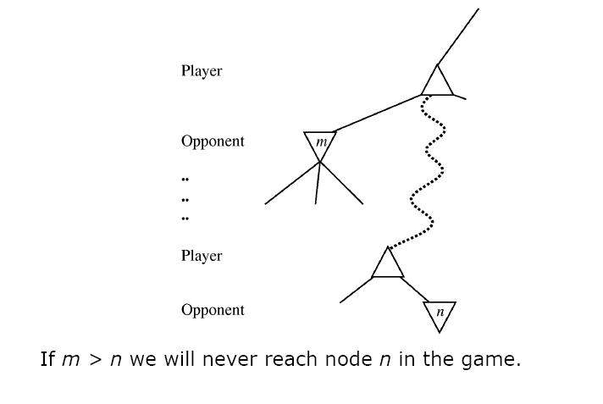
Game Playing: Adversarial Search
In another way

Slide 44
Evaluating Alpha-Beta algorithm
Alpha-Beta is guaranteed to compute the same value for the root node as computed by Minimax.
Worst case: NO pruning, examining O(b^{d}) leaf nodes, where each node has b children and a d-ply search is performed
Best case: examine only O(b^{d/2}) leaf nodes. You can search twice as deep as Minimax! Or the branch factor is b^{1/2} rather than b.
Best case is when each player's best move is the leftmost alternative, i.e. at MAX nodes the child with the largest value generated first, and at MIN nodes the child with the smallest value generated first.
In Deep Blue, they found empirically that Alpha-Beta pruning meant that the average branching factor at each node was about 6 instead of about 35-40

Slide 45
Evaluation Function
Evaluation function
  Performed at search cutoff point
  Must have same terminal/goal states as utility function
  Tradeoff between accuracy and time → reasonable complexity
  Accurate
    Performance of game-playing system dependent on accuracy/goodness of evaluation
    Evaluation of nonterminal states strongly correlated with actual chances of winning

Slide 46
Evaluation functions
For chess, typically linear weighted sum of features
Eval(s) = w₁ f₁(s) + w₂ f₂(s) + … + w_{n} f_{n}(s)
e.g., w₁ = 9 with
f₁(s) = (number of white queens) – (number of black queens), etc.
  Key challenge – find a good evaluation function:
  Isolated pawns are bad.
  How well protected is your king?
  How much maneuverability to you have?
  Do you control the center of the board?
  Strategies change as the game proceeds

Slide 47

When Chance is involved:
Backgammon Board

Slide 48
Expectiminimax
Generalization of minimax for games with chance nodes
Examples: Backgammon, bridge
Calculates expected value where probability is taken
over all possible dice rolls/chance events
- Max and Min nodes determined as before
- Chance nodes evaluated as weighted average

Slide 49
Expectiminimax
Expectiminimax(n) =
Utility(n) | for n, a terminal state
 | for n, a Max node
 | for n, a Min node
 | for n, a chance node

Slide 50
Game Tree for Backgammon
…
…
…
…
…
…
…
…
…
C
…
…
…
…
…
…
…
…
…
Notes:
Have to include chance nodes in addition to MIN and MAX nodes.
Branches leading from chance nodes denote possible dice rolls and each is labeled with the probability that it will occur (36 ways to roll the dice, but only 21 distinct rolls 6-5 is the same as 5-6)
How should we calculate MINIMAX value? Can only calculate the average or expected value taken over all possible dice rolls.
Lots more about this, if interested send me email for references.

Slide 51
Expectiminimax
400
400
400
Notes:
Obvious extension to the algorithm, as in minimax, is to cut off the search at some depth, and apply an evaluation function to each leaf.
Unlike minimax, however, it is not enough for the evaluation function to just give higher scores to better positions. The presence of chance nodes means that one has to be more careful...
Evaluation function assigns values of 1, 2, 3, 4 to the leaves: move a-1 is best. Evaluation function that preserves the ordering of the leaves (values of 1, 20, 30, 400) will select a-2. The algorithm behaves completely differently if we make a change in the scale of some evaluation values.
To avoid this behavior, the evaluation function must be a positive linear transformation of the probability of winning from a position.
Another problem with expectiminimax: very expensive!! Where minimax is O(b^{m}), expectiminimax is O(b^{m} n^{m}) where n is the number of distinct rolls.

Slide 52
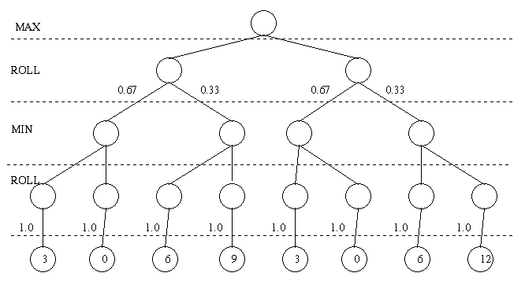
Expectiminimax Example
2
2
2
2
2
(0*0.67 + 6*0.33)
(0*0.67 + 6*0.33)
0
6
0
6
3
0
6
9
3
0
6
12
(3*1.0)
3
0
6
9
3
0
6
12

Slide 53
State-of-the-Art

Slide 54
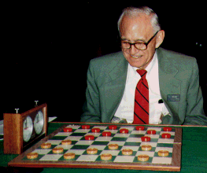
Checkers: Tinsley vs. Chinook
Name: Marion Tinsley
Profession: Teach mathematics
Hobby: Checkers
Record: Over 42 years loses only 3 games of checkers
World champion for over 40
years
Mr. Tinsley suffered his 4th and 5th losses against Chinook

Slide 55
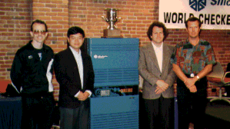
Chinook
First computer to become official world champion of Checkers!

Slide 56
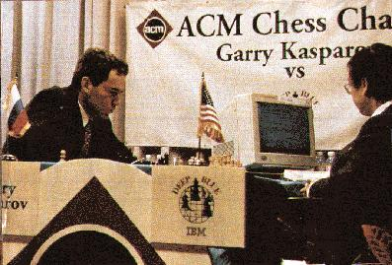
Chess: Kasparov vs. Deep Blue
Kasparov
5’10”
176 lbs
34 years
50 billion neurons
2 pos/sec
Extensive
Electrical/chemical
Enormous
Height
Weight
Age
Computers
Speed
Knowledge
Power Source
Ego
Deep Blue
6’ 5”
2,400 lbs
4 years
32 RISC processors
+ 256 VLSI chess engines
200,000,000 pos/sec
Primitive
Electrical
None
1997: Deep Blue wins by 3 wins, 1 loss, and 2 draws

Slide 57
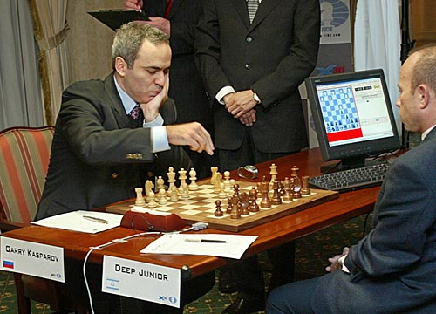
Chess: Kasparov vs. Deep Junior
Deep Junior
8 CPU, 8 GB RAM, Win 2000
2,000,000 pos/sec
Available at $100
August 2, 2003: Match ends in a 3/3 tie!

Slide 58
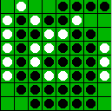
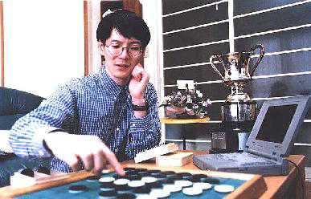
Othello: Murakami vs. Logistello
Takeshi Murakami
World Othello Champion
1997: The Logistello software crushed Murakami
by 6 games to 0

Slide 59
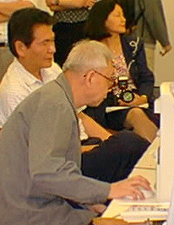
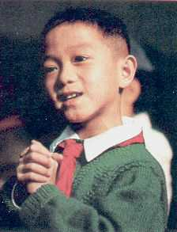
Go: Goemate vs. ??
Name: Chen Zhixing
Profession: Retired
Computer skills:
self-taught programmer
Author of Goemate (arguably the best Go program available today)
Gave Goemate a 9 stone
handicap and still easily
beat the program,
thereby winning $15,000

Slide 60
Go: Goemate vs. ??
Name: Chen Zhixing
Profession: Retired
Computer skills:
self-taught programmer
Author of Goemate (arguably the strongest Go programs)
Go has too high a branching factor for existing search techniques
Current and future software must rely on huge databases and pattern-recognition techniques
Gave Goemate a 9 stone
handicap and still easily
beat the program,
thereby winning $15,000
Jonathan Schaeffer

Slide 61
Secrets
Many game programs are based on alpha-beta + iterative deepening + extended/singular search + transposition tables + huge databases + ...
For instance, Chinook searched all checkers configurations with 8 pieces or less and created an endgame database of 444 billion board configurations
The methods are general, but their implementation is dramatically improved by many specifically tuned-up enhancements (e.g., the evaluation functions) like an F1 racing car

Slide 62
Perspective on Games: Con and Pro
Chess is the Drosophila of artificial intelligence. However, computer chess has developed much as genetics might have if the geneticists had concentrated their efforts starting in 1910 on breeding racing Drosophila. We would have some science, but mainly we would have very fast fruit flies.
John McCarthy
Saying Deep Blue doesn’t really think about chess is like saying an airplane doesn't really fly because it doesn't flap its wings.
Drew McDermott

Slide 63
Other Types of Games
Multi-player games, with alliances or not
Games with randomness in successor function (e.g., rolling a dice)
→ Expectminimax algorithm
Games with partially observable states (e.g., card games)
→ Search of belief state spaces
See R&N p. 175-180

Slide 64
Summary
A game can be defined by the initial state, the operators (legal moves), a terminal test and a utility function (outcome of the game).
In two player game, the minimax algorithm can determine the best move by enumerating the entire game tree.
The alpha-beta pruning algorithm produces the same result but is more efficient because it prunes away irrelevant branches.
Usually, it is not feasible to construct the complete game tree, so the utility value of some states must be determined by an evaluation function.

Slide 65
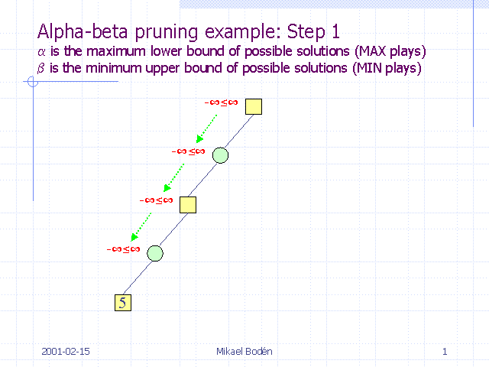
Game Playing: Alpha-beta pruning example
Slides of example from screenshots by
Mikael Bodén, Halmstad University, Sweden
found at
http://www.emunix.emich.edu/~evett/AI/AlphaBeta_movie/sld001.htm

Slide 66
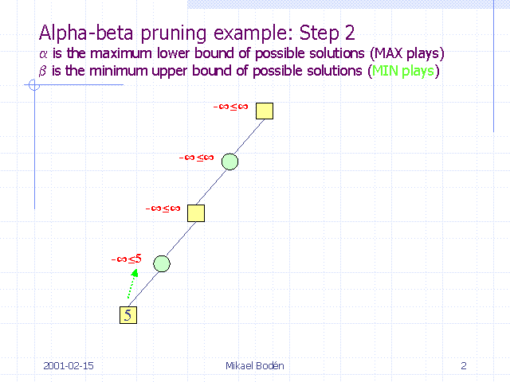
Game Playing: Adversarial Search

Slide 67
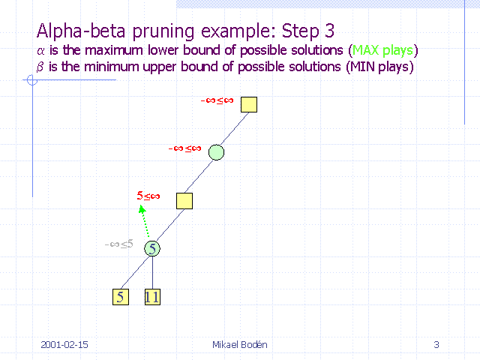
Game Playing: Adversarial Search

Slide 68
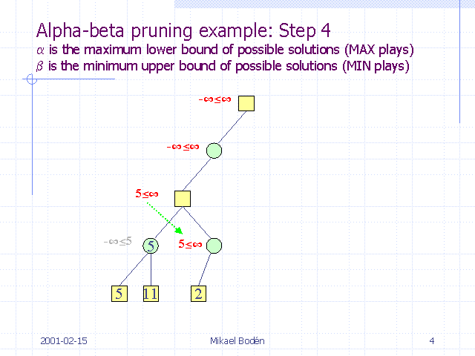
Game Playing: Adversarial Search

Slide 69
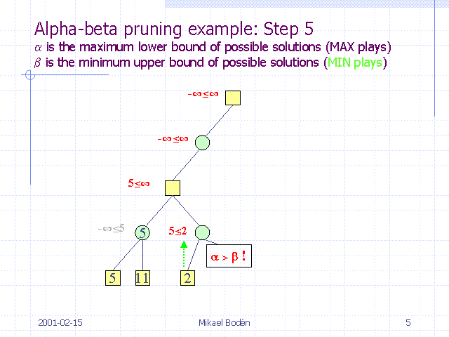
Game Playing: Adversarial Search

Slide 70
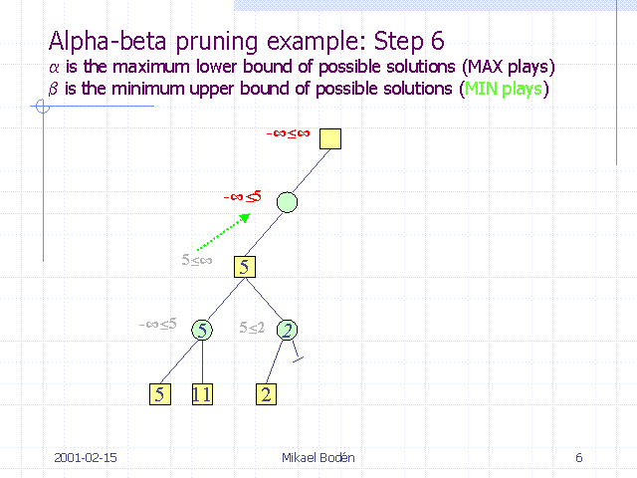
Game Playing: Adversarial Search

Slide 71
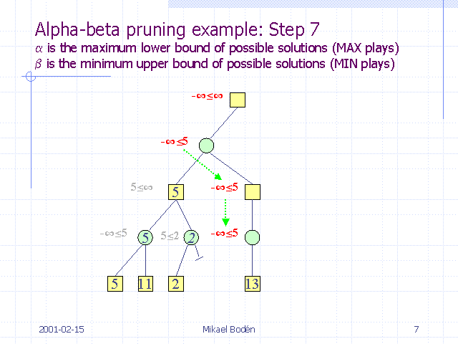
Game Playing: Adversarial Search

Slide 72
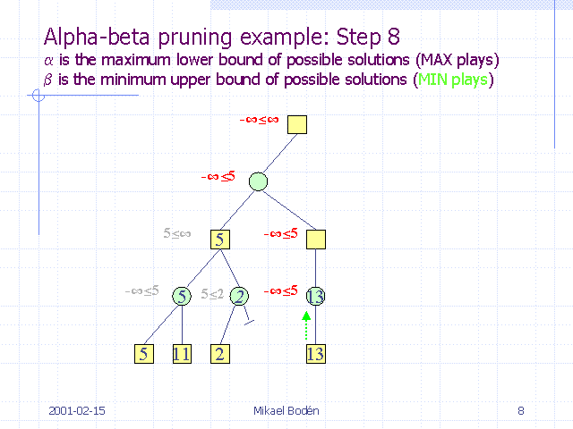
Game Playing: Adversarial Search

Slide 73
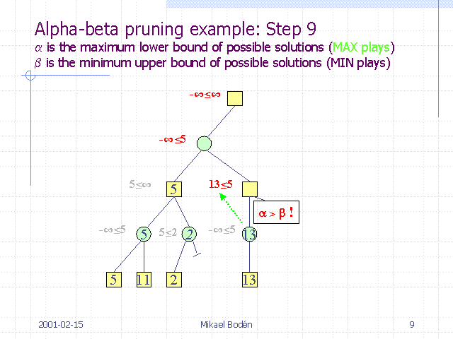
Game Playing: Adversarial Search

Slide 74

Game Playing: Adversarial Search

Slide 75
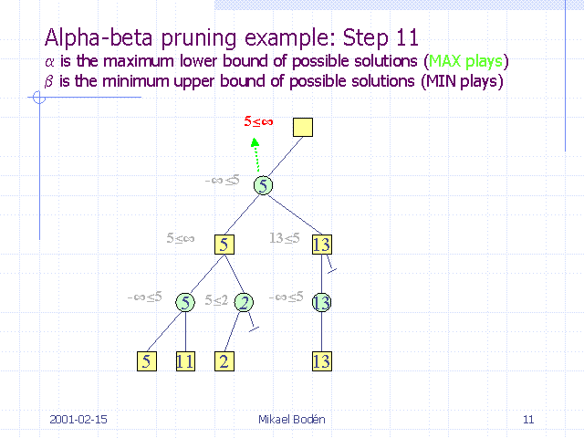
Game Playing: Adversarial Search

Slide 76
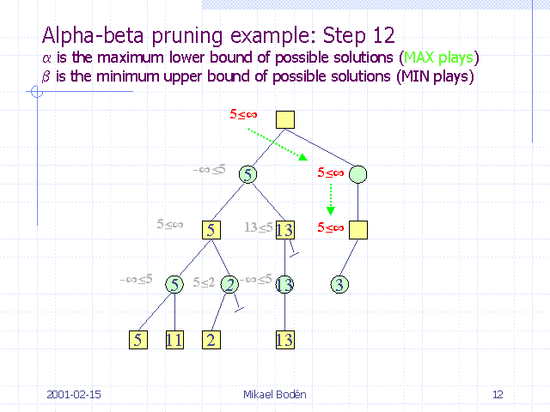
Game Playing: Adversarial Search

Slide 77
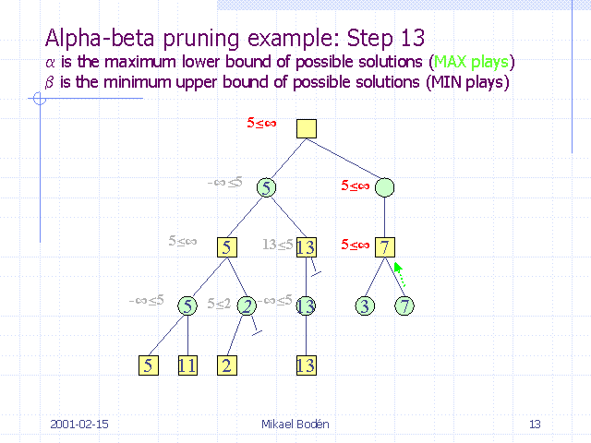
Game Playing: Adversarial Search

Slide 78
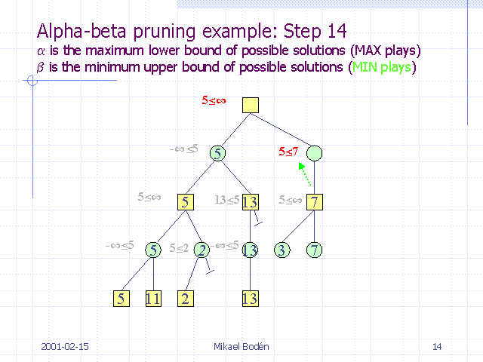
Game Playing: Adversarial Search

Slide 79
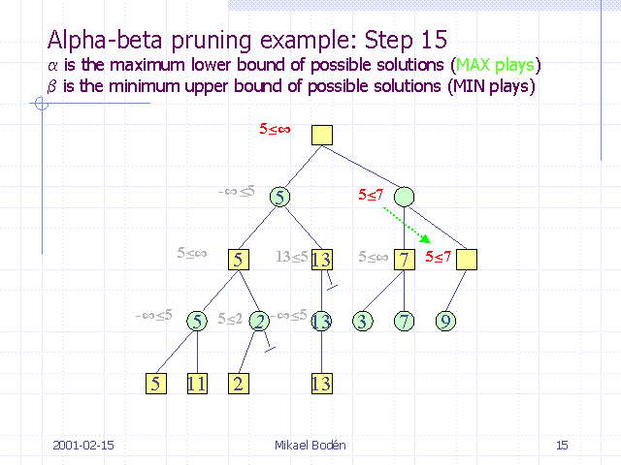
Game Playing: Adversarial Search

Slide 80
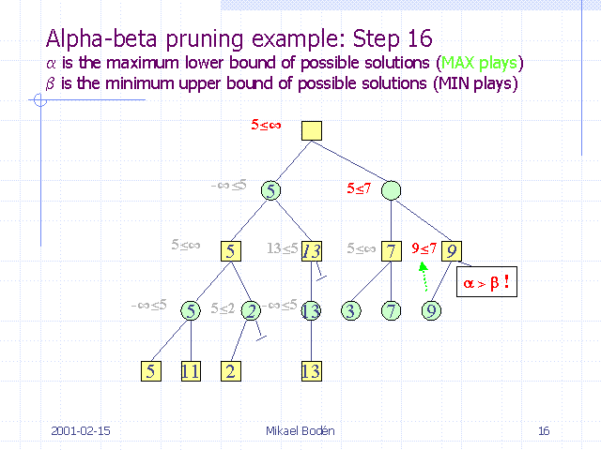
Game Playing: Adversarial Search

Slide 81
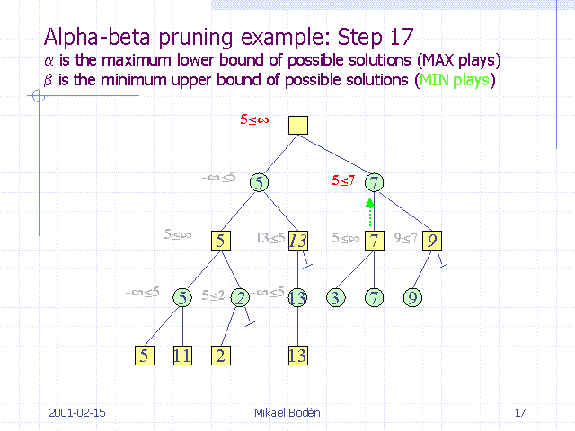
Game Playing: Adversarial Search

Slide 82
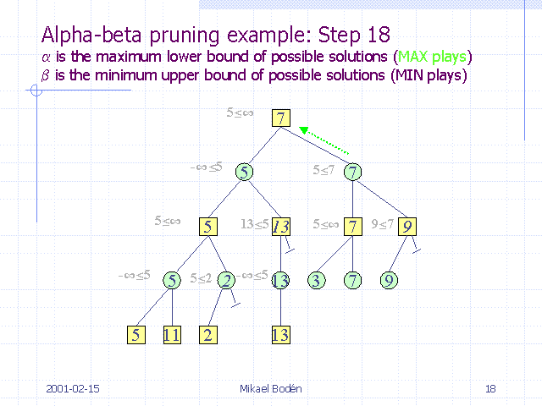
Game Playing: Adversarial Search

