Slide 1
Adversarial Search and Game Playing Examples University of Berkeley, USA http://www.aima.cs.berkeley.edu

Slide 2
Game Tree
MAX nodes
MAX’s play →
MIN nodes
MIN’s play →
Here, symmetries have been used to reduce the branching factor
Terminal state (win for MAX) →

Slide 3
Game Tree
MAX’s play →
MIN’s play →
In general, the branching factor and the depth of terminal states are large
Chess:
Number of states: ~10⁴⁰
Branching factor: ~35
Number of total moves in a game: ~100
Terminal state (win for MAX) →

Slide 4
Example: Tic-tac-Toe
e(s) = number of rows, columns, and diagonals open for MAX
− number of rows, columns, and diagonals open for MIN
8−8 = 0
6−4 = 2
3−3 = 0

Slide 5
Backing up Values
Tic-Tac-Toe tree
at horizon = 2
1
Best move
-1
1
-2
6-5=1
5-5=0
6-5=1
5-5=0
4-5=-1
5-4=1
6-4=2
5-6=-1
5-5=0
5-6=-1
6-6=0
4-6=-2

Slide 6
Continuation
1
1
0
2
1
3
1
2
1
1
1
0
2
0
1
1
0
2
2
3
1
2
2
1
1
0

Slide 7
Example

Slide 8
Example
The beta value of a MIN
node is an upper bound on
the final backed-up value.
It can never increase
β = 2
2

Slide 9
Example
The beta value of a MIN
node is an upper bound on
the final backed-up value.
It can never increase
β = 1
2
1

Slide 10
Example
α = 1
The alpha value of a MAX
node is a lower bound on
the final backed-up value.
It can never decrease
β = 1
2
1

Slide 11
Example
α = 1
β = 1
β = -1
2
1
-1

Slide 12
Example
α = 1
β = 1
β = -1
Search can be discontinued below
any MIN node whose beta value is
less than or equal to the alpha value
of one of its MAX ancestors
2
1
-1

Slide 13
An example of Alpha-beta pruning
0
max
min
0
0
max
0
min
0
-3
0
-3
3
max
0
5
-3
3
3
-3
0
2
-2
3

Slide 14
Final tree
Example of Alpha-beta pruning
max
min
max
min
max
0
5
-3
3
3
-3
0
2
-2
3

Slide 15
An example of Alpha-beta pruning
0
5
-3
3
3
-3
0
2
-2
3
5
2
5
-5
0
1
5
1
-3
0
-5
5
-3
3
2

Slide 16
Example
0
0
5
-3
3
3
-3
0
2
-2
3
5
2
5
-5
0
1
5
1
-3
0
-5
5
-3
3
2

Slide 17
Example
0
0
0
5
-3
3
3
-3
0
2
-2
3
5
2
5
-5
0
1
5
1
-3
0
-5
5
-3
3
2

Slide 18
Example
0
0
-3
0
5
-3
3
3
-3
0
2
-2
3
5
2
5
-5
0
1
5
1
-3
0
-5
5
-3
3
2

Slide 19
Example
0
0
-3
0
5
-3
3
3
-3
0
2
-2
3
5
2
5
-5
0
1
5
1
-3
0
-5
5
-3
3
2

Slide 20
Example
0
0
0
-3
0
5
-3
3
3
-3
0
2
-2
3
5
2
5
-5
0
1
5
1
-3
0
-5
5
-3
3
2

Slide 21
Example
0
0
3
0
-3
3
0
5
-3
3
3
-3
0
2
-2
3
5
2
5
-5
0
1
5
1
-3
0
-5
5
-3
3
2

Slide 22
Example
0
0
3
0
-3
3
0
5
-3
3
3
-3
0
2
-2
3
5
2
5
-5
0
1
5
1
-3
0
-5
5
-3
3
2

Slide 23
Example
0
0
0
0
3
0
-3
3
0
5
-3
3
3
-3
0
2
-2
3
5
2
5
-5
0
1
5
1
-3
0
-5
5
-3
3
2

Slide 24
Example
0
0
0
0
3
0
-3
3
5
0
5
-3
3
3
-3
0
2
-2
3
5
2
5
-5
0
1
5
1
-3
0
-5
5
-3
3
2

Slide 25
Example
0
0
0
0
3
2
0
-3
3
2
0
5
-3
3
3
-3
0
2
-2
3
5
2
5
-5
0
1
5
1
-3
0
-5
5
-3
3
2

Slide 26
Example
0
0
0
0
3
2
0
-3
3
2
0
5
-3
3
3
-3
0
2
-2
3
5
2
5
-5
0
1
5
1
-3
0
-5
5
-3
3
2

Slide 27
Example
0
0
2
0
2
0
3
2
0
-3
3
2
0
5
-3
3
3
-3
0
2
-2
3
5
2
5
-5
0
1
5
1
-3
0
-5
5
-3
3
2

Slide 28
Example
0
0
2
0
2
0
3
2
0
-3
3
2
0
5
-3
3
3
-3
0
2
-2
3
5
2
5
-5
0
1
5
1
-3
0
-5
5
-3
3
2

Slide 29
Example
0
0
0
2
0
2
0
3
2
0
-3
3
2
0
5
-3
3
3
-3
0
2
-2
3
5
2
5
-5
0
1
5
1
-3
0
-5
5
-3
3
2

Slide 30
Example
0
0
0
2
0
2
0
3
2
0
-3
3
2
5
0
5
-3
3
3
-3
0
2
-2
3
5
2
5
-5
0
1
5
1
-3
0
-5
5
-3
3
2

Slide 31
Example
0
0
0
2
0
2
0
3
2
1
0
-3
3
2
1
0
5
-3
3
3
-3
0
2
-2
3
5
2
5
-5
0
1
5
1
-3
0
-5
5
-3
3
2

Slide 32
Example
0
0
0
2
0
2
0
3
2
1
0
-3
3
2
1
-3
0
5
-3
3
3
-3
0
2
-2
3
5
2
5
-5
0
1
5
1
-3
0
-5
5
-3
3
2

Slide 33
Example
0
0
0
2
0
2
0
3
2
1
0
-3
3
2
1
-3
0
5
-3
3
3
-3
0
2
-2
3
5
2
5
-5
0
1
5
1
-3
0
-5
5
-3
3
2

Slide 34
Example
0
0
0
2
1
0
2
1
0
3
2
1
0
-3
3
2
1
-3
0
5
-3
3
3
-3
0
2
-2
3
5
2
5
-5
0
1
5
1
-3
0
-5
5
-3
3
2

Slide 35
Example
0
0
0
2
1
0
2
1
0
3
2
1
0
-3
3
2
1
-3
-5
0
5
-3
3
3
-3
0
2
-2
3
5
2
5
-5
0
1
5
1
-3
0
-5
5
-3
3
2

Slide 36
Example
0
0
0
2
1
0
2
1
0
3
2
1
0
-3
3
2
1
-3
-5
0
5
-3
3
3
-3
0
2
-2
3
5
2
5
-5
0
1
5
1
-3
0
-5
5
-3
3
2

Slide 37
Example
0
0
0
2
1
0
2
1
-5
0
3
2
1
-5
0
-3
3
2
1
-3
-5
0
5
-3
3
3
-3
0
2
-2
3
5
2
5
-5
0
1
5
1
-3
0
-5
5
-3
3
2

Slide 38
Example
0
0
0
2
1
0
2
1
-5
0
3
2
1
-5
0
-3
3
2
1
-3
-5
0
5
-3
3
3
-3
0
2
-2
3
5
2
5
-5
0
1
5
1
-3
0
-5
5
-3
3
2

Slide 39
Example
0
0
1
0
2
1
0
2
1
-5
0
3
2
1
-5
0
-3
3
2
1
-3
-5
0
5
-3
3
3
-3
0
2
-2
3
5
2
5
-5
0
1
5
1
-3
0
-5
5
-3
3
2

Slide 40
Example
1
0
1
0
2
1
2
0
2
1
-5
2
0
3
2
1
-5
2
0
-3
3
2
1
-3
-5
2
0
5
-3
3
3
-3
0
2
-2
3
5
2
5
-5
0
1
5
1
-3
0
-5
5
-3
3
2

Slide 41
Example
1
0
1
0
2
1
2
0
2
1
-5
2
0
3
2
1
-5
2
0
-3
3
2
1
-3
-5
2
0
5
-3
3
3
-3
0
2
-2
3
5
2
5
-5
0
1
5
1
-3
0
-5
5
-3
3
2

Slide 42
Nondeterminstic games are the games with both an element of chance and Add chance nodes to tree
Example with coin
flip instead of dice
0.5
0.5
0.5
0.5
2
4
7
4
6
0
5
-2

Slide 43
Example with coin flip instead of dice (cont.)
3
3
-1
0.5
0.5
0.5
0.5
2
4
0
-2
2
4
7
4
6
0
5
-2

Slide 44
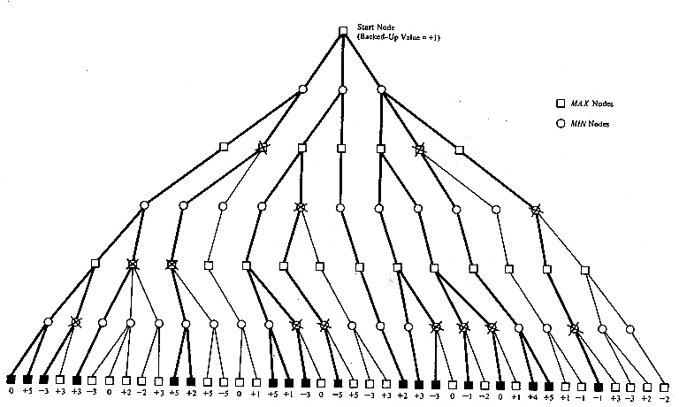
Alpha-Beta prunning in Tic-Tac-Toe

