Slide 1
Chapter 5
The Z Transform
Definition
Properties of the z-Transform
Inverse z-Transform
Solution of Difference Equations Using the z-Transform

Slide 2
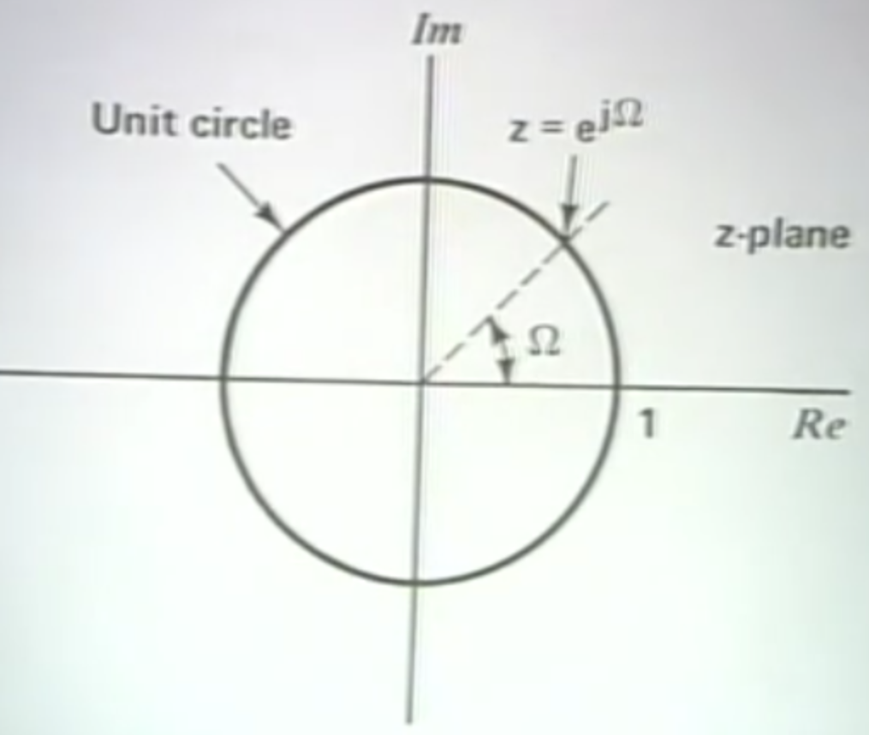


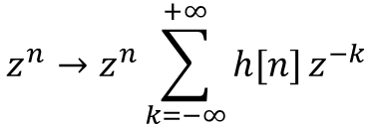

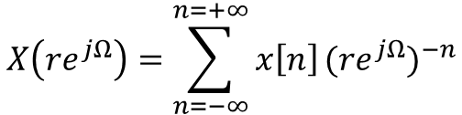
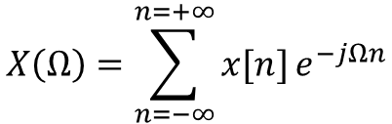

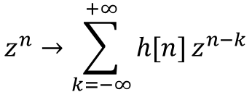



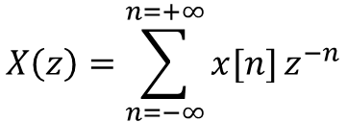

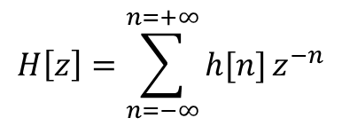
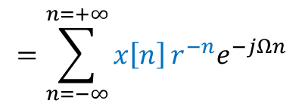
From DFT to Z-transform
Generalizing DFT
Z-transform
Eigen function
Unit circle in the complex space
Add module r
All the complex space
$$e^{jΩn}$$
$$z=re^{jΩ}$$
$$X\left(Ω\right)=\sum_{n=−∞}^{n=+∞}{x[n]}e^{−jΩn}$$
$$z=e^{jΩ}(r=1)$$
$$X\left(z\right)=\sum_{n=−∞}^{n=+∞}{x[n]}z^{−n}$$
input
Output (convolution)
Z-transform
$$z^{n}→\sum_{k=−∞}^{+∞}{h[n]}z^{n−k}$$
$$z^{n}→z^{n}\sum_{k=−∞}^{+∞}{h[n]}z^{−k}$$
input
Output
$$H\left[z\right]=\sum_{n=−∞}^{n=+∞}{h[n]}z^{−n}$$
$$z^{n}→H\left(z\right){ z}^{n}$$
$$H\left(z\right)$$
Fourier transform of $x\left[n\right]r^{−n}$
$$X\left(re^{jΩ}\right)=\sum_{n=−∞}^{n=+∞}{x\left[n\right]}{({re}^{jΩ})}^{−n}$$
$$=\sum_{n=−∞}^{n=+∞}{x\left[n\right]}r^{−n}e^{−jΩn}$$
$$X\left(z\right)=Z\left[x\left[n\right]\right]=DFT[x\left[n\right]r^{−n}]$$
$$r^{−n}e^{−jΩn}$$

Slide 3


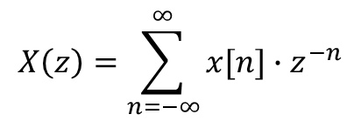


Z - Transform
Introduction
The Z-transform plays the same role in the analysis of discrete-time signals and LTI systems as the Laplace transform does in the continuous-time signals and LTI systems.
It offers the techniques for digital filter design and frequency analysis of digital signals.
Definition of z-transform:
The z-transform of the discrete-time $x[n]$ is given by:
$$X\left(z\right)=\sum_{n=−∞}^{∞}{x[n]∙z^{−n}}$$
Z
Where z is
a complex variable
$$x[n]$$
$$X\left(z\right)$$
For a causal sequence:
$$x\left(n\right)=0 for n<0$$
All the values of z that make the summation to exist form a region of convergence (ROC) .

Slide 4



Example 1
Problem:
Given the sequence, $x\left(n\right)=u(n)$, find the z-transform of $x\left(n\right)$
Solution:
From the definition of the z-transform:
ROC: Region of Convergence
(values of z for the convergence)
we know,
Therefore,
When,

Slide 5


Example 2
Problem:
Consider the exponential sequence, $x\left(n\right)=a^{n} u(n)$, find the z-transform of $x\left(n\right)$.
Solution:
From the definition of the z-transform
Since this is a geometric series Therefore,
Region of
Convergence
that will converge for,

Slide 6


Z-Transform
Table

Slide 7
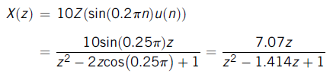
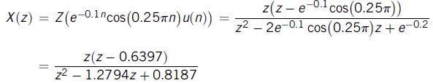
Example 3
Problem:
Find the z-transform for each of the following sequences:
a.
b.
Solution:
a.
From line 9 in the Table:
b.
From line 14 in the Table:

Slide 8





Z-Transform Properties (1)
Linearity:
$x_{1}(n)$ and $x_{2}(n)$ denote the sampled sequences, a and b are the arbitrary constants.
Example 4
Problem:
Find the z-transform of
Solution:
Applying the linearity of the z-transform
Line 3
Using z-transform Table
Therefore, we get,
Line 6

Slide 9

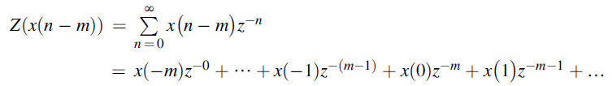




Z-Transform Properties (2)
Z-Transform
Shift Theorem:
$$x\left(n\right)$$
$X\left(z\right)$
Verification:
Since $x(n)$ is assumed to be causal:
Then we achieve,
Factoring $z^{−m}$from Equation we get,

Slide 10



Example 5
Problem:
Determine the z-transform of
Solution:
Using shift theorem,
Using z-transform table, line 6:

Slide 11









Z-Transform Properties (3)
Convolution
In time domain,
eq.(1)
In Z-transform domain,
Verification:
$$x\left(n\right) from eq. (1)$$
Taking the z-transform of eq.(1)
$$z^{−n}=z^{−k}z^{−(n−k)}$$

Slide 12






Example 6
Problem:
Given the sequences,
Find the z-transform
of the convolution.
Solution:
Applying the z-transform of the two sequences,
$Z[x_{1}\left(n\right)$]
$Z[x_{2}\left(n\right)$]
Therefore we get,

Slide 13







Inverse z-Transform: Examples
The inverse z-transform for the function $X(z)$ is defined as:
Example 7
Find the inverse z-transform of
Solution
We get,
Using table,
Example 8
Find the inverse z-transform of
Solution
We get,
Using table,

Slide 14





Inverse z-Transform: Examples
Example 9
Find the inverse z-transform of
Solution
Since,
From line 9 in the Table
By coefficient matching,
Therefore,
Example 10
Find the inverse z-transform of
Solution
Using Table

Slide 15
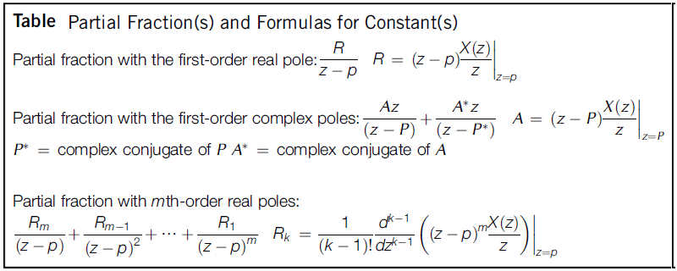
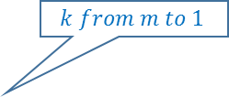
Inverse z-Transform: Using Partial Fraction
$$k from m to 1$$

Slide 16










Inverse z-Transform: Using Partial Fraction
Problem:
Find the inverse z-transform of
Solution:
Example 11
First eliminate the negative power of z.
Dividing both sides by z,
Finding the
constants:
$$multiplying by z$$
Therefore, inverse z-transform is:

Slide 17





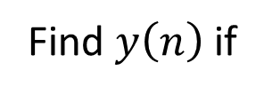
Inverse z-Transform: Using Partial Fraction
Problem:
Find $y\left(n\right)$if
Example 12
Solution:
Dividing Y(z) by z,
Applying the partial fraction expansion,
We first find B:
Next find A:

Slide 18


Example 12 –contd.
Using the polar form,
Now we have:
Therefore, the inverse z-transform is:
from Line 15 in Table

Slide 19



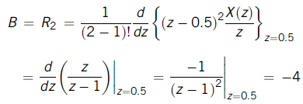
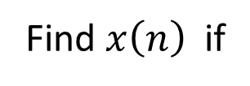
Inverse z-Transform: Using Partial Fraction
Problem:
Find $x\left(n\right)$ if
Example 13
Solution:
Dividing both sides by z:
Where,
Using the formulas for m^{th}-order,
m=2, p=0.5

Slide 20
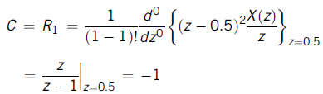





Example 13 –contd.
Then,
From Table,
Finally we get,

Slide 21









Partial Fraction Expansion Using MATLAB
Problem:
Find the partial expansion of
Example 14
Solution:
$$(c_{0}+c_{1}z^{−1}+c_{2}z^{−2})$$
The denominator polynomial
can be found using MATLAB:
$$[c_{0} c_{1} c_{2}]$$
Therefore,
and
MATLAB performs the
partial fraction expansion
The solution is:
residues
poles
direct term

Slide 22

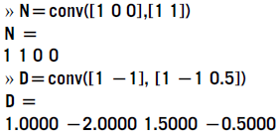



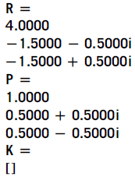
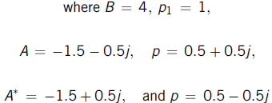
Partial Fraction Expansion Using MATLAB
Problem:
Find the partial expansion of
Example 15
Solution:

Slide 23






Partial Fraction Expansion Using MATLAB
Problem:
Find the partial expansion of
Example 16
Solution:
Then

Slide 24
Difference Equation Using Z-Transform
The procedure to solve difference equation using Z-Transform:
Apply the z-transform to the difference equation.
Substitute the initial conditions.
Solve for the difference equation in the z-transform domain.
Find the solution in the time domain by applying the inverse z-transform.

Slide 25

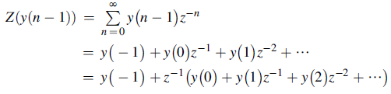





Example 17
Problem:
Solve the difference equation when the initial condition is $y\left(−1\right)=1.$
Solution:
We have
Taking z-transform on both sides:
Substituting the initial condition and z-transform on right hand side using Table:
Arranging Y(z) on left hand side:

Slide 26
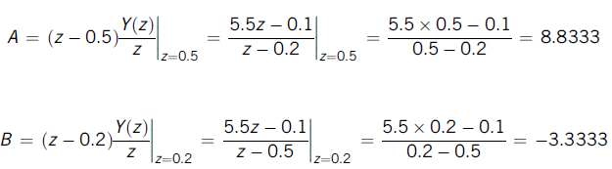

Example 17 –contd.
Solving for A and B:
Therefore,
Taking inverse z-transform, we get the solution:

Slide 27


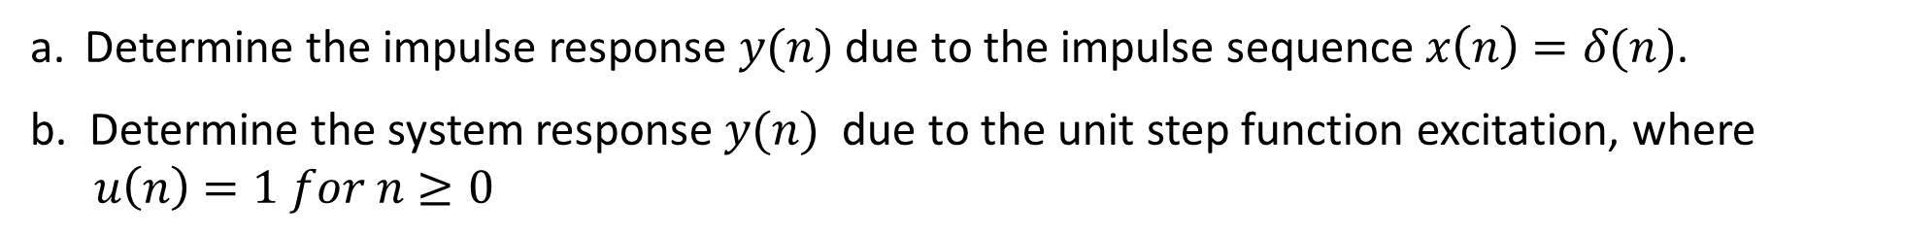
Example 18
Problem:
A DSP system is described by the following differential equation with zero initial condition:
Determine the impulse response $y(n)$ due to the impulse sequence$x\left(n\right)=δ(n)$.
b. Determine the system response$y(n)$ due to the unit step function excitation, where $u\left(n\right)=1 for n≥0$
Solution:
a. Applying the z-transform on both sides:
Applying
On right side

Slide 28





Example 18 –contd.
We multiply the numerator and denominator by z²
Using the partial fraction expansion
Solving for A and B:
Therefore,
Hence the impulse response:

Slide 29


Example 18 –contd.
b. The input is step unit function:
Corresponding z-transform:
Notice that
[Slide 27]
Then the z-transform of the output sequence $y(n)$,
Using the partial fraction expansion
and the system response is found by using Table:

