Slide 1
Modern Systems Analysis and Design Third Edition
Chapter 2
Succeeding as a Systems Analyst
2.1

Slide 2
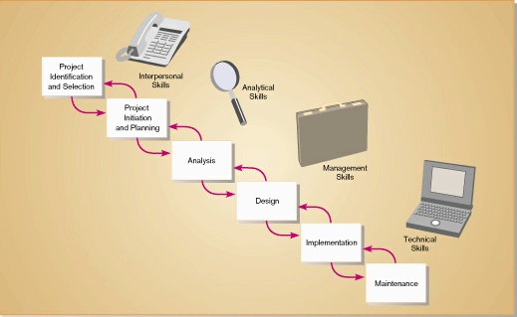
Relationship between systems analyst’s skills and the SDLC cycle

Slide 3
Analytical Skills for Systems Analysis
Four Sets of Analytical Skills
Systems Thinking
Organizational Knowledge
Problem Identification
Problem Analyzing and Solving
Systems Thinking
System
A system is an interrelated set of components, with an identifiable boundary, working together for a purpose
A system has nine characteristics
A system exists within an environment
A boundary separates a system from its environment
2.3

Slide 4
Systems Thinking
Characteristics of a System
Components
An irreducible part or aggregation of parts that make up a system, also called a subsystem
Interrelated Components
Dependence of one subsystem on one or more subsystems
A Boundary
The line that marks the inside and outside of a system and that separates the system from its environment
A Purpose
The overall goal or function of a system
An Environment
Everything outside the system’s boundary that interacts with the system
2.4

Slide 5
Systems Thinking
Interfaces
Point of contact at which the system meets its environment or where subsystems meet each other
Input
Whatever a system takes from its environment in order to fulfill its purpose
Output
Whatever a system returns to its environment in order to fulfill its purpose
Constraints
Limits to what it can do and how it can achieve its purpose within an environment (capacity, speed or capabilities)

Slide 6
Systems Thinking
Important System Concepts
Open Systems
Interact freely with their environments, taking in input and returning output
As environment changes, systems much adapt to changes or suffer consequences
Closed Systems
Does not interact with environments
Adaptability are not issues for closed systems
Business Information Systems are open Systems

Slide 7
Systems Thinking
Important System Concepts (Continued)
Decomposition
The process of breaking down a system into smaller components which can be further broken down
Allows the systems analyst to:
Break a system into small, manageable subsystems
Focus on one area at a time
Concentrate on component relating to one group of users
Build different components at independent times
2.7

Slide 8
Systems Thinking
Important System Concepts (Continued)
Modularity
Process of dividing a system into modules of a relatively uniform size
Direct result of decomposition
Modules simplify system design
Coupling
The extent to which the subsystems depend on each other
Subsystems should be as independent as possible else
failure of one subsystem fails the entire system.
Cohesion
Extent to which a system or a subsystem performs a single function
2.8

Slide 9
Systems Thinking
Important System Concepts (Continued)
Logical System Description
Portrays the purpose and function of the system
Does not tie the description to a specific physical implementation
Physical System Description
Focuses on how the system will be materially constructed
2.9

Slide 10
Systems Thinking
Applying Systems Thinking to Information Systems
Information systems are subsystems in larger organizational systems
Taking input from, and returning output to, their organizational environments
Data flow diagrams represent information systems as systems (clearly illustrate)
Inputs
Outputs
System boundaries
Environment
Subsystems
Interrelationships
2.10

Slide 11
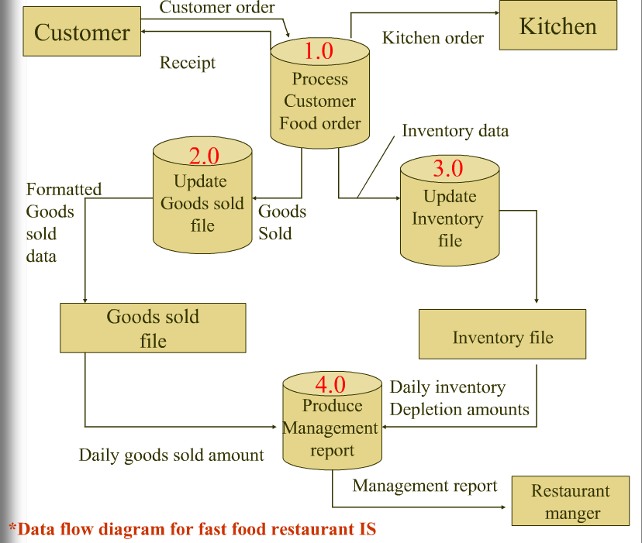

Slide 12
Organizational Knowledge
Understanding of how organizations work
Knowledge of specific functions and procedures of organization and department
How work officially gets done
How departments operates, its purpose, its relationships with other departments, its relationships with customers and suppliers
Internal policies
Competitive and Regulatory Environment
Organizational Strategies and Tactics
2.12

Slide 13
Problem Identification
Problem: Difference between an existing situation and a desired situation
Problem solving: the process of finding a way to reduce differences
Identification is process of defining differences
Differences are defined by comparing the current situation to the output of a model that predicts what the output should be
2.13

Slide 14
Problem Analyzing and Solving
Must analyze the problem and determine how to solve it
Four Phases
Intelligence
All relevant information is collected
Design
Alternatives are formulated
Choice
Best alternative solution is chosen
Implementation
Solution is put into practice
2.14

Slide 15
Technical Skills for Systems Analysis
Constant re-education is necessary as technology changes rapidly
Activities to keep skills up-to-date
Trade publications
Professional societies
Attend classes or teach at a local college
Attend courses sponsored by organization
Conferences and trade shows
Browse Websites
Participate in new groups and conferences
2.15

Slide 16
Technical Skills for Systems Analysis
Understanding of a wide variety of technologies is required (requires continuous learning)
Microcomputers, workstations, minicomputers and mainframe computers
Programming languages
Operating systems
Database and file management systems
Data communication standards
Systems development tools and environments
Web development languages and tools
Decision support system generators
2.16

Slide 17
Management Skills for Systems Analysis
Know how to manage your work and use organizational resources in the most productive way
Four categories
Resource Management
Project Management
Risk Management
Change Management
2.17

Slide 18
Resource Management
Systems analyst needs to know how to get the most out of the resources of an organization, including team members
Includes the following capabilities
Predicting resource usage
Tracking resource consumption
Effective use of resources
Evaluation of resource quality
Securing resources from abusive use
Relinquishing resources when no longer needed
2.18

Slide 19
Project Management
Two Goals
Prevent projects from coming in late
Prevent projects from going over budget
Assists management in keeping track of project’s progress
Consists of several steps
Decomposing project into independent tasks
Determining relationships between tasks
Assigning resources and personnel to tasks
2.19

Slide 20
Risk Management
Ability to anticipate what might go wrong in a project
Minimize risk and/or minimize damage that might result
Placement of resources
Prioritization of activities to achieve greatest gain
Change Management
Ability to assist people in making transition to new system
Ability to deal with technical issues related to change
Obsolescence
Reusability
2.20

Slide 21
Interpersonal Skills for Systems Analysis
Mastery of interpersonal skills is paramount to success as a Systems Analyst
Four types of skills:
Communication skills
Working alone and with a team
Facilitating groups
Managing expectations
2.21

Slide 22
Communication Skills
Effective communication helps to establish and maintain good working relationships with clients and colleagues
Clearly and Effectively communicate with others
Three types used by Systems Analyst
Interviewing and Listening
Questionnaires
Written and Oral Presentations
Skills improve with experience
2.22

Slide 23
Interviewing and Listening
Means to gather information about a project
Listening to answers is just as important as asking questions
Effective listening leads to understanding of problem and generates additional questions
Expensive and time-consuming
Questionnaires
Advantages:
Less costly than interviews
Results are less biased due to standardization
Disadvantages
Less effective than interviews due to lack of follow-up
2.23

Slide 24
Written and Oral Presentations
Used to document progress of project and communicate this to others
Communication takes several forms:
Meeting agenda
Meeting minutes
Interview summaries
Project schedules and descriptions
Memoranda requesting information
Requests for proposals from vendors and contractors
Oral presentations
2.24

Slide 25
Working Alone and with a Team
Working alone on aspects of project involves managing:
Time
Commitments
Deadlines
Team work involves establishing standards of cooperation and coordination
Know when to trust judgment of others and when to question it
Understand strengths and weakness of team members
Table 2-2 presents characteristics of a high-performance team
2.25

Slide 26
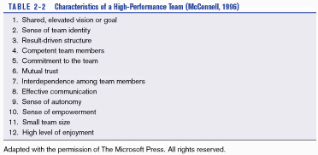
Characteristics of High-Performance Team
Must have motivation and a vision

Slide 27
Facilitating Groups
Involves guiding a group without being a part of the group
Must work to keep the effort on track
Useful skill for sessions such as Joint Application Development (JAD)
Managing Expectations
Managing expectations is directly related to successful system implementation
Skills for successful expectation management
Understanding of technology and workflows
Ability to communicate a realistic picture of new system to users
Effective education of management and users throughout systems development life cycle
2.27

Slide 28
Systems Analysis as a Profession
Standards have been established for education, training, certification and practice
Standard ways of analyzing, designing, and implementing systems
Society for Information Management
Association of Information Technology Professionals
Association for Computing Machinery (ACM)
Certified Computing Professional (CCP) exam
Several aspects:
Standards of Practice
Ethics
Career Paths
2.28

Slide 29
Standards of Practice
Endorsed Development Methodology
Specific procedures and techniques to be used during development process
Promote consistency and reliability across all of an organization’s development projects
Approved Development Platforms
Organizations standardize around a specific platform, sometimes tied to development methodology
Standardization of Roles
Roles are becoming better defined across organizations
Development of a Common Language
Common programming languages
Common modeling languages, such as Unified Modeling Language (UML)
2.29

Slide 30
Ethics
Professional Ethics
Business Ethics
Stockholder approach
Any action taken by a business is acceptable as long as it is legal and maximizes stockholder profit
Stakeholder approach
Any action that violates rights of stakeholder must be rejected
Social Contract approach
Any action that is deceptive, can dehumanize employees or that could discriminate is rejected
2.30

Slide 31
Career Paths
Consulting
Information Systems within a large corporation
Software vendors
Other opportunities outside of systems analysis
2.31

