Slide 1
Biostatistics for the Biological and Health Sciences
Chapter 1
Introduction to Statistics
Copyright © 2018, 2014, 2012 Pearson Education, Inc. All Rights Reserved

Slide 2
Introduction to Statistics
1-1 Statistical and Critical Thinking
1-2 Types of Data
1-3 Collecting Sample Data

Slide 3
Key Concept
The process involved in conducting a statistical study consists of “prepare, analyze, and conclude.”
Statistical thinking involves critical thinking and the ability to make sense of results. Statistical thinking demands so much more than the ability to execute complicated calculations.

Slide 4
Data
Data
  Collections of observations, such as measurements, genders, or survey responses

Slide 5
Statistics
Statistics
  The science of planning studies and experiments, obtaining data, and organizing, summarizing, presenting, analyzing, and interpreting those data and then drawing conclusions based on them.

Slide 6
Population
Population
  The complete collection of all measurements or data that are being considered. Typically, a population is the complete collection of data that we would like to make inferences about.

Slide 7
Census versus Sample
Census
  The collection of data from every member of a population
Sample
  A subcollection of members selected from a population

Slide 8
Example: Residential Carbon Monoxide Detectors (1 of 2)
In the journal article “Residential Carbon Monoxide Detector Failure Rates in the United States”, it was stated that there are 38 million carbon monoxide detectors installed in the United States. When 30 of them were randomly selected and tested, it was found that 12 of them failed to provide an alarm in hazardous carbon monoxide conditions.

Slide 9
Example: Residential Carbon Monoxide Detectors (2 of 2)
In this case, the population and sample are as follows:
Population: All 38 million carbon monoxide detectors in the United States
Sample: The 30 carbon monoxide detectors that were selected and tested
The objective is to use the sample data as a basis for drawing a conclusion about the population of all carbon monoxide detectors, and methods of statistics are helpful in drawing such conclusions.

Slide 10
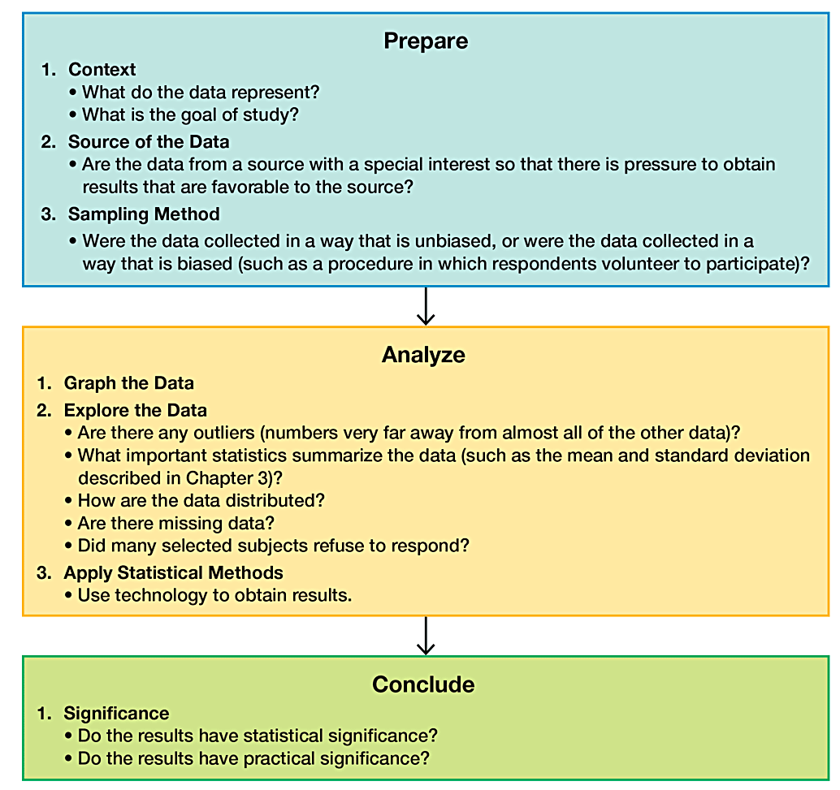
Statistical and Critical Thinking

Slide 11
Prepare (1 of 2)
Pleasure Boats and Manatee Fatalities from Boat Encounters
Pleasure Boats (ten of thousands) | 99 | 99 | 97 | 95 | 90 | 90 | 87 | 90 | 90
Manatee Fatalities | 92 | 73 | 90 | 97 | 83 | 88 | 81 | 73 | 68
Context
  The table includes the number of registered pleasure boats in Florida (tens of thousands) and the number of manatee fatalities from encounters with boats in Florida for each of several recent years.
  The format of the table suggests the following goal: Determine whether there is a relationship between numbers of boats and numbers of manatee deaths from boats.

Slide 12
Prepare (2 of 2)
Pleasure Boats and Manatee Fatalities from Boat Encounters
Pleasure Boats (ten of thousands) | 99 | 99 | 97 | 95 | 90 | 90 | 87 | 90 | 90
Manatee Fatalities | 92 | 73 | 90 | 97 | 83 | 88 | 81 | 73 | 68
Source of the Data
  The data in the table are from the Florida Department of Highway Safety and Motor Vehicles and the Florida Marine Research Institute. The sources certainly appear to be reputable.
Sampling Method
  The data were obtained from official government records known to be reliable. The sampling method appears to be sound.

Slide 13
Voluntary Response Sample (1 of 2)
Voluntary Response Sample
  Voluntary Response Sample or Self-Selected Sample is one in which the respondents themselves decide whether to be included.

Slide 14
Voluntary Response Sample (2 of 2)
The following types of polls are common examples of voluntary response samples. By their very nature, all are seriously flawed because we should not make conclusions about a population on the basis of samples with a strong possibility of bias:
Internet polls, in which people online can decide whether to respond
Mail-in polls, in which people can decide whether to reply
Telephone call-in polls, in which newspaper, radio, or television announcements ask that you voluntarily call a special number to register your opinion

Slide 15
Example: Voluntary Response Sample (1 of 2)
Nightline asked viewers to call with their opinion about whether the UN headquarters should remain in the United States. Viewers then decided themselves whether to call with their opinions, and 67% of 186,000 respondents said that the UN should be moved out of the United States.
In a separate, independent survey, 500 respondents were randomly selected and surveyed, and 38% of this group wanted the UN to move out of the United States.

Slide 16
Example: Voluntary Response Sample (2 of 2)
The two polls produced dramatically different results. Even though the Nightline poll involved 186,000 volunteer respondents, the much smaller poll of 500 randomly selected respondents is more likely to provide better results because of the far superior sampling method.

Slide 17
Analyze
After completing our preparation by considering the context, source, and sampling method, we begin to analyze the data.
Graph and Explore
  An analysis should begin with appropriate graphs and explorations of the data.
Apply Statistical Methods
  A good statistical analysis does not require strong computational skills. A good statistical analysis does require using common sense and paying careful attention to sound statistical methods.

Slide 18
Conclude (1 of 2)
The final step in our statistical process involves conclusions, and we should develop an ability to distinguish between statistical significance and practical significance.
Statistical Significance
  Statistical significance is achieved in a study if the likelihood of an event occurring by chance is 5% or less.
    Getting 98 girls in 100 random births is statistically significant because such an extreme outcome is not likely to result from random chance.
    Getting 52 girls in 100 births is not statistically significant because that event could easily occur with random chance.

Slide 19
Conclude (2 of 2)
Practical Significance
  It is possible that some treatment or finding is effective, but common sense might suggest that the treatment or finding does not make enough of a difference to justify its use or to be practical.

Slide 20
Example Statistical Significance Versus Practical Significance (1 of 2)
ProCare Industries once supplied a product named Gender Choice that supposedly increased the chance of a couple having a baby with the gender that they desired. In the absence of any evidence of its effectiveness, the product was banned by the Food and Drug Administration (FDA) as a “gross deception of the consumer.”
Suppose that the product was tested with 10,000 couples who wanted to have baby girls, and the results consist of 5200 baby girls born in the 10,000 births. This result is statistically significant because the likelihood of it happening due to chance is only 0.003%, so chance doesn’t seem like a feasible explanation.

Slide 21
Example Statistical Significance Versus Practical Significance (2 of 2)
That 52% rate of girls is statistically significant, but it lacks practical significance because 52% is only slightly above 50%. Couples would not want to spend the time and money to increase the likelihood of a girl from 50% to 52%. (Note: In reality, the likelihood of a baby being a girl is about 48.8%, not 50%.)

Slide 22
Analyzing Data: Potential Pitfalls (1 of 2)
Misleading Conclusions
  When forming a conclusion based on a statistical analysis, we should make statements that are clear even to those who have no understanding of statistics and its terminology.
Sample Data Reported Instead of Measured
  When collecting data from people, it is better to take measurements yourself instead of asking subjects to report results.
Loaded Questions
  If survey results are not worded carefully, the results of a study can be misleading.

Slide 23
Analyzing Data: Potential Pitfalls (2 of 2)
Order of Questions
  Sometimes survey questions are unintentionally loaded by the order of the items being considered.
Nonresponse
  A nonresponse occurs when someone either refuses to respond or is unavailable.
Percentages
  Some studies cite misleading percentages. Note that 100% of some quantity is all of it, but if there are references made to percentages that exceed 100%, such references are often not justified.

Slide 24
Introduction to Statistics
1-1 Statistical and Critical Thinking
1-2 Types of Data
1-3 Collecting Sample Data

Slide 25
Key Concept
A major use of statistics is to collect and use sample data to make conclusions about populations.

Slide 26
Parameter
Parameter
  a numerical measurement describing some characteristic of a population

Slide 27
Statistic
Statistic
  a numerical measurement describing some characteristic of a sample

Slide 28
Quantitative Data
Quantitative (or numerical) data
  consists of numbers representing counts or measurements.
Example: The weights of supermodels
Example: The ages of respondents

Slide 29
Categorical Data
Categorical (or qualitative or attribute) data
  consists of names or labels (not numbers that represent counts or measurements).
Example: The gender (male/female) of professional athletes
Example: Shirt numbers on professional athletes uniforms - substitutes for names

Slide 30
Working with Quantitative Data
Quantitative data can be further described by distinguishing between discrete and continuous types.

Slide 31
Discrete Data
Discrete data
  result when the data values are quantitative and the number of values is finite, or “countable.”
  Example: The number of tosses of a coin before getting tails

Slide 32
Continuous Data
Continuous (numerical) data
  result from infinitely many possible quantitative values, where the collection of values is not countable.
Example: The lengths of distances from 0 cm to 12 cm

Slide 33
Levels of Measurement
Another way of classifying data is to use four levels of measurement: nominal, ordinal, interval, and ratio.

Slide 34
Nominal Level
Nominal level of measurement
  characterized by data that consist of names, labels, or categories only, and the data cannot be arranged in some order (such as low to high).
Example: Survey responses of yes, no, and undecided

Slide 35
Ordinal Level
Ordinal level of measurement
  involves data that can be arranged in some order, but differences (obtained by subtraction) between data values either cannot be determined or are meaningless.
Example: Course grades A, B, C, D, or F

Slide 36
Interval Level
Interval level of measurement
  involves data that can be arranged in order, and the differences between data values can be found and are meaningful. However, there is no natural zero starting point at which none of the quantity is present.
  Example: Years 1000, 2000, 1776, and 1492

Slide 37
Ratio Level
Ratio level of measurement
  data can be arranged in order, differences can be found and are meaningful, and there is a natural zero starting point (where zero indicates that none of the quantity is present). Differences and ratios are both meaningful.
Example: Class times of 50 minutes and 100 minutes

Slide 38
Summary - Levels of Measurement
Nominal - categories only
Ordinal - categories with some order
Interval - differences but no natural zero point
Ratio - differences and a natural zero point

Slide 39
Big Data
Big data
  refers to data sets so large and so complex that their analysis is beyond the capabilities of traditional software tools. Analysis of big data may require software simultaneously running in parallel on many different computers.
Data science
  involves applications of statistics, computer science, and software engineering, along with some other relevant fields (such as sociology or finance).

Slide 40
Missing Data
A data value is missing completely at random if the likelihood of its being missing is independent of its value or any of the other values in the data set. That is, any data value is just as likely to be missing as any other data value.
A data value is missing not at random if the missing value is related to the reason that it is missing.

Slide 41
Correcting for Missing Data
Delete Cases: One very common method for dealing with missing data is to delete all subjects having any missing values.
Impute Missing Values: We “impute” missing data values when we substitute values for them.

Slide 42
Introduction to Statistics
1-1 Statistical and Critical Thinking
1-2 Types of Data
1-3 Collecting Sample Data

Slide 43
Key Concept
The method used to collect sample data influences the quality of the statistical analysis.
Of particular importance is the simple random sample.
If sample data are not collected in an appropriate way, the data may be so utterly useless that no amount of statistical torturing can salvage them.

Slide 44
The Gold Standard
Randomization with placebo/treatment groups is sometimes called the “gold standard” because it is so effective. (A placebo such as a sugar pill has no medicinal effect.)

Slide 45
Basics of Collecting Data
Statistical methods are driven by the data that we collect. We typically obtain data from two distinct sources: observational studies and experiments.

Slide 46
Experiment
Experiment
  apply some treatment and then proceed to observe its effects on the individuals. (The individuals in experiments are called experimental units, and they are often called subjects when they are people.)

Slide 47
Observational Study
Observational study
  observing and measuring specific characteristics without attempting to modify the individuals being studied

Slide 48
Example: Ice Cream and Drownings (1 of 2)
Observational Study:
        Observe past data to conclude that ice cream causes drownings (based on data showing that increases in ice cream sales are associated with increases in drownings). The mistake is to miss the lurking variable of temperature and the failure to see that as the temperature increases, ice cream sales increase and drownings increase because more people swim.

Slide 49
Example: Ice Cream and Drownings (2 of 2)
Experiment:
  Conduct an experiment with one group treated with ice cream while another group gets no ice cream. We would see that the rate of drowning victims is about the same in both groups, so ice cream consumption has no effect on drownings.
  Here, the experiment is clearly better than the observational study.

Slide 50
Design of Experiments (1 of 4)
Replication
  Replication is the repetition of an experiment on more than one individual.
  Good use of replication requires sample sizes that are large enough so that we can see effects of treatments.

Slide 51
Design of Experiments (2 of 4)
Blinding
  Blinding is a technique in which the subject doesn’t know whether he or she is receiving a treatment or a placebo.
  Blinding is a way to get around the placebo effect, which occurs when an untreated subject reports an improvement in symptoms.

Slide 52
Design of Experiments (3 of 4)
Double-Blind
  Blinding occurs at two levels:
  The subject doesn’t know whether he or she is receiving the treatment or a placebo.
  The experimenter does not know whether he or she is administering the treatment or placebo.

Slide 53
Design of Experiments (4 of 4)
Randomization
  Randomization is used when subjects are assigned to different groups through a process of random selection. The logic is to use chance as a way to create two groups that are similar.

Slide 54
Simple Random Sample
Simple Random Sample
  A sample of n subjects is selected in such a way that every possible sample of the same size n has the same chance of being chosen.
  A simple random sample is often called a random sample, but strictly speaking, a random sample has the weaker requirement that all members of the population have the same chance of being selected.

Slide 55
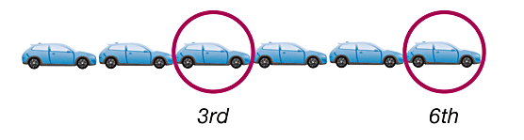
Systematic Sampling
Select some starting point and then select every kth element in the population.

Slide 56

Convenience Sampling
Use data that are very easy to get.

Slide 57
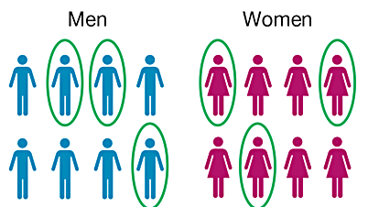
Stratified Sampling
Subdivide the population into at least two different subgroups (or strata) so that the subjects within the same subgroup share the same characteristics. Then draw a sample from each subgroup (or stratum).

Slide 58
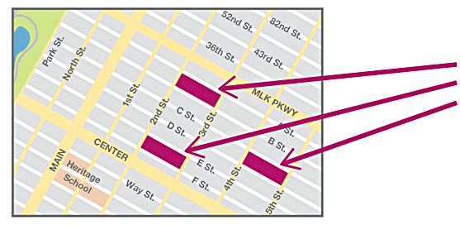
Cluster Sampling
Divide the population area into sections (or clusters), then randomly select some of those clusters, and choose all the members from those selected clusters.

Slide 59
Multistage Sampling
Collect data by using some combination of the basic sampling methods.
In a multistage sample design, pollsters select a sample in different stages, and each stage might use different methods of sampling.

Slide 60
Observational Studies
Observe and measure, but do not modify.

Slide 61
Types of Observational Studies
Cross-sectional study
  Data are observed, measured, and collected at one point in time, not over a period of time.
Retrospective (or case control) study
  Data are collected from a past time period by going back in time (through examination of records, interviews, and so on).
Prospective (or longitudinal or cohort) study
  Data are collected in the future from groups sharing common factors (called cohorts).

Slide 62
Confounding
Confounding
  occurs in an experiment when the experimenter is not able to distinguish between the effects of different factors.
  Try to plan the experiment so that confounding does not occur.

Slide 63
Controlling Effects of Variables (1 of 2)
Completely Randomized Experimental Design
  Assign subjects to different treatment groups through a process of random selection.
  Randomized Block Design
    A block is a group of subjects that are similar, but blocks differ in ways that might affect the outcome of the experiment.

Slide 64
Controlling Effects of Variables (2 of 2)
Matched Pairs Design
  Compare two treatment groups by using subjects matched in pairs that are somehow related or have similar characteristics.
  Rigorously Controlled Design
    Carefully assign subjects to different treatment groups, so that those given each treatment are similar in ways that are important to the experiment.

Slide 65
Sampling Errors (1 of 2)
No matter how well you plan and execute the sample collection process, there is likely to be some error in the results.
Sampling error (or random sampling error)
  occurs when the sample has been selected with a random method, but there is a discrepancy between a sample result and the true population result; such an error results from chance sample fluctuations.

Slide 66
Sampling Errors (2 of 2)
Nonsampling error
  Nonsampling is the result of human error, including such factors as wrong data entries, computing errors, questions with biased wording, false data provided by respondents, forming biased conclusions, or applying statistical methods that are not appropriate for the circumstances.
Nonrandom sampling error
  Nonrandom sampling error is the result of using a sampling method that is not random, such as using a convenience sample or a voluntary response sample.

